Slide 1
TECHNOLOGY ADVANCEMENT AND OUTREACH
Web Coordinators Meeting
Hosted by
Drew Bittner
October 21, 2010
Room 5E-081
Call In #

Slide 2
Agenda
Around the Room (Drew) – 15 min.
Redesign Update (Glenda, Chris & Wendy) – 20 min.
Usability Software (Wendy) – 5 min.
FY11 Maintenance Plans (Drew) – 5 min.
EERE Customer Survey (Elizabeth) – 5 min.
Energy Savers Lighting Update (Allison) – 5 min.
Communication Standards (Elizabeth) – 5 min.

Slide 3
Redesign Update
Phase 1 Complete: Refaced 10 program corporate sites and several non-program sites by FYE 2010 deadline
Programs:
  Solar (8/13)
  ITP (8/18)
  WIP (8/31)
  Wind & Water (9/7)
  Biomass (9/16)
  Vehicles (9/18)
  Buildings (9/20)
  Fuel Cells (9/24)
  Geothermal (9/29)
  FEMP (9/30)
Non-Programs:
  EERE Info Center (8/20)
  site admin pages (8/23)
  Education (9/7)
  Office of EERE/Recovery Act (9/8)
Phase 2 Next: Reface subsites, applications/databases, and remaining office/non-program sites
Notes:
We’ve counted over 80 subsites/apps/other sites to reface in Phase 2.

Slide 4
Redesign Update
What’s Next
In Progress:
  Cleaning up templates (from Phase 1)
    Preparing guidance for program site developers
  Refacing applications that can be done as-is, e.g., Library
  Preparing for Phase 2 subsite refacings:
    Identifying subsites & subsite owners/developers
    Firming up subsite template mockups
    Prioritizing order of refacings
Next Steps:
  Meet with program/subsite contacts to:
    a) kickoff refacing and schedule start date
    b) discuss rearchitecture plans
Notes:
If you (subsites) have a sense of when you’d like to have your site refaced, feel free to contact me directly.
FUNDING
TAO will cover refacings for sites on EERE servers, but not rearchitectures.
There is no deadline for the completion of rearchitectures; however, it is recommended that program managers consider rearchitecture costs when working on their web budgets.
Rearchitecting work is to be done by program developers, but EES will be involved.

Slide 5
Redesign Update
Phase 2 Refacing Process Overview
Subsite selects template and develops homepage mockup
Subsite submits mockup to template review team for approval
(e-mail Chris Stewart and Glenda Garcia)
Refacing begins
  Control period (2-5 business days)
  Program review/approval (1 business day)
Refacing complete and refaced site goes live!
Notes:
This is a general overview of the subsite refacing process. When we hold our individual kick off meetings with subsite managers, we’ll provide more detail.
The first step begins with the subsite selecting a template – template options will be posted on Redesign page of Comm Standards site.
Subsite then develops homepage mockup based on a template and submits it to template coordinator Chris Stewart and me. We’ll make sure that the mockup is in compliance with the template and that the design is reviewed by others on the review team.
Once the mockup is approved, the refacing can begin. Energy Enterprise Solutions will do the refacing work for all sites in OpenText. Certain apps and other subsites on the EERE template will be done by the subsites developers with the template code provided by NREL.
When we start the refacing, the site will go into a control period whereby workflow is disconnected and site administrators are not allowed to edit the site. We do allow for emergency changes and will discuss that process with subsite managers during our individual kickoff meetings.
After we complete our QA on a staging server, we give the subsite owners a day to review the site before we take it live the next day.
We’d like to shoot for refacing all subsites for a program at the same time, one right after the other.

Slide 6
Redesign Update
Rearchitecting Process
Required
New site architecture
Updated feature and other graphics
Optional
Archiving out-dated and unused content
Develop a content inventory
Conduct user research, top task analysis, or usability testing
Identify your top Web site goals
Develop a search engine optimization (SEO) strategy

Slide 7
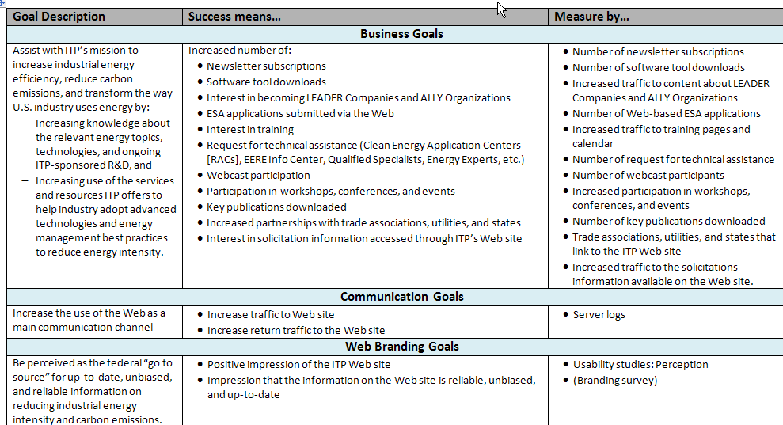
Redesign Update
Establish measurable program goals
Notes:
As you’ve heard from Chris, the rearchitecture phase will require each program to make some changes to their sites.
While you’re thinking about how to rearrange your site for the new template, we’d like to encourage you to go one step farther and really use this time as an opportunity to think about how you can optimize your site for your target users to help meet your program’s goals.
We know that a successful site will help us accomplish our program goals by helping users accomplish their tasks. So we’d like to recommend that you consider establishing some measurable program goals for the Web site, and then take a look to see where they overlap with user tasks.
This is a copy of ITP’s goals, which I handed out at the last meeting. But you can see that we established different types of goals, and that each are able to be measured. For example, one of the goals is to increase the number of software tool downloads, which can be measured over time by looking at the statistics.

Slide 8
Redesign Update
Who is visiting your site and what are their tasks?
Stakeholder input
Interviews
Webmaster feedback
User
research
Focus groups
Previous usability studies
Online survey
Statistics / web logs
Notes:
In order to be sure that our sites are usable for our target audience, the first thing we need to do is learn a little more about who are target audiences are, and what specifically they are coming to our sites to do.
There are several easy ways to go about learning more about your audience. For example:
Take a look at any existing sources of data you might have about your users, like surveys, Webmaster feedback, previous usability studies.
Then think creatively about other sources you might be able to mine for information on your users – for example, you might want to take a look at your Web site statistics and search logs, talk to folks in your program or at the EERE information center who interact regularly with your users.
You might want to consider doing an online survey. Surveys are a great way to get information on your audiences, and they don’t take a lot of staff time – however, just be aware that the OMB approval process can drag on for several weeks, so if you’re going to do a survey, I’d start it now.

Slide 9
Redesign Update
Incorporate user feedback into your redesign
Question | Usability technique
How does my current site work for my users? | User observation
How should I organize my site so it’s intuitive to my users? | Card sorting Tree testing
Does my new site layout make sense to my users? | Wireframe testing Pre-launch usability test
Notes:
Once you have a better idea of who your audience is and what they want to do, you can build some check in points with your users into your project plan. Building a series of check in points into your design process will help ensure that you don’t go too far down the wrong road before you course correct.
I’ve listed some common usability techniques you can use to answer questions that come up in the site design process. Again, you’ll mix and match these techniques depending on the questions you’re trying to answer:
If you want to redesign, but you’re having trouble convincing your program management, you might want to consider doing a small usability study with your main audience group – see how successful they are at completing their top tasks using your site.
If you already know you want to redesign, and you want to make sure the new site is organized so it’s intuitive for users, you might want to do a card sort to help you create your new site structure. You can also test a new IA using tree testing (there’s online software called Tree Jack where you ask users to complete a series of top tasks, the software shows them an outline of your new IA, and asks them where they would click, and records their answers.
Once you create a new design for your site, you may want to test it out by watching users interact with your wireframes, and/or do a pre-launch usability test. There are lots of ways to test your wireframes – there are a bunch of software packages available that allow you to create clickable wireframes, and then run an unmoderated test of your wireframes, similar to Tree Jack, where you ask users to complete a series of tasks, and the software records where they click.
There are a bunch of quick and dirty user check points that won’t take a lot of your time, but will give you a lot of bang for your buck.

Slide 10
Redesign Update
Optimize content and site structure for your users
Remove or archive content (HTML pages and PDFs) that:
Doesn’t support user top tasks or program goals (use content inventory)
Is out of date
Is rarely used (consult statistics/PublicInsite report)
Optimize content
Develop a search engine optimization strategy
Rewrite content use plain language and the language of your users
Make sure content is scannable
Use PDFs conservatively, be sure their content is clear
Structure content
Organize content according to users’ mental models
Layer content from general to specific
Notes:
The final thing we’d like to recommend is that you think about ways to optimize your content and site structure for your audience during the rearchitecture.
You can use any data that you’ve gathered from your user research or your user check in points to guide your decisions about content and site structure. But one of the things we know from past usability studies is that the EERE sites are content heavy, which is both a blessing and a curse. Having too much content makes it hard for users to find what they are looking for, and it is expensive to maintain.
So, I’ve put up some best practices that can help you declutter and streamline your sites:
You may want to consider (READ SLIDE)
Optimize – scannable: use bullets, headers, chunk it
- PDFs: users will click on PDFs, but only if they’re pretty sure they’ll get the answer they are looking for
And again, I’d encourage you to check in with your users throughout this process to see if what you’re doing makes sense to them.

Slide 11
Redesign Update
EERE Web Site Redesign Coordinator
Glenda Garcia
glenda.garcia@ee.doe.gov
301-903-8693
EERE Web Template Coordinator
Chris Stewart
chris.stewart@nrel.gov
303-275-3669
TAO Web Usability Coordinator
Wendy Littman
wendy.littman@hq.doe.gov
301-525-7521

Slide 12
Usability Software
Usability software from TAO
Survey Gizmo: http://www.surveygizmo.com/
DESCRIPTION: Online survey tool that offers a series of advanced features for analyzing data, including the ability to run reports on the data, create charts, segment the data by referring URL, etc.
Web Sort: http://websort.net/
DESCRIPTION: Online tool for conducting remote card sorts. This tool provides a series of reports to help with data analysis.
Tree Jack: http://www.optimalworkshop.com/treejack.htm
DESCRIPTION: Online tool for remotely testing out an information architecture. Tree Jack helps answer questions about which labels work best, whether a structure is too deep, and where to put certain types of content.
Crazy Egg: http://www.crazyegg.com/
DESCRIPTION: Online tool that collects information on where users click on a page; can help answer questions about how users interact with your design.
Notes:
I also wanted to let you know about a number of online usability tools, some of which I mentioned before, that TAO has purchased and is making available to the programs to use in doing your usability work.
We currently have (READ SLIDE)
We will probably also be purchasing some remote wireframe testing software in the future, once we have tested out a few packages – in the meantime, I can give you names of existing software if you want to test it out.

Slide 13
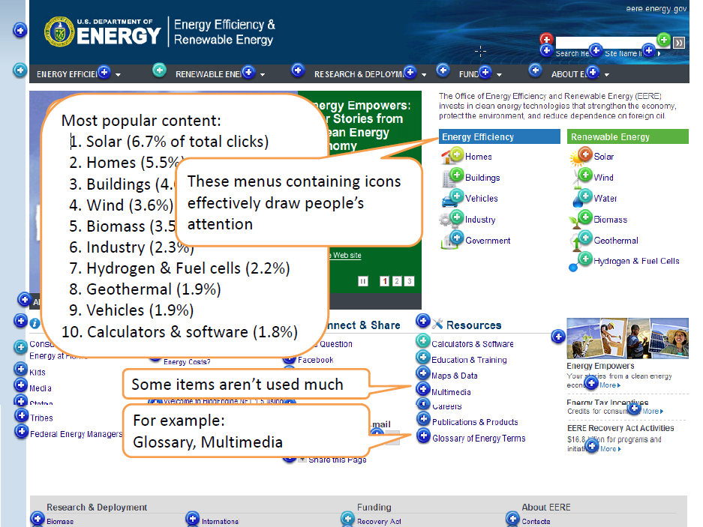
Usability Software
Notes:
Crazy Egg collects information on where people click on a particular page, and so it can help you answer questions about how users interact with your design.
For example, this was a Crazy Egg analysis that Anthro-Tech did after the home page was redesigned (WALK THRU)

Slide 14
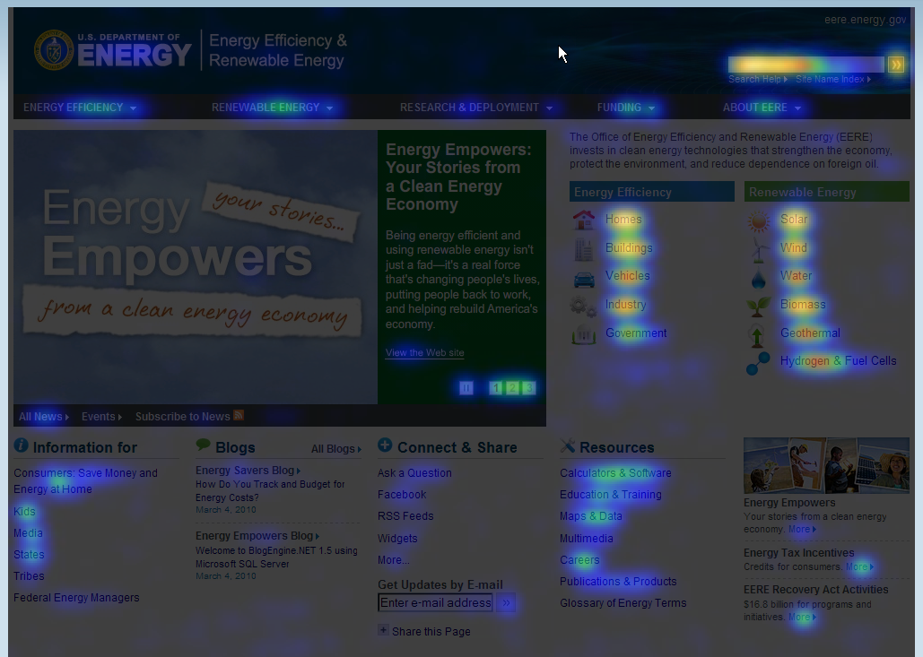
Usability Software
Notes:
This is another view that makes it a little easier to see at a glance where people are clicking.

Slide 15
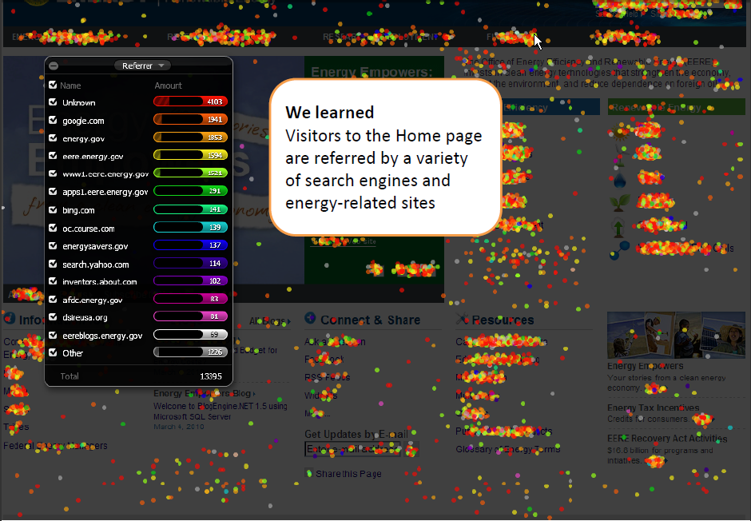
Usability Software
Notes:
This is the confetti view, which has a number of different reports on referrers, search engines, days of the week that people visit, etc.
I wanted to show you a little bit about what Crazy Egg does today, because I’m going to be kicking off a new quarterly usability webinar series for World Usability Day, which is coming up in November. The topic for the first seminar is going to be how you can use Crazy Egg to improve the usability of your Web site.
Keep your eye out for an email invitation to the Webinar.

Slide 16
FY11 Maintenance Plans
Do you have a copy of your FY10 plan? If not, request one from Billie Newland
Use maintenance plan template
Send plan to Billie Newland, cc Drew Bittner and your program manager
Consider content and technical tasks, including link scans, contact updates, and technical reviews
  How often?
  Who completes?
  Can tasks be spread throughout the year?
Notes:
16

Slide 17
EERE Customer Survey
EERE’s customer survey will run Oct. 25-Nov. 8 on the EERE home page and program home pages.
Notes:
17

Slide 18
Energy Savers Lighting Update
energysavers.gov/lighting
Notes:
18

Slide 19
Communication Standards
Plain Writing Act of 2010 signed into law October 13.
Many topics and issues addressed, including:
Federal employees need to be trained to write in plain language.
We need to create and maintain plain language Web pages.
Notes:
19

Slide 20
Communication Standards
Plain language isn’t “simple” English, it’s “simplified” English that is clear and easy to understand.
Communication Standards includes several content guidelines to help you meet this requirement.
The Web Content Guidelines section includes many best practices that suggest clear, concise writing.
  Clear headers, short paragraphs, and careful use of acronyms can help you meet plain language requirements.
  This helps you write in “plain language”—and makes your site easier for users to understand.
Notes:
20

Slide 21
Wrap Up
Next Meeting Nov. 18

