Slide 1
EERE Web Coordinators
Monthly Meeting
Hosted by Drew Bittner
Feb. 17, 2011
(630) 869-1013

Slide 2
Agenda
Around the Room (15 min) – Drew
Plain Writing Act (20 min) – Amy Bunk, Miriam Vincent
Energy.gov Refresh (10 min) – Liz Meckes
Vehicles Crazy Egg Data (10 min) – Suzanne Williams
Usability Consulting (5 min) – Wendy Littman
Standards Tip (5 min) – Elizabeth Spencer
Progress Alerts & News Releases (10 min) – Kevin Brosnahan

Slide 3
Best Practice - Plain Language
Amy Bunk
Miriam Vincent
Plain Language Action and Information Network (PLAIN)

Slide 4
Plain Writing Act of 2010
Act requires federal agencies to use clear communication that the public can understand.
Included are documents that:
  Are needed to get federal benefits or services or for filing taxes
  Provide information about benefits or services
  Explain how to comply with requirements administered or enforced by the federal government
Notes:
Act requires federal agencies to use clear communication that the public can understand.
Documents included under the Act are:
needed to get federal benefits or services or for filing taxes
provide information about benefits or services
Explain how to comply with requirements administered or enforced by the federal government
4

Slide 5
Plain Writing Act of 2010
What does my agency need to do?
Create a plain writing section of its website.
Follow OMB–issued Guidance.
Create plain writing guidance.
  Agencies may follow the Federal Plain Language Guidelines.
Notes:
What does my agency need to do?
Create a plain writing section of its website — we've already written model language for you to use.
Follow OMB–issued Guidance.
Create plain writing guidance.
Agencies may follow the Federal Plain Language Guidelines.
5

Slide 6
Plain Writing Act of 2010
On April 13, 2011 OMB must:
Issue final guidance for the Act.
Notes:
Under the Act OMB must issue guidance for the Act by April 13, 2011
OMB has issued preliminary guidance on the Act – Nick will be discussing it. I’ll just mention that it is posted on plainlanguage.gov.
For specific plain writing guidance use:
your agency’s internal plain language guidance OR
the Federal Plain Language Guidelines found on PLAIN’s web site – plainlanguage.gov
6

Slide 7
Plain Writing Act of 2010
By July 13, 2011 agencies must:
Designate a senior official for "plain writing"
Explain and train agency staff on the Act
Set up a procedure to oversee implementation of the Act
Have agency points of contact for the Act
Post compliance plans on line
Notes:
By July 13, 2011 agencies must:
Designate a senior official for "plain writing"
Explain the Act's requirements to staff
Train agency staff in plain writing
Establish a procedure to oversee the implementation of the Act within the agency
Designate staff as points of contact for the agency plain writing web page
Web page needs to give the public a way to provide input on:
its implementation of the Act and
its reports under the Act
Post compliance plan for meeting the requirements of the Act on its plain writing web page
7

Slide 8
Plain Writing Act of 2010
Starting October 13, 2011 agencies must:
Use plain language in any new or substantially revised document
Write annual compliance reports and post these reports on its plain language web page
Notes:
Starting October 13, 2011 agencies must:
Use plain language in any new or substantially revised document that:
Is needed to get federal benefits or services or for filing taxes, or
Provides information about benefits or services, or
Explains how to comply with requirements administered or enforced by the federal government
Write annual compliance reports and post these reports on its plain writing web page. Pl.gov has a sample page and DoI already has its page posted.
8

Slide 9
Regulations
The Act does not cover regulations
The following Executive Orders emphasize the need for plain language in regulations:
  E.O. 13563 Improving Regulation and Regulatory Review
  E.O. 12866 Regulatory Planning and Review
  E.O. 12988 Civil Justice Reform
Best Practices for Federal Agencies
Notes:
While the Act does not cover regulations, the following Executive Orders emphasize the need for plain language in regulations:
E.O. 13563 says that our regulatory system must ensure that regulations are written in plain language. (Sec. 1 Par. (a)).
E.O. 12866 Regulatory planning and review - says that regulations must be "simple and easy to understand, with the goal of minimizing uncertainty and litigation..." (Sec. 1, Par. (b)(12))
E.O. 12988 Civil Justice Reform says that each regulation must specify its effect "in clear language". (Sec. 3 Par. (b)(2)).
Best Practices for Federal Agencies – for regulations.gov and Federal Docket Management System (FDMS)
states that agencies should use plain writing:
In regulatory documents, descriptions, and content to make sure that stakeholders have a clear understanding of agency requirements and intentions, and
[plain writing should also be used]
when conducting detailed analyses, comparisons of alternative solutions, and creating supporting documentation to increase understanding and reduce uncertainty.
9

Slide 10
Starting a Plain Language Program
Make it SMART:
  Specific
  Measurable
  Achievable
  Realistic
  have a Timeframe
Notes:
Starting a Plain Language Program
Make it SMART:
Specific
Measurable
Achievable
Realistic
have a Timeframe
10

Slide 11
Define Goals Clearly
Make sure your organization:
Understands what Plain Language is
Is on the same page: 1 training program for the entire organization
Identifies key “pain points” and works to improve those documents first
Looks for small successes and aim for continuous improvements
Notes:
Define Goals Clearly:
Make sure your organization:
Understands what Plain Language is
Is on the same page: 1 training program for the entire organization
Identifies key “pain points” and works to improve those documents first
Looks for small successes and aims for continuous improvements
11

Slide 12
High Level Support
Your program will fail without top level support!
Your senior managers need to be plain language champions
Have top level messages promote plain language
Encourage managers to attend plain language class
Have regular meetings to brief management on your program
Notes:
High level support
Your program will fail without top level support!
Your senior managers need to be plain language champions
Have top level messages promote plain language
Encourage managers to attend plain language class
Have regular meetings to brief management on your program
12

Slide 13
Program Tips
Have training classes often (once a month or once a quarter)
Offer class to HQ and the field
Send broadcast messages to remind employees about the importance of clear writing
Create an electronic writing guide accessible to workforce
Make educational videos
Create a recognition program
Notes:
Program Tips:
Have training classes often (once a month or once a quarter)
Offer class to HQ and the field
Send broadcast messages to remind employees about the importance of clear writing
Create an electronic writing guide accessible to workforce
Make educational videos
Create a recognition program
13

Slide 14
Key Plain Language Techniques
Identify and Write for Your Audience
Use Active Voice
Keep paragraphs and sentences short
Limit jargon, legalese and acronyms
Notes:
Key Plain Language Techniques
Identify and Write for Your Audience –
Use Active Voice
Keep paragraphs and sentences short
Limit jargon, legalese and acronyms
14

Slide 15
Writing for your audience
Put yourself in your reader’s shoes
Who is my audience?
What does my audience need to know?
What does my audience already know about the subject?
What questions will my audience have?
Notes:
Put yourself in your reader’s shoes
Who is my audience?
What does my audience need to know?
What does my audience already know about the subject?
What questions will my audience have?
15

Slide 16
Active Voice
Be transparent! Show who or what is doing the action upfront.
Instead of: New regulations were proposed.
Use: The Department of Transportation proposed new regulations.
Notes:
Use ACTIVE VOICE
Be transparent! Show who or what is doing the action upfront.
Instead of: New regulations were proposed.
Use: The Department of Transportation proposed new regulations.
16

Slide 17
Active Voice (cont)
Active Voice:
Eliminates ambiguity:
  Passive: “It must be done.”
  Active: “You must do it.”
Emphasizes important messages
  Passive: “O-ring temperature will be achieved at 32 degrees
  Active: “The O-rings will fail at 32 degrees.”
Notes:
Active Voice:
Eliminates ambiguity:
Passive: “It must be done.”
Active: “You must do it.”
Emphasizes important messages
Passive: “O-ring temperature will be achieved at 32 degrees
Active: “The O-rings will fail at 32 degrees.”
17

Slide 18
Keep it short
With respect to the review of existing regulations and the promulgation of new regulations, section 3(a) of Executive Order 12988, “Civil Justice Reform,” 61 FR 4729 (February 7, 1996), imposes on Executive agencies the general duty to adhere to the following requirements: (1) Eliminate drafting errors and ambiguity; (2) write regulations to minimize litigation; and (3) provide a clear legal standard for affected conduct rather than a general standard and promote simplification and burden reduction. With regard to the review required by section 3(a), section 3(b) of Executive Order 12988 specifically requires that Executive agencies make every reasonable effort to ensure that the regulation: (1) Clearly specifies the preemptive effect, if any; (2) clearly specifies any effect on existing Federal law or regulation; (3) provides a clear legal standard for affected conduct while promoting simplification and burden reduction; (4) specifies the retroactive effect, if any; (5) adequately defines key terms; and (6) addresses other important issues affecting clarity and general draftsmanship under any guidelines issued by the Attorney General. Section 3(c) of Executive Order 12988 requires Executive agencies to review regulations in light of applicable standards in section 3(a) and section 3(b) to determine whether they are met or it is unreasonable to meet one or more of them. DHS has completed the required review and determined that, to the extent permitted by law, this final rule meets the relevant standards of Executive Order 12988.

Slide 19
Keep it short
“The most valuable of all talents is never using two words when one will do.”
~Thomas Jefferson
This rule meets the applicable standards in sections 3(a) and 3(b)(2) of Executive Order 12988.

Slide 20
Jargon and acronyms
Avoid obscure and archaic language
  Example: Hereby, Wherefore, ab initio
Use language your audience is familiar with
  Instead of: The patient is being given positive-pressure ventilatory support.
  Use: The patient is on a respirator.
Define your acronyms
  You may use your Transportation Worker Identification Credential (TWIC) at airport checkpoints.
Notes:
Avoid obscure and archaic language
Example: Hereby, Wherefore, ab initio
Use language your audience is familiar with
Instead of: The patient is being given positive-pressure ventilatory support.
Use: The patient is on a respirator.
Define your acronyms
You may use your Transportation Worker Identification Credential (TWIC) at airport checkpoints.
20

Slide 21
Resources
PLAIN monthly meetings
  Held the 2nd Wednesday of each month.
PLAIN’s website: www.plainlanguage.gov
Federal Plain Language Guidelines.
  http://www.plainlanguage.gov/howto/guidelines/bigdoc/index.cfm

Slide 22
Resources
PLAIN offers free, half day training to all federal agencies.
Provide us with:
A few tentative dates for class
Location of training
Number of students (We prefer 20 or more)
You can have your trainers take the class and develop
an agency specific training class based on our class.

Slide 23
Additional resources
GSA Webcontent Managers are developing plain language webinars
NIH has an online plain language course open to the public
FAA Plain Language program
USCIS Plain Language program
SEC Plain English Initiative

Slide 24
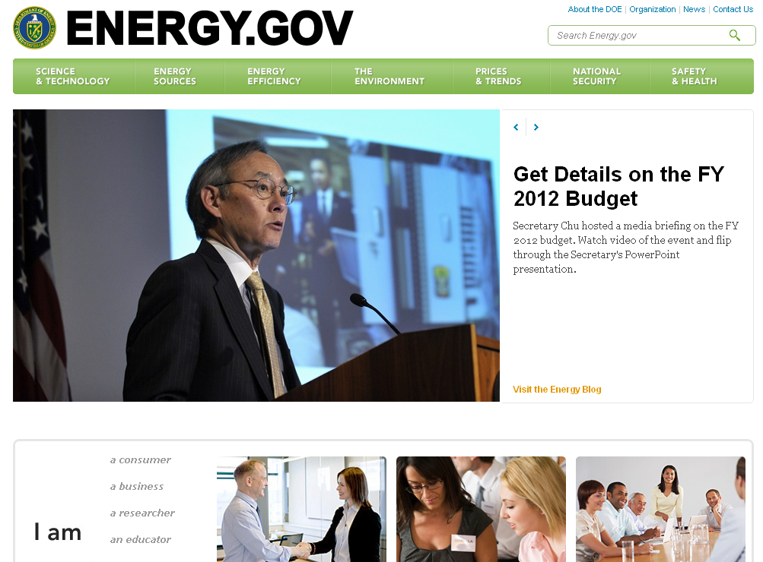
Energy.gov Refresh

Slide 25
VTP Crazy Egg Study - Background
The DOE Vehicle Technologies Program web site has been live since 2003.
The site has grown quite large over the course of eight years. In that time, it has been refaced but has had no systematic evaluation of site content.
As the first step in a site evaluation, the VTP program contacted Wendy Littman of EES to conduct a Crazy Egg survey on four of the site’s pages.

Slide 26
Pages Surveyed
Pages surveyed were chosen based on traffic statistics from the preceding six months. They included:
Home Page http://www.eere.energy.gov/vehiclesandfuels/
Hybrid and Vehicle Systems Page
http://www.eere.energy.gov/vehiclesandfuels/
technologies/systems/index.html
EPAct Home Page
http://www.eere.energy.gov/vehiclesandfuels/epact/
index.html
About the Program Page
http://www.eere.energy.gov/vehiclesandfuels/about/
index.html

Slide 27
Process
Wendy Littman helped us set up Crazy Egg to track the selected pages for two weeks in December 2010.
Crazy Egg reports were accessible throughout the time statistics were being gathered.
The VTP web team at Argonne National Laboratory held a conference call with Wendy in early January 2011 to go over the results.
The results will be used as part of a larger evaluation of site use, leading ultimately to a site redesign.

Slide 28
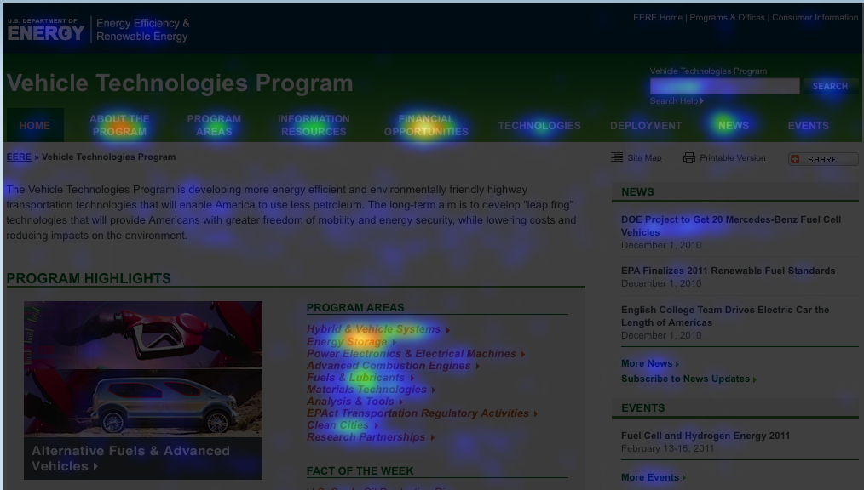
Heatmap – Home
Areas receiving the most attention were About the Program, Hybrid & Vehicle Systems/Energy Storage, and Financial Opportunities.
Notes:
28

Slide 29
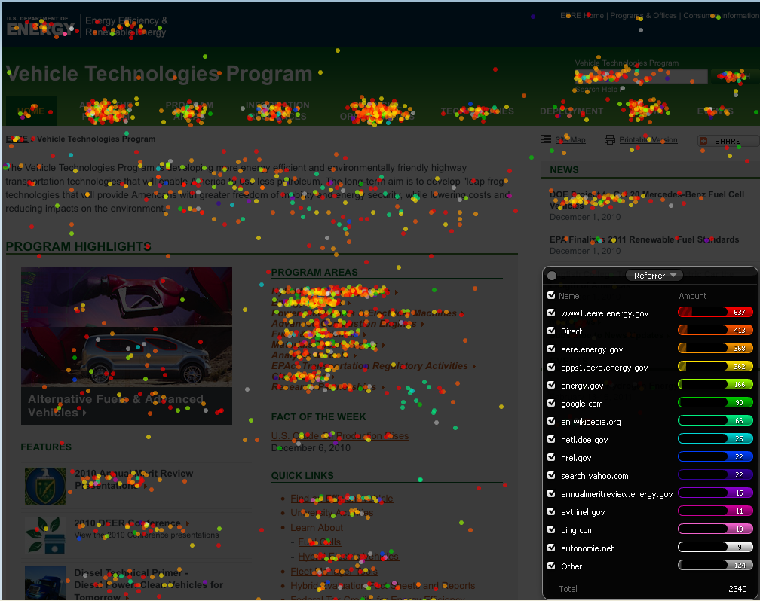
Confetti Map – Home
Largest number of visitors to the VTP Home page came in through the EERE site.
Notes:
29

Slide 30
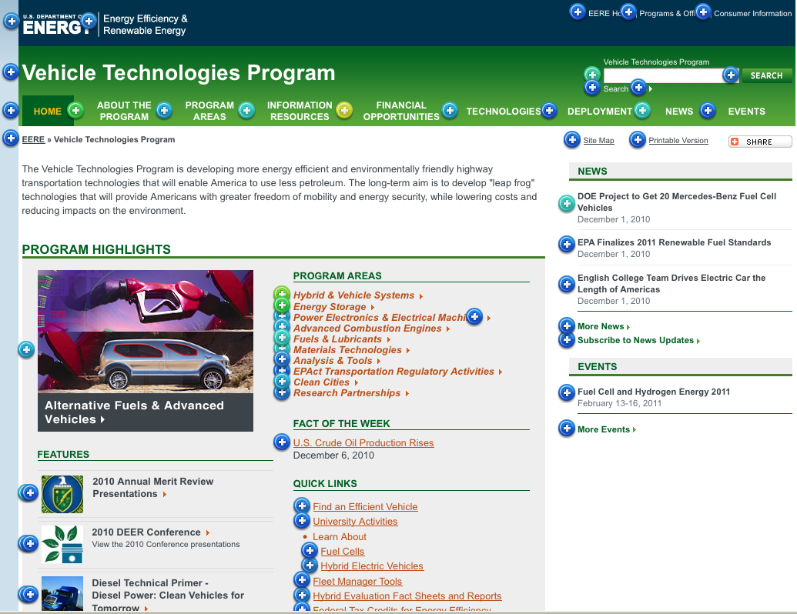
Click Count – Home
Most-clicked items were Financial Opportunities in the top nav bar and Announcement of Financial Opportunity down in the feature area (below the fold).
Notes:
30

Slide 31
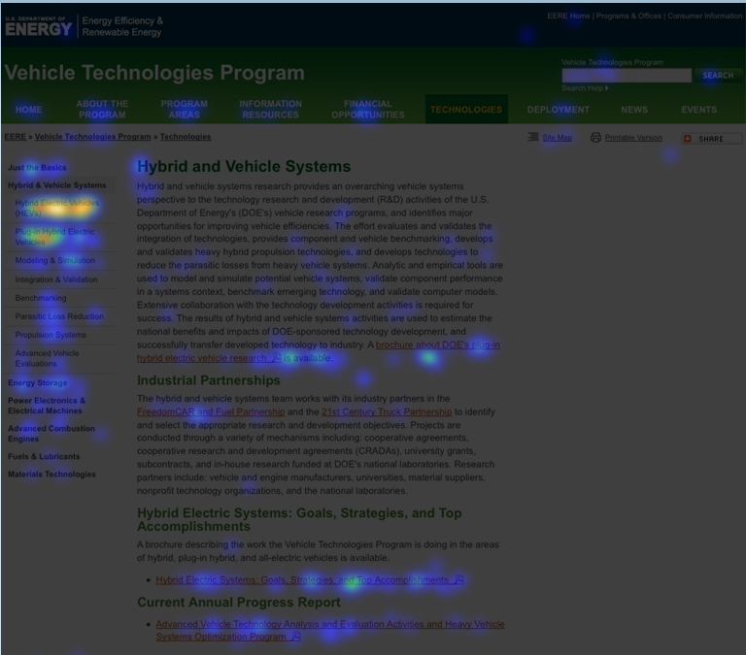
Heatmap – Hybrid & Vehicle Systems
Hybrid Electric Vehicles (HEVs) left-nav link generated the most interest.
Notes:
31

Slide 32
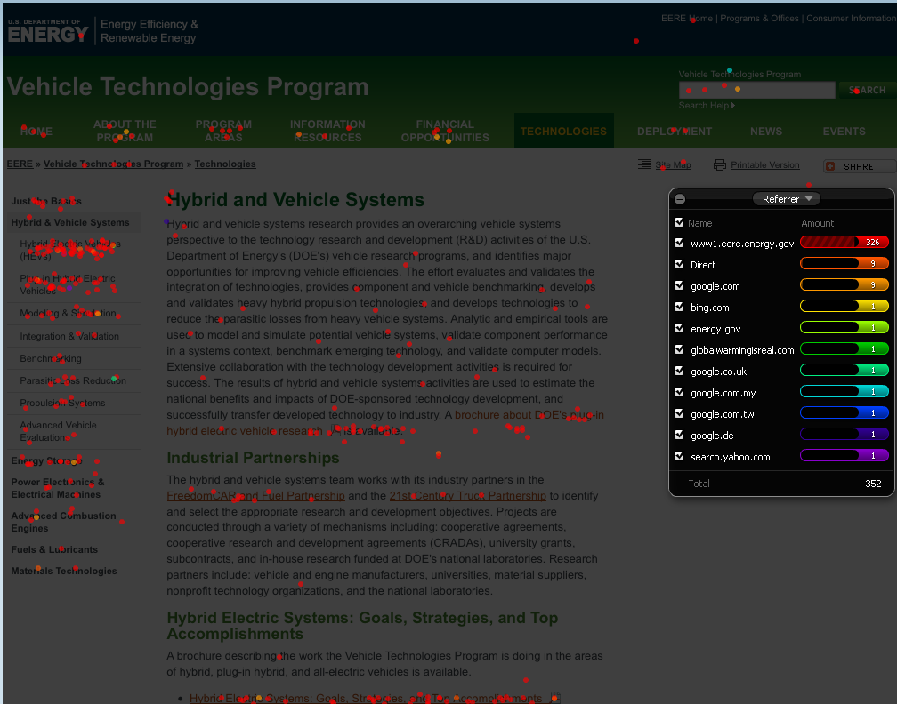
Confetti Map - Hybrid & Vehicle Systems
EERE page generated the most referrals to the Hybrid and Vehicle Systems page, by far.
Notes:
32

Slide 33
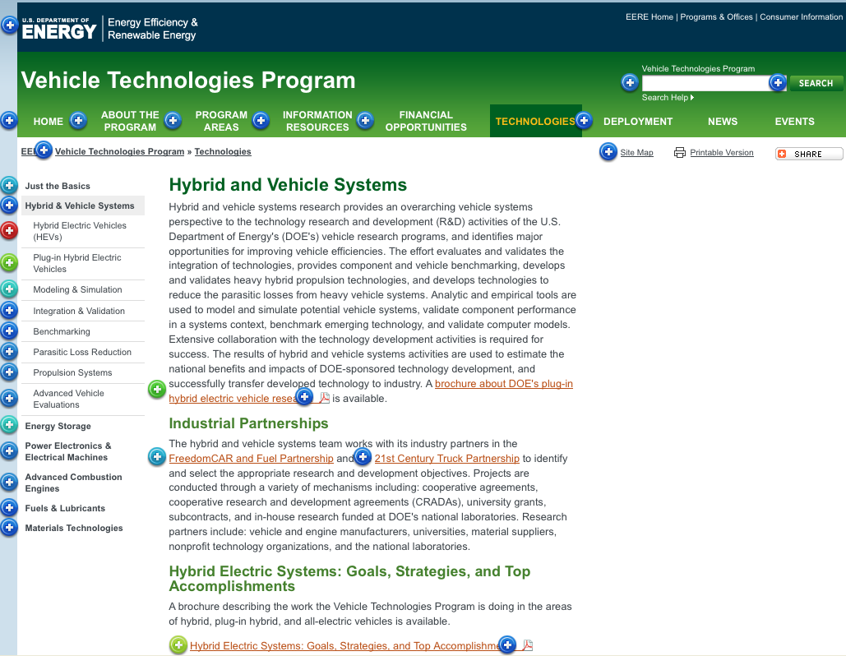
Click Count - Hybrid & Vehicle Systems
Hybrid Electric Vehicles left-nav link was most clicked-on, followed by the left link for Plug-in Hybrid Electric Vehicles.
Notes:
33

Slide 34
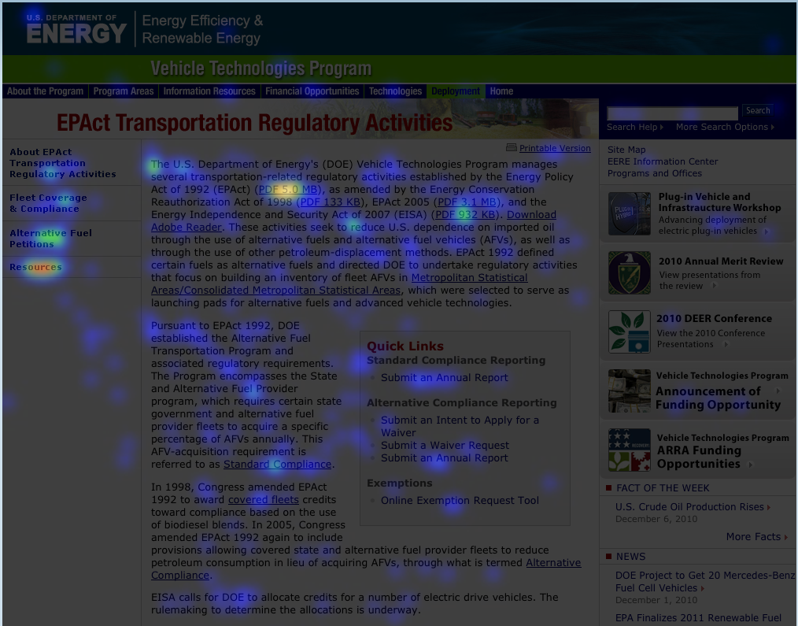
Heatmap – EPAct
Left-nav link for Resources and PDF of the Energy Policy Act of 1992 generated the most interest.
Notes:
34

Slide 35
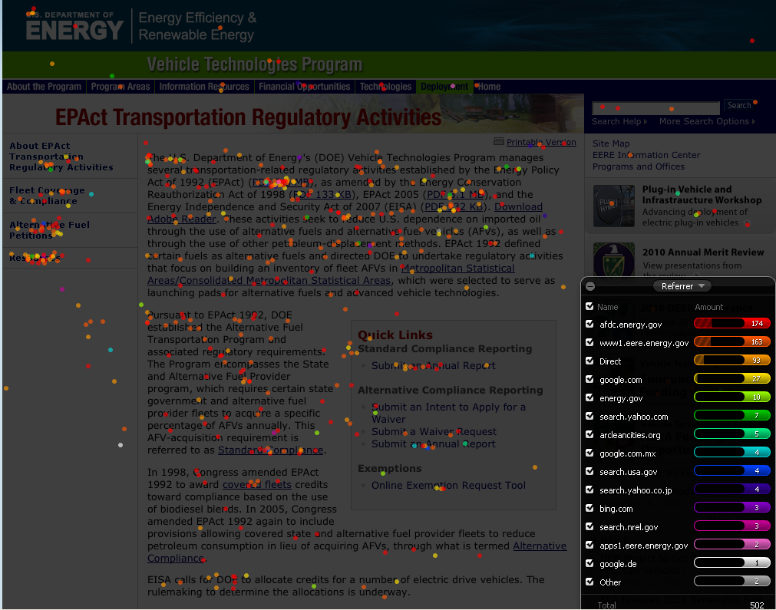
Confetti Map – EPAct
The AFDC site referred the most visitors to the EPAct page, followed closely by the EERE site.
Notes:
35

Slide 36
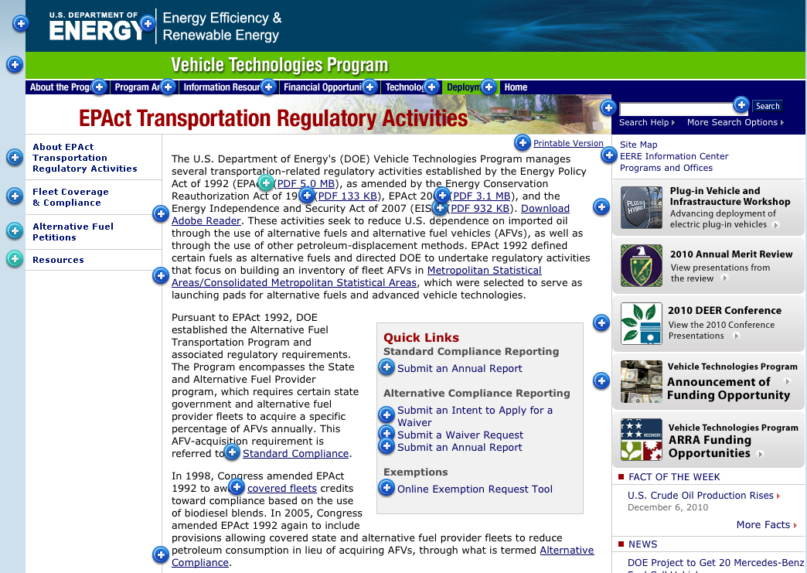
Click Count - EPAct
PDF of the Energy Policy Act and Resources in left nav were clicked
on most.
Notes:
36

Slide 37
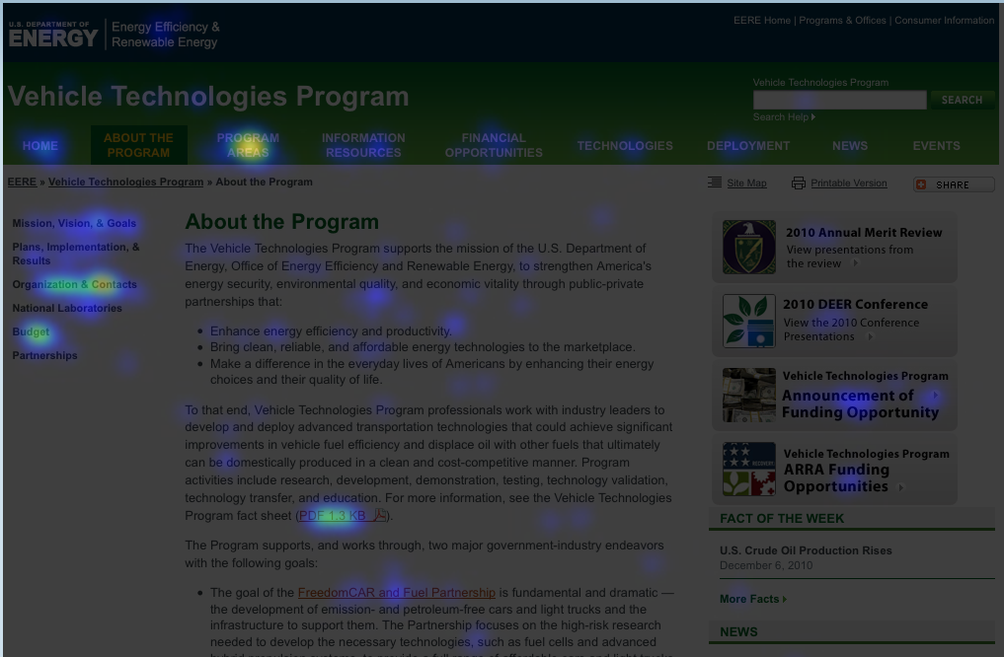
Heatmap - About the Program
Program Areas in the top nav, and Organization & Contacts and Budget links in the left nav generated the most interest.
Notes:
37

Slide 38
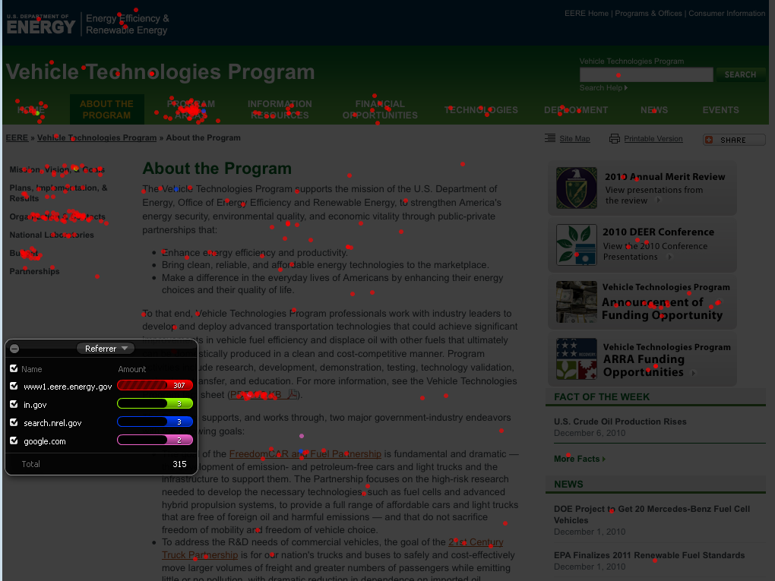
Confetti Map – About the Program
Most visitors to the About the Program page came from the EERE site.
Notes:
38

Slide 39
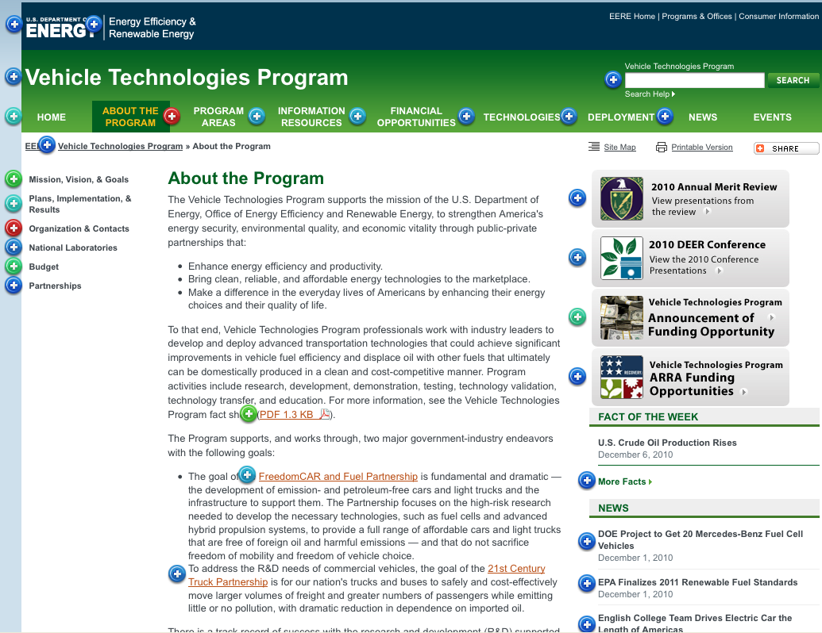
Click Count – About the Program
Largest numbers of clicks were evenly divided between Program Areas, and Organization & Contacts, followed by the VTP Program fact sheet; left-nav Mission, Vision, & Goals link; and left-nav Budget link.
Notes:
39

Slide 40
Summary of Findings
Other findings from the Crazy Egg survey include:
Click-through rates are surprisingly high.
Lots of visitors come to the site overnight.
Visitors use the top navigation more than expected.
Deployment top-nav link isn’t being used much.
Right-side page features don’t get a lot of attention.
Visitors aren’t conducting a lot of searches.
Site map isn’t used much.

Slide 41
Next Steps
The VTP web team is/will be:
Working with EES to archive outdated PDF files to make search results more relevant and HTML-page-centric.
Preparing to interview EERE Information Center Staff for insight into the VTP audience and its needs.
Analyzing search logs to see what people seek on the VTP site.
Planning to perform a card sort on major VTP information categories.
Assembling recommendations for reworking the VTP site architecture and content.

Slide 42
Usability Update
Current EERE Usability Efforts
9 out of 10 programs have recently, are currently, or soon plan to engage in usability or user research activities.
Most popular research activity this FY: Crazy Egg click stream analysis (4 corporate sites, 7 programs)
4 sites currently engaging in or planning user research (surveys)
2 sites completed, 4 sites planning usability studies
2 sites completed card sorts, 1 planning a card sort
Notes:
There’s been a lot of great usability work happening so far this year, and I’ve spoken to several of you and understand a lot of programs have plans to do user research or other usability activities later this year.
(READ SLIDE)
9 out of 10 programs (not wind)
Use research (biomass, buildings, Energy Savers, Geothermal); others thinking about surveys, and several looking at statistics and Information Center reports to see what they can learn about their users.
Ux studies (ITP, Solar completed; CTS, library, Energy Savers, Solar)
Card sorting (Comm standards, buildings)
I really appreciate the fact that many of you have been so good about looping me into your plans for usability and user research work.

Slide 43
Usability Update
TAO’s Usability Coordination Services
TAO’s goals:
Build a community of Web communicators who are knowledgeable about and consistently practice user-centered design.
Help coordinate knowledge-sharing within that community such that members can actively learn from each other.
To help achieve these goals, TAO provides:
Access to online tools
Templates and examples
Mentoring and training on usability techniques
Usability plans and work product consultation
Notes:
There have been some questions from a couple folks recently about the specifics of TAO’s usability consulting services, so I thought it might be helpful to share that information with everyone, so we’re all on the same page.
TAO has two goals with regard to usability:
(READ GOALS)
To help achieve these goals, TAO provides a number of different resources as well as my time in helping to facilitate the usability efforts that are happening across EERE. (READ BULLETS)
Access to online tools (Crazy Egg, Tree Jack, Web Sort, Survey Gizmo) – TAO takes care of the cost of these tools, I can train you on how to use them, and in addition, we have an expert on staff now who can build your surveys out for you in our standard template to make that process easier for you.
I can provide Templates and examples for you so you aren’t starting from scratch in developing survey questions or user profiles, for example.
I offer one on one mentoring and group training on usability techniques.
I have also been asked to provide consultations on usability plans and work products. This is really in part an effort to ensure that we are all being consist in how we are practicing usability. It’s also an opportunity for me to share with you what other programs have done and are finding, since that might influence your usability study designs.

Slide 44
Usability Update
TAO’s Usability Coordination Services
Please keep me in the loop, early and often!
Check in points:
Usability plans
Work products (card sorting labels, survey questions, etc.)
Reports
Contact:
Wendy Littman
TAO Usability Coordinator
301-525-7521
wendy.littman@ee.doe.gov
Notes:
So to help me help you, what we’re asking you to do is keep me in the loop when you’re planning and doing your usability work.
At the very minimum, please plan to check in with me:
when you are in the process of fleshing out your usability or user research plans;
when you have developed work products like card sorting labels, survey questions, or user testing scripts; and
when you produce reports on your usability efforts.
I’ll may have some feedback for you on your plans and products; taking my suggestions is optional, but at least this gives me the chance to share knowledge from the experience of other programs with you.
Here’s my contact information, in case you don’t already have it.
Questions?

Slide 45
Communication Standards Tip
Podcast Series
Coming Soon: Podcast #6
“How to Start and Maintain a Blog”

Slide 46
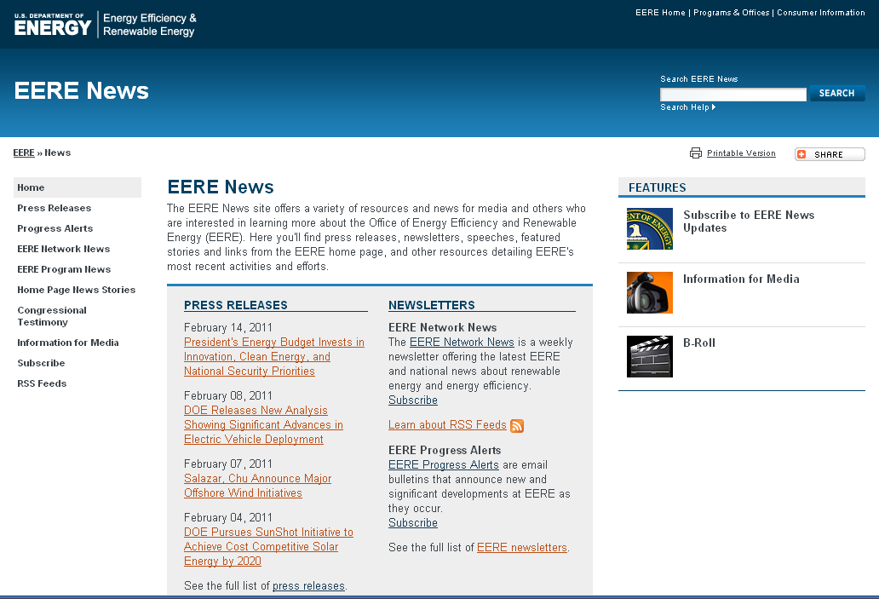
Progress Alerts & News Releases

Slide 47
Wrap Up
Next meeting
March 17
5E-081

