Slide 1
EERE Web Coordinators
Monthly Meeting
Hosted by Drew Bittner
March 24, 2011

Slide 2
Agenda
Around the Room (15 min) – Drew
EERE Intranet (5 min) – Lou
Energy.gov Refresh (5 min) – Liz
Introducing Rob Bectel (10 min) – Drew & Rob
AFDC Mobile Tools (10 min) – Trish
Crazy Egg Analysis: Usage Trends (15 min) – Wendy
Web process (10 min) – Drew
Standards Tip (5 min) – Elizabeth

Slide 3
EERE Intranet

Slide 4
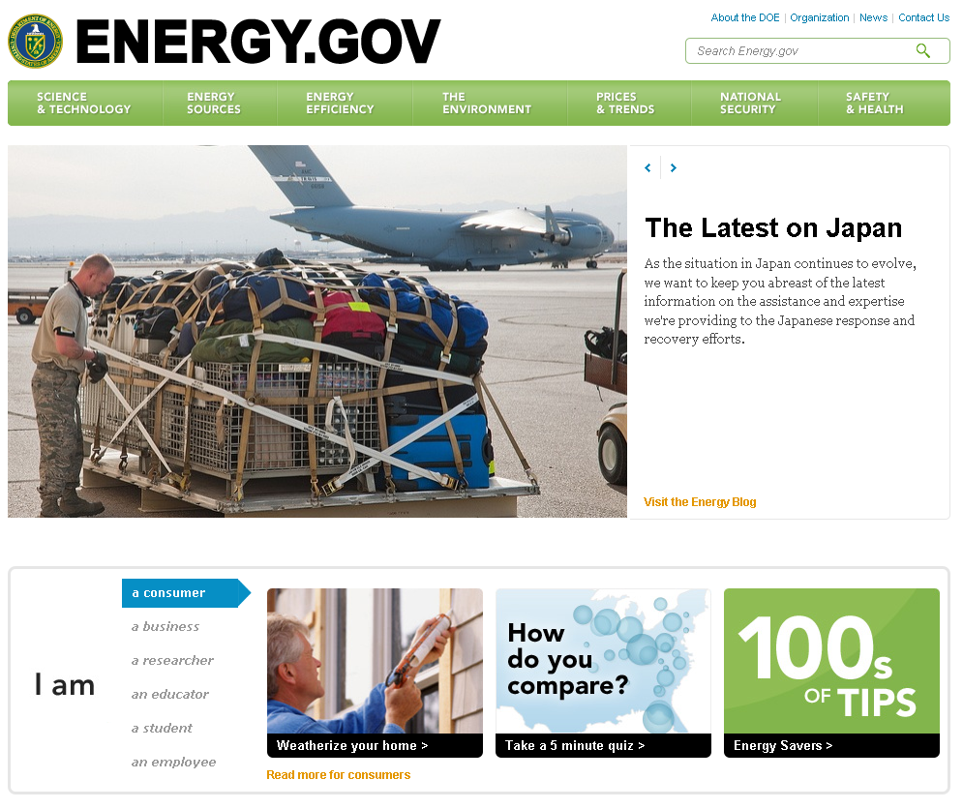
Energy.gov Refresh

Slide 5
Introducing Rob Bectel
Rob is EERE’s new Chief Technology Officer

Slide 6
AFDC Mobile Tools
Clean Cities Mobile
Trish Cozart
Clean Cities and AFDC Web Manager
NREL

Slide 7
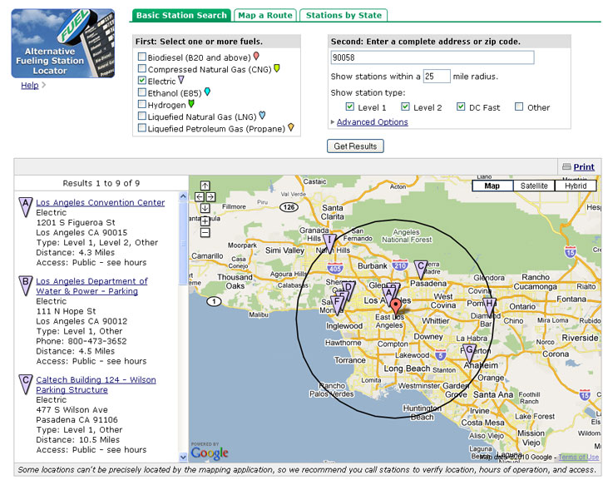
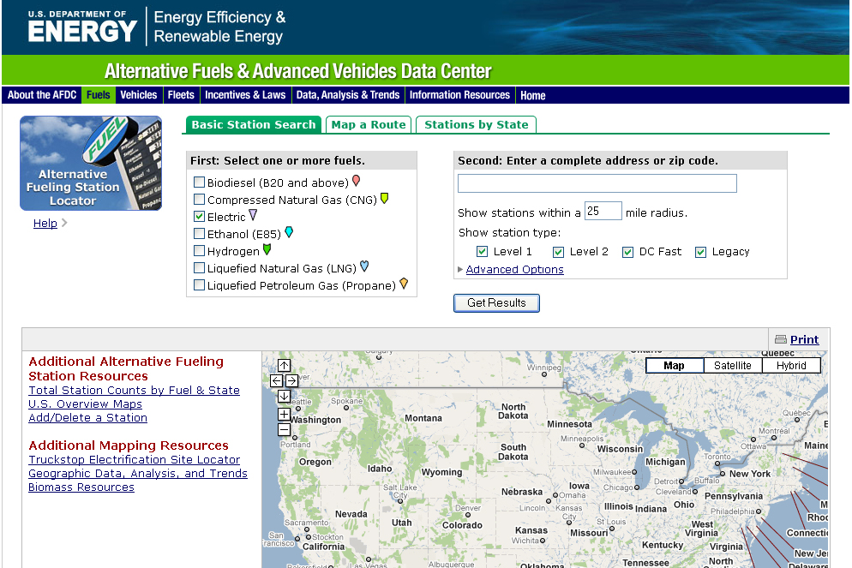
Going Mobile

Slide 8
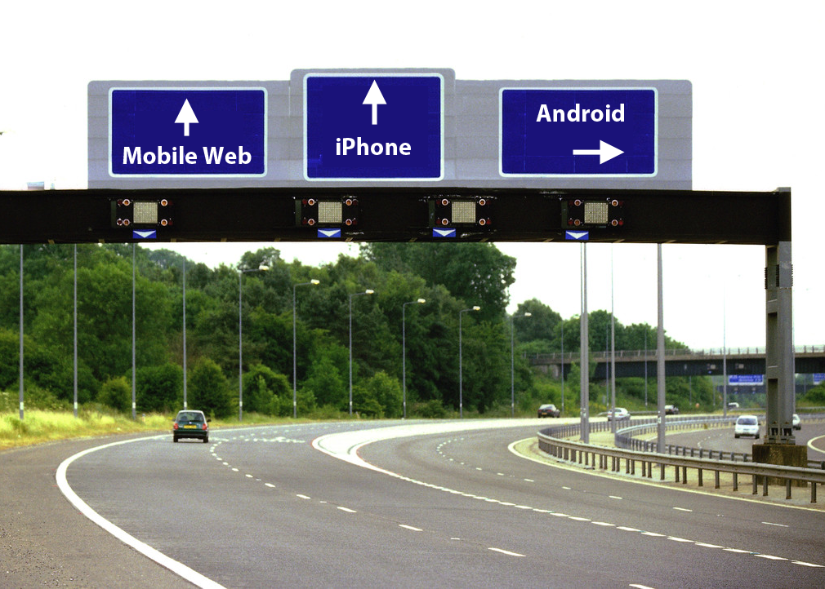

Slide 9
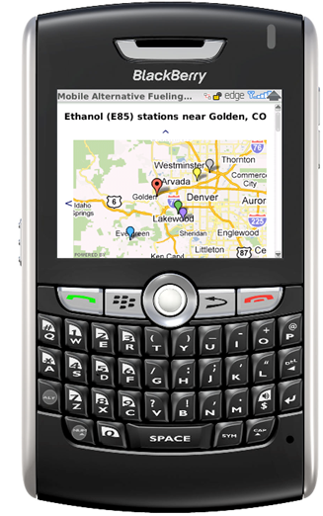
Eeny, Meeny, Miny, Moe
Mobile Web
  Simple Web Design (HTML)
  Responsive Web Design
  Fancy Web App Design (HTML5, Java)
Native App (iPhone, Android)

Slide 10
Handset Share: Gartner Q1 2010: Market Share
Web/App Usage: AdMob Operating System Share, May 2010

Slide 11
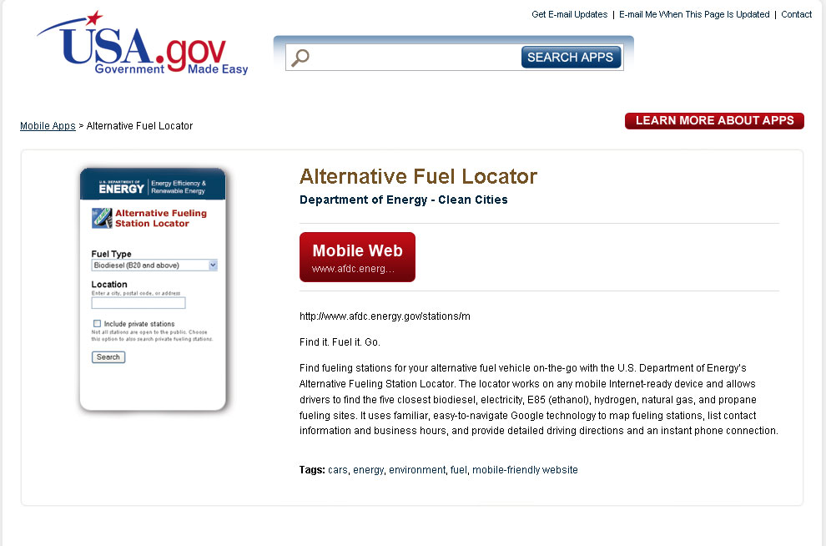
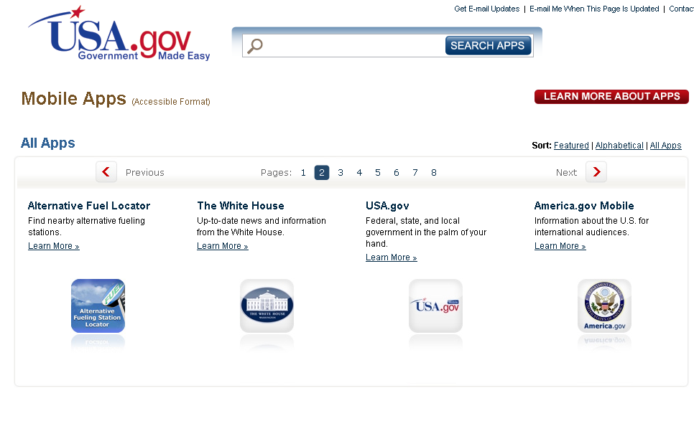
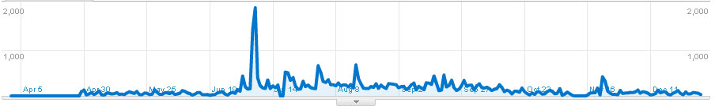
Don’t Worry, Be Appy.

Slide 12
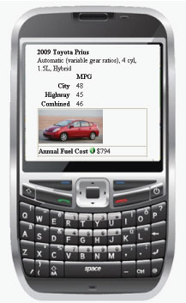
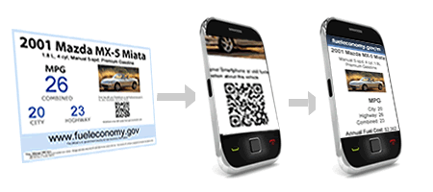
Fuel Economy

Slide 13
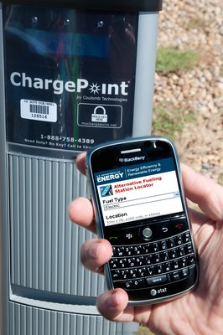
Data and Content
Great Data & Content
= Great Possibilities

Slide 14
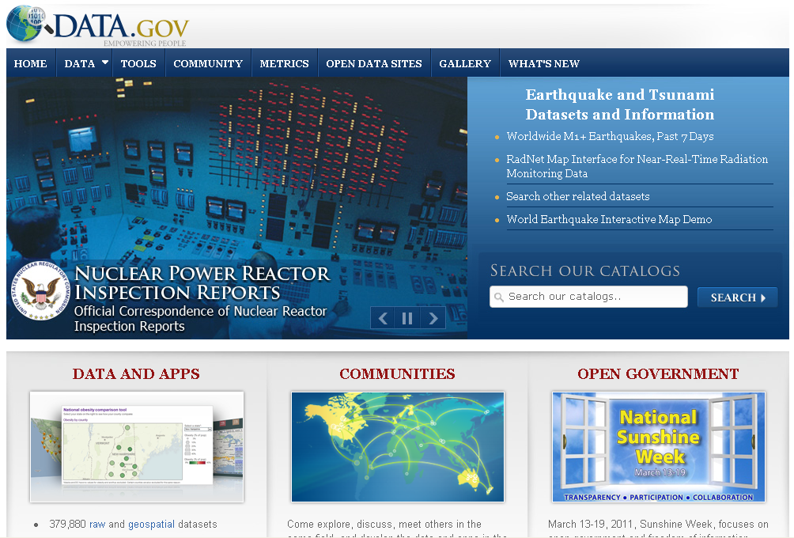
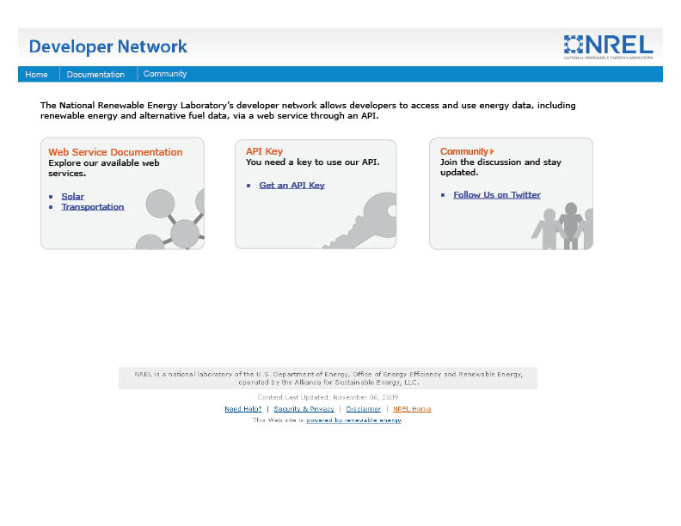
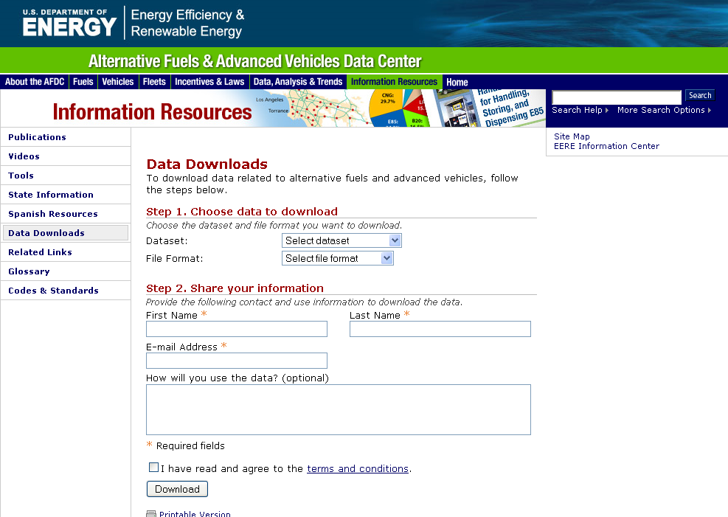
Come and Get It!

Slide 15
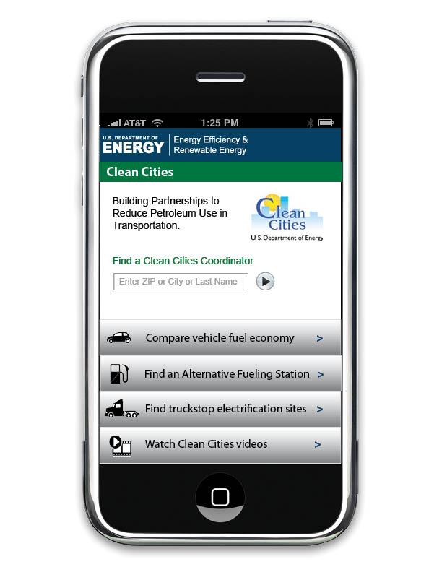
It’s Go Time
What’s Next?
  Clean Cities coordinator directory
    Mobile page optimize
  Alternative Fueling Station Locator
    Mobile optimize with HTML5 in a iPhone and Android wrapper
  Mobile home page
  Videos
  Crowd sourcing for stations

Slide 16
Crazy Egg Analysis: Usage Trends
So far, we’ve used Crazy Egg on:
EERE home page
1 landing page
4 corporate sites
7 program sites (new template)
7 subsites (2 in the new template)
Starting to see some usage trends emerge.
Notes:
Crazy Egg is one of 4 new online software packages that TAO has purchased for the programs to use to gather feedback on our sites remotely.
For those of you who are new to this, Crazy Egg collects information on where users are clicking when they come to your page during a certain time period, and then it uses that data to create heat maps and other reports of usage patterns.
This tool is a great place to start addressing some of our questions about how users are interacting with our web sites.
Over the last year, many EERE sites have done Crazy Egg studies, some several times. In particular, it’s now been used on 7 of the 10 refaced program sites, and we’re starting to see some trends emerging in how people are interacting with our program level sites in the new template.

Slide 17
Crazy Egg Analysis: Usage Trends
Agenda
Review usage trends
Future research questions
Notes:
Today we wanted to share with you some of the usage trends that are starting to emerge for sites in the new program template.
Then we’ll provide some recommendations for you to consider when developing content for your pages based on the click analytics.
Chris will talk about some of the ways EERE is planning to address some of the template-level findings.

Slide 18
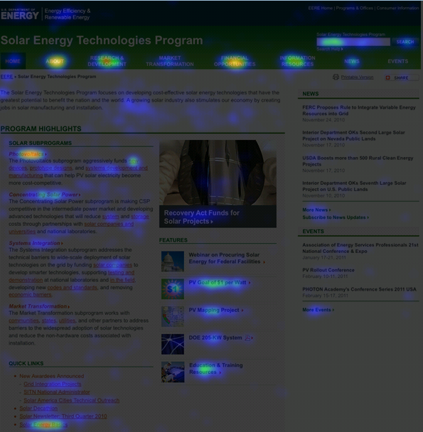
Crazy Egg Analysis: Usage Trends
Notes:
Let’s start by taking a look at a typical usage heat map of a program home page. The brighter areas indicate more clicks, dark areas indicate less clicks. In general, you can see that the top navigation and the center content area receives the most traffic; the right column gets less.

Slide 19
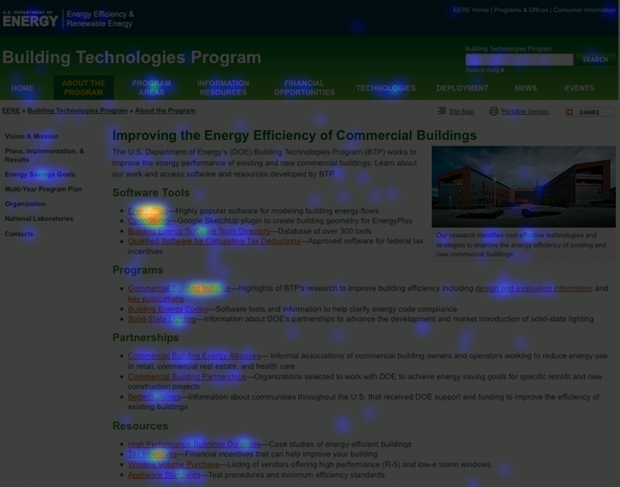
Crazy Egg Analysis: Usage Trends
Notes:
Here’s a typical second level page. Again, links in the center content receive the most traffic. The left navigation and the top navigation also draw some clicks, but generally less than on home pages (in the case of top navigation). Elements in the right column consistently draw less traffic.

Slide 20
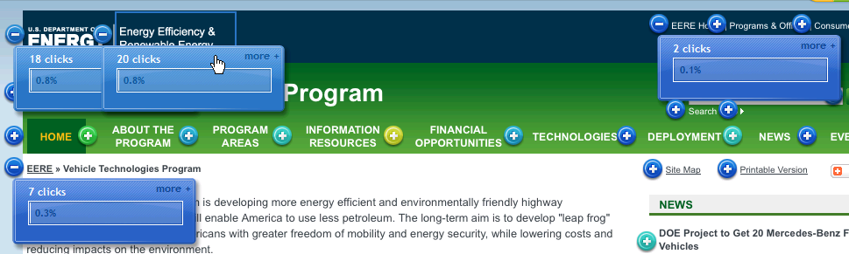

Crazy Egg Analysis: Usage Trends
Navigating to DOE/EERE
Few visitors navigate back to DOE/EERE from program sites.
Those that do primarily use left side of blue banner (fewer use breadcrumb, right side of blue banner, footer).
Visitors click on “Home” even on program home pages (0.4-0.7%).
Notes:
Few visitors navigate back to DOE/EERE from program sites.
Those that do primarily use left side of blue banner (fewer use breadcrumb, right side of blue banner, footer).
Visitors click on “Home” in the top navigation on the program home pages (0.4-0.7%) – could be because they expect this will take them back to EERE/DOE (requires further investigation).

Slide 21
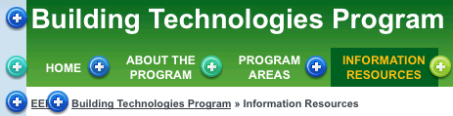
Crazy Egg Analysis: Usage Trends
Navigating Back to Program Home
Most visitors use the “Home” button in the top navigation (can receive up to 7% of click traffic)
The green bar and the breadcrumb are used less often (generally less than 1% each).
Notes:
Most common way for people to navigate from second levels back to home page is by using the “home” button in the green bar (can receive up to 7% of click traffic).
The program name in the green bar and the breadcrumb are used less often (generally less than 1% each).

Slide 22
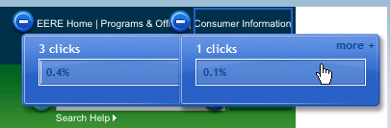
Crazy Egg Analysis: Usage Trends
Global Navigation
Not drawing much attention.
Preliminary evidence suggests that this trend also extends to subsites.
Notes:
Not drawing much attention (Programs & Offices, Consumer Information each get 0-0.5% of clicks.
Preliminary evidence suggests that this trend also extends to subsites.
This was also something Chris and his team observed in the template usability study they did in the fall.

Slide 23
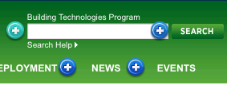
Crazy Egg Analysis: Usage Trends
Search
~2-4% of visitors perform searches from home or second level pages.
Search help is rarely used.
Notes:
Generally we’re finding that approximately 2-4% of visitors are doing searches from home or second level pages.
Search help is not being used at all.

Slide 24
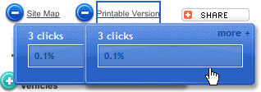
Crazy Egg Analysis: Usage Trends
Site Map, Printable Version, Share
Visitors do interact with these features (usually draw 0-0.5% of page clicks).
Share is rarely used.
Notes:
Visitors do interact with these features (usually draw 0-0.5% of page clicks).
Share is rarely used.

Slide 25
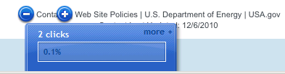
Crazy Egg Analysis: Usage Trends
Footer
Receives 0-1% of page traffic.
Contacts is most popular; Policies, DOE get some traffic.
Notes:
Receives 0-1% of page traffic.
Contacts is most popular; Policies, DOE get some traffic.

Slide 26
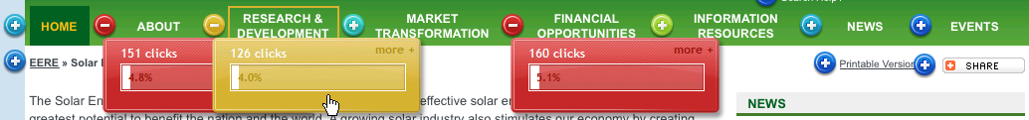
Crazy Egg Analysis: Usage Trends
Top Navigation
Primarily used on home pages (can constitute 15-25% of page traffic).
Usage on second levels varies considerably (6-26%).
Most popular: About, Financial Opportunities, Information Resources
Least popular: News, Events, and Deployment
Notes:
Primarily used on home pages (can constitute 15-25% of page traffic).
Usage on second levels varies considerably (6-26%).
About, Financial Opportunities, and to some degree, Information Resources are the most utilized top navigation items on home pages. In addition to these items, Program Areas and some of the program-specific buttons are popular on second levels.
News, Events, and Deployment are the least popular top navigation choices on both home and second level pages.

Slide 27
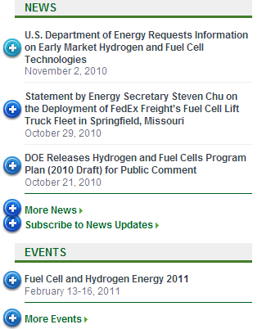
Crazy Egg Analysis: Usage Trends
Right Column
Consistently draws less traffic.
Particular news stories or features draw more traffic than others (depends on subject).
A few visitors use the “Subscribe to News, More News” links.
Notes:
The right column consistently draws less traffic than the center or the navigation.
Particular news stories or features draw more traffic than most (this seems to depend on content of the story/feature).
A few visitors use the “Subscribe to News, More News” links.

Slide 28
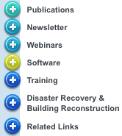
Crazy Egg Analysis: Usage Trends
Left Navigation
Receives up to 43% of the page clicks (second levels)
Effectively draw people’s attention.
Consistently gets more clicks than the top navigation on second level pages.
Notes:
The left navigation receives up to 43% of the page clicks, and seems to effectively draw people’s attention on second levels.
It consistently gets more clicks than the top navigation on second level pages.

Slide 29
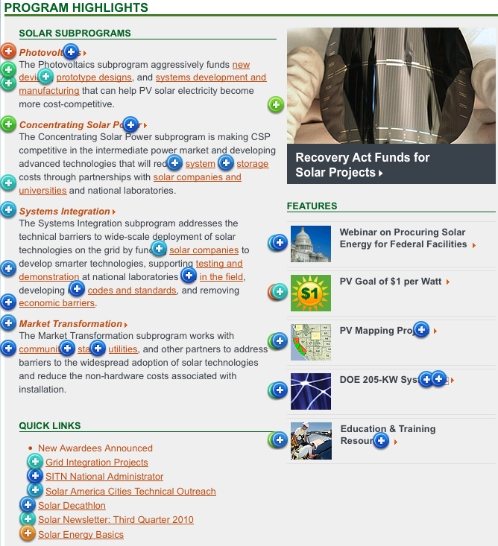
Crazy Egg Analysis: Usage Trends
Center Content
Attracts more clicks than other areas of page.
Info above the fold is more clicked than info below the fold.
Tops of lists get more clicks than bottoms of lists.
Visitors click on program descriptions.
Rotators draw attention.
Traffic to feature graphics depends on content/design.
Visitors click on unlinked graphics.
Notes:
Content in the center area (especially underlined links) generally attracts more clicks than other parts of the page.
Generally information above the fold is more clicked than information at the bottom of the page, but you can see here that visitors will scroll down and click on content that is of interest to them at the bottom of the page.
Generally links near the top of lists get more clicks than links at the bottom of lists (but not always).
A surprising number of visitors attempt to click on the program descriptions found on most program home pages. These are blocks of text that contain no links.
Visitors interact with rotators (~2-4% of clicks). They click on the text and on the image.
Traffic for feature graphics seems to depend on the content of the feature graphic (state-specific or financial content is drawing attention; bright colors draw attention).
Visitors try to click on unlinked graphics sometimes.

Slide 30
Crazy Egg Analysis: Usage Trends
Future Research
Why is the global navigation drawing so little attention?
Why are visitors clicking on “Home” in the top navigation on home pages?
Do EERE visitors tend to visit one or multiple programs when they come? Can users easily go between program sites?
How do visitors feel about the rotators?
What accounts for the great popularity of certain feature graphics?
Why are visitors clicking on the home page program descriptions?
Can visitors clearly distinguish between images that are clickable and those that are static?
Do visitors understand what they will find in Information Resources?
Do visitors understand and find value in the content found under labels like Deployment and Market Transformation, since they are often not heavily clicked on?
Do users understand what site they are searching?
How are users interacting with the right column? How much content is useful vs overwhelming ?
Notes:
(CHRIS) We are planning to do additional usability work so we can better understand how people are using the template, and continue to refine it. We would like you to help us with this by gathering data on template usage when you do your own program usability studies.
Here are some of the questions we’d like to get more feed back on:
Why is the global navigation drawing so little attention? (Is it not visible enough? Are people finding consumer information a different way instead? Do people generally have a need to view multiple program sites at each visit, or do they stick to one program?)
Why are visitors clicking on “Home” in the horizontal navigation on home pages? (Are they confused by the purpose of this button on home pages? Do they expect it to take them back to DOE/EERE?)
Do EERE visitors tend to visit one or multiple programs when they come? If so, are they able to successfully go between program sites using the new template?
How do visitors feel about the rotators? (Do they like them or find they annoying? How do they interact with them – do they like to know how many features there are? Do they like having a pause button?)
What accounts for the great popularity of a select few feature graphics? (Are visitors overwhelmed by number of features? Are certain features effectively capturing user top tasks, while the rest do not? Do visitors find the graphical treatment of particular features more compelling than others?)
Why are visitors clicking on the home page program descriptions? (Do they expect them to be linked? What are they trying to find when they do this?)
Can visitors clearly distinguish between text/images that are clickable and those that are static?
Do visitors understand what they will find in the Information Resources section (this section is often clicked on, but the click rate could be due to the fact that this is a very broad and general label as was shown in the ITP usability study)?
Do visitors find value in the content found under labels like Deployment and Market Transformation, since they are often not heavily clicked on? (Do people not click on these items because they don’t find value in the topics, or because the labels are jargony and confusing?)
Do users understand what site they are searching?
How are users interacting with the right navigation, and what is the right number of stories to draw attention but not overwhelm?
Wendy and I will be working together to develop some questions/follow ups that you could add to your usability studies in order to help us answer these questions.

Slide 31
Crazy Egg Analysis: Usage Trends
Wendy Littman – EERE Usability Coordinator
wendy.littman@hq.doe.gov
301-525-7521
Notes:
Here is our contact info if you have questions…

Slide 32
Web process
1. Concept development: Kickoff meeting, project information form, charter, Project Review Team meeting, identify content and draft architecture, create mockups
- Project Review Team meeting
2. Content: Write and optimize content, select images and documents, finalize architecture
- Template Coordinator IA review
3. Production: Prepare content for coding and code site
- QA checklist and security scan
4. Approvals and publishing: QAs and changes, pre-go-live tasks, reviews and approvals, go live
- QA changes, DOE and PRT approval
5. Maintenance and ongoing refinements: Maintenance plan, further analysis, stay informed
- Submit maintenance plan

Slide 33
Communication Standards Tip
EERE Web Style Guide
In the next few weeks, we’ll be adding information to the
EERE Web style guide:
Clarification on ampersands
R&D
We’ll be looking at “e-mail” vs. “email” soon!

Slide 34
Wrap Up
Next meeting: April 21

