Slide 1
EERE Web Coordinators
Monthly Meeting
Hosted by Drew Bittner
May 19, 2011

Slide 2
Agenda
Around the Room (15 min) – Drew
Clean Cities Mobile Tools (10 min) – Trish
Website content certification and marketing plans (15 min) – Drew
Official Use Only (5 min) – Drew
Events Archive: Fuel Cell Technologies (10 min) – Michelle
EERE Intranet (5 min) – Lou
Standards Tip (5 min) – Elizabeth

Slide 3
AFDC Mobile Tools
Clean Cities Mobile
Trish Cozart
Clean Cities and AFDC Web Manager
NREL

Slide 4
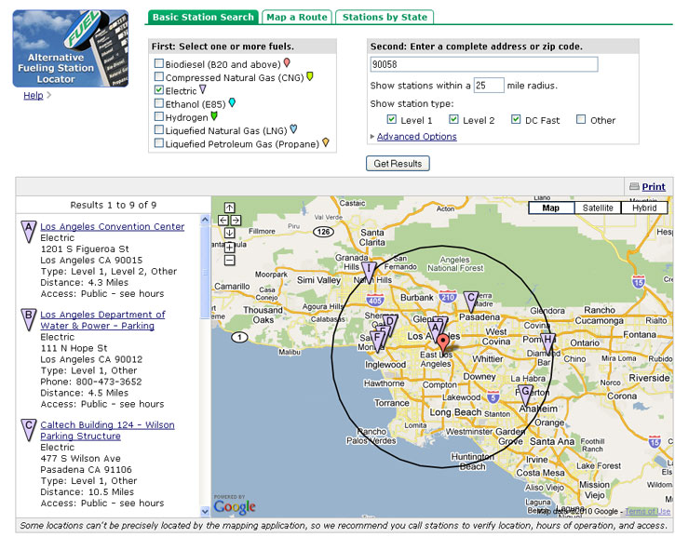
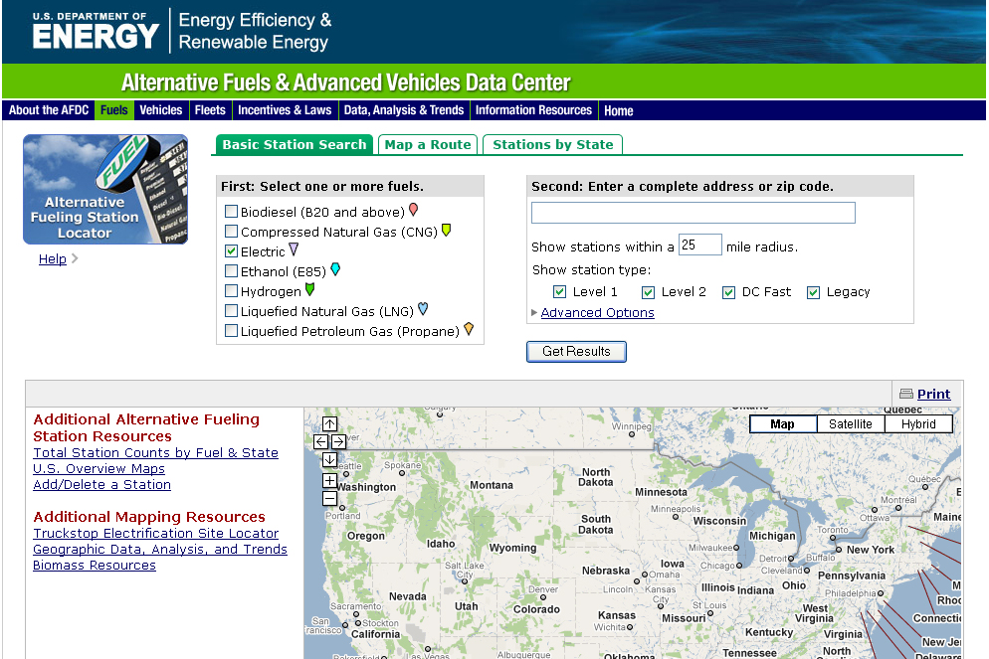
Going Mobile

Slide 5
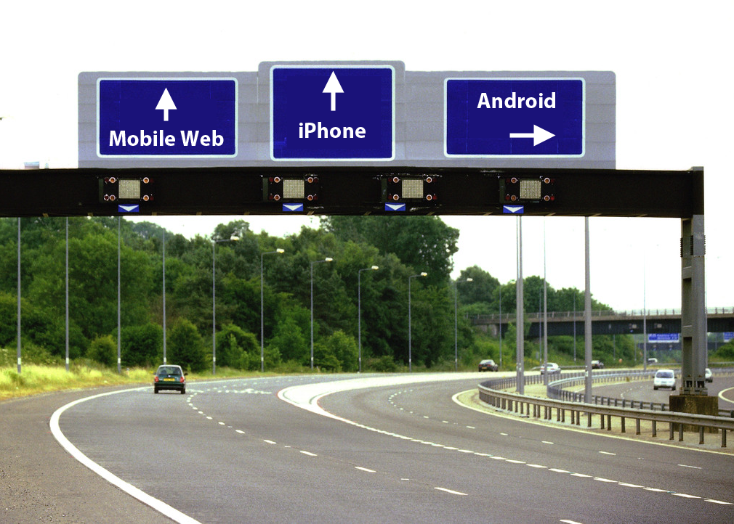

Slide 6
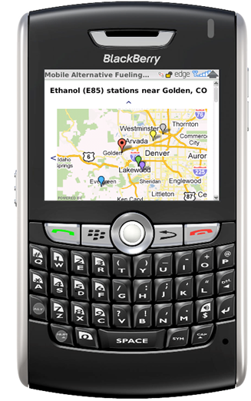
Eeny, Meeny, Miny, Moe
Mobile Web
  Simple Web Design (HTML)
  Responsive Web Design
  Fancy Web App Design (HTML5, Java)
Native App (iPhone, Android)

Slide 7
Handset Share: Gartner Q1 2010: Market Share
Web/App Usage: AdMob Operating System Share, May 2010

Slide 8
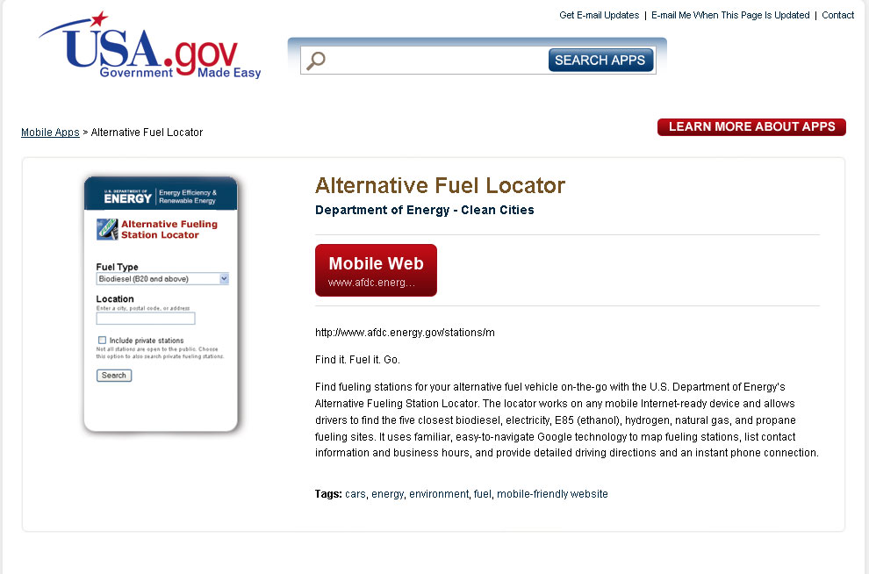
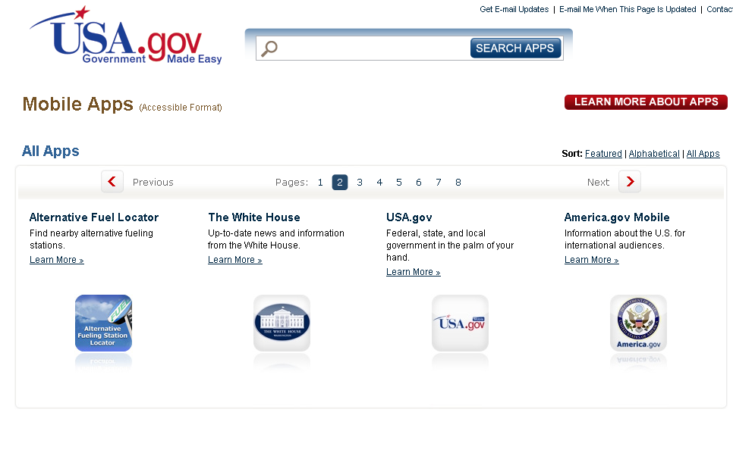
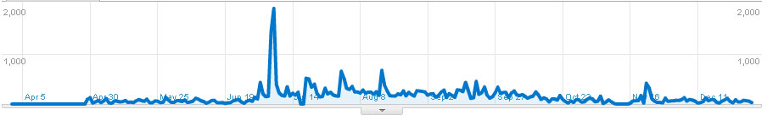
Don’t Worry, Be Appy.

Slide 9
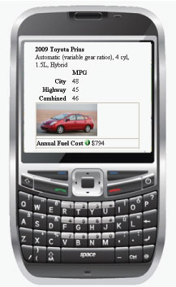
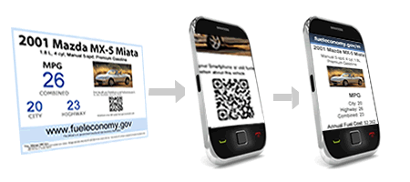
Fuel Economy

Slide 10
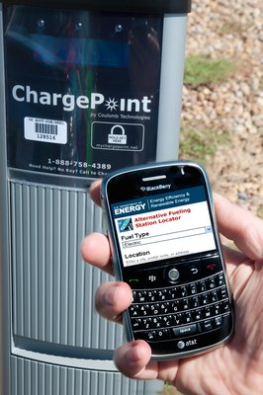
Data and Content
Great Data & Content
= Great Possibilities

Slide 11
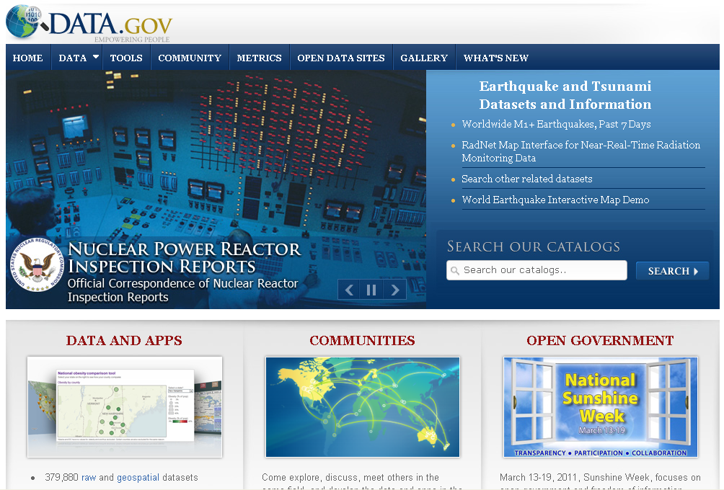
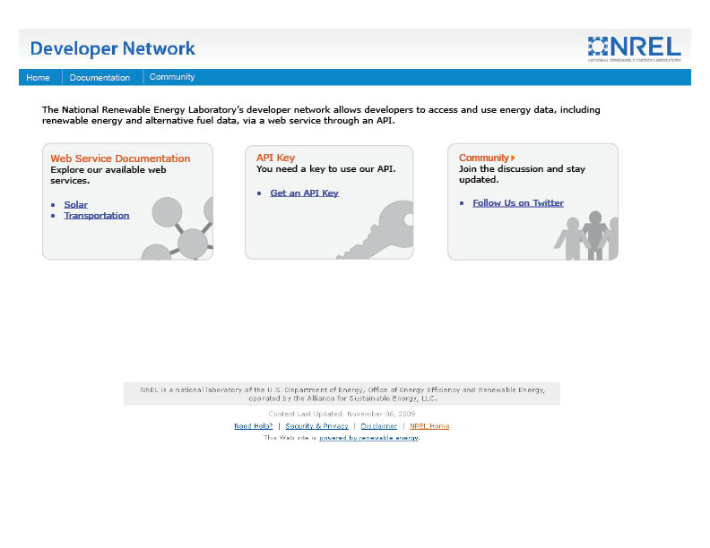
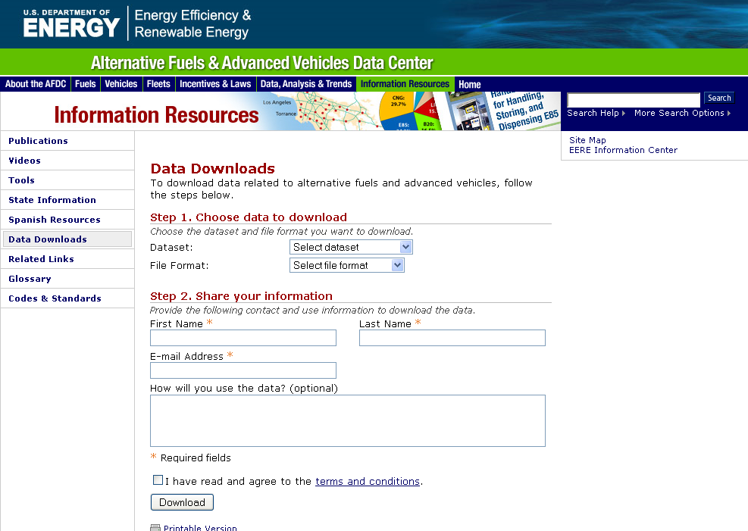
Come and Get It!

Slide 12
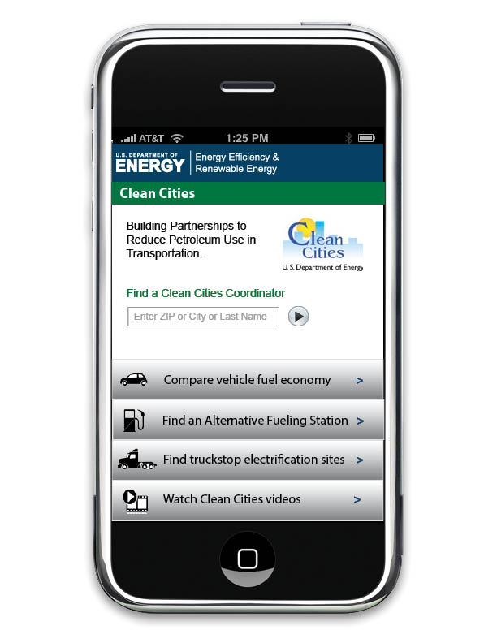
It’s Go Time
What’s Next?
  Clean Cities coordinator directory
    Mobile page optimize
  Alternative Fueling Station Locator
    Mobile optimize with HTML5 in a iPhone and Android wrapper
  Mobile home page
  Videos
  Crowd sourcing for stations

Slide 13
Website content certification and marketing plans
Starting this summer, as part of submitting site maintenance plans, you will be required to review all of your websites and certify:
  The site’s content is approved as still current and valid;
  The site’s content needs updating (with notes on what specifically must be updated) or extensive modification; or
  The site may be archived and taken down.
Implementation details will be provided via the Communication Standards website and blog.

Slide 14
Website content certification and marketing plans
Starting this summer, as part of the Project Review Team process, all sites will be required to submit a marketing communications plan.
The goal is to ensure as new EERE websites are created, there’s an accompanying strategy outlining how new Web products are promoted.
  Examples include widgets, blog and Facebook posts, GovDelivery notifications, cross-posting on other EERE websites, etc.
Implementation details and a sample plan will be provided via the Communication Standards website and blog.

Slide 15
Official Use Only
Please do not post anything on EERE websites that is "For Official Use Only" or "Proprietary."
There are some documents with this language currently on the EERE site.
In the next week, we’ll be contacting you if "For Official Use Only" or "Proprietary” content exists on your sites.

Slide 16
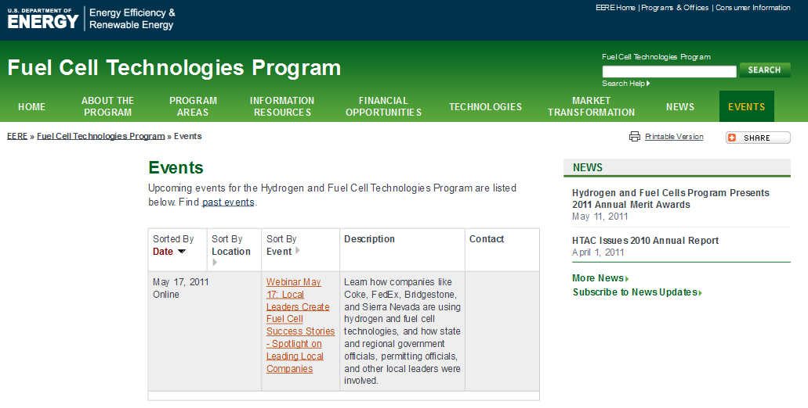
Events Archive: Fuel Cell Technologies

Slide 17
Upcoming EERE Intranet Redesign Outreach Activities
May 13-17: E-mail EERE & ask for volunteers to participate in (1) online survey & (2) one-one-one interviews (limited to @10 TD interviews)
May 23: Begin promoting intranet redesign through desktop screensaver
May 23-27: E-mail EERE & ask for volunteers to participate in intranet usability testing – card sort
May 30-Jun 3: Conduct usability testing round one – card sort
June 6: E-mail EERE & ask for new intranet name ideas
June 13: E-mail EERE & ask for volunteers to participate in intranet usability testing – tree jack
June 20-24: Conduct usability testing, round 2 – tree jack/information architecture validation
June 1: Begin putting OIBMS content on new intranet site (pilot site)

Slide 18
Communication Standards Tip
Copyright
Here you'll find the requirements for acquiring permission to use materials that are under copyright. Copyright is a property right whereby authors obtain, for a limited time, certain exclusive rights to their works. This includes:
Content coded in HTML on the page
PDFs or other downloadable files posted on the site, such as presentations, from organizations and companies not funded by DOE
Images and photos.

Slide 19
Wrap Up
Next meeting: June 16

