Slide 1
EERE Web Coordinators
Monthly Meeting
Hosted by Drew Bittner
November 17, 2011
Phone: 1 (470) 200-0304
Access Code: 223-133-792

Slide 2
Agenda
Around the Room (15 min) – Drew
Solar Career Mapping Tool (15 min) – Christina
Transition Team Update (10 min) – Suzanne
Site Inventory Reduction (10 min) – Leslie
Personally Identifiable Information/OMB Approval for Usability Studies (10 min) – Wendy
Communication Standards Tip (5 min) – Elizabeth

Slide 3
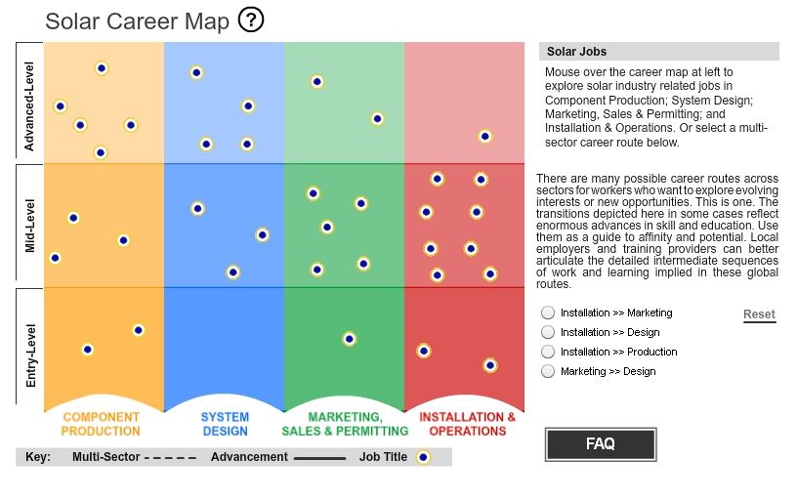
Solar Career Mapping Tool
http://www.eere.energy.gov/solar/careermap/

Slide 4

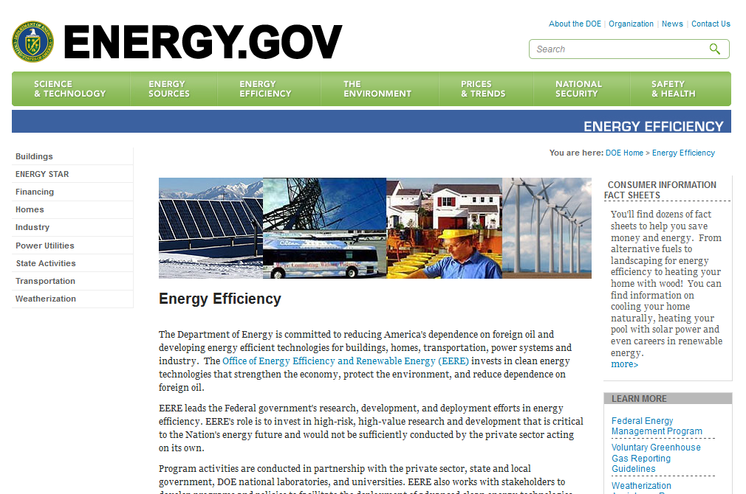
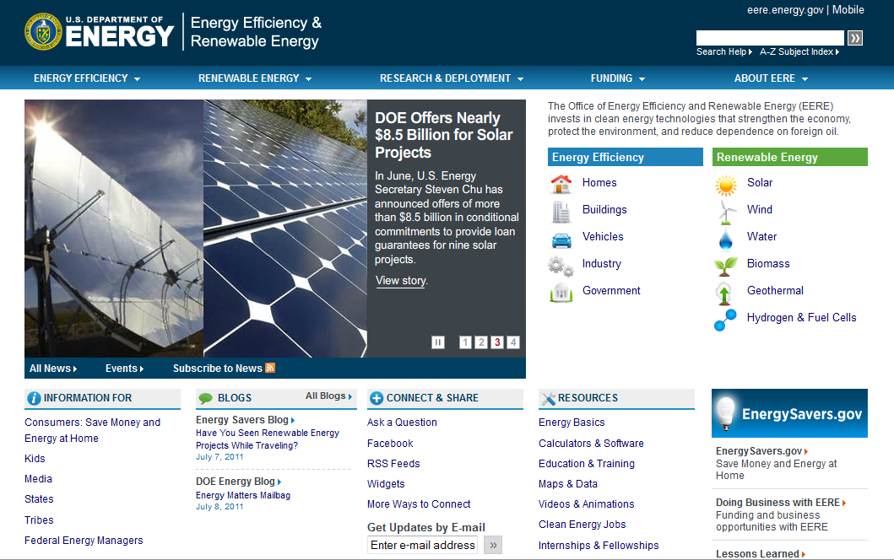
Transition Team Update
Energy.gov Integration Project
Status Update
Suzanne Boyd
EERE Web User Experience
July 11, 2011
Notes:
4

Slide 5


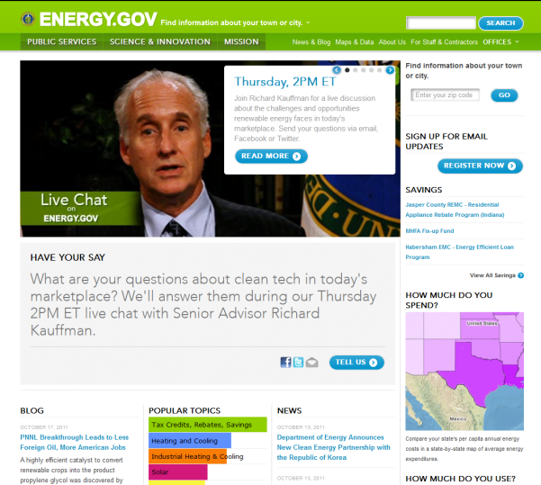

Identify EERE key audiences and their goals
Refresher: Project Goals
Help users be successful on the Energy.gov / EERE site
Achieve EERE & DOE organizational goals
Reduce energy consumption
Increase adoption of renewable energy technologies
Strengthen energy security
Protect the environment
Notes:
Our focus - audience driven
Drives our approach and how we measure success for the integration

Slide 6

Approach | 3 phases
EERE Transition
We are here
Phase 1
Phase 2
Phase 3
Discovery &
user research
Information architecture, final site design and content plan
Production and launch
Notes:
6

Slide 7
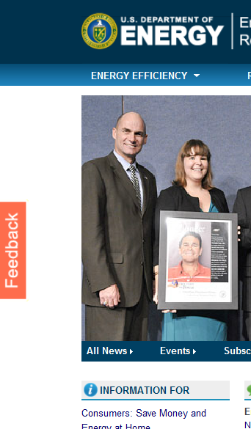
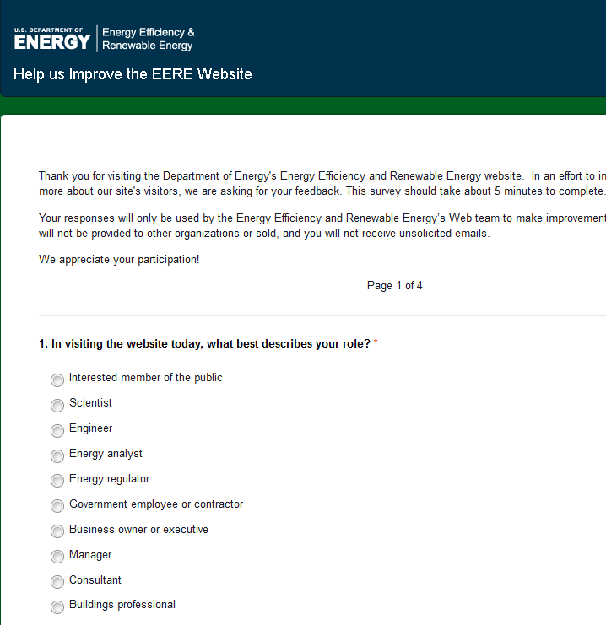
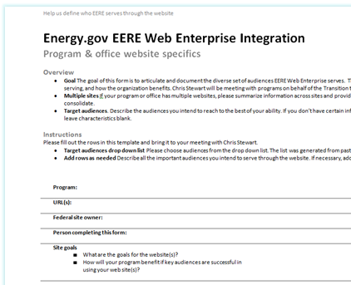
Getting your input on audiences and goals
Thank You!
Survey
Audience research
100+
user research reports
Audiences & goals
Notes:
Web trends
Usability reports
Crazy Egg
Information center reports
List serve feedback document
Tree Jack studies
Card sort reports
Search logs
7

Slide 8
Phase 1: status update
Project start up
SEPT
OCT
NOV
DEC
JAN
FEB
Project plan and kick-off
a
Establish core team / roles
a
Communication plan
a
Discovery
a
EERE corporate goals
a
Energy.gov design, taxonomy, interface
a
Program & stakeholder audiences and goals
Comparative analysis
User research
Online survey
User research from programs and offices
a
Web analytics & search logs
Information center reports
Social media
Usability study
Integration recommendation & roadmap
Notes:
8

Slide 9
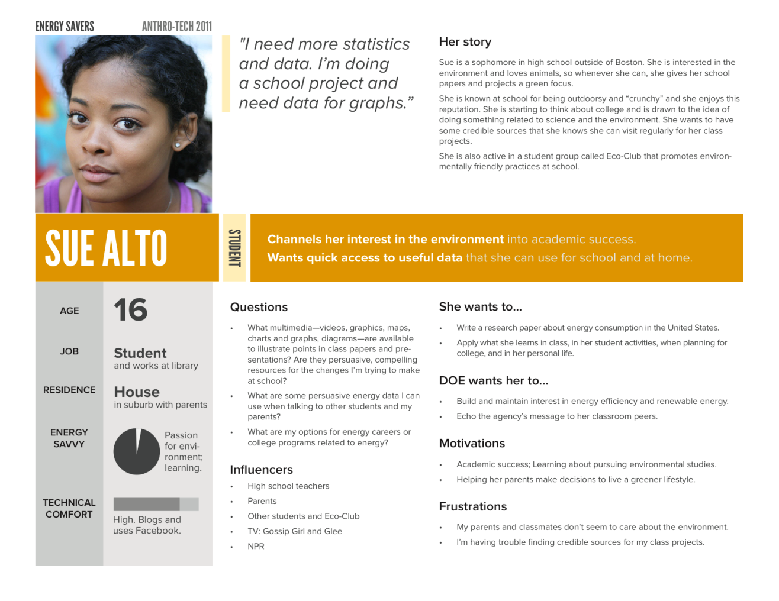
What’s next …
Analyze and synthesize user research
Segment and prioritize audiences
Develop primary personas for EERE
Prepare for usability study

Slide 10

Questions?

Slide 11
EERE Site Inventory Reduction
Who – EERE C&O to work with programs
What – Reduce number of EERE sites and URLs
Why – Whitehouse Executive Order 13571 and DOE Web Reform Initiative
How
  Definition of a site
  EERE’s list
  Criteria for consideration
  Process
Notes:
Implementing Executive Order 13571 on Streamlining Service Delivery and Improving Customer Service

Slide 12
Definition of a Site
"Website" is defined as a collection of interconnected web pages with a unique homepage and navigation.
Unique navigation
Unique site name
Examples
Building Technologies
http://www.eere.energy.gov/buildings/
Building America
http://www.eere.energy.gov/buildings/building_america/ (subsite)
Notes:
"Website" is defined as a collection of interconnected web pages with a unique homepage and navigation. For example, http://www.eere.energy.gov/ and http://www1.eere.energy.gov/buildings/ are considered unique websites according to this definition. In addition, any website DOE HQ provides funding for - including interagency or partnership websites - should be listed. For example, websites such as CleanEnergyMinisterial.org, FuelEconomy.gov, EnergyStar.gov, OSTI.gov should be listed.
If you're not sure whether something 'counts as a website,' err on the side of it being considered a unique website and list it separately.
This definition corresponds with what the Federal Web Managers' Council has used in the past and present.
The Web Reform initiative calls for the reduction of both domain names and "websites.”

Slide 13
EERE’s List
170 sites and subsites
  Applications are counted if they meet the criteria for a site or subsite
Not included
  Social media
  Applications that are not a site or subsite
  Mobile variants

Slide 14
Criteria for Consideration
Are there any site consolidations or removals already planned?
Is the site currently funded?
Is the site serving a current Whitehouse, DOE, or EERE initiative?
Is there active marketing/promotion of the URL/site or is the URL no longer being used?
Does the content duplicate content on Energy.gov or EERE?
Who are the audiences for the site and can the content be combined into another public site or Intranet?
Is the using a non-standard template and/or URL?
How much traffic is the site getting? (get data from Web stats and referring URLs).
When was the content last updated?

Slide 15
Process
C&O
  Send list of sites to Web coordinators by Nov. 23.
Web coordinators
  Review list and criteria
  Send a list of potential site reductions to Drew Bittner and Leslie Gardner by Dec. 1.
Final decisions for any site reductions will be determined between C&O and the programs.

Slide 16
PII Rules for Usability Studies
Personally Identifiable Information (PII) is:
Information that can be used to trace an individual’s identity, for example:
  Name, address (email or street), phone
  Name of employer
  Demographic information
  Social security number
  Date and place of birth
  Education
  Financial transactions
  Medical history
  Criminal or employment history

Slide 17
PII Rules for Usability Studies
EERE’s rules for protecting PII during usability work:
Only collect what you absolutely need.
Future studies that use the data should be compatible with the original study.
De-identify PII data before analysis.
Label documents containing PII as “Official Use Only.”
Store PII on an EERE resource which has been granted a Security Authorization (not personal equipment, USB drives, laptops, or other removable media).
Do not disclose PII for other purposes without the consent of the participant.
If a device containing PII is accessed or stolen by an unauthorized individual, you must report it immediately.

Slide 18
OMB Fast Track Approval
OMB approval is required whenever we interact with 10 or more members of the public.
Your collection is eligible for the fast track process if:
The data collection is focused on service improvement
The data collection is voluntary
Statistical rigor is not required
The burden on participants is not high
You won't distribute the results publicly.

Slide 19
OMB Fast Track Approval
Process for getting OMB approval through fast track:
Contact Wendy Littman for a copy of the fast track approval form.
Submit form and a copy of your survey/study to Christina Rouleau (copy Wendy).
Revise based on Chris’s comments; resubmit.
Chris will submit to OMB – they have 5 days to review the collection for approval.

Slide 20
OMB Fast Track Approval
For more information on PII rules for usability studies or OMB fast track approval, contact:
Wendy Littman
wendy.littman@ee.doe.gov
301-525-7521

Slide 21
Communication Standards Tip
Alt Text
Alt text (short for "alternative text") describes images on the Web for visitors who use screen readers to access Web sites. To meet Section 508 requirements, all EERE Web sites are required to provide alt text with their images.
http://www.eere.energy.gov/communicationstandards/content/alt_text.html

Slide 22
Wrap Up
Next meeting: December 15

