Slide 1
EERE Communications
EERE Web Coordinators Meeting
Conference line: (646) 307-1705 Passcode: 791-234-636
8/21/2014

Slide 2
Agenda
Web Coordinators Meeting
Around the Room – Drew Bittner
EERE Open Data Efforts – Kristen Honey
Topical Reorganization – Shannon Shea
Communications Standards Update – Elizabeth Spencer & Paige Terlip
Web Advisory Board Meeting
Migration Update – Billie Bates
Web Council & Energy.gov Release Update – Drew Bittner
Energy.gov Feedback Next Steps – Migration Team

Slide 3
Agenda
Web Coordinators Meeting
Around the Room – Drew Bittner
EERE Open Data Efforts – Kristen Honey
Topical Reorganization – Shannon Shea
Communications Standards Update – Elizabeth Spencer & Paige Terlip
Web Advisory Board Meeting
Migration Update – Billie Bates
Web Council & Energy.gov Release Update – Drew Bittner
Energy.gov Feedback Next Steps – Migration Team

Slide 4
EERE Open Data Efforts
Executive Order Open Data Policy, M-13-13
inventory.data.gov tool, hosted by GSA
Cross-Agency Priority (CAP) Goal = Open Data
Project Open Data evaluation by OMB
DOE-wide Open Data Strategy
Pete Tseronis (CTO) and OCIO lead
EERE Open Data Strategy — OpenEI.com
EERE Strategic Programs lead
Energy Datapalooza
American Energy Data Challenge (AEDC)
Contest #1 — Energy Ideas
Contest #2 — Apps for Energy
Contest #3 — Open Data by Design
Contest #4 — American Energy Challenge

Slide 5
Open Data Role of EERE Strategic Programs – Context
Represent EERE interests in Project Open Data
Identify and communicate best practices to EERE offices to meet Project Open Data requirements and data.gov deadlines
Attend cross-agency Open Data Policy trainings, as appropriate and in collaboration with OCIO, to develop Knowledge Training (KT) sessions and dissemination to EERE.
Represent EERE interests in DOE-wide Open Data Strategy
EERE Strategic Programs part of Pete Tseronis (DOE CTO) & OCIO weekly meetings to articulate early version of DOE Open Data Strategy with EERE offices/needs in mind.

Slide 6
Open Data Role of EERE Strategic Programs – Context
Guarantee EERE “interim solution” to satisfy M-13-13 mandates by November 2014 deadline
Raise visibility of existing solution, EERE’s OpenEI.org platform, with other DOE offices
Energy Datapalooza DOE point of contact
Datapalooza featured EERE successes
American Energy Data Challenge co-lead for “Open Data by Design,” featuring EERE resources for maximum benefits to EERE offices.

Slide 7
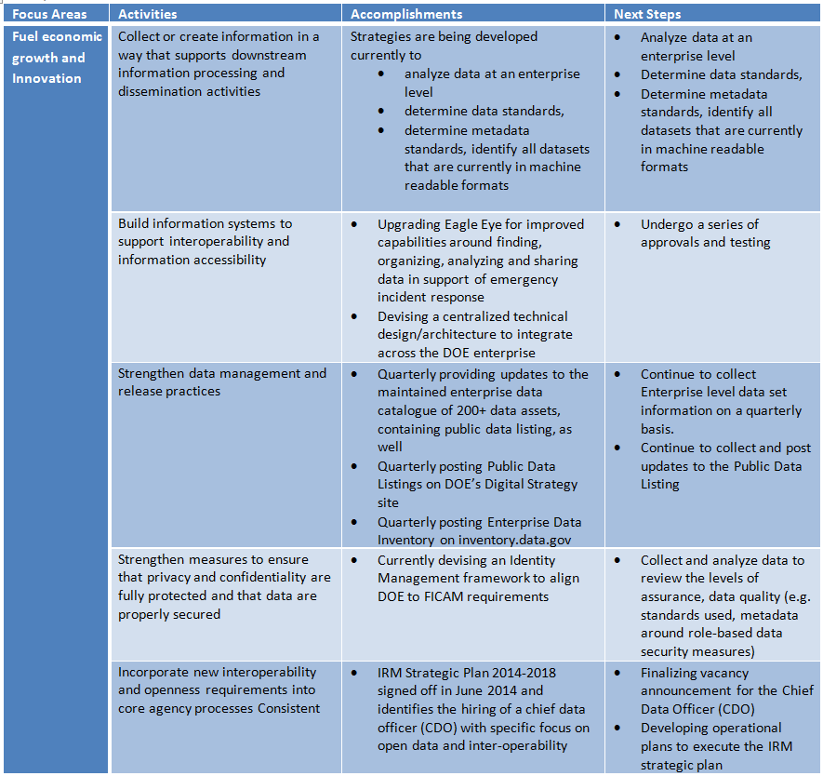
DOE-Wide Open Data Strategy
Pete Tseronis & OCIO launched DOE’s Open Data Strategy Team, July 2014
DOE’s POC is:
Nancy Russo (Accenture)
on behalf of Pete Tseronis (DOE CTO)
nancy.russo@accenturefederal.com

Slide 8
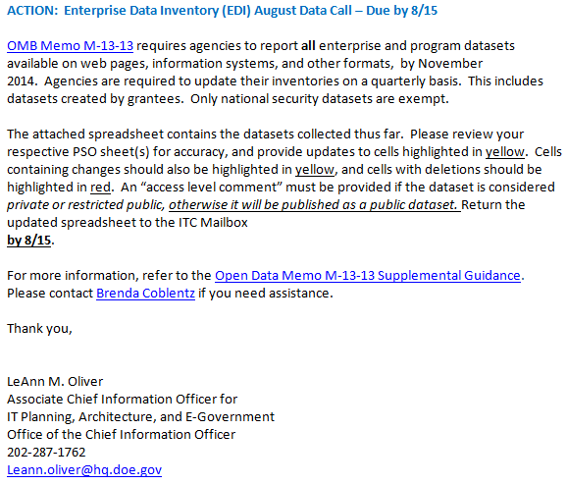
OCIO Enterprise Data Inventory (EDI) Data Call
GSA’s data.gov will serve as “phone book” White Pages for public to easily find open data
“NASA model” = OpenEI.org linked data serves as rich, highly functional platform to connect world to energy information

Slide 9
OCIO Enterprise Data Inventory (EDI) Data Call
EERE Strategic Programs Policy & Analysis with NREL upgrading OpenEI.org to CKAN platform
OpenEI backend will automatically send data to energy.gov for automated harvesting by data.gov
OpenEI data tagging and schema will satisfy “Common Core” M-13-13 requirements.
DOE must satisfy M-13-13 & Project Open Data criteria by Nov 30, 2014.

Slide 10
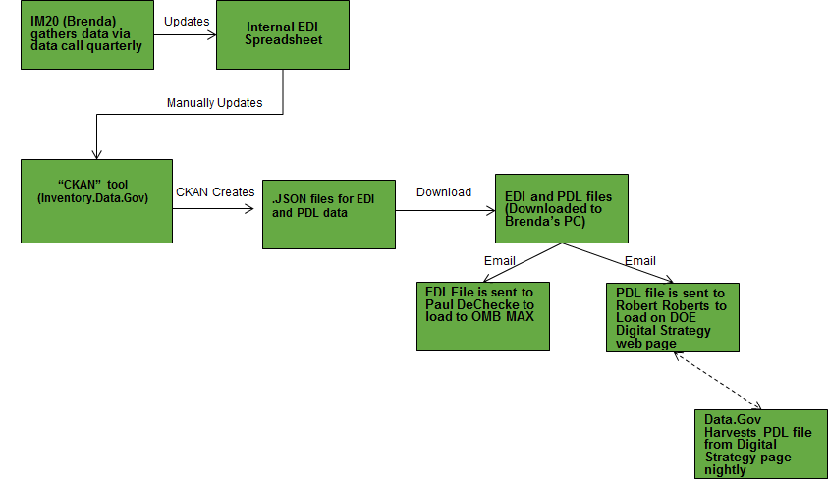
Manual DOE Process for EDI/PDL Dataset Inventories
Points of Contact:
Brenda Coblentz (OCIO) Brenda.Coblentz@hq.doe.gov
LeAnn Oliver (OCIO) LeAnn Oliver@hq.doe.gov

Slide 11
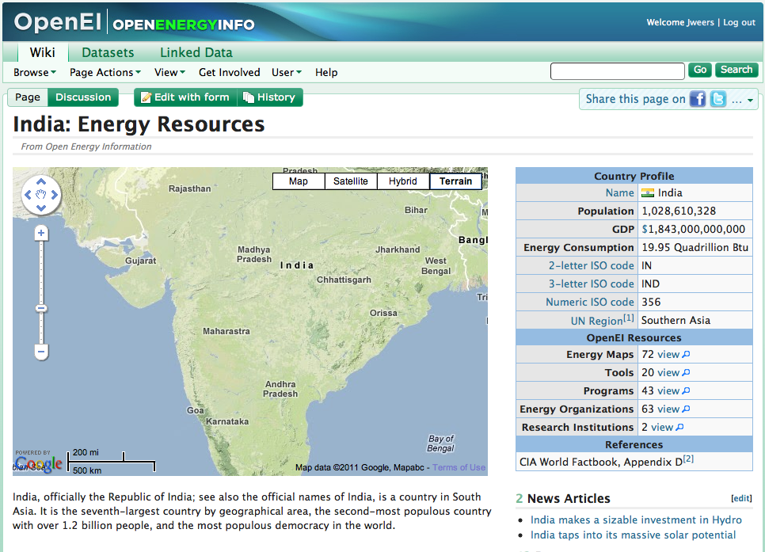
EERE Open Data Strategy — OpenEI
Open Energy Information (OpenEI) is a knowledge sharing online community dedicated to connecting people with the latest energy information and data.
Currently includes more than 55,000 content pages and more than 900 downloadable datasets
Downloadable data spreadsheets, machine-readable data services, user-generated maps, and citations with links to original sources
Uses crowdsourcing to generate new datasets, content and contributions, and includes input forms for easy information updates

Slide 12
EERE Open Data Strategy — OpenEI
Uses Linked Open Data to connect the world to energy data and information
Provides information that is useful to a wide audience, including utilities, policy makers, academics and consumers.
By providing access to energy-related information via geographic discovery, visualizations and apps, and topic-oriented gateways, OpenEI helps users make better informed decisions.
Points of Contact:
Kristen Honey (AAAS Fellow, EERE) Kristen.Honey@ee.doe.gov
Debbie Brodt-Giles (NREL) Debbie.Brodt.Giles@nrel.gov
http://en.openei.org/wiki/Main_Page

Slide 13
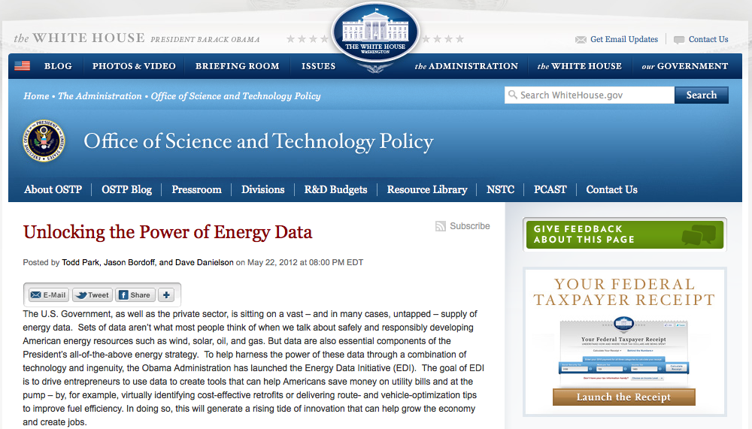
Open Government and Energy Data Initiatives | Date
DOE issued press release to launch OpenEI as its Open Government Initiative | 12/09
DOE releases Open Government Plan, which highlights OpenEI | 4/10
OpenEI recognized by the White House as a Flagship Open Government Initiative | 4/10
OpenEI featured on White House Innovations Gallery | 1/11
White House Announces Energy Data Initiative | 5/12
OpenEI included in OMB Federal Digital Strategy | 8/12
OSTP Open Access Memo Issued to Federal Agencies | 2/13
Notes:
POC: Debbie Brodt-Giles; Debbie.Brodt.Giles@nrel.gov
Project Team
Organization – Name
Summary text [for 3 different audiences]
EERE leadership (default) –
Energy analysts –
External stakeholders –

Slide 14
OpenEI Strategy
Catalyze the collection of the world’s energy information to advance the adoption of renewable energy, fuel innovation and better inform energy decisions of policy makers, researchers, investors, and consumers
Linked Open Data for Improved access to energy-related information
Easy, legal, & scalable data sharing and ratings
Community support for contributions and collaboration
Assessments of information quality & provenance
Services for application development & derived data knowledge
Crowdsourced
Dataset Generation
Notes:
POC: Debbie Brodt-Giles; Debbie.Brodt.Giles@nrel.gov
Project Team
Organization – Name
Summary text [for 3 different audiences]
EERE leadership (default) –
Energy analysts –
External stakeholders –

Slide 15
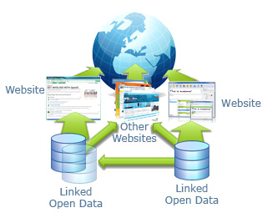
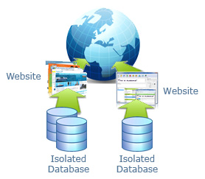
What is Linked Open Data?
Typical Websites Without Linked Open Data
With Linked Open Data
Notes:
Stores all information in its own database
Other sites have similar design pattern
Duplication of effort and information
Both sites responsible for updating information
Potential for online community to be presented with conflicting information
WITH LOD:
Datasets are shared behind the scenes
Each site can focus on key data and import supplemental data
Imported data updates automatically
Provides users with consistent information across multiple sites
Other Websites can consume LOD resources to present new content in exciting and unanticipated ways

Slide 16
IM20 (Brenda)
gathers data
via quarterly
data call
Updates
Internal EDI Spreadsheet
DOE Process
Manual updates
“CKAN” tool
(inventory.data.gov)
CKAN creates
.JSON files for EDI and PDL data
Download
EDI and PDL files
(Downloaded to Brenda’s PC)
E-mail
E-mail
Program repositories on OpenEI.org
Program POCs enter metadata to OpenEI.org
EDI file is sent sent to Paul DeChecke to load to OMB MAX
PDL file is sent to DOE Public Affairs to load on DOE Digital Strategy web page
CKAN Tool on OpenEI.org
OpenEI.org
CKAN creates
.JSON files for EDI and PDL
Data.gov harvests PDL from Digital Strategy web page nightly
OpenEI.org
Automated
Harvested
Machine readable formats
EERE 1
EERE 2
EERE 3
EERE 4
Other EERE-funded repositories

Slide 17
Automated EERE Process for PDLs
Points of Contact:
Kristen Honey (AAAS Fellow, EERE) Kristen.Honey@ee.doe.gov
Debbie Brodt-Giles (NREL) Debbie.Brodt.Giles@nrel.gov
Program repositories on OpenEI.org
Program POCs enter metadata to OpenEI.org
CKAN Tool on OpenEI.org
OpenEI.org
CKAN creates
.JSON files for EDI and PDL
OpenEI.org
Automated
Harvested
Machine readable formats
EERE 1
EERE 2
EERE 3
EERE 4
Other EERE-funded repositories

Slide 18
Cost Options
2014 Upgrades | Current guidance for FY15 funding:
EERE SP funded | AWS Hosting; server administration; reactive maintenance of platform; Do-it-Yourself interface for EERE CKAN catalog; no active content management or support to EERE POCs or OpenEI users; will begin to eliminate features and un-funded content; eventual obsolescence
Plus-Ups for EERE Catalog
EERE SP funded | Above plus: Active development/maintenance of EERE Catalog; efficient interface with data.gov; custom EERE-branded skin; harvesting available content from other EERE platforms; technical support to EERE POCs entering data; content maintenance; usage analytics and reporting; proactive maintenance of platform
(not yet funded) | Above plus: Active partnering with other EERE and energy platforms; active maintenance of Apps and Community sections; marketing and social outreach; usability analysis and enhancement; limited support to DOE data events
(not yet funded) | All the bells and whistles. Items above plus: Robust engagement with Community section; Participation in Federal Open Data world and DOE data events; Feeding success stories, best practices to DOE OPA

Slide 19
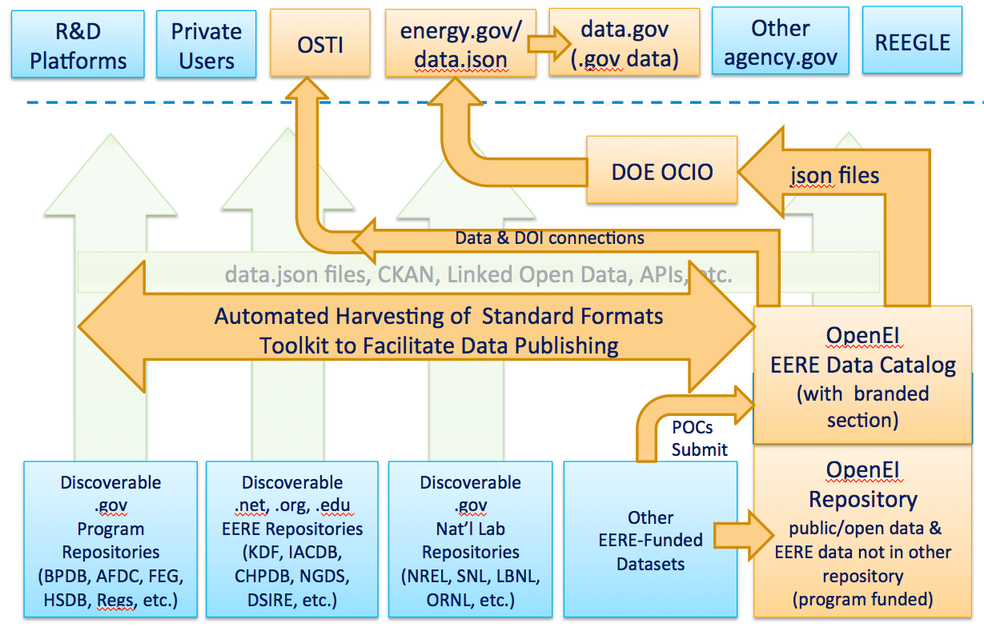
EERE Data Catalog & the Federal Landscape
Notes:
overview of the general DOE data landscape and shows how OpenEI can provide value in three specific ways:
Acting as a single catalog of meta-data describing all of EERE’s datasets, wherever they may reside
Serving as a data repository for those EERE datasets that are not already associated with an existing domain-specific platform or website
Automating data connections to already established data platforms
Some EERE Offices have existing domain-specific data and research platforms that have been successful for many years, supporting unique technology and market communities to meet program goals. In these cases, OpenEI can partner to provide a comprehensive central catalog for EERE digital assets and simplify broader open access.

Slide 20
OpenEI Schedule Details – Hard Deadline Nov 30, 2014
July – Sept
2014
EERE Strategic Programs Policy & Analysis contracting with NREL for EERE upgrades to OpenEI.org:
CKAN platform
.JSON files for Public Data Listings
energy.gov automated uploads
data.gov nightly harvests of energy.gov for automated updating.
Kristen & EERE Strategic Programs Office work closely with OCIO.
Clarify OpenEI role for all DOE & DOE’s Open Data Policy strategy.
July – Nov
2014
Notes:
POC: Debbie Brodt-Giles; Debbie.Brodt.Giles@nrel.gov
Project Team
Organization – Name
Summary text [for 3 different audiences]
EERE leadership (default) –
Energy analysts –
External stakeholders –

Slide 21
OpenEI Schedule Details – Hard Deadline Nov 30, 2014
Aug
2014
Kristen speaking at EERE Web Coordinators Meeting 8/21 to give EERE Offices information about Project Open Data and EERE plan.
Kristen will individually follow-up with all EERE offices, using identical surveys/protocol as DOE-wide OCIO open data effort.
EERE SP support to identify and upload datasets to OpenEI.org.
EERE Office’s long-term data management plan.
Aug – Nov
2014
Notes:
POC: Debbie Brodt-Giles; Debbie.Brodt.Giles@nrel.gov
Project Team
Organization – Name
Summary text [for 3 different audiences]
EERE leadership (default) –
Energy analysts –
External stakeholders –

Slide 22
Agenda
Web Coordinators Meeting
Around the Room – Drew Bittner
EERE Open Data Efforts – Kristen Honey
Topical Reorganization – Shannon Shea
Communications Standards Update – Elizabeth Spencer & Paige Terlip
Web Advisory Board Meeting
Migration Update – Billie Bates
Web Council & Energy.gov Release Update – Drew Bittner
Energy.gov Feedback Next Steps – Migration Team

Slide 23
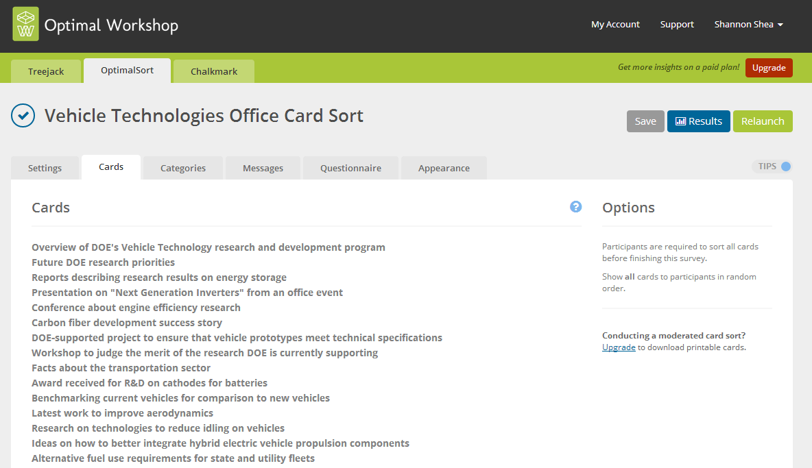
Topical Reorganization
Why topic based?
Investigating users mental models – running a card sort
How a card sort works: vehicletech.optimalworkshop.com
Creating the cards
OMB approval.

Slide 24
Topic Based Websites
Analyzing the Card Sort
Notes:
Analyzing – more of an art than science; because everyone sorts the cards slightly differently and names the categories differently, so need to look for patterns in how people grouped different cards together –

Slide 25
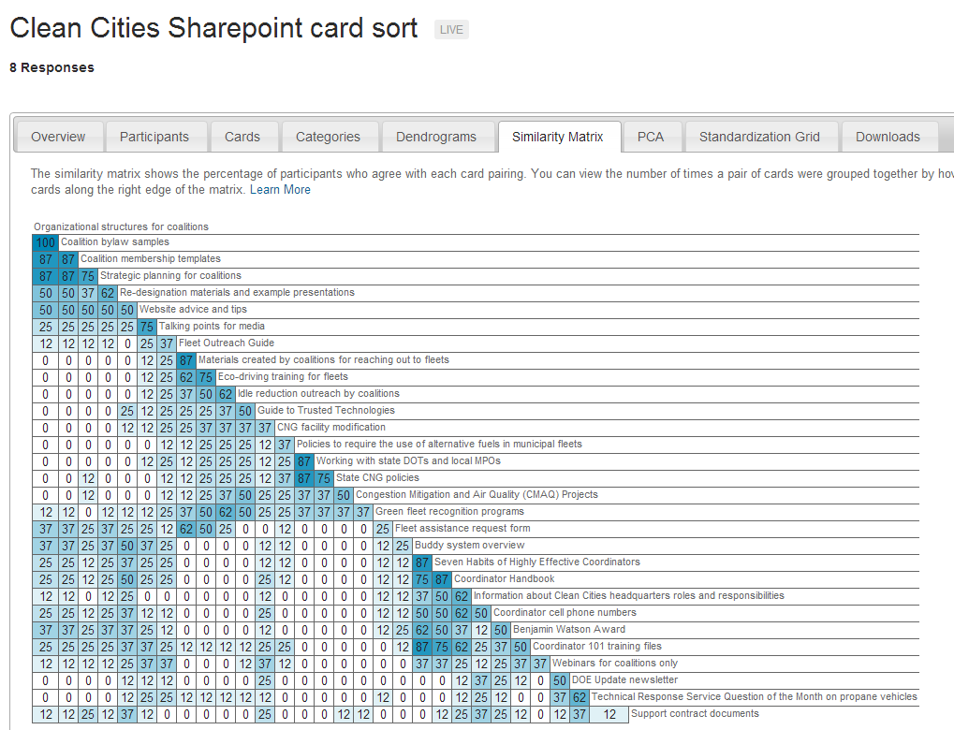
Topic Based Websites
Analyzing the Card Sort
Notes:
What cards are associated the most often with each other? What are the most common types of categories? Did people name these categories similarly?

Slide 26
Agenda
Web Coordinators Meeting
Around the Room – Drew Bittner
EERE Open Data Efforts – Kristen Honey
Topical Reorganization – Shannon Shea
Communications Standards Update – Elizabeth Spencer & Paige Terlip
Web Advisory Board Meeting
Migration Update – Billie Bates
Web Council & Energy.gov Release Update – Drew Bittner
Energy.gov Feedback Next Steps – Migration Team

Slide 27
Website Maintenance
Starting in December, all Web teams will be asked to attend two special Web Governance Team meetings in December and June, where they’ll report on their website maintenance.
The new process is on the Website Maintenance page:
eere.energy.gov/communicationstandards/maintenance.html
Before the meetings, offices will need to fill out the website maintenance template:
eere.energy.gov/communicationstandards/docs/website_maintenance_template.doc

Slide 28
Website Maintenance
The purpose of this meeting is to provide an overview of:
Content you reviewed
Content you updated, added, or removed
Plans for updating your website in the future.
You do not need to bring lists of URLs or comprehensive examples. Summarize what you’ve done. See the template for ideas.
We recommend:
Content inventories
Content analysis.
Neither are required, but they can help you do more systematic reviews of your websites. Guidelines for both are available on Communication Standards.

Slide 29
Report Template
The report template is now live on Communication Standards.
eere.energy.gov/communicationstandards/templates_print.html
The new report template provides an outline that includes tips and formatting instructions.
The report template is available as an InDesign file. If you do not have InDesign, you can use the design layer PDF as a reference for how to format your document using another publishing tool.

Slide 30
Report Template
Some key features include:
Cover: The front cover includes a place for co-authors and the back cover designates a space for co-branding information. However, the PGT will approve co-branding requests on a case-by-case basis.
Tables, graphs, and charts: Formatting instructions, such as font and color, are available in the pink design layer for tables, bar graphs, and pie charts.
Captions, bullets, and sidebar boxes: The pink design layer also includes formatting tips and tricks for sidebar boxes, image captions, and bullets.
Sections: The template clearly defines each section including the foreword, preface, acknowledgements, nomenclature of acronyms, executive summary, report body, glossary, references, and bibliography. You may modify these sections as necessary.

Slide 31
Agenda
Web Coordinators Meeting
Around the Room – Drew Bittner
EERE Open Data Efforts – Kristen Honey
Topical Reorganization – Shannon Shea
Communications Standards Update – Elizabeth Spencer & Paige Terlip
Web Advisory Board Meeting
Migration Update – Billie Bates
Web Council & Energy.gov Release Update – Drew Bittner
Energy.gov Feedback Next Steps – Migration Team

Slide 32
Migration Status Update
Most recently sent live:
WIP Solution Center
Procuring Solar for Federal Facilities
Currently being migrated:
SSL (rest of site)
Golden Reading Room
Queuing up next:
Postdoctoral Research Awards
Analysis

Slide 33
Agenda
Web Coordinators Meeting
Around the Room – Drew Bittner
EERE Open Data Efforts – Kristen Honey
Topical Reorganization – Shannon Shea
Communications Standards Update – Elizabeth Spencer & Paige Terlip
Web Advisory Board Meeting
Migration Update – Billie Bates
Web Council & Energy.gov Release Update – Drew Bittner
Energy.gov Feedback Next Steps – Migration Team
Notes:
Organic Groups update is happening in the background this weekend. Please keep track of your changes starting on Friday in case they need to roll back servers.

Slide 34
Agenda
Web Coordinators Meeting
Around the Room – Drew Bittner
EERE Open Data Efforts – Kristen Honey
Topical Reorganization – Shannon Shea
Communications Standards Update – Elizabeth Spencer & Paige Terlip
Web Advisory Board Meeting
Migration Update – Billie Bates
Web Council & Energy.gov Release Update – Drew Bittner
Energy.gov Feedback Next Steps – Migration Team

Slide 35
Energy.gov Feedback Next Steps
Thank you for your feedback!
In response:
Expanded site coordinator roles. Amy Glickson and Jason Kardell are your first points of contact for questions.
Kicked off a Communication Standards update to add new resources for publishing in energy.gov.
Drafting a plan for improved cross-promotion across channels managed by PA, EERE Corporate, offices, and initiatives.
Presenting publishing needs to PA’s new hire for review and scheduling after the organic groups and media module updates.

Slide 36
Wrap Up
Next meeting: September 18, 1:30 – 3:00 p.m.

