Slide 1
EERE Communications
EERE Web Coordinators Meeting
Conference line: (415) 655-0059 Passcode: 351-989-627
10/16/2014

Slide 2
Agenda
Web Coordinators Meeting
Introduction – Carolyn Hinkley
OpenEI Demo – Jon Weers
Communications Standards Update – Elizabeth Spencer
News Feeds on Topic Landing Pages – Paige Terlip
Migration Update – Billie Bates

Slide 3
Agenda
Web Coordinators Meeting
Introduction – Carolyn Hinkley
OpenEI Demo – Jon Weers
Communications Standards Update – Elizabeth Spencer
News Feeds on Topic Landing Pages – Paige Terlip
Migration Update – Billie Bates

Slide 4
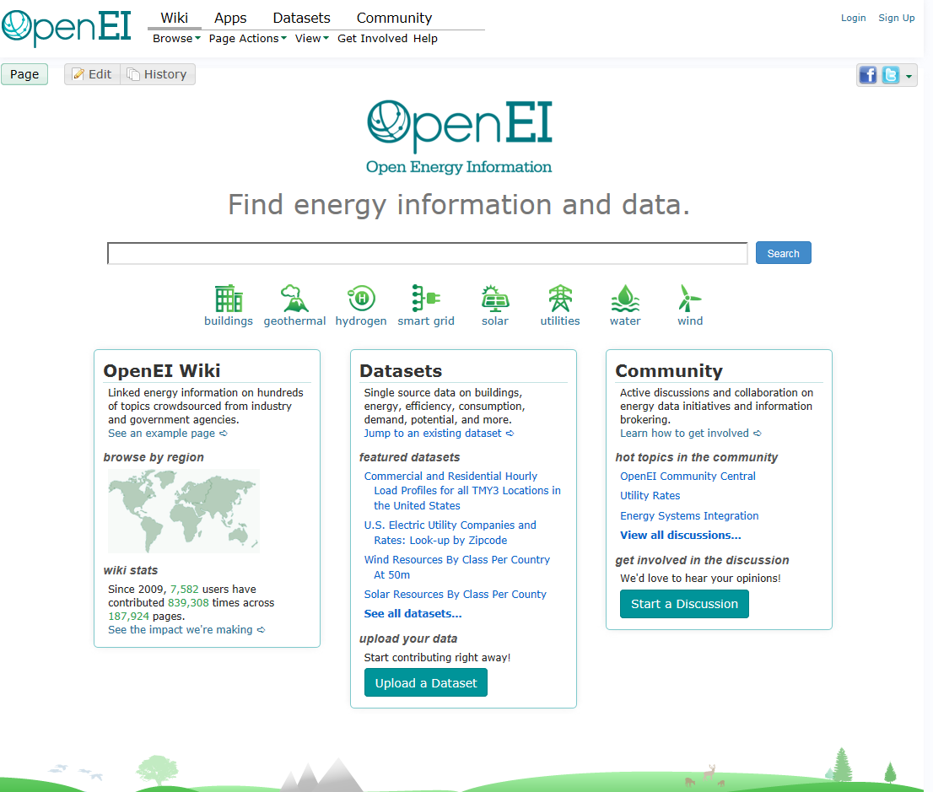
OpenEI: Energy Information
OpenEI is a free and open knowledge sharing platform created to facilitate access to energy-related data, models, tools, and information.
Multiple platforms
Semantic mediawiki
Datasets
Community
Apps
More than 78,000 wiki pages
Over 840 Datasets
In a variety of open formats
At least 5,000 registered users.

Slide 5
The Open Knowledge Foundation (OKFN)
International non-profit devoted to open data, https://okfn.org/.
Creators of CKAN
Primary features of CKAN
Multiple resources per dataset
Can be files or links
Advanced search
Modern, dynamic facets
Folksonomy, SOLR keyword searching
Resource preview
Built on international Web standards
Familiarity resulting from known conventions
Strong online community
Data.gov, the US NGDS, data.gov.uk, dozens of other countries, including Australia, Brazil, etc.
Extensible
Federates easily with itself through a harvest extension
Data.gov compatibility.

Slide 6
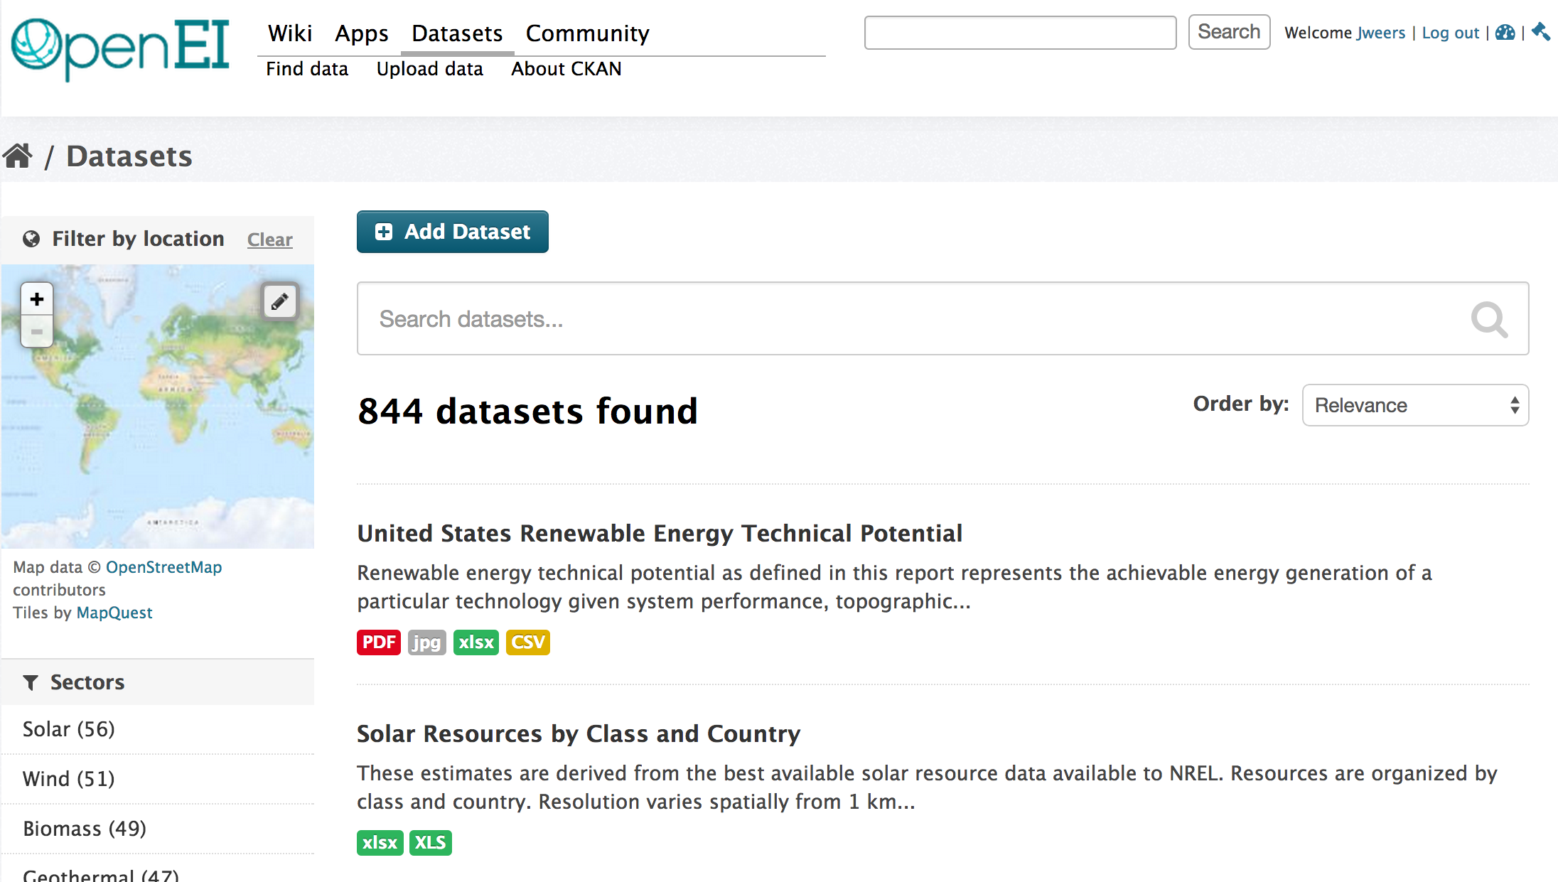
OpenEI Demonstration
Live demonstration of CKAN instance: http://en.openei.org/datasets/dataset

Slide 7
OpenEI Demonstration
Data search via side filters
Map filter
Metadata collection (edit) form
License MUST be specified
An ambiguously licensed dataset is nearly useless
DOE I.D. number and “EERE funded” checkbox
Multiple resources per dataset
Ability to link or upload
Solves a number of logistical problems
Link to copyrighted material and upload supporting data
Register assets hosted elsewhere that are not published in a data.gov-friendly catalog
Multiple sources
Added a number of assets, including the GDR
However, since the GDR is CKAN compatible, we can (and did) just pull it all in.
Notes:
What you just saw (in theory)

Slide 8
OpenEI Demonstration
How you can participate:
Upload your open datasets to the platform
Help us determine existing data repositories that should be federated or harvested with OpenEI
Understand that this platform will provide data.json files to DOE’s OCIO which will then feed Data.gov – this helps make your data accessible by all!
Openei.org

Slide 9
OpenEI Demonstration
How you can participate:
Think about utilizing OpenEI for your data collection, data generation, and data visualization needs
Contact us to learn more about building applications and meeting program goals using this platform.
Questions? Email us!
Jon Weers – Jon.weers@nrel.gov
Debbie Brodt-Giles – Debbie.brodt.giles@nrel.gov
Openei.org

Slide 10
Proposed EERE Data Catalog on OpenEI
R&D
Platforms
Private Users
OSTI
energy.gov/data.json
data.gov
(.gov data)
Other agency.gov
REEGLE
DOE OCIO
json files
data.json files, CKAN, Linked Open Data, APIs, etc.
Automated Harvesting of Standard Formats
Toolkit to Facilitate Data Publishing
OpenEI
EERE Data Catalog (with .gov partitioned section)
POCs Submit
OpenEI
Repository
public/open data & EERE data not in other repository
(program funded)
Discoverable
.gov
Program Repositories
(BPDB, AFDC, FEG, HSDB, Regs, etc.)
Discoverable
.gov
Nat’l Lab Repositories
(NREL, SNL, LBNL, ORNL, etc.)
Discoverable
.net, .org, .edu
EERE Repositories
(KDF, OpenEI, IACDB, CHPDB, NGDS, DSIRE, etc.)
Other
EERE-Funded
Datasets
Notes:
NREL is currently funded to investigate this; to start to work with other repositories to help them make their data available
- lots of options, with different funding considerations

Slide 11
Proposed EERE Data Catalog on OpenEI
R&D
Platforms
Private Users
OSTI
energy.gov/data.json
data.gov
(.gov data)
Other agency.gov
REEGLE
DOE OCIO
json files
data.json files, CKAN, Linked Open Data, APIs, etc.
Automated Harvesting of Standard Formats
Toolkit to Facilitate Data Publishing
OpenEI
EERE Data Catalog (with .gov partitioned section)
Lots of great data platforms already in place.
We will work with them to open up their data to share with others.
POCs Submit
OpenEI
Repository
public/open data & EERE data not in other repository
(program funded)
Discoverable
.gov
Program Repositories
(BPDB, AFDC, FEG, HSDB, Regs, etc.)
Discoverable
.gov
Nat’l Lab Repositories
(NREL, SNL, LBNL, ORNL, etc.)
Discoverable
.net, .org, .edu
EERE Repositories
(KDF, OpenEI, IACDB, CHPDB, NGDS, DSIRE, etc.)
Other
EERE-Funded
Datasets
Notes:
NREL is currently funded to investigate this; to start to work with other repositories to help them make their data available
- lots of options, with different funding considerations

Slide 12
Questions
What about duplication of content?
More locations means it’s easier to find
Duplication happens
Better to do it right and on purpose
Consistent answers to the same questions
Near real-time updates to federated content
Increased SEO and authority.

Slide 13
Agenda
Web Coordinators Meeting
Introduction – Carolyn Hinkley
OpenEI Demo – Jon Weers
Communications Standards Update – Elizabeth Spencer
News Feeds on Topic Landing Pages – Paige Terlip
Migration Update – Billie Bates

Slide 14
Website Maintenance
We’ve updated the Video standards on Communication Standards:
eere.energy.gov/communicationstandards/videos.html
The biggest change is the section on public and unlisted videos. Public videos:
Publicly appear on the DOE YouTube channel
May be added to the EERE video gallery or the video rotator on the EERE home page
Are usually more widely promoted.
However…

Slide 15
Website Maintenance
Public videos should also be short and designed for the general public. They must also be approved by EERE Communications.
Ultimately, the media team will require that you submit scripts and/or rough cuts for review, and will usually require changes to your video content or branding in order for it to be approved.
All other videos are “unlisted.” These are not publicly visible on the DOE YouTube channel, but can be embedded on program Web pages.
Additionally, we made a few technical changes to the video page:
We are now adding text version links to videos on YouTube.
Captions should be in .SRT format.
We now explain how to post a video in Energy.gov.

Slide 16
Agenda
Web Coordinators Meeting
Introduction – Carolyn Hinkley
OpenEI Demo – Jon Weers
Communications Standards Update – Elizabeth Spencer
News Feeds on Topic Landing Pages – Paige Terlip
Migration Update – Billie Bates

Slide 17
Landing Page News Feeds
Landing page news feeds are not populating the same content as news feeds on the program pages due to how energy.gov handles website permissions.
Tagging program-level news to appear on these pages would populate these stories in the top-level news feed that is carefully curated by the media team.
The solution
Remove news blocks from all EERE landing pages for now
Aligns with recent Crazy Egg testing that showed users only clicked on news 3% of the time
Explore with DOE PA a way to add program news to landing pages without interspersing them with top-level news.

Slide 18
Agenda
Web Coordinators Meeting
Introduction – Carolyn Hinkley
OpenEI Demo – Jon Weers
Communications Standards Update – Elizabeth Spencer
News Feeds on Topic Landing Pages – Paige Terlip
Migration Update – Billie Bates

Slide 19
Migration Status Update
Currently in the queue:
SSL (rest of site)
Postdoctoral Research Awards
Queuing up next:
Solar Energy Resource Center
Analysis
Also coming up:
Reskinning EERE databases and applications.

Slide 20
Wrap Up
Next meeting: November 20, 1:30 – 3:00 p.m.

