Slide 1
EGS Subprogram Overview
June 6, 2011
Geothermal Technologies Program Peer Review
Bethesda, MD
Jay Nathwani
Geothermal Technologies Program
Office of Energy Efficiency and Renewable Energy
U.S. Department of Energy

Slide 2
Program Strategy
The Program currently supports a diverse portfolio that spans near- to long-term resources and low to high risk technology development. The Recovery Act played a big role in this strategy.
Higher Risk
Enhanced Geothermal
Systems
  Potential: NREL Estimates 16,000 GWe in the United States
Innovative Exploration Technologies
  Potential: USGS estimates 30 GWe of undiscovered hydrothermal
Permeable Sedimentary Resources
  Potential: USGS estimates up to 240 GWe (to be updated in 2012)
Low Temperature and Coproduced Resources
  Potential: USGS estimates up to 120 GW of untapped low-temperature geothermal resources
Lower Risk
Near-Term
Long-Term
2
Notes:
FY 2011 budget details (appropriation):
Total - $38 million
EGS- $16 M
IET- $13 M
Analysis - $5 M
Low Temp - $2 M
Perm Sed - $2 M
ARRA Funding (+):
IET - $97.2 M
EGS Demo – $44.2 M
EGS R&D - $111.9 M
Low Temp – $18.7 M
NGDS - $33.7 M
GHP - $62.4 M
Additional Included Funding:
EGS Demo FY 02 and FY 08 = $21.5 M
6 year reservoir life is based on a 3% thermal drawdown – MIT used this analysis.
Note that soultz has not calculated thermal drawdown
USGS Sedimentary Basin Estimate:
1. Estimate is for the thermal energy sedimentary rocks (both sandstone and shale) containing pore water in the northern Gulf of Mexico Basin ONLY i.e. Gulf Coast Region.
2. The estimates to date do NOT delineate between sediments with and without hydrocarbons, i.e. geopressured is permeable sedimentary to the world outside of DOE.
3. Assumes conversion efficiency of 8 percent. This is rather conservative and 10 percent is the figured commonly used today.
In general, USGS Resource update will:
Expand the current USGS geothermal resource assessment to include all 50 U.S. States, and include:
Low temperature geothermal resources, less than 90 C resources.
Classify EGS resource and integrate for single comprehensive geothermal resource classification system.
Geothermal resources within sedimentary basins, geopressured, oil/gas. Examine HT sedimentary basins.
Integration into the national geothermal data system.
IET Resource
USGS 2008 Geothermal Resource Assessment (Williams and Reed)
Identified hydrothermal sites
Currently installed capacity excluded
Resource Potential include entire probability spread, the numbers in the slide are mean values.
Identified hydrothermal:
5% probability = 16,457 MW
95% prob = 3,678 MW
Undiscovered Hydro
5% prob = 73,286 MW
95% prob = 7,917 MW
Low Temperature and Coproduced Resources
MIT 2006 - The Future of Geothermal Energy aka the MIT Report (Tester et al.)
From Appendix A.2.2 Coprocessed Water Associated with Oil and Gas Production – assuming a temperature of 140degC (adding MW for each state listed)
USGS 1979
Assessment of Geothermal Resources of the United States – 1979, Geological Survey Circular 390. United States Department of the Interior, 1979. Muffler, I.J., Editor, 1979.
(ftp://ftp.ngdc.noaa.gov/hazards/circular790.pdf) Page 132, article titled “Assessment of Geopressured-Geothermal Resources
in the Northern Gulf of Mexico Basin” by R. H. Wallace, Jr., T. F. Kraemer, R. E. Taylor, and J. B. Wesselman
EGS
NREL 2010
Updated US Geothermal Supply Curve (Augustine et. al)
Assumptions based on USGS 2008 Assessment
“Near-Field” EGS from regions near identified hydrothermal sites
The MW capacity was estimated to be the difference between mean and 95th%ile hydrothermal resource estimate
Greenfield EGS estimate based on volume method of thermal energy in rock 3-10 km depth and ≥150 ºC
Does not consider economic or technical feasibility
Enhanced Geothermal Systems (EGS) – Activities undertaken to increase the permeability in a targeted subsurface volume via injecting and withdrawing fluids into and from the rock formations that are intended to increase the ability to extract energy from a subsurface heat source.

Slide 3
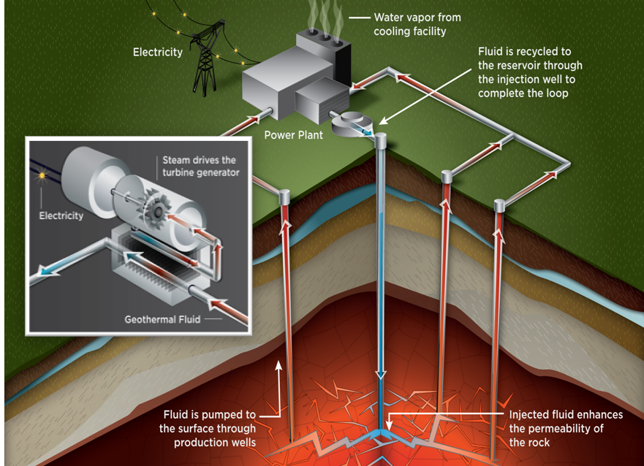
EGS Opportunity
Opportunity
  Heat is present almost everywhere at depth.
  EGS can provide emission-free baseload power across the U.S.
Key Elements
  Stimulation opens up fractures in crystalline rock, creating a reservoir km below the surface.
  Water is injected through the reservoir and back to the surface to produce electricity.
Challenges
  Geothermal reservoirs must be engineered so that flow rates remain high while thermal drawdown is limited.
  Establishing inter-well connectivity is critical yet difficult to demonstrate.
  Induced seismicity must be understood both as a tool and a potential hazard; effective mitigation measures must be developed.
3

Slide 4
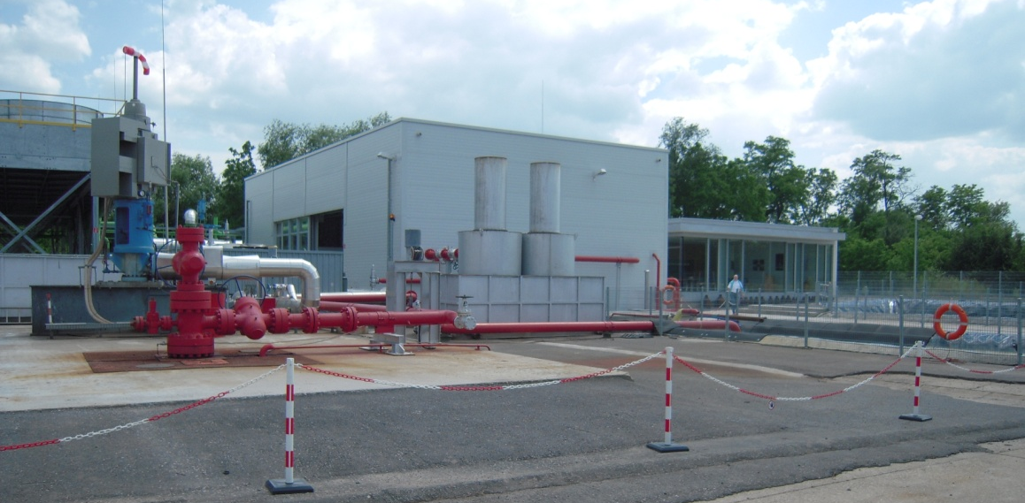
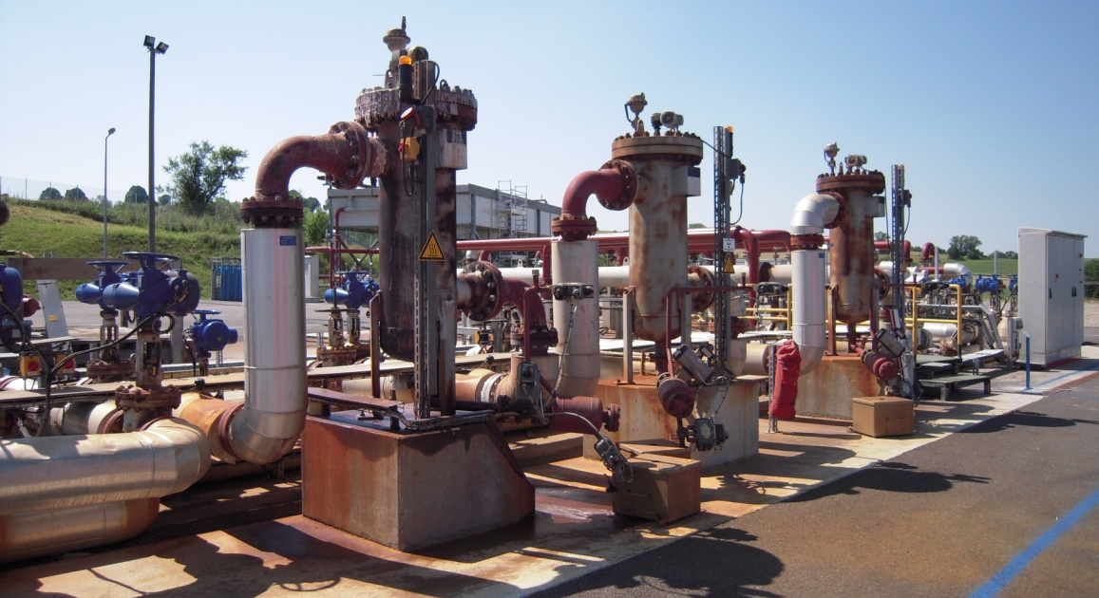
Goals & Metrics
Establish technical feasibility of 5 MWe by 2020 and sustain for 5 years
Reduce high level of risk during early stages of EGS development
Resolve key component R&D challenges
Demonstrate and validate stimulation techniques that sustain fluid flow and heat extraction rates.
  Validate EGS reservoir creation through demonstration projects in a variety of geologic environments
  Optimize reservoir flow rates and thermal drawdown to enable long-term, economical energy production
Roadmapping workshop will refine performance and cost metrics.
Flow Rate: 60 kg/s
Drilling Systems: 10,000 m, 374° C
Downhole Sensors: >1000 hours
Water Losses: <10%
Reservoir Life: ~30 years
Source: Sierra Geothermal Power
4
Notes:
Hesitation to move beyond “known”
fields

Slide 5
Overview and Budget
Conduct RD&D to demonstrate technical feasibility of power production from an EGS reservoir and over the long-term, reduce the costs of energy production
Approach
Technology Advancement through R&D
Develop tools and models that better characterize fractures and fracture networks. Advance high-temperature and high-pressure tools, sensors and equipment. Gain public support through experience and better scientific understanding of induced seismicity.
Demonstrations
Seven demonstration projects in Nevada, California, Oregon, Alaska, and Idaho Controlled hydrofrac stimulation is underway at Desert Peak, NV
Award Year | Estimated Total Funding (millions) | # Projects
Pre- FY 2008 | $4.3 (Demos) | 1 (Demos)
FY 2008 | $19.0 (R&D) $18.6 (Demos) | 17 (R&D) 3 (Demos)
ARRA | $111.9 (R&D)* $ 44.2 (Demos) | 76 (R&D) 3 (Demos)
FY2009 | $29
FY2010 | $16
FY2011 | $16
FY2012 | $61.5 (Request)
* includes cross-cutting R&D
5

Slide 6
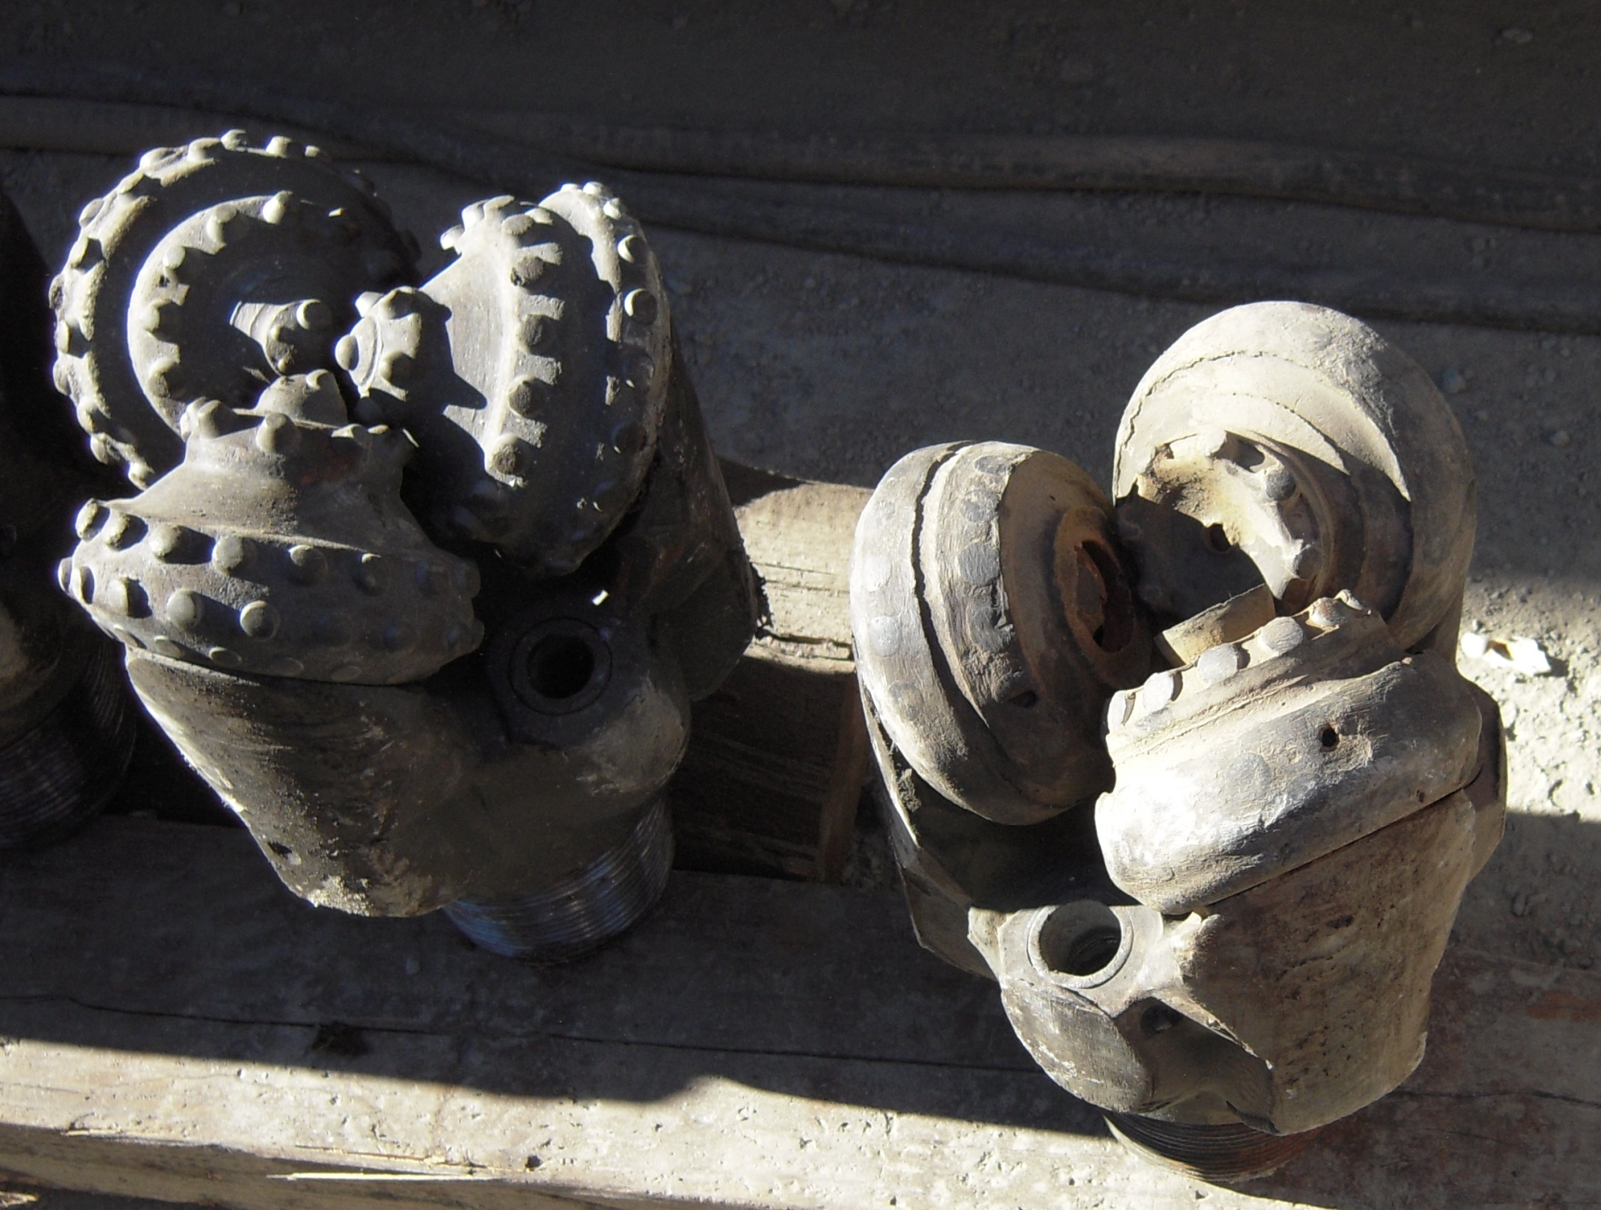
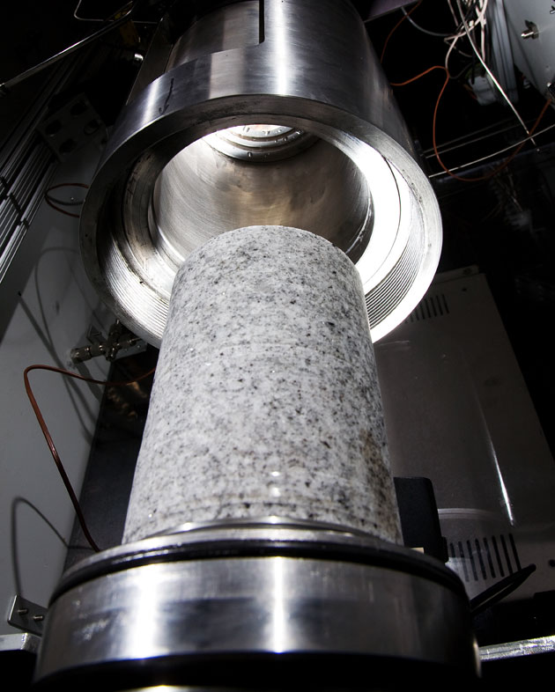
Enhanced Geothermal Systems (EGS)
The Program collaborates with industry, universities and national laboratories on R&D, which drives cost reductions for all geothermal systems. EGS Demonstration projects includes near field and green field sites.
EGS Demonstration Projects
Polycrystalline diamond compact drill bit which has worn down in hard rock (below) and must be replaced – adding time and cost to drilling.
Recipient | Project Site | Site Information | Status
AltaRock Energy Inc ($21.5 M) | Newberry Volcano, OR | High potential in an area without existing geothermal development | Completing EA and ISMP
Naknek Electric Association ($12.4 M) | Naknek, AK | Located in remote location in Alaska without existing geothermal development | Logging will be initiated next month
TGP Development Co. ($10.4 M) | New York Canyon, NV | Site adjacent to existing hydrothermal sites and shows high temperatures at shallow depths | Revising scope change
Ormat Technologies, Inc. ($4.3 M) | Desert Peak, NV | Adjacent to existing hydrothermal sites | Completed controlled hydrofrac
University of Utah ($8.9 M) | Raft River, ID | Improve performance of the existing Raft River geothermal field | Induced Seismicity draft report under review
Ormat Technologies Inc ($3.4 M) | Bradys Hot Springs, NV | Improve performance of the existing geothermal field | Building geologic and structural 3D model
Geysers Power Company, LLC ($6.2 M) | The Geysers, CA | Two existing wells will be reopened and deepened for injection and stimulation | Stimulation is planned
Raft River, ID (Source: US Geothermal)
The Program is investing in innovative drilling technologies – including hydrothermal spallation, (right) which use superheated water to cut through rock.
NakNek, AK (Source: NEA)
6
Notes:
Bands relate to type of project:
Green: true greenfield
Orange: Potentially New Geothermal Fields, immediate area without current geothermal development
Blue: Expansion of existing geothermal fields, improve the performance of an existing resource
Grey: In-field EGS, re-opening an existing well
Desert Peak, NV (Ormat)— The Desert Peak team began injecting at a target pressure of 550 psi on December 6, but unfortunately there were some issues with the injection pump bearings. The new pump is currently being shipped from California and will be coming back online shortly. The team still sees small improvements in injectivity. The injectivity at Desert Peak is directly tied to GTP’s first quarter FY11 milestones. At this time GTP is on target to meet that milestone.
The Geysers, CA (Calpine)—on October 26,2010 Calpine successfully passed a Go/No-Go decision point.. The well is ready for stimulation and Calpine is ahead of schedule and under budget.
Newberry, OR (AltaRock)— On December 7, 2010 URS with Alta Rock, presented its induced seismicity report to the state and federal regulators, URS and the public. Eric Hass of the DOE Golden Field. Office was present at the meeting in Prineville, OR. DOE and BLM are working together to share information relevant to their respective Stage Gate and EA processes. Additionally, AltaRock is periodically meeting with the public to address concerns.
New York Canyon, NV (Terra-Gen)—
Terra-Gen is waiting until after the FONSI and Record of Decision is released to procure a drilling permit. Terra-Gen will be issuing a subcontract to perform a water analysis to analyze potential impacts of the project on water quality and availability in the nearby community.
Background seismic data is being collected at the New York Canyon using a surface network.
Brady’s Hot Springs, NV (Ormat)—The Golden Field office is working with Ormat to revise the scope of this project. The revised scope will incorporate a larger and more encompassing geologic and structural model.
Naknek, AK (Naknek Electric)—Naknek Electric Association has filed Chapter 11 bankruptcy and is providing updates to the DOE.

Slide 7
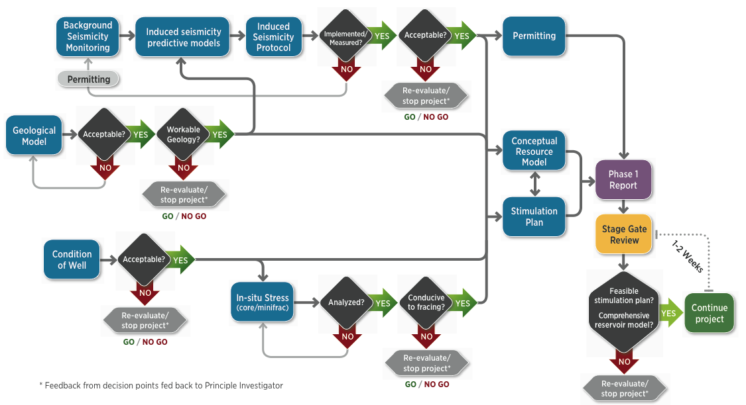
EGS Demonstration Induced Seismicity Stage Gate
DOE-funded EGS demonstration projects must comply with a series of technical stages gates, including compliance with the induced seismicity protocol.
Induced Seismicity Protocol Includes:
Reliable fault structure modeling, study and monitoring of regional background seismicity and local induced seismicity before and during injection and production, synthesis of a complex predictive geomechanical model, maximum magnitude predictions, public relations outreach and education plan, including protocol for handling structural damage claims.
7
Notes:
Interim Protocol for DOE EGS Demos Requires:
Grantees to collect stress data, background seismicity, and geology data prior to actual field stimulation. Once the data are collected, the grantee will use predictive stimulation models to estimate and forecast potential induced seismicity magnitude and potential
The Department will task an independent team of experts to review these results as a part of a go/no-go decision point.

Slide 8
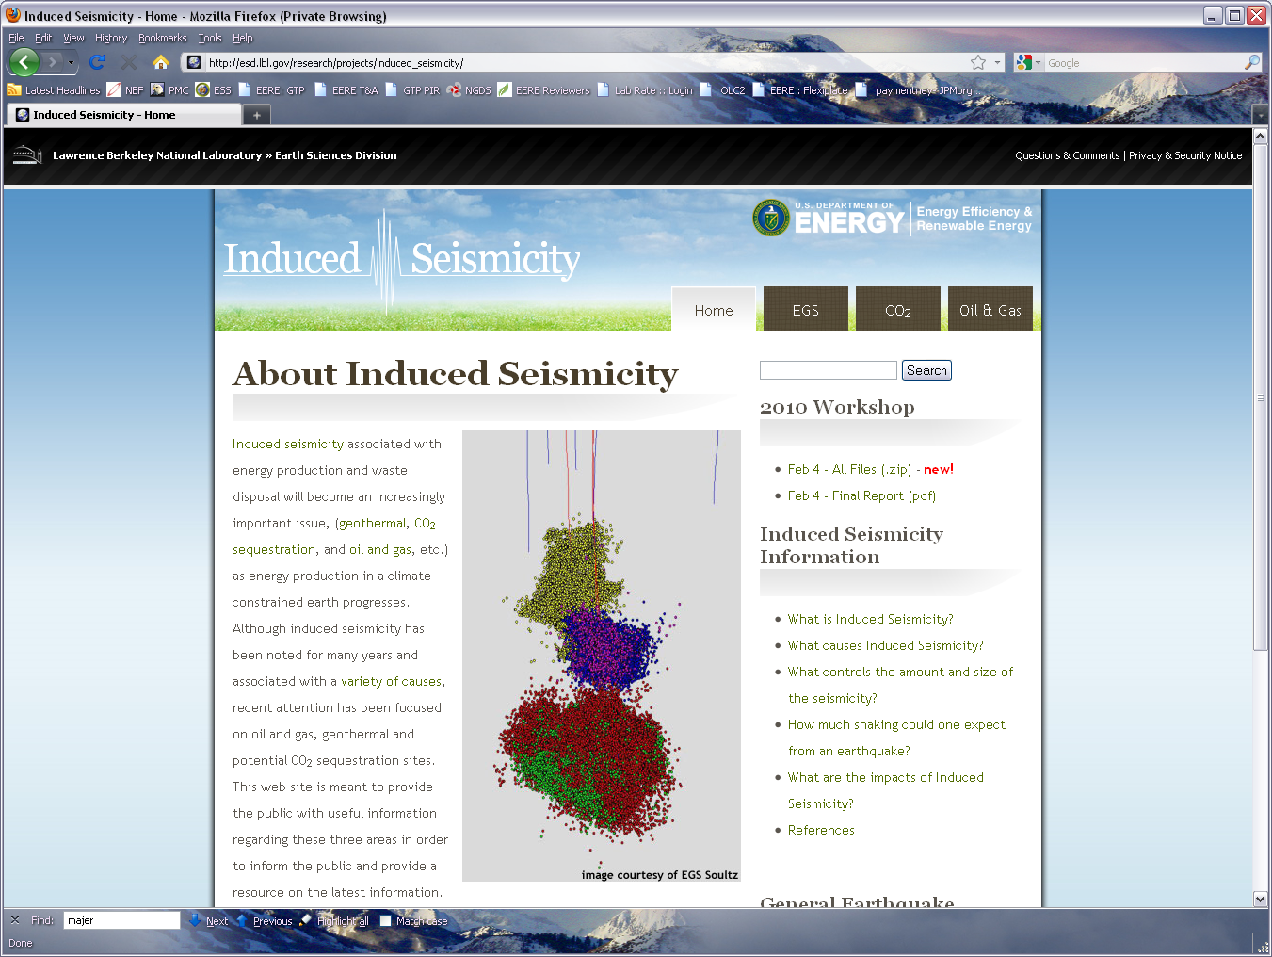
New Induced Seismicity Protocol
The Program addresses induced seismicity by establishing and updating clear protocols and best practices, performing R&D, and collaborating both domestically and internationally to build a strong knowledge base.
Living document for the public and regulators, and geothermal operators- should change as methods, experience and regulations change.
Local conditions at project sites, including population density around sites, past seismicity, etc will dictate the action that takes place at each project.
Procedures are suggested as an approach in order to engage the public, industry and regulators.
Provides a more accurate approach to address and estimate seismic risk associated with EGS.
Identifies “ground motion” as the more relevant impact of induced seismicity as opposed to event magnitudes.
Recommendations are based on pre-existing, well established engineering standards used in mining, constructions etc. related to shaking and noise.
Discusses legal implications of recommended actions.
8

Slide 9
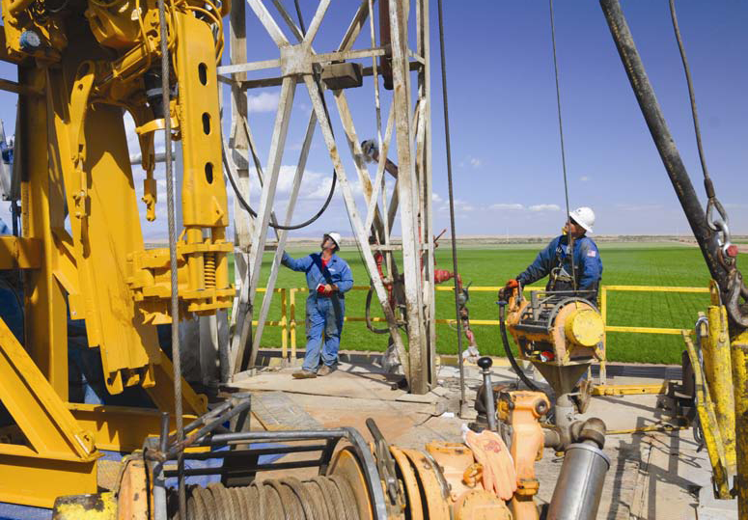
EGS Roadmap Workshop
DOE’s continued EGS technology RD&D will have critical impact on the U.S. energy supply, but not without gaining public support through experience and better scientific understanding.
GTP will be holding a two-part EGS Roadmap Workshop
Purpose: Exchange facts and information with subject matter experts to define performance and cost metrics and milestones needed to achieve EGS goals.
Interested parties to e-mail to EGS@ee.doe.gov:
  Name and contact information
  Reason for participation and expected contributions to the workshop
  An attached biography and CV
Photo credit: Ram Power Corp.
Timeline
Workshop I – June 2011
Draft Debut – Sept 2011
Final Debut – Oct 2011
9

Slide 10
Thank you!
Jay Nathwani
Team Lead, Enhanced Geothermal Systems
Geothermal Technologies Program
Office of Energy Efficiency and Renewable Energy
U.S. Department of Energy
Jay.nathwani@ee.doe.gov

