Slide 1
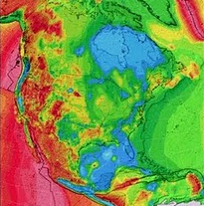
National Geothermal Data System,
Resource Assessment and Classification
Three-part strategy to reduce geothermal
development risks
System Design, Development and Testing: Geothermal Data Consortium led by Boise State University. This distributed web-based system design leverages the Geosciences Information Network (NSF, U.S. Geological Survey, and American Association of State Geologist). Geothermal Desktop to include financial assessment tool.
Data Development, Collection & Maintenance: Populate NGDS by linking to high quality data sets in partnership with all state geological surveys and other geothermal data providers including Southern Methodist University and GTP technology partners.
Resource Assessment and Classification: Implement Inter-Agency Agreement with U.S. Geological Survey which includes revising and updating the assessment of low-temperature geothermal resources

Slide 2
$37.92M for 4 Cooperative Agreements &
U.S. Geological Survey Interagency Agreement
BSU: $4,992,089 ($697,386 expended to date) NGDS Design, Testing and Mgm’t. Geothermal Data Consortium led by Boise State University.
Arizona Geological Survey $21,858,224 : (on behalf of the American Association of State Geologists): Data Development, Collection & Maintenance: Populate NGDS by linking to high quality data sets in partnership with all state geological surveys and other principal State geothermal data providers.
Southern Methodist University: $5,250,000 Data Development, Collection & Maintenance: Update SMU Heat Flow Database to include onshore US and offshore regions of the Gulf of Mexico. Also includes GRC library containing 36,000 geothermal documents
BSU: $1,550,000 Data Development, Collection & Maintenance: Establish DOE Geothermal Data Repository (DOE-GDR) for Legacy and Current Project data; define data and meta data types and formats, acquire and manage project data
U.S. Geological Survey: $4,270,366 ($2,025,400 in FY 10) Initiate National Resource Assessment and Classification of Conventional Geothermal Resources; Enhanced Geothermal Systems, Geothermal Resources in Sedimentary Basins, and revising and updating the assessment of low-temperature geothermal resources.

Slide 3
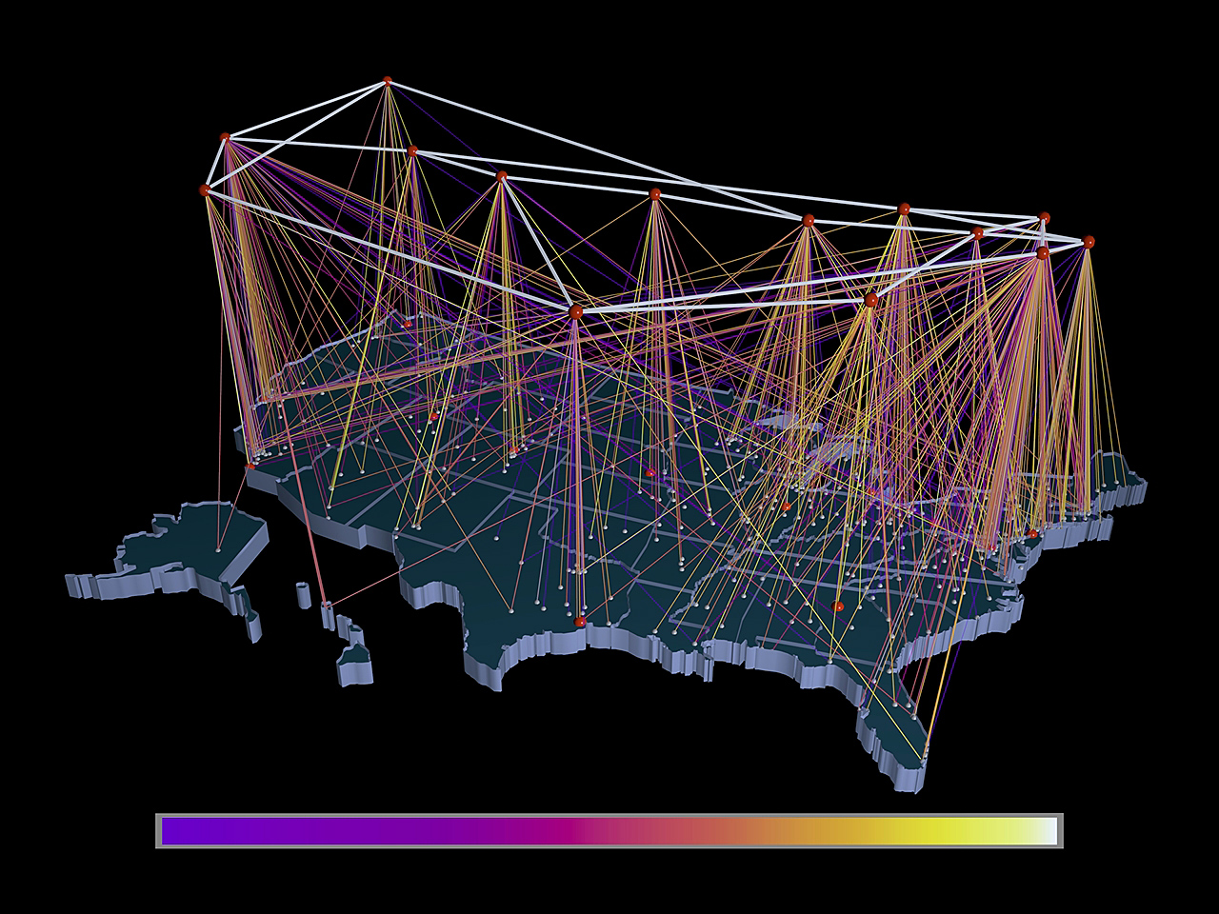
DOE Geothermal Data Repository,
Boise State University (BSU)
Illinois State
Geological Survey
(UIUC)
Nevada Bureau of
Mines & Geology
(UNR)
U.S. Geological
Survey
Kentucky Geological
Survey (UK)
Southern Methodist University (SMU)
Arizona Geological
Survey
State Geological Survey Hub
National & Other Geothermal Hub
Notes:
3

Slide 4
NGDS
System Architecture
What will NGDS do for users? (functional view) - users will be able to:
Contribute - add and catalog data resources in the NGDS
Discover - search a distributed data catalog to locate data resources relevant to their need
Acquire - access and download useful data resources in consumable formats
Evaluate - determine relevance, timeliness, pedigree, methods, etc. of data resources
Analyze - utilize data for their own calculations and/or simulations, and derive new data

Slide 5
NGDS
System Architecture
How NGDS will be accessed? (client view)
Geothermal Desktop - “heavy client” to support a growing set of complex catalog, visualization and analysis capabilities
Web Site(s) - support foundational catalog access and research capabilities
Web Services - allow development of custom applications using a rich set of predefined standards-based components for catalog, document and data utilization
Security Management - provide protection of proprietary information limiting access to those with appropriate privileges

Slide 6
NGDS
System Architecture
What is providing the NGDS capability? (server view)
NGDS Catalog - hosts the metadata that supports discovery and acquisition of data resources
NGDS Document Repository (multiple) - hosts NGDS unstructured data resources (documents, images, etc.) - hosts NGDS structured data sets (spreadsheets, XML data sets, etc.)
NGDS Database (multiple) - hosts a comprehensive set of structured data (observations and other fielded data) that can be queried to generate new useful data sets
Web Services Infrastructure - supports the deployment and operation of NGDS services interfaces for the catalog, database and document repository

Slide 7
NGDS
System Architecture
What kinds of GEOTHERMAL data will NGDS include? (data view)
Geothermal-specific Data (heat flow, heat generation, temperature at depth, however., uncertain how other categories would not include geothermal data)
Engineering Data (technology, modeling, designs, …)
Well Data (type, status, depth, casing, …)
Business Data (financial, regulatory, ownership, taxes, …)
Geological Data (stratigraphy, hydrology, pressure, porosity, …)
Geochemical Data (chemistry, methods, source, conductivity, …)
Infrastructure Data (transmission, land classification, roads, power plants, …)
Production/Disposal/Injection Data (oil, gas, water, flow rates, …)
Geophysical and Synthetic Data (remote sensing, gravity, magnetics, geodetic, …)

