Slide 1
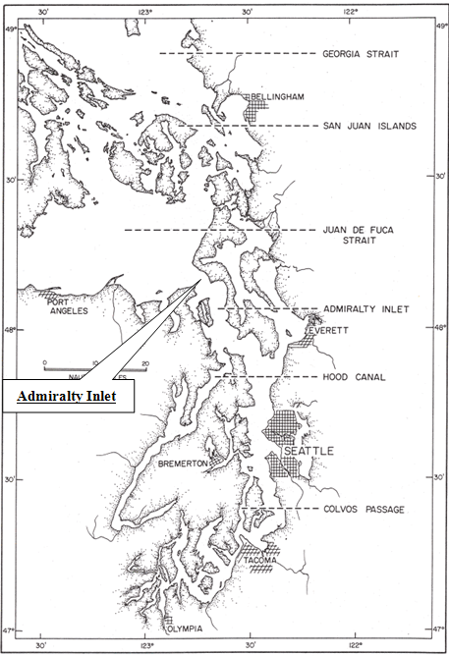
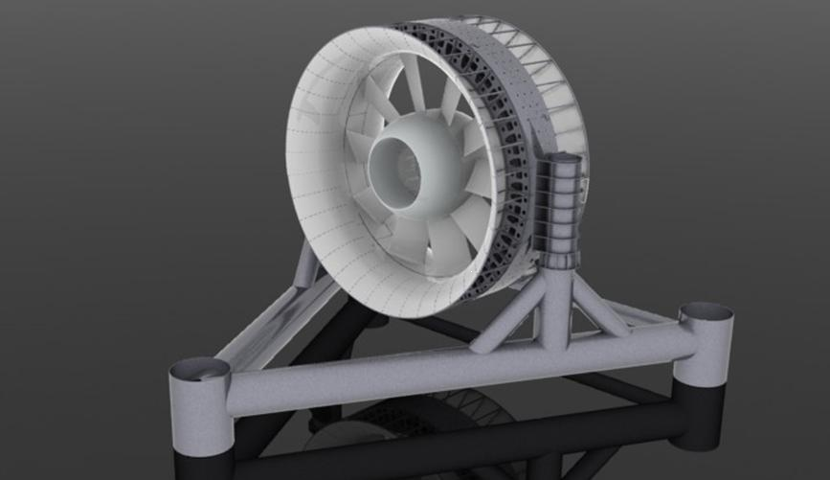

Water Power Peer Review
  Puget Sound Pilot Tidal Energy Project (TRL 7/8)
Dr. Brian Polagye (for Craig Collar)
University of Washington (Snohomish PUD)
bpolagye@uw.edu
November 1, 2011

Slide 2
Purpose & Objectives
Snohomish County Public Utility District and its partners propose to deploy two tidal energy turbines in Admiralty Inlet, Puget Sound, WA. ‘
Site identified as one of the largest tidal hydrokinetic resources in the United States.
Requires deep water technology (depth > 50 m)
Sensitive environment within the range of several endangered species and under existing anthropogenic stress.

Slide 3
Purpose & Objectives
Project Statement: Deploy, operate, and evaluate two Open-Centre Turbines developed and manufactured by OpenHydro Group Ltd.
6 m rotor diameter
~250 kW peak generation
Grid connected (separate cables)
3-5 year deployment
6th Generation Open-Centre Turbine
Project Purpose: Gather data to advance the technical, economic, social, and environmental viability of commercial-scale tidal energy.
These data are critical to the responsible advancement of commercial scale tidal energy in the United States.

Slide 4



Integration
Resource characteristics – informing device design
Acoustic characterization of tidal energy devices
Risk assessment case study
Passive acoustic system for localizing marine mammals
Interest in instrumentation package testing

Slide 5
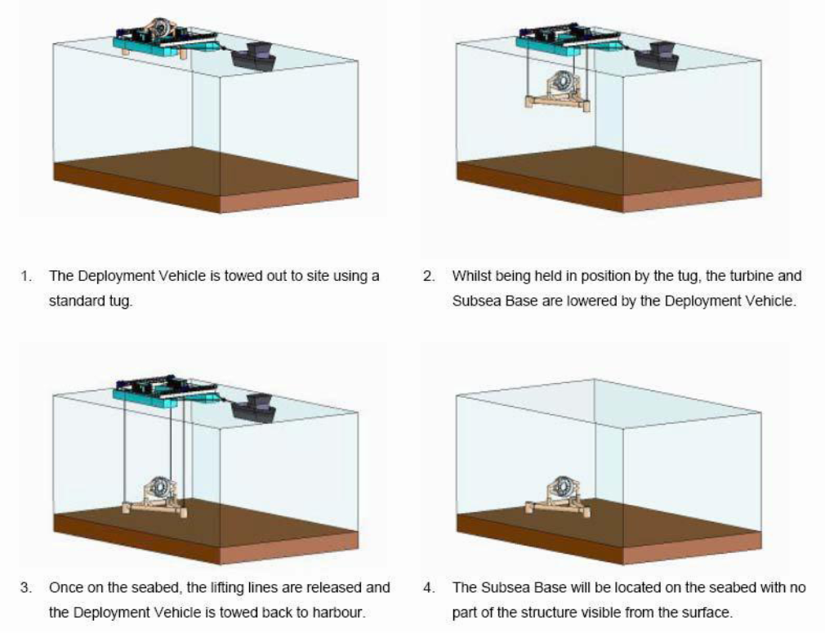
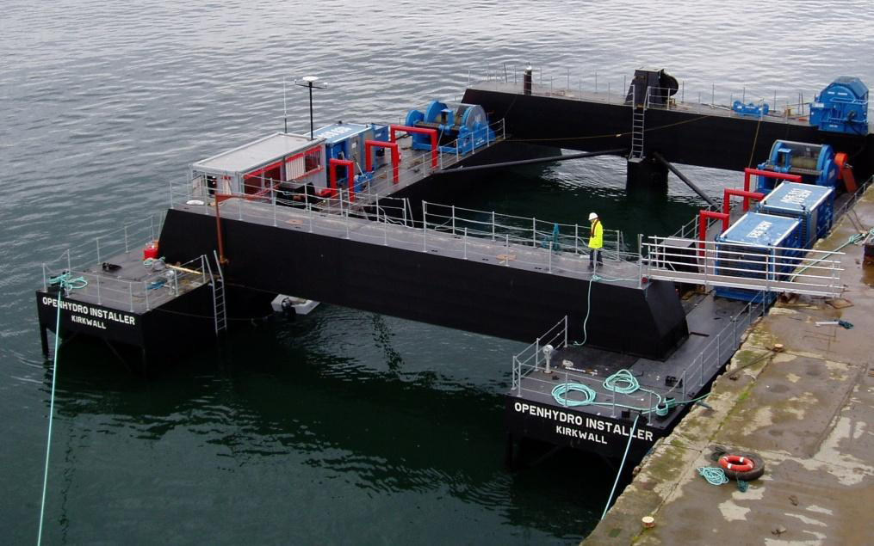
Technical Approach – Deployment
Installed directly on the seabed (no surface visibility)
Steel tubular frame filled with concrete and stone ballast
No pinning, piling, or drilling to secure the turbine foundation to the seabed

Slide 6
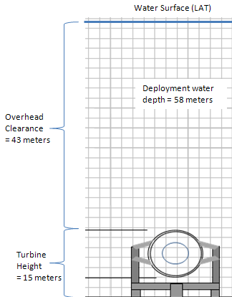
Technical Approach – Monitoring Challenges
Adequately monitored pilot projects are the only viable way to reduce technical, economic, social, and environmental uncertainties
Challenging for any tidal energy development , but more so for deployment in Admiralty Inlet
  Largely beyond the reach of human divers
  Beneath the photic zone
  Conditions are the rule – not the exception – for most utility-scale tidal energy resources
  Maintaining and upgrading monitoring
  Requires recovery, redeployment, and reconnection to turbine power and communications
  Need to minimize biofouling over periods of several months

Slide 7
Technical Approach – Monitoring Implementation
Stereo Imaging
CTDO
Water quality
?
Marine life
Device condition
Junction Bottle
Wet-mate power and fiber
Hydrophone Array
Doppler profilers
?
Marine mammals
Device noise
Power and Communications Distribution
Wake
Inflow conditions
Turbine SCADA
Export Cable
Rotation rate
Stress/strain
Vibration
Temperature
Generated power
Power for monitoring
> 4 fiber optic channels

Slide 8
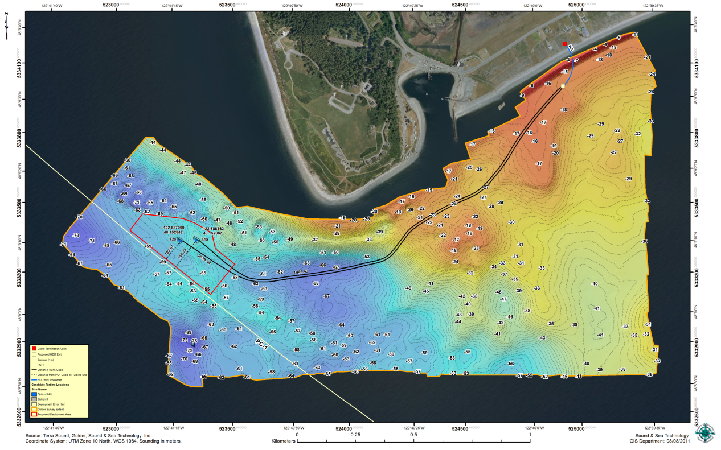
Technical Approach – Performance Evaluation
Turbine SCADA
  Rotational rate
  Structural strain
  Vibration
  Generator temperature
Shore Station
  kWh produced
  Capacity factor
  Power quality
  Availability
  System Efficiency
Operations
  Reliability
  Maintainability
  O&M costs by process
Project Layout: Turbines and Export Cables

Slide 9
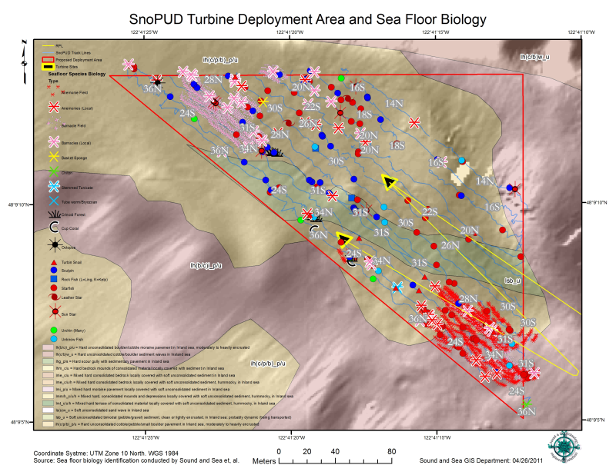
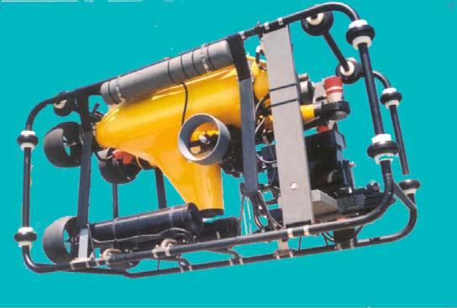
Technical Approach – Static Effects
Concerns Addressed
  Colonization of support structures (artificial reef effects)
  Modification to benthic habitat around turbine base
  Modification of benthic habitat by turbine wake
Approach
  ROV surveys during diurnal inequality
  Benthic habitat monitored at several “monuments”
  Quarterly during first year
  Six months thereafter
Benthic habitat survey
Deep Ocean Phantom 2+2 ROV

Slide 10
Technical Approach – Acoustics
Concerns Addressed
  Received levels of noise in vicinity of project
  Variations in received levels with power output
  Variations in received levels over time
Approach
  Intensive post-installation characterization (drift measurements)
  Low duty-cycle, long-term monitoring (on turbine)
Heave isolation
DAQ
Computer
Anti-strum faring
Hydrophone
Flow Shield
Pressure Logger
NNMREC drifting survey instrumentation

Slide 11
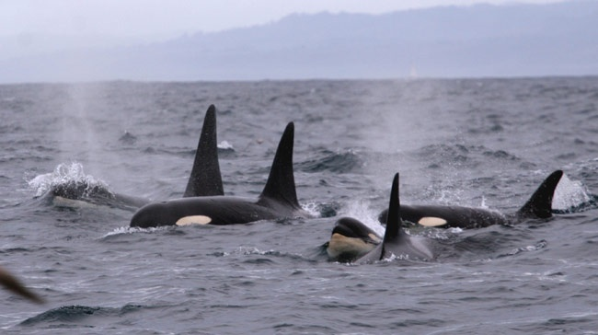
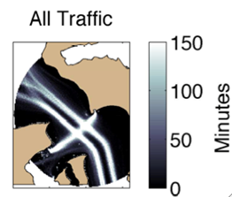
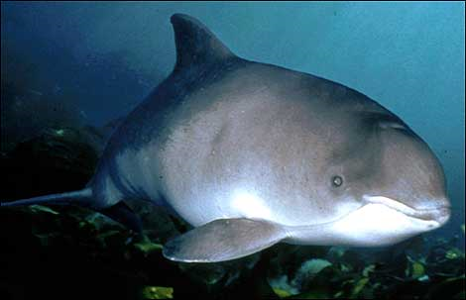
Technical Approach – Marine Mammals
Concerns Addressed
  Behavioral changes associated with project operation
Approach
  Shoreline observers
  Click detection
  Vocalization detection (and localization)
Key Challenges
  Signal to noise

Slide 12
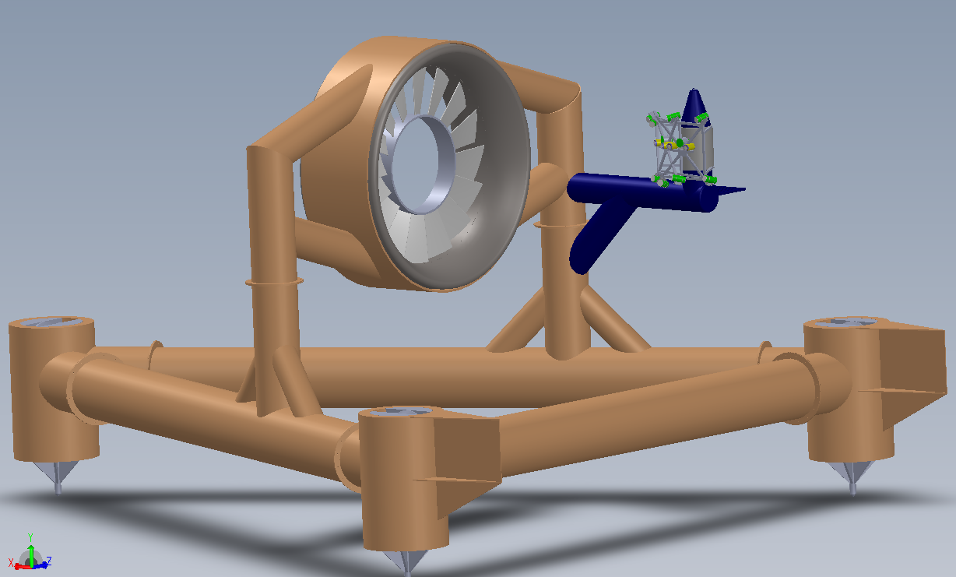
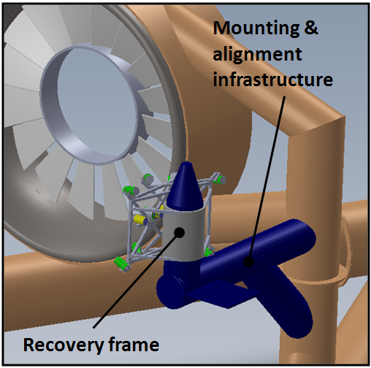
Technical Approach – Dynamic Effects
Concerns Addressed
  Interaction of marine animals with turbine rotor
  Species interacting with turbine
Approach
  Stereo imaging with artificial illumination
  Duty cycle, transitioning to triggered or event-based illumination

Slide 13
Plan, Schedule, & Budget
Schedule (Calendar Year – Under Development)
4Q11: Complete contract negotiations with DOE.
1Q12: Submit Final Pilot Plant License Application to FERC.
2-3Q12: Final Project design.
3-4Q12: Complete all permitting processes and project budget.
4Q12: Go/No-go decision to move forward with turbine order.
2013: Turbine and foundation fabrication, shipping, staging.
2014: Project installation and commissioning
2014-18: Project operations and testing.
Budget
Proposed Project Budget: $20,300,000
Proposed Recipient Cost Share: $10,300,000

