Slide 1
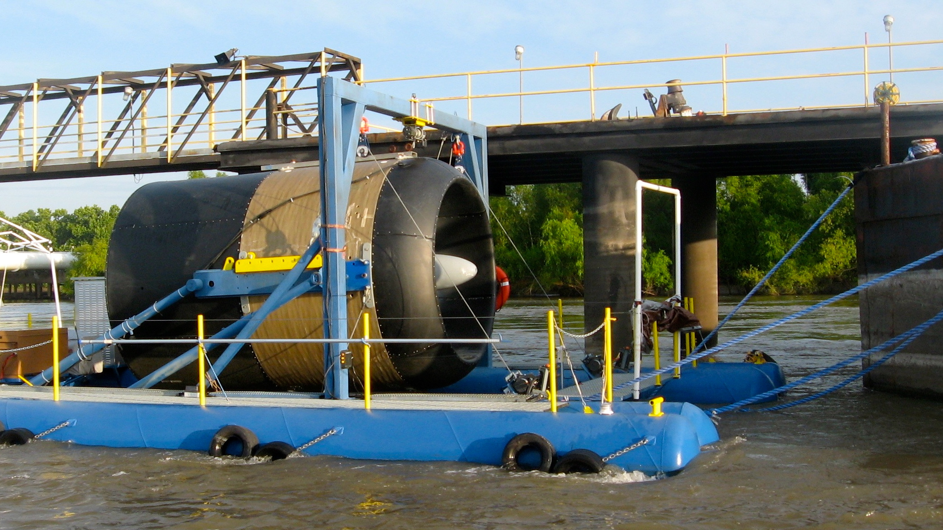
Water Power Peer Review
  The Water-to-Wire (W2W) Project
Dr. Edward C. Lovelace
Free Flow Power
elovelace@free-flow-power.com, 978-381-4666
November 1-3, 2011

Slide 2
Purpose, Objectives, & Integration
Purpose: evaluate & optimize the performance, environment, and cost factors of the FFP hydrokinetic system for Mississippi River commercial deployment
Problem Addressed:
- limited data on practical resource potential
- commercial immaturity of hydrokinetics; particularly for river applications
  Relevance to DOE Mission:
  - resource potential: addressed thru seasonal deployment, surveys, and modeling
  - commercialization barriers: addressed thru equipment design, electricity generation in a relevant environment, commercial systems financial analysis

Slide 3
Technical Approach
Technical Approach/Methods:
Phase I: site identification, turbine performance, environmental effects
Phase I Methods:
- design, fab, test, deployment, & monitoring of generating equipment in a relevant environment
- mapping analysis of river bathymetry, overlayed GIS competing use layers, and location of proposed piling arrays
- field surveys of bathymetry and velocity and analysis with existing flow data
- field observation data for debris, fish, and navigation

Slide 4
Technical Approach
Technical Approach/Methods:
Phase II: development of commercial infrastructure (links with piling placement effort in Phase I)
Phase II Methods:
- design of piling, yoke, and cabling systems (conceptual mechanical design, loading analysis, operational analysis for normal and faulted behavior)
- supply chain analysis of capital and operations cost

Slide 5
Technical Approach
Key Issues/Significance:
To-date the key accomplishments are 1. the successful continuous electricity generation in a relevant environment. This addresses some of the concerns/risks peculiar to this market (debris, sediment, velocity) and their impact on practical generation from the resource and equipment performance, 2. contributions towards commercial project development (e.g. licensing studies)
Unique Aspects:
FFP is one of the few equipment and project developers focused primarily in rivers, with a piling based approach, and with a significant project pipeline in the FERC commercial licensing process

Slide 6
Plan, Schedule, & Budget
Schedule
Initiation date: 2/15/10
Planned completion date: 2/15/12
Milestones FY10/11:
  1Q11: complete USGS Conte Lab testing of turbine
  3Q11: deployed turbine and floating mount test bed for in-river electricity generation
Budget:
Variances have been minor to account for floating mount hardware cost growth and taken from analysis budget
Expended as of 7/30/11:
  $815,416 DOE funds (59% of total)
  $1,381,671 Cost-shared
Budget History
FY2009 |  | FY2010 |  | FY2011
DOE | Cost-share | DOE | Cost-share | DOE | Cost-share
 |  | $1,384,503 | $2,318,236 (>50%)

Slide 7
Accomplishments and Results
Accomplishments/Significance:
- the successful continuous electricity generation in a relevant environment. This addresses some of the concerns/risks peculiar to this market (debris, sediment, velocity) and their impact on practical generation from the resource and equipment performance,
- contributions towards commercial project development (e.g. licensing studies)
Benchmarks:
turbine performance meets design expectations
no performance degradation in continuous operation due to river effects
steady velocity profile of resource verified (e.g. baseload capability)
4 FERC study reports completed (over 1,500 pages of work available for public review)

Slide 8
Challenges to Date
Challenges:
cost and schedule management of floating mount test bed
scheduling coordination between stakeholders and weather for in-river deployment
Impact on Progress
delayed in-river deployment 6 months
Resolution Approaches:
minor cost shifting from analytical tasks
contingency planning with alternate deployment scenarios

Slide 9
Next Steps
Future Milestones FY12:
  2Q12: complete turbine deployments
  2Q12: complete piling based systems analysis
Potential Future Activities: supporting negotiated study plan
- in-situ deployment
4 pilings, 1 turbine/piling
6 months pre-deployment monitoring (fish & hydraulics)
12 months operational monitoring
- fish testing
- EMF and acoustic testing

