Slide 1
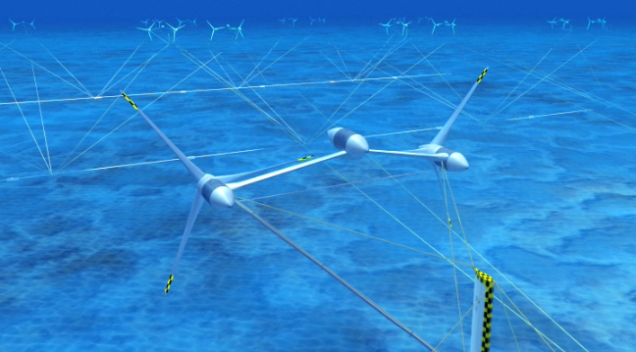

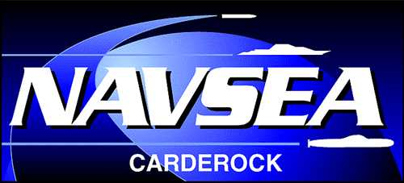

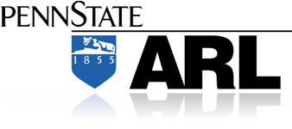
Water Power Peer Review
  Aquantis 2.5 MW Ocean-Current Generation Device- AWP
Alex Fleming: PI
Dehlsen Associates, LLC
E-Mail: afleming@ecomerittech.com
805.845.9100
September 26,11

Slide 2
Purpose, Objectives, & Integration
Principal Objective of the Aquantis Project
  Developing technology to harness the energy resource in the Gulf Stream
Primary Challenges
  Achieving an acceptable cost of energy
  Understanding the resource impact on system performance
  Designing a structure that withstands the large hydrodynamic loads
  Designing a moored platform with static and dynamic stability
  Designing a robust system with 20-year life
  Developing a cost-effective installation and maintenance strategy
  Determining effective computational and experimental tools
  Understanding potential environmental impacts

Slide 3
Technical Approach
Key Issues and Methodology
  Resource assessment
    Assess existing Gulf-Stream ADCP data
    Deploy instrumentation array to acquire better data
  Turbine design
    Perform a comprehensive parametric conceptual design study
    Use NREL codes (HARP_Opt & WT_Perf) for hydrodynamic design
    Use computational fluid dynamics (CFD) to analyze the design
    Design the blades to best match the drivetrain (torque, rpm)
    Design the blade structure for large hydrodynamic loads
      Evaluate composite materials, steels, and foams
    Design the blade-to-hub attachments
    Use finite-element analysis (FEA) to assess the structural designs
    Consider cost, manufacturing, weight, and buoyancy

Slide 4
Technical Approach
Key Issues and Methodology
  Drive train design
    Evaluate direct drive, gear drive, and hydraulic drive
    Focus on robustness for 20-year life and limited maintenance
    Develop a bearing-and-seal package for the large loads
  Stability, mooring, and anchoring
    Use unsteady CFD and a rotorcraft code to develop hydrodynamic coefficients
    Revise a proven Navy coefficient-based simulation tool for to assess platform stability (static and dynamic)
    Use Orcina marine dynamic analysis software (OrcaFlex) for mooring
    Determine installation and maintenance strategies
  Cost-of-energy model
    Revise an existing model based on wind power
    Focus on capital and operational & maintenance (O&M) costs
    Base all system decisions on cost of energy

Slide 5
Plan, Schedule, & Budget
Schedule:
Initiation date: 10/01/09
Planned completion date: 9/30/12
Contract Award - Effective Date 02/01/2010 - date signed 02/22/2010 . Total Contract Cost - $4,128,377 (DOE Funded Costs - $1,500,000; Dehlsen Associates matching funded costs - $2,628,377) – period of performance 02/01/2010 through 05/31/2012
Modification 001 – Effective Date 03/19/2010 - date signed 04/09/2010 – removed NEPA provision 21
Modification 002 – date signed 07/08/2011 – provided incremental funding to fully fund the project;
Milestones _Go/No-Go : Next Steps
Budget:
Siting Study for a Hydrokinetic Energy
Project Located Offshore Southeast Florida Completion Status
Summary of Tasks
Task 1. Design & Analysis 25%
Task 2. Mooring & Attachment 35%
Task 3 Enabling Technology Direct Drive 45%
Task 4. Documentation 20%
Budget History-AWP
FY2010 |  | FY2011 |  | FY2012
DOE | Cost-share | DOE | Cost-share | DOE | Cost-share
$65,744 | $110,514 | $774,258 | $1,042,971 | $659,998 | $1,474,892

Slide 6
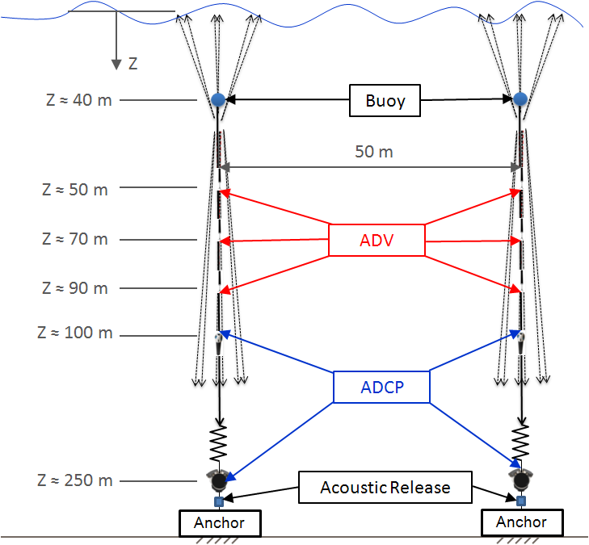
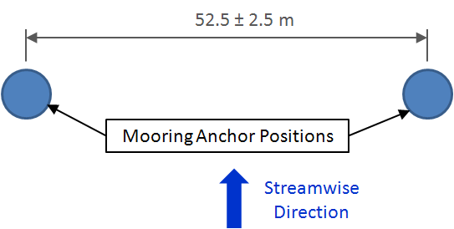
Accomplishments and Results
Resource Assessment
  Analyzed ADCP data acquired by Florida Atlantic University
  Designed a new moored instrumentation array
    To be deployed late in 2011 at a Navy site adjacent to preferred Gulf Stream location

Slide 7
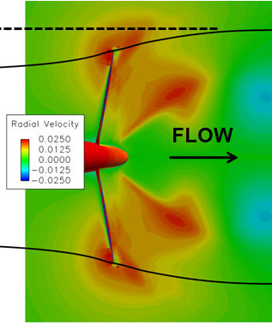
Accomplishments and Results
Turbine Design
  Completed a comprehensive parametric conceptual design study
    Varied rated power, diameter, blade number, blade chord, …
    Evaluated variable-speed and fixed-speed designs
    Evaluated various blade manufacturing and attachment concepts
  Made critical design decisions:
    Use fixed-pitch blades (robustness)
    Design for variable speed (robustness, limited cavitation)
      Do not use brakes during normal operation
      Use passive depth control to limit loads
    Design for an existing hydraulic pump
      Establish the rated power and diameter
      Design for appropriate rpm
Relative Velocities and Outer Streamline from CFD

Slide 8
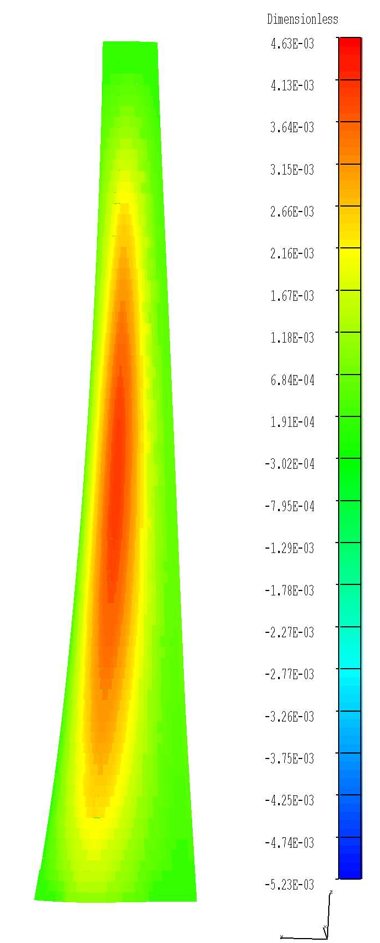
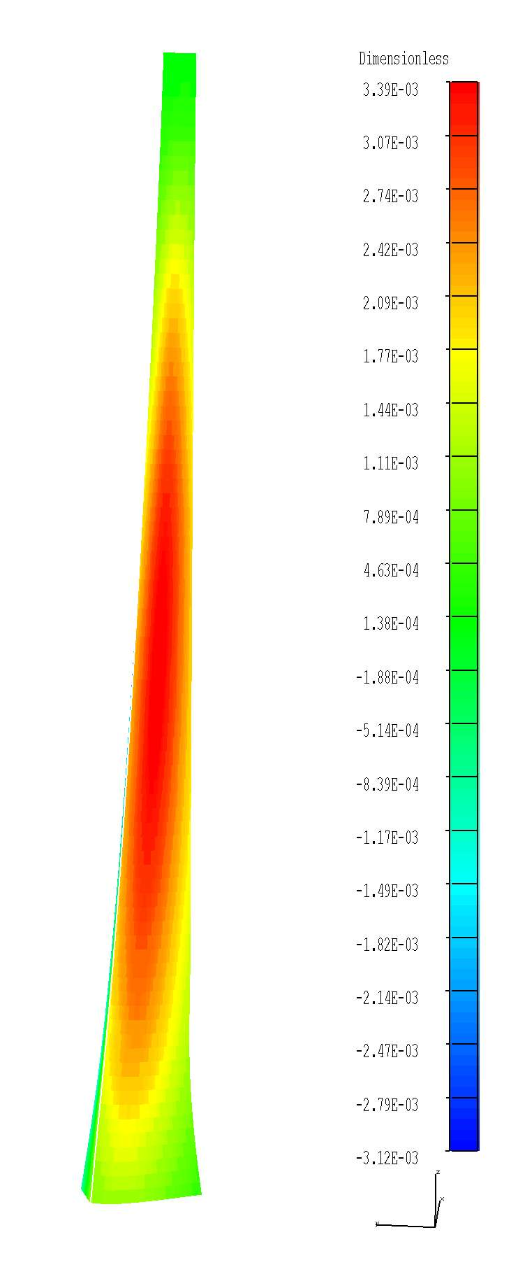
Accomplishments and Results
Turbine Design
  Performed testing of expanded-plastic foams
    Do not use (too water absorbing)
    Use syntactic foams instead to achieve desired buoyancy
  Developing two blade manufacturing concepts:
    Using steel spar, composite skin, and syntactic foam
    Using composite spar, composite skin, and syntactic foam
  Developing a redundant blade-to-hub attachment
Spanwise Strain in Composite Skin Using FEA

Slide 9
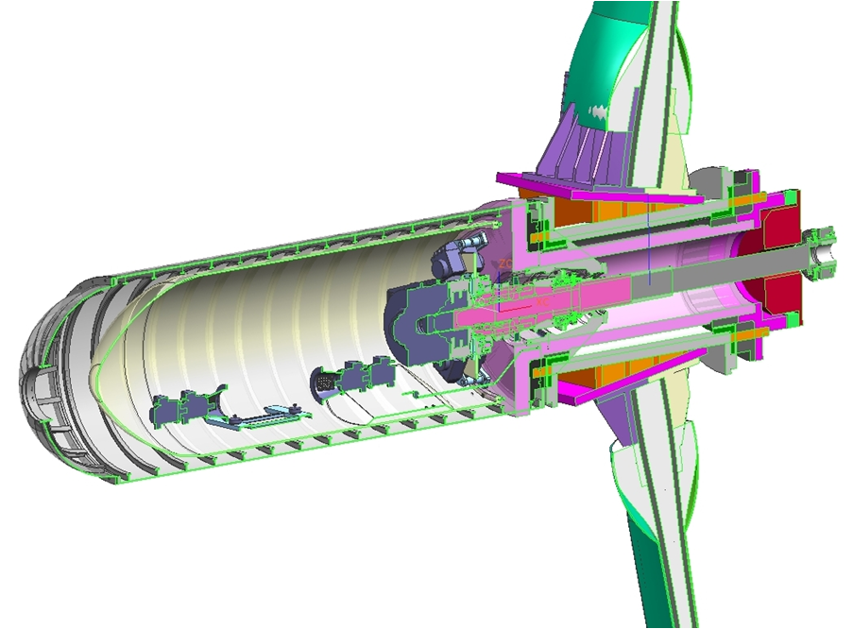
Accomplishments and Results
Drive train Design
  Eliminated direct drive to a permanent-magnet generator (excessive weight, volume, and cost)
  Eliminated gear drive (potential maintenance issues)
  Developing hydraulic-drive system
    Evaluating existing hydraulic pumps and motors
    Designing hydraulic lines, heat exchanger, generator, electronic system, instrumentation package, pressure vessel, braking system, connection to the grid …
  Designing two bearing-and- seal packages:
    Oil-lubricated design with tapered roller bearings
    Seawater-film bearing with a flex coupling
Pressure-Vessel Nacelle with Potential Blade Attachment, Seawater-Film Bearing, and Hydraulic Drive

Slide 10
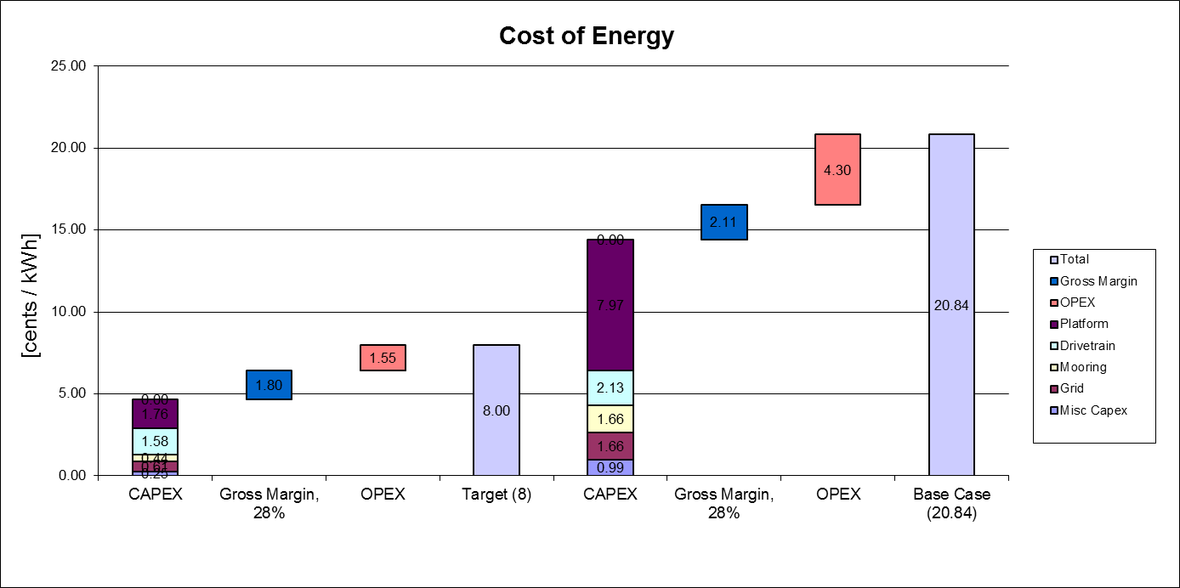
Accomplishments and Results
Cost-of-Energy Model
16.53 cents/kWh
6.45 cents/kWh

Slide 11
Challenges to Date
Challenge: designing the Aquantis system without full knowledge of the Gulf Stream resource—including extreme loads and knowledge of the seafloor properties
  Mitigation Approach: acquire new and better resource data
Challenge: designing the blades to achieve a 20-year life
  Mitigation Approach: conduct risk-mitigation testing (and corresponding numerical analyses) for (1) material characterization, (2) spar structural integrity, (3) skin/spar assembly, and (4) spar-to-hub attachment assembly

Slide 12
Challenges to Date
Challenge: designing the turbine to increase the operational life of the hydraulic drive (in the absence of gear drive)
  Mitigation Approach: Increase the turbine rpm and blade diameter (to overcome losses in the hydraulic drive)
Challenge: designing the blades, the blade attachments, the wings (or trusses), and the bearing-and-seal package to withstand the larger loads (due to increased rpm, blade diameter, and number of turbines)
  Mitigation Approach: Evaluate the cost and weight of the resulting structure with a smaller-load design and compare the cost of energy

Slide 13
Next Steps
2010
2011
2012
2013
2014
2015
Q4
Q1
Q2
Q3
Q4
Q1
Q2
Q3
Q4
Q1
Q2
Q3
Q4
Conceptual
Design (5/5/11)
TR1
TR3
TR4
TR6
TR7
TR8
TR9
TR2
TR5
PDR
(10/18/11)
CDR
(10/15/12)
(x/x/x)
Detailed Design
Build 1:20 model
Build Full Scale Turbine
Finalize
Configuration
(09/15/11)
Tow Tank
Test of 1:20 scale
(03/15/12)
At sea
Test of 1/20 scale
(2/21/13)
At sea
full scale test
(3/15/14)
Full Scale Drive Train Test
(11/15/12)

