Slide 1
Water Power Peer Review
The Southeast National Marine Renewable Energy Center is preparing a technology development and testing facility in the Florida Current for open-ocean current device prototypes.
Offshore test berths ~12 mi east of Fort Lauderdale, Florida (2-4 kt current)
  Designed for ⅛-¼ scale systems
  Both oceanographic and turbine performance measurement instrumentation
On-shore dynamometer for generator systems testing and evaluation
20 kW/3 meter experimental research turbine for component and sub-system development
Status:
Test berth buoy undergoing sea trials
Outer Continental Shelf (OCS) lease from BOEMRE anticipated Q1 CY2012
Experimental turbine in fabrication and testing
  Small Scale Turbine Testing and Development
Susan H. Skemp
Southeast National Marine Renewable Energy Center at Florida Atlantic University
sskemp@fau.edu
September 27, 2011
SNMREC Offshore Testing Facility

Slide 2
Purpose, Objectives, & Integration
No at-sea test facility for open-ocean current MHK energy exists, and several technology gaps remain to accelerate commercialization.
  The SNMREC’s capabilities will fulfill several Water Power Program (WPP) objectives: Tasks 1.1.2 (Current Energy System Deployment and Development) and 1.1.4 (Component Design and Development) in the DOE WPP Work Breakdown Structure (WBS).
  Research turbine development is a key element of a greater strategy to establish test and demonstration capabilities for commercial prototypes; when realized together, test facility and certification standards can be validated.

Slide 3
Technical Approach
The SNMREC is building a generic research turbine and in parallel, solving commercialization-critical technology gaps.
Key issues being addressed: device reliability and monitoring (with integrated environmental measurements), rotor design tools and models, and rotor materials and performance.
A complete prognostics system, with custom but standardized data management, allows for quick commercial integration and future flexibility. Collaboration with NREL and ERAU ensures rotor research is compatible with national tool development.

Slide 4
Plan, Schedule, & Budget
Schedule
Initiation date: 1 December 2011 (expected)
Planned completion date: 31 December 2012 (expected)
  although this was a successful 2008 proposal, funding was deferred
Given BOEMRE lease (expected in early 2012):
  experimental prototype assembly in early 2012, deployment in summer, 2012
  testing extends into 2013
Deployment depends on BOEMRE lease, but initial tow-tests will provide data.
Budget:
Budget details under discussion, dependent on negotiated SOW
No funds expended to date
Budget History
FY2009 |  | FY2010 |  | FY2011
DOE | Cost-share | DOE | Cost-share | DOE | Cost-share
$0 | $0 | $250K | $250K | $250K | $250K

Slide 5
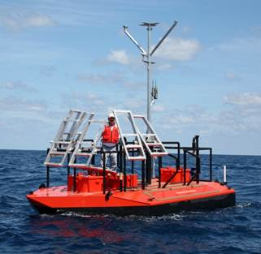
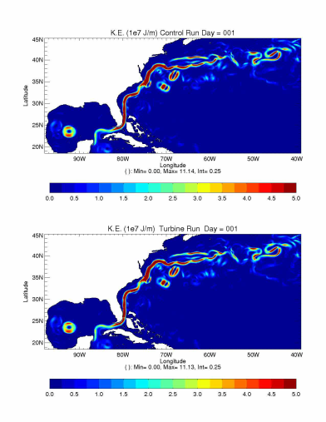
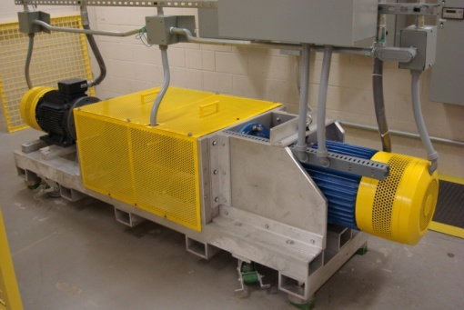
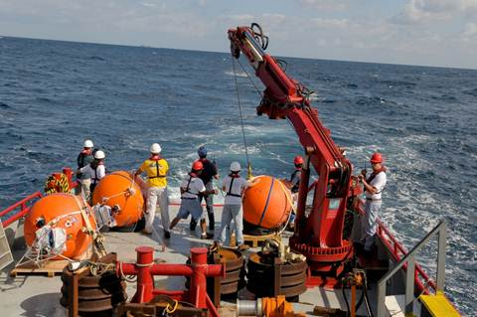
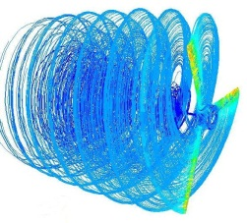
Accomplishments and Results
Project has not formally begun. However, proposed scope builds upon program elements conducted under other Federal and State of Florida funding. Program element accomplishments to date include:
  System design of turbine and test berth
  Operational dynamometer
  Test berth buoy sea trials
  Prognostics system architecture and software
  Four year research foundation for modeling and tech development
  Resource measurement and modeling (ocean current and temperature profile data over 3 years)

Slide 6
Challenges to Date
To date, the single greatest challenge has been working through the BOEMRE lease application process. As the first Outer Continental Shelf (OCS) applicant, SNMREC, BOEMRE, and other cognizant agencies have been involved in the learning process.
Offshore test berth and turbine designs have been dictated in part by regulatory recommendations, and have necessarily evolved in tandem.
An iterative and cooperative approach with BOEMRE on the lease application has resulted in their EA preparation and our pending lease. We anticipate continued collaboration and accelerated progress.

Slide 7
Next Steps
Pending approved scope, experimental turbine construction will continue. Electrical and mechanical systems will be tested separately, and then integrated for testing under tow near-shore (summer 2012).
When BOEMRE lease received, test berth will be installed and vetted with complete integrated turbine. Gulf Stream data collection and experiments will then begin (late 2012).
Prognostics and rotor research will be in parallel with turbine testing, and results will be available to developers and partners by the end of 2013.

