Slide 1
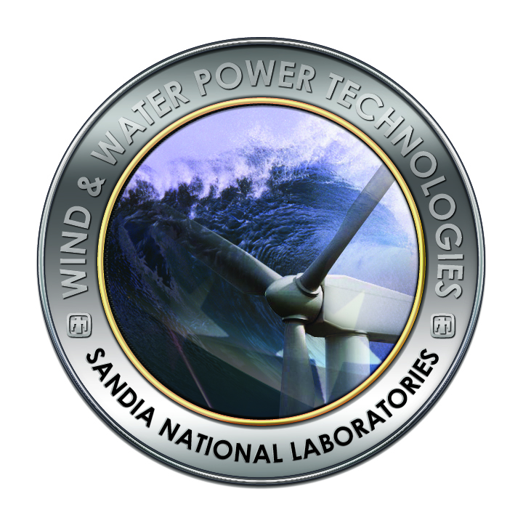
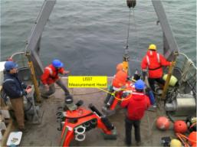
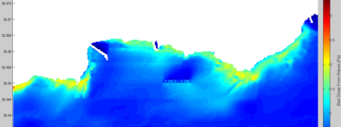
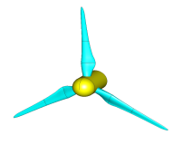
Water Power Peer Review
MHK Device
  Tools & Methods to Measure/Predict Environmental Impacts: Effects on the Physical Environment
Jesse Roberts
Sandia National Laboratories
jdrober@sandia.gov; 505-844-5730
November 3, 2011

Slide 2
Purpose, Objectives, & Integration
The MHK industry in the US faces challenges associated with siting, permitting, construction, and operation of pilot- and full-scale facilities because little is known about the potential effects of MHK device operation in coastal areas, estuaries, or rivers. This lack of knowledge affects the actions of regulatory agencies, the opinions of stakeholder groups, and the commitment of energy project developers and investors.
  Therefore SNL efforts are geared towards accelerating environmentally sound MHK deployment by developing practical, accessible tools and peer-reviewed publications to help industry and regulators evaluate environmental effects & mitigation measures and to establish best siting and design practices. SNL will continue to offer free training courses for open-source tools developed.
  SNL’s objectives are the assessment of changes to the physical (i.e. currents, waves, sediments, and water quality) & acoustic environment potentially incurred through operation of various types of MHK devices and arrays. Understanding MHK-driven changes to the physical and acoustic environment will enable evaluation of how these changes may affect local aquatic life.

Slide 3
Technical Approach
SNL will (1) collect baseline and post-MHK-installation field and lab data, (2) enhance an open-source circulation and transport code (SNL-EFDC) to account for the physics governing the motion of the flow through and around MHK arrays, (3) develop representative (simplified ocean, tidal, or river system) and site-specific models, and (4) exercise models to investigate the influence of MHK array size and configuration on marine and riverine health.
SNL will investigate the relationship between the number and configuration of MHK devices installed and the subsequent effects on the environment to maximize energy capture and minimize detrimental effects to the ecosystem.
SNL-EFDC array optimization tool is open-source, includes enhanced sediment transport and water quality routines, a GUI, and is validated against scaled flume tests. Validation against full-scale field-deployed turbine upcoming.
SNL will (1) design a reference turbine, (2) build finite-element model to determine flow field and noise generated by the spinning rotor structure (accounting for hydrodynamic and vibro-acoustic noise). Inform fish ensonification studies.

Slide 4
Plan, Schedule, & Budget
Schedule
Initiation date: September 2009
Significant milestones or deliverables for the project include:
  Develop proof-of-concept MHK-turbine array optimization tool (SNL-EFDC). September, 2010
  Modify SNL-EFDC to directly incorporate output from SWAN wave model. September, 2010
  Release and complete two training classes for SNL-EFDC MHK-Turbine Array Optimization Tool. August, 2011
  Design and model flow around reference turbine spinning rotor. September, 2011
  Field data collection of turbulence and velocity deficit in the wake of the full-scale Free Flow Power turbine in the Mississippi River. Report March, 2012
  Acoustic predictions from a reference MHK turbine. Report, March 2012
  MHK turbine array optimization study in the Mississippi River. September, 2012
  Nearshore sedimentation risk for wave energy farm installations. September, 2012
  Influence of tidal turbine arrays on water quality within tidal embayment’s. Report September, 2012
Budget:
Subtle variances are associated with a delay in placing contracts with our university partners. University efforts were delayed by 1 quarter.
67% or $0.8M out of $1.2M has been expended to date
Budget History
FY2009 |  | FY2010 |  | FY2011
DOE | Cost-share | DOE | Cost-share | DOE | Cost-share
$598K | N/A | $119.8K | N/A | $478.4K | N/A
*SNL budget is only for direct costs and contracts to university/contract partners. Does not include funding (~$900K) to other National Labs

Slide 5
Accomplishments and Results
The following highlights the most important technical accomplishments achieved during this reporting period:
Development, validation, and release of the SNL-EFDC array optimization tool.
Completed two SNL-EFDC training courses for; (1) Free Flow Power, and (2) FERC, BOEM, DOE, Navy SPAWAR
MHK turbine array optimization study within a generic large river system.
Development of SNL-EFDC models of San Francisco Bay, East River, Mississippi River, and Santa Cruz Bight.
Design and hydrodynamic modeling of a reference MHK turbine rotor to enable predictions of rotor noise.
Simulating the presence of wave energy converters within the SWAN wave model and integrating results into SNL-EFDC.
All of the above accomplishments have corresponding milestones that were completed on schedule and on budget

Slide 6
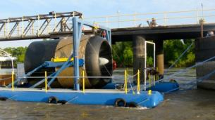
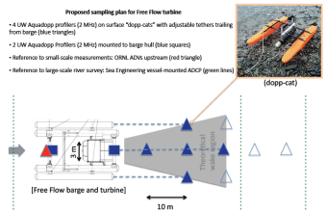
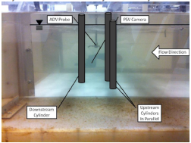
Field and Lab Testing
Major Accomplishments
  Completed data collection of suspended sediment in Admiralty Inlet, Puget Sound
    Helped to close noise budget in Admiralty Inlet and develop relationship between SSC and tides
  Scaled lab tests (Bucknell): verified flow characteristics & completed initial measurements of scour around mock MHK-support (cylinder). Designed scaled support and turbine array experiments.
    Provide scaled validation data sets
  Created test plan for field measurements around FFP demonstration turbine.
    Will be first ever public data set of flow around MHK-turbine

Slide 7




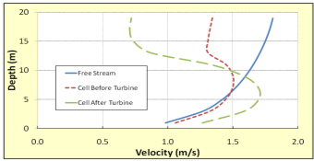
MHK-Friendly Tool Development
Major Accomplishments
  Verification/validation of SNL-EFDC open-source code against scaled flume data
  Released code to public and completed two SNL-EFDC array optimization training courses
  Large river array optimization: maximize power production/minimize environmental effects
MHK Device
MHK Device
K-ε modifications
Empirical constants
Treats MHK-turbine device as a momentum sink and source of turbulent kinetic energy and its dissipation rate

Slide 8
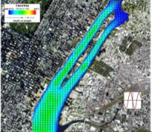
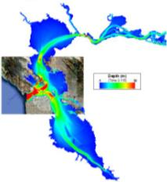
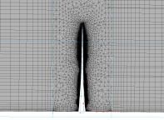

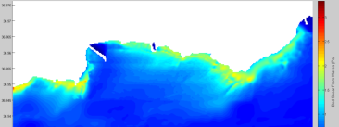
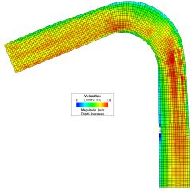
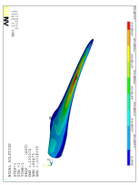
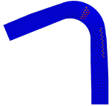



WECs, Site Models and Acoustics
Major Accomplishments
  Acoustics: finalized design, FEA, & CFD modeling of reference turbine for acoustic modeling
  Developed several site models for array optimization studies
    SF Bay, East River, Santa Cruz Bight, and Mississippi River
  WEC representation within SWAN wave model and incorporation in SNL-EFDC circulation
    Link with SNL Technology work to validate wave shadow effect landward of array
No Buoys
Scenario 2
Scenario 1
17 Buoys in ~12.5 m deep water
20,000 m³/s
Scenario 3
Scenario 2

Slide 9
Challenges to Date
Technical challenges included:
Implementation and validation of ”MHK friendly” algorithms within SNL-EFDC
Identifying pre-existing errors within the original EFDC source code that prolonged the validation phase.
Challenge Resolution:
SNL worked with the original author and other expert users of EFDC to identify and resolve pre-existing errors within the code and to support validation of “MHK friendly” modifications to the code.

Slide 10
Next Steps
Current and Tidal Efforts:
Field data collection of turbulence and velocity deficit in the wake of the full-scale Free Flow Power turbine in the Mississippi River
SNL-EFDC validation against field data and multiple scaled-turbines in large flume
MHK turbine array optimization study in the Mississippi River
  Maximize energy capture/minimize deleterious effects to the physical environment
Influence of tidal turbine arrays on water quality within tidal embayment’s
Wave Energy Efforts:
Sensitivity study of SWAN wave model representations of WEC arrays and influence on wave patterns and sediment bed shear stress within and landward of the array
  Validate WEC array simulation against experimental test data
WEC array effects on wave, current, and sediment circulation resulting from coupled wave and hydrodynamic model (model forced by waves, winds, and tides)
Methodology to evaluate sediment stability risk for wave energy farm installations
Acoustic Efforts:
Acoustic signature predictions from a full-scale reference MHK turbine using CHAMP
Acoustic measurements within the PSU/ARL water tunnel of an innovative sub-scale test rotor
Acoustic predictions of innovative sub-scale test rotor and comparison with test data

