Slide 1
Water Power Peer Review
Effects on Aquatic Organisms:
  Acoustics,
  Toxicity,
  Benthic Habitat Alteration
Dr. Mark Bevelhimer – Oak Ridge National Laboratory
Dr. Glenn Cada – Oak Ridge National Laboratory
  2.1.3.2 Acoustics
  2.1.3.3 Toxicity
  2.1.3.4 Benthic Habitat Alteration
Mark Bevelhimer
865-574-0266
bevelhimerms@ornl.gov
November 3, 2011
2.1.3 Effects on Aquatic Organisms

Slide 2
Purpose, Objectives, & Integration
ACOUSTICS
Knowledge gap: Poor understanding of effects of MHK noise on health and behavior of aquatic organisms. Regulatory agencies require assurance that noise from construction and operation will not adversely affect aquatic animals.
Programmatic goal: Reduce the regulatory costs, time, and potential environmental impacts associated with developing, siting, permitting, and deploying MHK systems.
  Project objectives:
  Determine levels of acoustic output from MHK devices relative to other noise sources and response thresholds of aquatic animals
  Develop assessment methods for studying effects of acoustics on a variety of freshwater organisms
  Subtask integration: The results of this task will be incorporated into the risk assessments of ANL and PNNL

Slide 3
Technical Approach
Approach:
Develop sampling and analysis protocol for measuring and evaluating underwater sounds.
Characterize a variety of natural and anthropogenic sounds in freshwater and tidal ecosystems as a baseline for comparison.
Record sounds emitted from operating MHK devices.
Analyze recorded sounds and compare to known hearing thresholds of fish and other aquatic organisms.
Conduct controlled sound exposure studies with freshwater fish.
Key Issues:
How much noise is acceptable? Which frequencies?
How big an area could be impacted by single or array of devices?
Unique aspects:
Development of protocol with affordable and easily used instruments and analytical software.
Use of near field-like conditions in controlled experiments.
ACOUSTICS

Slide 4
Plan, Schedule, & Budget
Schedule
Initiation date: Oct 1, 2009
Planned completion date: Sept 30, 2012
FY10 milestones:
  Q4 - Annual report describing results of literature review and study plan, Sept 30, 2010
FY11 milestones:
  Q2 - Provide list of selected study sites and noise creating targets for ambient noise characterization. Milestone ID = 50104 03/31/2011
  Q4 - Provide annual report on field characterization of non-MHK big river sounds. Milestone ID = 46312 09/30/2011
Budget:
No variances in proposed budget
$142K carryover from FY11
ACOUSTICS
Budget History
FY2009 |  | FY2010 |  | FY2011
DOE | Cost-share | DOE | Cost-share | DOE | Cost-share
$0 | - | $320K | - | $321K | -

Slide 5
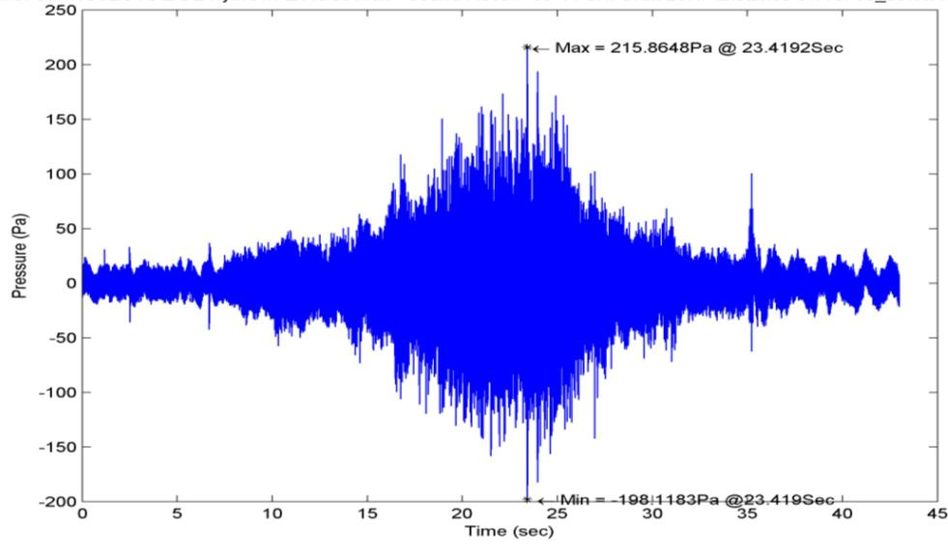
Accomplishments and Results
Completed literature review of effects of noise on freshwater fish.
Recorded and analyzed underwater noises for variety of natural and anthropogenic sources.
Compared recorded noises to fish hearing thresholds.
Produced annual report on field characterization of big river sounds. (Q4 milestone - 9/30/2011)
ACOUSTICS
Sound recorded from passing boat.

Slide 6
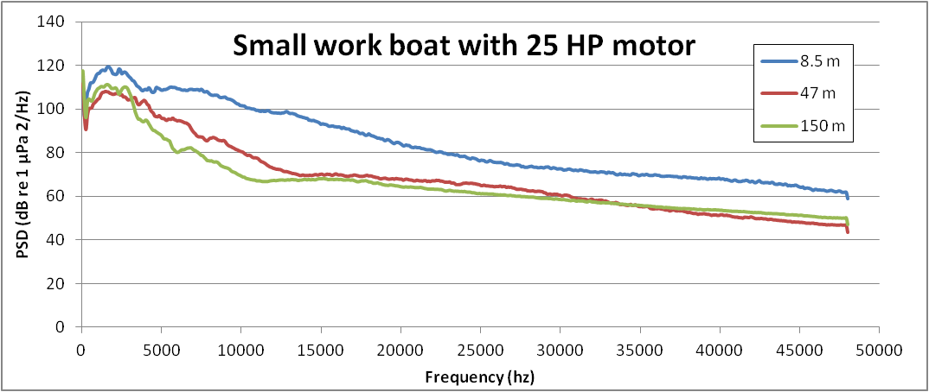
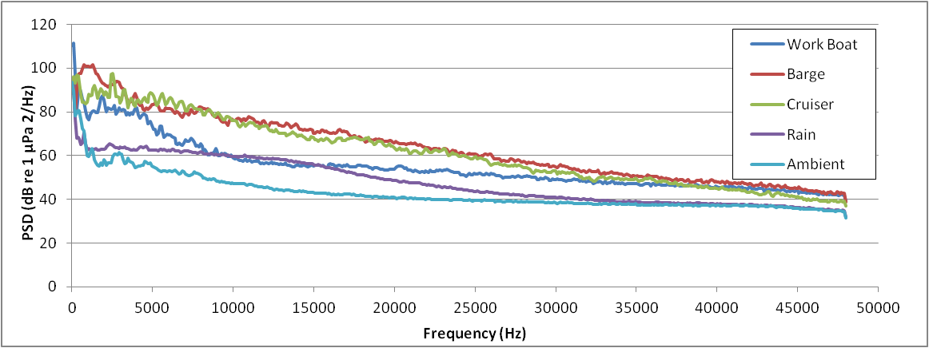
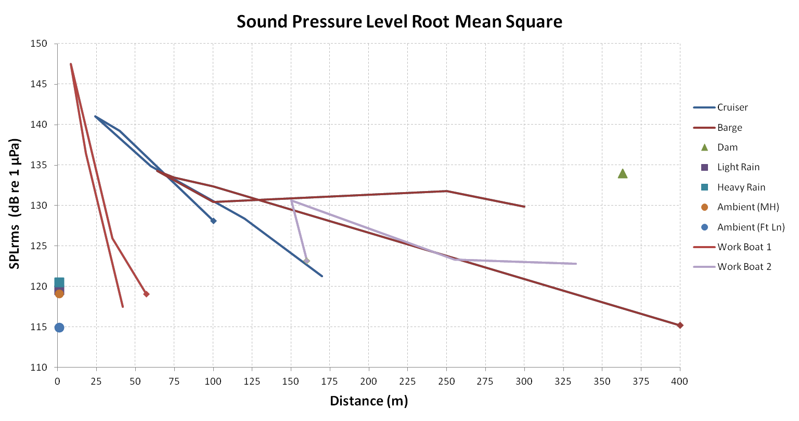
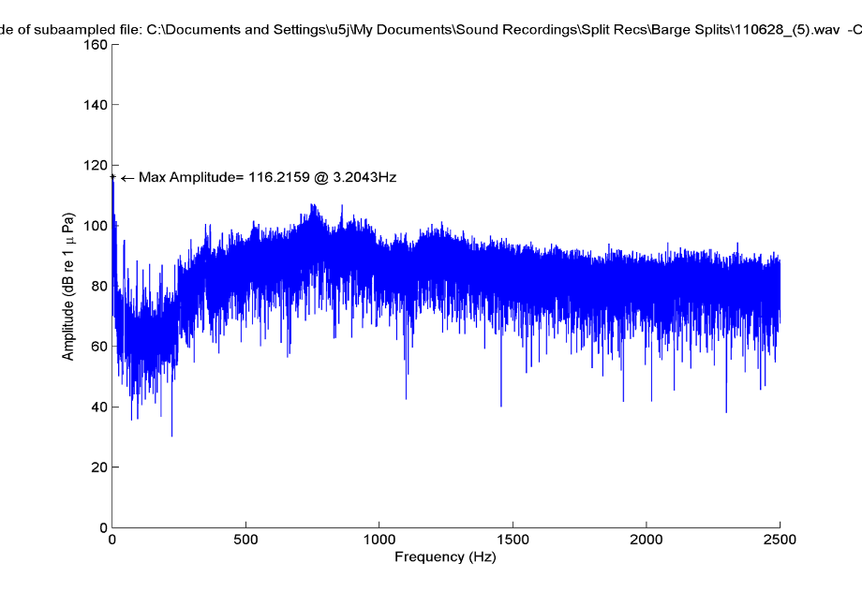
Accomplishments and Results
ACOUSTICS
Different sources
Comparison to fish hearing thresholds
Various sources and distances

Slide 7
Challenges to Date
ACOUSTICS
Measurement in flowing water is challenging.
Flow shields will be used. Drift sampling employed.
Very few MHK devices in the field for measurement.
Plans to sample at FreeFlow Power site as soon as operational again.
Controlled experiments of fish behavioral response require very large tanks or netpens.
Not impossible to overcome but has caused delays in starting studies.

Slide 8
Next Steps
ACOUSTICS
FY12 Milestones:
Q1 - Record sounds at operating MHK device including device and ambient noise.
Q2 - Controlled exposure studies will be commenced to evaluate the behavioral response of various freshwater fish species to reproduced MHK noises.
Q3 - Analysis of recordings collected at MHK sites will be completed.
Q4 – Submit article for journal publication that describes noise created by an MHK device and provides comparison to other ambient noises and fish hearing thresholds.
Next steps (beyond this project):
Measurements at arrays of devices
Controlled exposure studies could easily be expanded to more species and
Fish behavior monitoring at sites in conjunction with noise measurement

Slide 9
Purpose, Objectives, & Integration
TOXICITY
Knowledge gap: Critical to the success of MHK devices are materials and coatings that are resistant to corrosion, biofouling, and fatigue, while remaining affordable, easy to manufacture, and exhibiting low toxicity to the environment. There is poor understanding of the effects of possible toxic emissions from MHK devices on health of aquatic organisms. Regulatory agencies are concerned about toxic emissions from MHK devices and will likely require assurance that chemicals that are released or eroded from anti-fouling coatings will not adversely affect aquatic animals.
Programmatic goal: Reduce the regulatory costs, time, and potential environmental impacts associated with developing, siting, permitting, and deploying MHK systems.
  Project objectives:
  Evaluate the environmental toxicity of contaminants released from antifouling compounds likely to be used on MHK devices.
  Test new types of anti-fouling compounds (e.g., silicone-based and nano-based) for environmental toxicity.
  Subtask integration: The results of this task will be incorporated into the risk assessments of ANL and PNNL

Slide 10
Technical Approach
TOXICITY
Approach:
Develop information on nature of coatings to be used
Assess potential amounts that may be released via leaching
Evaluate possible toxicity to receptor organisms
Perform standard toxicity test with leachate from anti-fouling compounds
Key issues:
There are no standard protocol for collecting leachate from coated coupons, so we are trying several approaches with varying times of leaching before testing. Also considering sand abrasion.

Slide 11
Plan, Schedule, & Budget
Schedule
Initiation date: Oct 1, 2009
Planned completion date: Sept 30, 2012
FY10 milestones: Annual report, Sept 30, 2010
FY11 milestones:
  Q2 - Commence toxicity testing of newly developed anti-fouling coatings. Milestone ID = 50074 03/31/2011
  Q4 - Annual report on toxicity testing of anti-fouling coatings. Milestone ID = 50073 09/30/2011
Budget:
No variances in proposed budget
$92K carryover to FY12 for Toxicity
TOXICITY
Budget History
FY2010 |  | FY2011 |  | FY2012 (expected)
DOE | Cost-share | DOE | Cost-share | DOE | Cost-share
$125K | 0 | $125K | 0 | $125K | 0

Slide 12
Accomplishments and Results
TOXICITY
Completed several rounds of toxicity tests with Ceriodaphnia (zooplankton) and fathead minnows with different leaching and aging periods.
Only toxic effects observed to date are with blank discs and primer coating.
Continued discussions with manufactures and study collaborators (Sandia Nat. Lab, North Dakota St. U.) on additional sampling materials.
Made arrangements for North Dakota State scientists to provide coupons with coatings they have been testing.
Made arrangements with ORNL material scientist to provide coupons with nano-scale superhydrophobic coatings.

Slide 13
Accomplishments and Results
Table 1. Results of chronic Ceriodaphnia toxicity tests of freshwater leachates from International Paints antifouling coatings at the end of a 7-d curing period
Sample | Concentration (%) | Survival (%) | Mean (± S.D.) offspring/female
Control | 100 | 100 | 33.5 (4.2)
Uncoated discs | 100 | 100 | 32.6 (4.6)
Primered discsª | 100 | 100 | 29.4 (4.0)
Intersleek 970 | 100 | 100 | 29.4 (2.4)
Intersleek 757 | 100 | 100 | 31.1 (3.4)
TOXICITY
Table 2. Results of chronic Ceriodaphnia toxicity tests of 7-d freshwater leachates from International Paints antifouling coatings after an initial 7-d curing period.
Sample | Concentration (%) | Survival (%) | Mean (± S.D.) offspring/female
Control | 100 | 100 | 26.0 (3.7)
Uncoated discs | 100 | 100 | 28.0 (3.9)
Primered discsª | 100 | 100 | 24.6 (4.6)
Intersleek 970 | 100 | 100 | 27.5 (4.3)
Intersleek 757 | 100 | 100 | 26.0 (4.6)

Slide 14
Accomplishments and Results
Table 3. Results of chronic Ceriodaphnia toxicity tests of 7-d freshwater leachates from International Paints antifouling coatings after a 4-mo aging period.
Sample | Concentration(%) | Survival(%) | offspring/female
Control | 100 | 100 | 28.0 (5.5)
Uncoated discs | 100 | 100 | 28.5 (6.4)
Primered discsª | 100 | 100 | 31.3 (6.5)
Intersleek 970 | 100 | 100 | 31.0 (8.4)
Intersleek 757 | 100 | 100 | 27.4 (4.9)
TOXICITY
Table 4. Results of acute fathead minnow toxicity tests of freshwater leachates from International Paints antifouling coatings
Sample | Concentration (%) | Survival (%)
7- day leachate after curing
Control | 100 | 100
Uncoated discs | 100 | 100
Primered discs ª | 100 | 100
Intersleek 970 | 100 | 100
Intersleek 757 | 100 | 100
7- day leachate after aging
Control | 100 | 100
Uncoated discs | 100 | 56*
Primered discs ª | 100 | 67*
Intersleek 970 | 100 | 100
Intersleek 757 | 100 | 100

Slide 15
Challenges to Date
Period and mechanisms of leaching for laboratory tests need to be relevant to actual leaching from devices in the field.
As results of anti-fouling coating studies on MHK devices are analyzed we hope to gain better data on how much is lost to the environment.
Other modifications to FY 11 methods:
Marine grade aluminum to be used for coupons
Larger coupons for more surface area
Stirring during leaching to better simulate field conditions
TOXICITY

Slide 16
Next Steps
FY12 Milestones:
Q1 - Begin toxicity tests on marine (i.e., saltwater) organisms so that potential impacts of antifouling coatings can be evaluated for marine systems as well as freshwater systems.
Q2 - Complete data synthesis for freshwater toxicity tests to date and assess need for supplemental tests in
Q3 - Complete laboratory toxicity tests with freshwater organisms.
Q4 - Complete laboratory toxicity tests with marine organisms. Complete data analysis and summarize study results in a final report.
TOXICITY

Slide 17
Purpose, Objectives, & Integration
HABITAT
Knowledge gap: There is little knowledge of the possible effects on bottom sediments and benthic habitat as a result of construction and operation of MHK devices in large rivers. Regulatory agencies are concerned about habitat alteration from MHK devices and will likely require assurance that such changes will be small and inconsequential.
Programmatic goal: Reduce the regulatory costs, time, and potential environmental impacts associated with developing, siting, permitting, and deploying MHK systems.
  Project objectives:
  Categorize the type and amount of benthic habitat that could be affected during the installation and operation of MHK projects in freshwater environments.
  Identify the sensitivity of aquatic biota in various habitat types to MHK-caused alterations in their habitats.
  Develop habitat- and biota-specific monitoring protocols for identifying the onset of potentially unacceptable ecological impacts during the siting, construction, and operation of MHK projects.
  Subtask integration: The results of this task will be used to calibrate SNL’s hydrodynamic / sediment transport modeling and also incorporated into the risk assessments of ANL and PNNL.

Slide 18
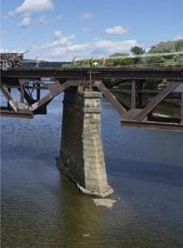
Technical Approach
Approach:
Develop field techniques and protocols for characterizing the distribution of different sediment types in large rivers using hydroacoustics (i.e., sonar).
While waiting for MHK devices to be installed, characterize the effect on river sediment distribution of other in-river structures such as bridge pilings.
Characterize sediments at a soon-to-be developed MHK site so that the effects of devices in place can be measured in future sampling.
Estimate possible effects of MHK devices on benthic habitat and benthic organisms based on predictions of sediment redistribution, what types of benthic organisms are present, and their dependence on particular types of benthic habitat.
Key Issues:
How will benthic habitat be altered?
How much and which types will be gained or loss?
How would distribution and abundance of benthic organisms change?
Unique aspects:
Sonar techniques are more rapid and more easily conducted
  than direct sediment sampling techniques
HABITAT

Slide 19
Plan, Schedule, & Budget
Schedule
Initiation date: Oct 1, 2009
Planned completion date: Sept 30, 2012
FY10 milestones: Q4 - Annual report, Sept 30, 2010
FY11 milestones:
  Q3 – Submit field sampling plan for MHK site benthic substrate characterization; to include mobile sonar surveys and sediment grab samples for ground-truthing of automated characterization. 06/15/2011
  Q4 - Annual report on Benthic Habitat Alteration studies. 09/30/2011
Budget:
No variances in proposed budget
$44K carryover to FY12 for Habitat Alteration
HABITAT
Budget History
FY2010 |  | FY2011 |  | FY2012 (expected)
DOE | Cost-share | DOE | Cost-share | DOE | Cost-share
$150K | 0 | $150K | 0 | $150K | 0

Slide 20
Accomplishments and Results
Received and trained on use of hydroacoustics system (split-beam boat mounted sonar) and analytical software.
Developed field sampling plan. (3Q milestone)
Conducted several sampling trips to surrogate bridge piling sites to collect bathymetric and sediment data and to refine sampling techniques at a manageable and nearby site.
Analyzed data to identify effects of in-river
structures on scouring and habitat type.
Submitted FY11 annual report
describing progress to date
to DOE (Q4 milestone)
HABITAT

Slide 21
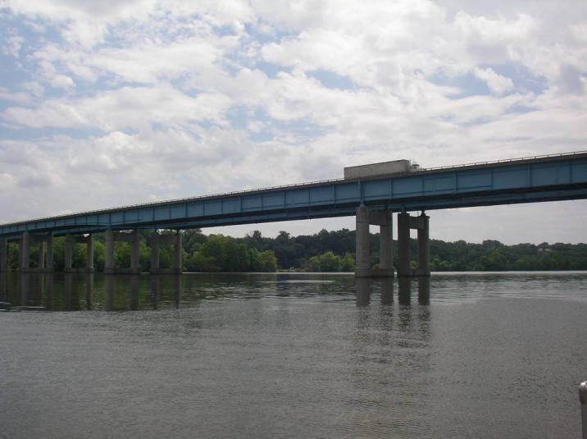
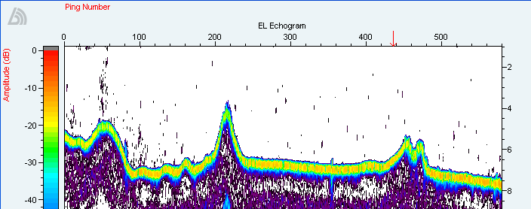
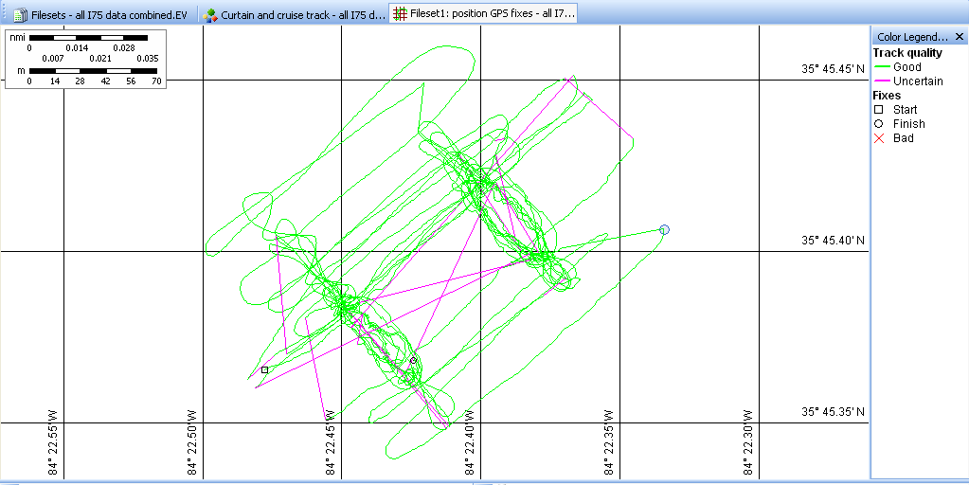
Accomplishments and Results
Interstate bridge over Tennessee River
Single transect behind 3 bridge pilings
identifies sediment deposition areas
HABITAT
Depth (m)
Multiple geo-located transects around 2 bridge pilings

Slide 22
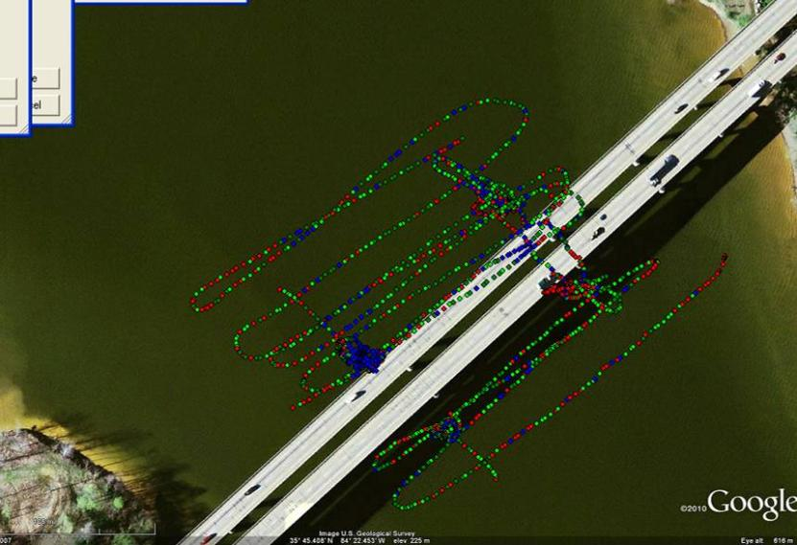
Accomplishments and Results
HABITAT
Multiple geo-located transects converted to bottom bathymetry around piling (indicated by dashed line).
Multiple geo-located transects used to characterize different bottom types shown by different colors.

Slide 23
Challenges to Date
HABITAT
Bigger boat will be needed on lower Mississippi.
Plan to hire boat and captain. Have designed mounting mechanism for transducer to be easily fit to another boat.
Since so few devices have been installed (not just on test platforms) we are only able to sample pre-deployment conditions at this point.

Slide 24
Next Steps
FY12 Milestones
Q1: Characterize sediment distribution at at least one MHK site. Sediment data from this study will be supplied to SNL for sediment transport modeling efforts
Q2: Create a catalogue of potential biotic receptors of benthic habitat alteration in big river systems. This catalogue would identify those organisms that should be considered as possibly being affected by MHK development and operation in large rivers where MHK permits have been issued.
Q3: Complete analysis of impacts on benthic organisms based on expected changes in sediment distribution as a result of MHK operations.
Q4: Develop a cost-effective protocol for benthic habitat evaluation that can be used by project developers to address environmental concerns. The protocol will include methods for sediment characterization, predicting sediment changes, identifying potentially affected biota and analyzing likely impacts.
Next steps (beyond this project):
Pre and post-deployment characterization of sediment and benthic organisms at active MHK sites.
Enhanced collaborative effort with sediment transport modelers to improve model predictions.
HABITAT

