Slide 1
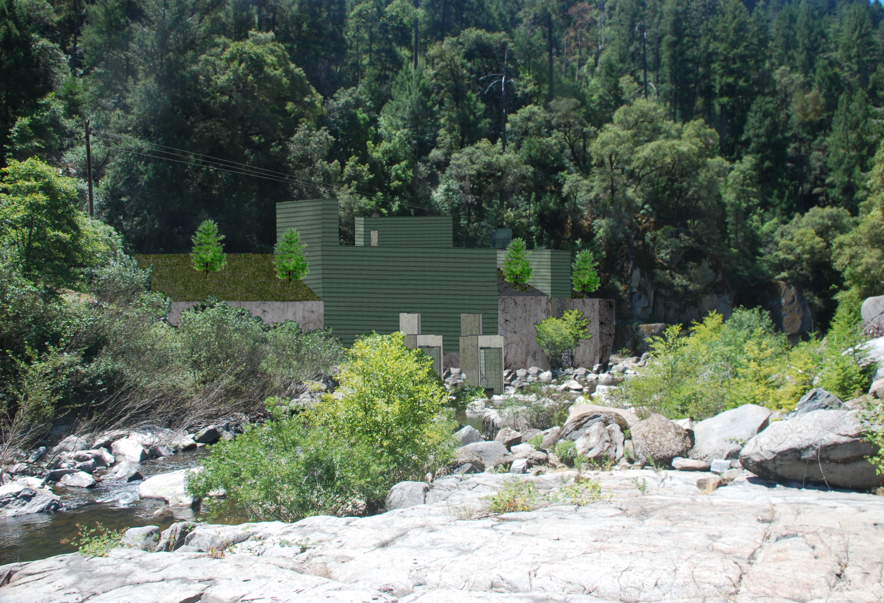
Water Power Peer Review
  Sacramento Municipal Utility District
  Slab Creek Small Hydro Project
  Water Power 2010 Sustainable Small Hydro
  Sacramento Municipal Utility District
  Slab Creek Small Hydro Project
PI: Scott Flake P.E.
Sacramento Municipal Utility District
E-mail: sflake@smud.org (916) 732-6174
November 2011

Slide 2
Purpose, Objectives, & Integration
Project Purpose:
  Demonstrate how existing power tunnels can be used in the construction of small hydro plants to take advantage of minimum flows when placing the plant at the base of the dam is not feasible .
  Strategy: Utilize existing infrastructure and technology to demonstrate cost effective ways to develop small hydro at existing dams.
Relation to Program Objectives:
  Demonstrate use of existing tunnels and infrastructure to cost effectively develop small hydro at existing dams;
  Demonstrate the value of dual Francis turbines to maximize energy production from highly variable minimum releases from hydroelectric dams;
  Establish a streamlined approach to hydroelectric license amendment process for small hydro projects added to existing hydro facilities; and
  Demonstrate the economically competitive nature of new small hydro projects in comparison to other utility-scale technologies.

Slide 3
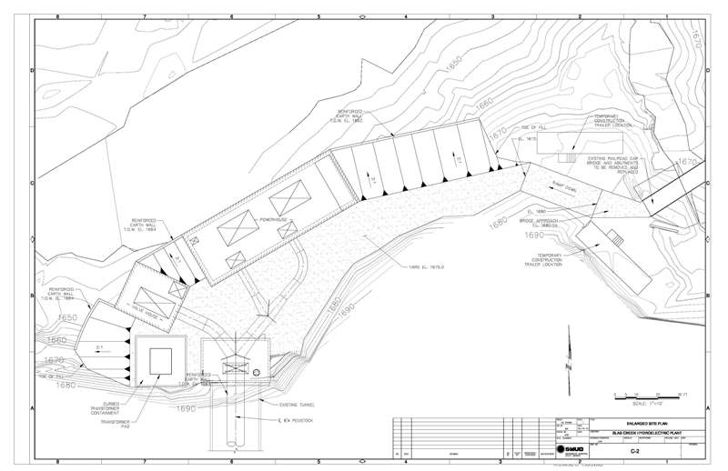
Plan View of Slab Creek Powerhouse
Tsunami test

Slide 4
Visual Simulation of new Slab Creek Powerhouse

Slide 5
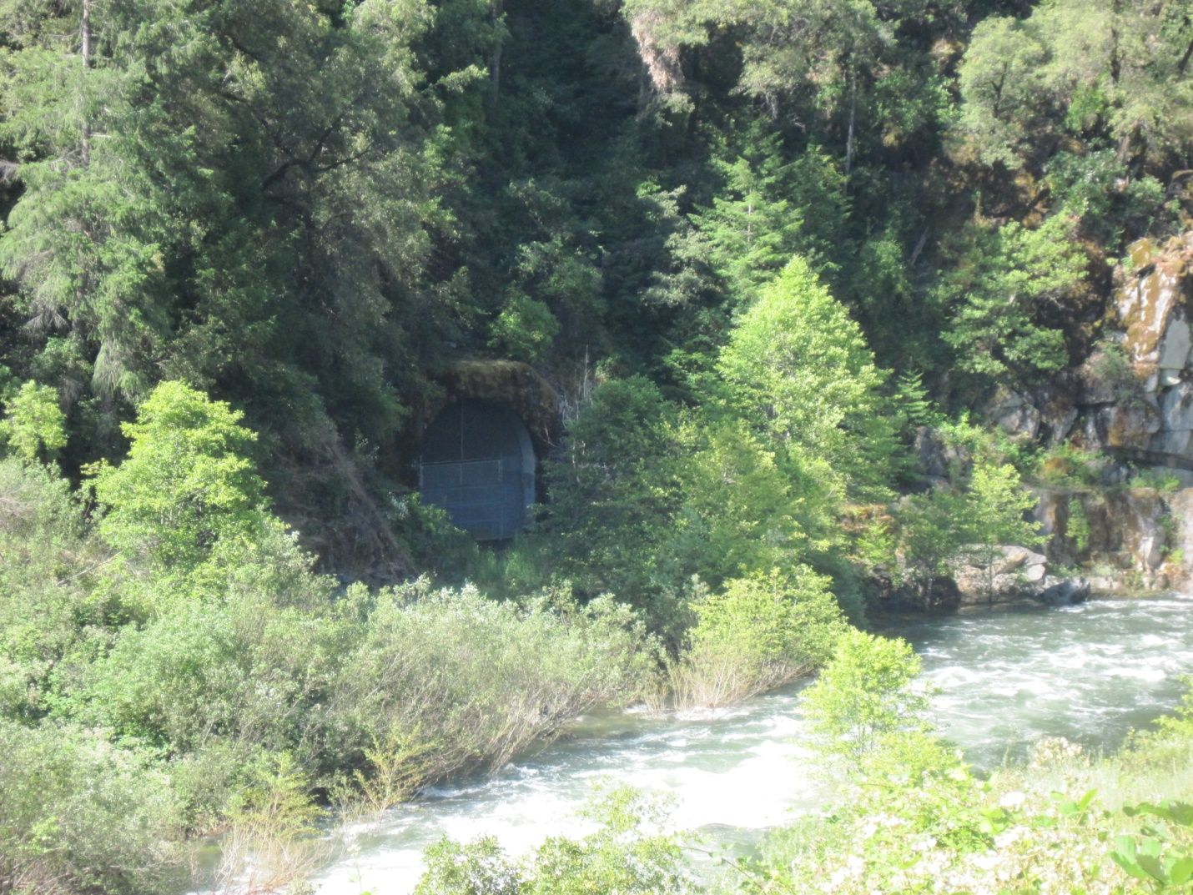
View of Tunnel Adit

Slide 6
Project Schedule
New Slab Creek Powerhouse Project Preliminary Schedule* of Licensing and Construction
 | 2011 | 2012 |  |  |  | 2013 |  |  |  | 2014
 | Q4 | Q1 | Q2 | Q3 | Q4 | Q1 | Q2 | Q3 | Q4 | Q1 | Q2 | Q3 | Q4
FERC ISSUES NEW UARP LICENSE
PRE-FILING CONSULTATION
Distribute Initial Document
Stakeholder Comment Period
Conduct Add’l. Studies, if necessary
File License Amendment Application
File 401, 404 and 1600 Permit Apps
POST-FILING NEPA PROCESS
Prepare and Release Draft EA
Final EA & License Order
SMUD CEQA Supplement Analysis
401, 401 and 1600 Permit
FINAL DESIGN
Geotechnical Investigation
Final Designs & Cost Report
FERC Review
CONSTRUCTION
Stream Bank Foundation
Water Conveyance
Powerhouse
Equipment
Transmission Line

