Slide 1
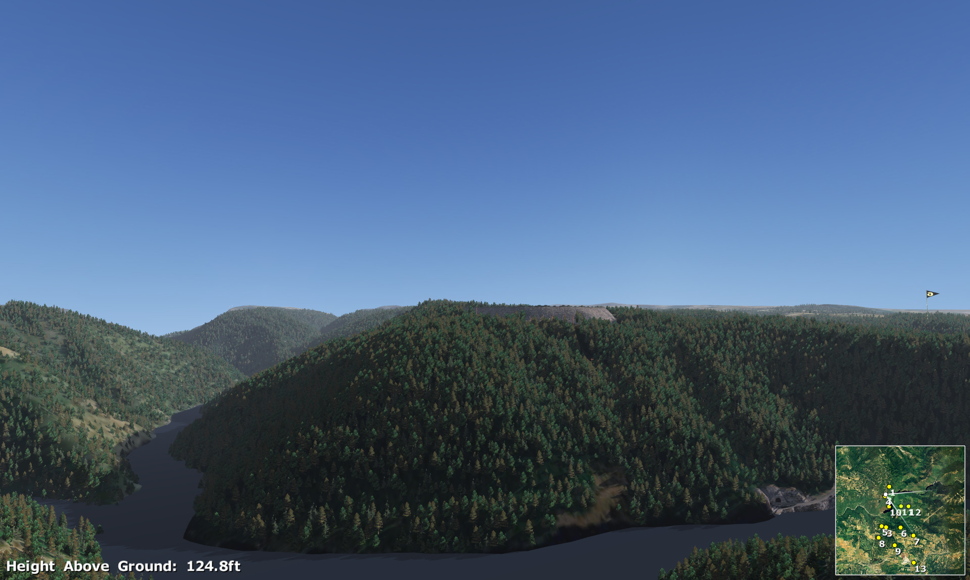
Water Power Peer Review
  Sacramento Municipal Utility District
  Iowa Hill Pumped-storage Development
  Water Power 2010 Sustainable Pumped-storage
  Sacramento Municipal Utility District
  Iowa Hill Pumped-storage Development
PI: Scott Flake P.E.
Sacramento Municipal Utility District
E-mail: sflake@smud.org (916) 732-6174
November 2011

Slide 2
Purpose, Objectives, & Integration
Project Purpose:
  Demonstrate methods to reduce uncertainty in cost and schedule development of Pumped-storage Projects.
  Define and quantify the value streams of Iowa Hill relative to conventional gas units with future anticipated higher levels of variable renewable generation.
Relation to Program Objectives:
  Identify geotechnical defects in the subsurface that could result in costly remedial measures.
  Determine depth of the weathered zone, landslides, and toppled rock in construction area.
  Develop detailed information through the powerhouse gallery, tunnels, and shafts on minimum in-situ stresses to inform the degree of steel lining needed.
  Determine ancillary service requirements to balance increased variable renewable generation.
  Examine value from pumped storage relative to conventional gas generation for providing on peak energy and ancillary services in the SMUD Balancing Authority, and as part of the entire California region.

Slide 3
Visual Simulation of Iowa Hill Pumped-storage Development

Slide 4
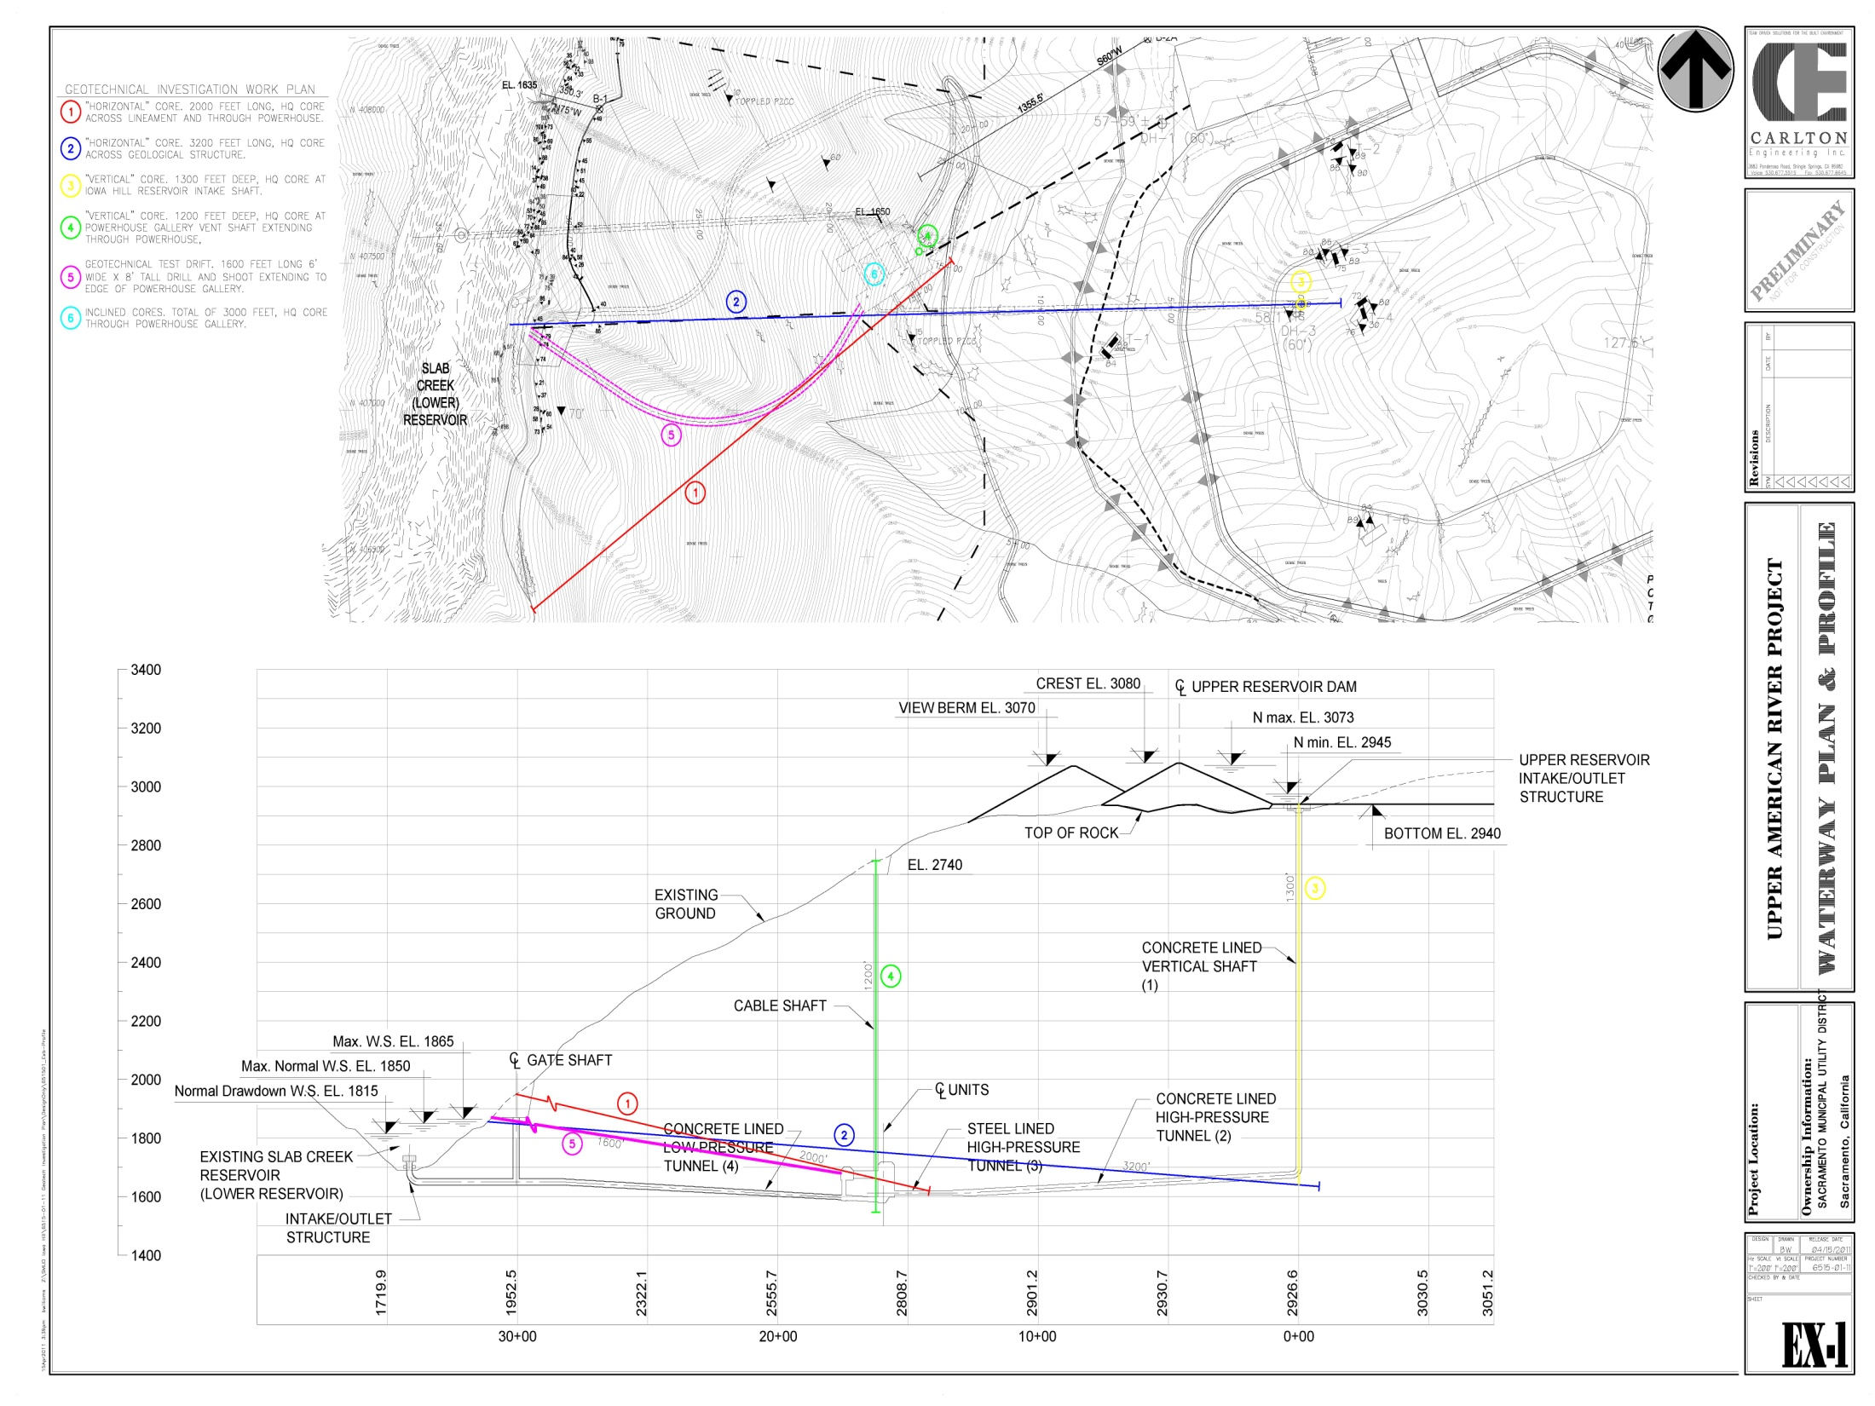
Plan View of Proposed Geotechnical Exploration
Tsunami test

Slide 5
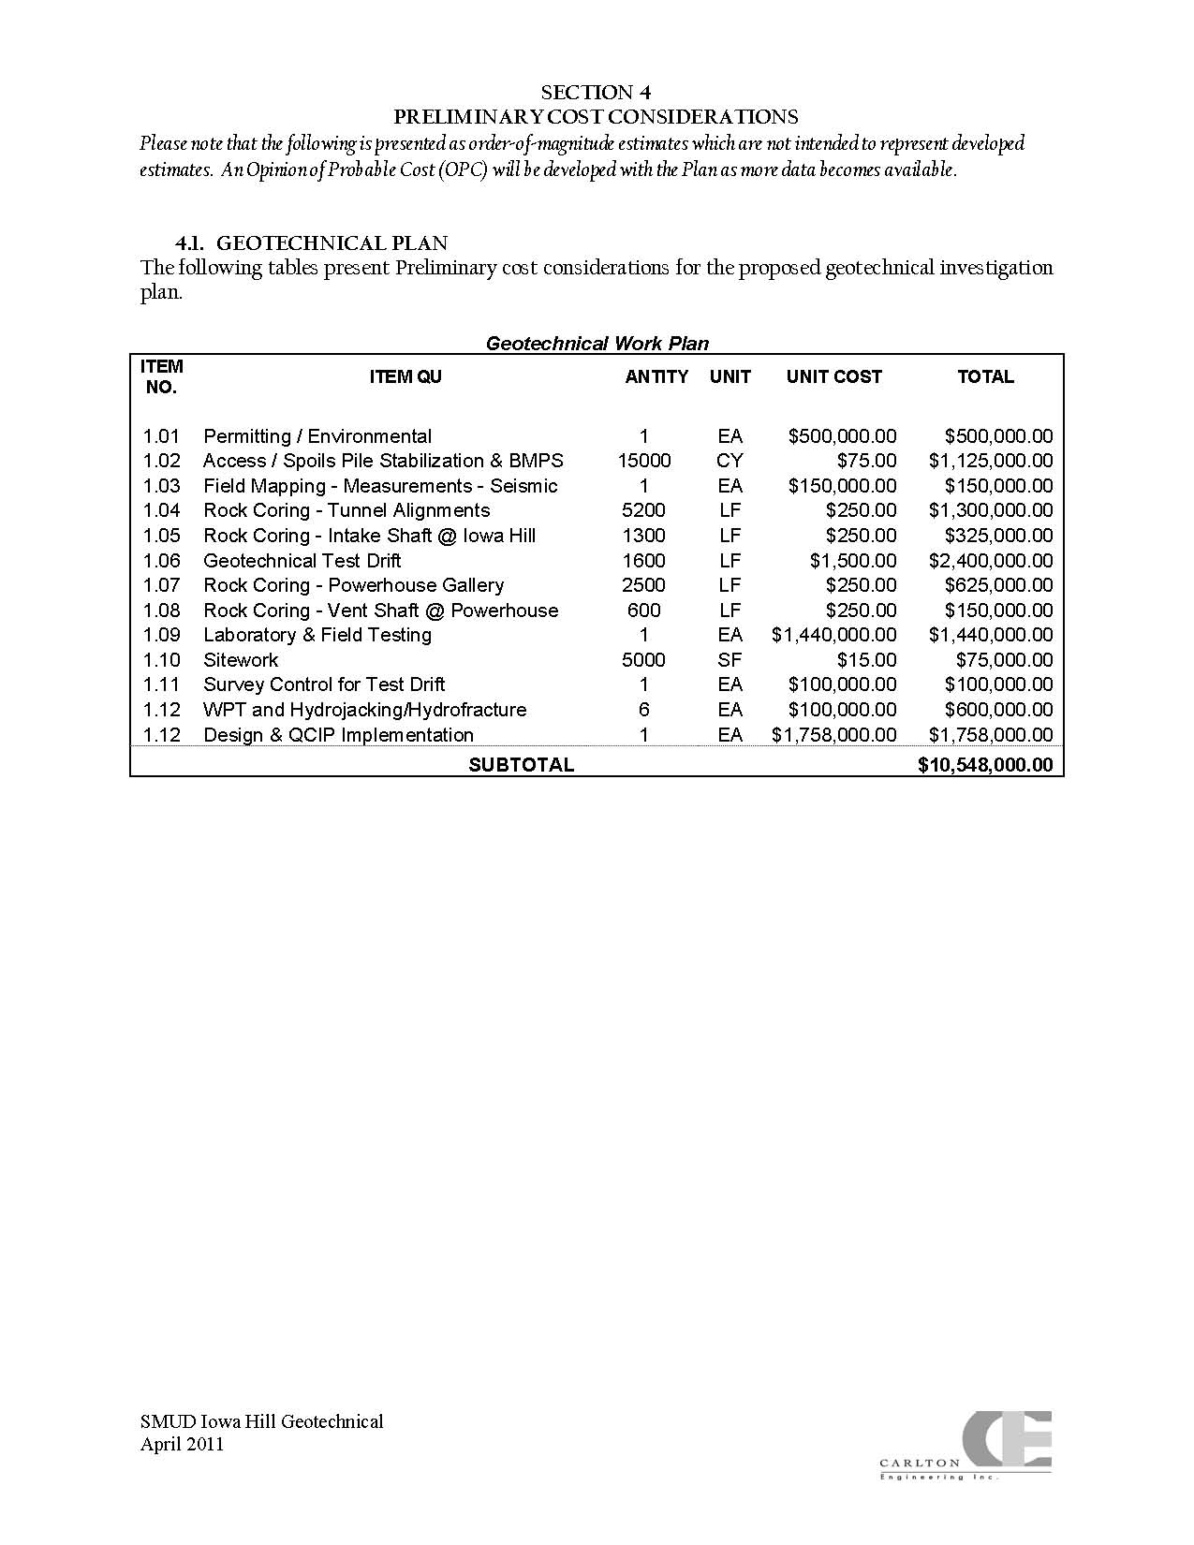
Plan and Budget

Slide 6
Schedule
Iowa Hill Pumped-storage Development Preliminary Schedule* of Post-License Design and Construction
 | 2011 | 2012 | 2013 | 2014 | 2015 | 2016 | 2017 | 2018
FERC ISSUES NEW UARP LICENSE
FINAL DESIGN AND PERMITTING
Value Stream Modeling
Geotechnical Investigation
File 401, 404 and 1600 Permit Applications
Final Design & Cost Report
FERC Review and Approval
SMUD Board Decision on Iowa Hill
CONSTRUCTION
Site Clearing
Transmission Line Construction
Upper Reservoir Construction
Tunnel Construction
Site Restoration
Underground Facilities Construction

