Slide 1
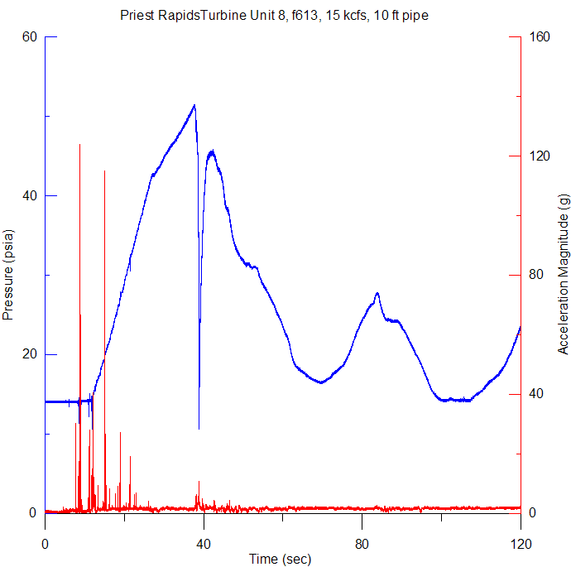
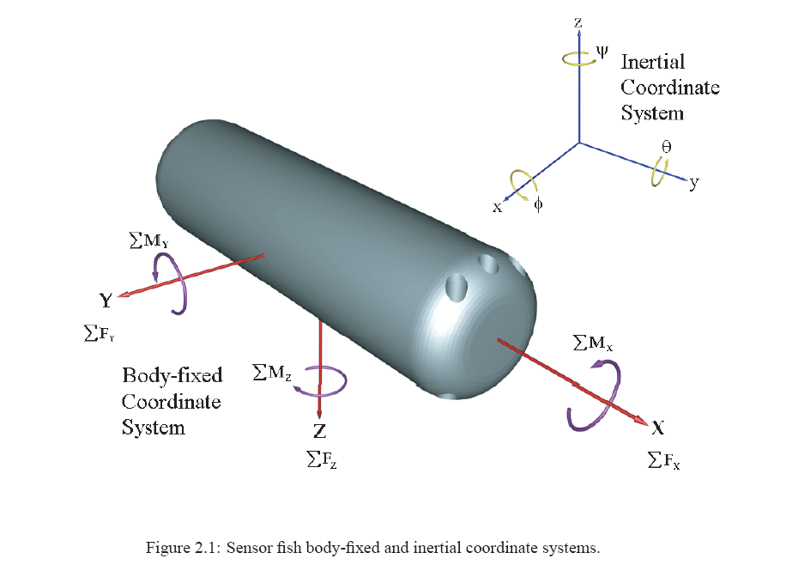
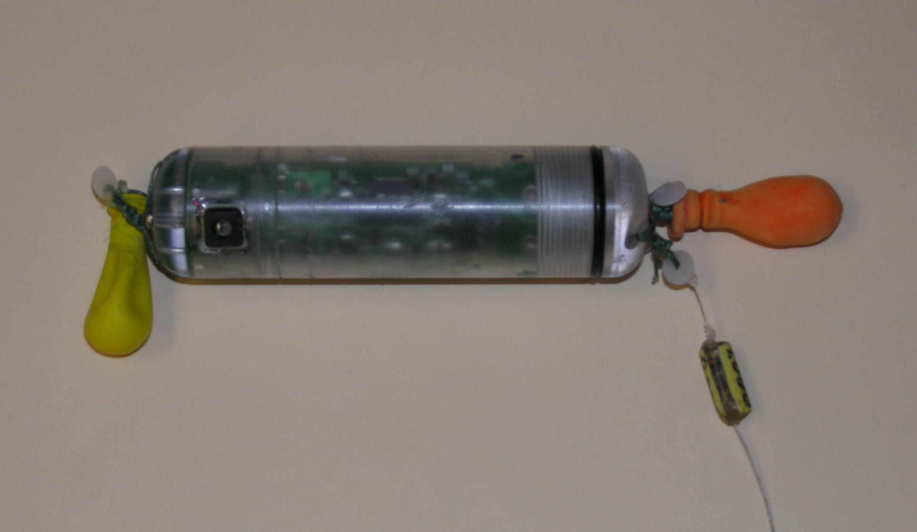
Water Power Peer Review
Z. (Daniel) Deng
Thomas J. Carlson
  Sensor Fish Redesign Collaboration
Pacific Northwest National Laboratory
Zhiqun.Deng@pnnl.gov (509) 372-6120
Thomas. Carlson@pnnl.gov (503) 417-7562
November, 2011
DOE Water Power Program

Slide 2
Purpose, Objectives, & Integration
Project Purpose
  Redesign a proven device to address current needs to observe conditions in the water passageways of hydroturbines that affect power production performance and fish passage safety
Objectives
  Identify measurement applications identified by turbine designers, power production entities, research institutes, and regulators
  Develop design specifications that address application needs
  Build and test prototypes in the laboratory and at operating power production facilities
Integration
  Place the sensor fish a commercial vendor that can build the sensor and support its use by others

Slide 3
Technical Approach
Work with potential users to identify requirements for application
Design to meet application requirements
Perform both laboratory and full scale field tests of prototypes
Implement an innovative design to reduce deployment and recovery complexities and costs
Place the new Sensor Fish with a commercial vendor capable of building the sensor at a competitive cost and supporting its users

Slide 4
Plan, Schedule, & Budget
Schedule
Initiation: January 2012
Completion: September 2013
FY12 Milestones
  Q2: Application Space Definition
  Q3: Design Specification Finalization, Prototype Build Initiation
  Q4: Complete Prototype Build, Initiate Laboratory Testing
Budget
  DOE Funding $300K
  Partner Funding $50K
  Partner In-Kind Contributions of Labor and Support for Field Testing

