Slide 1
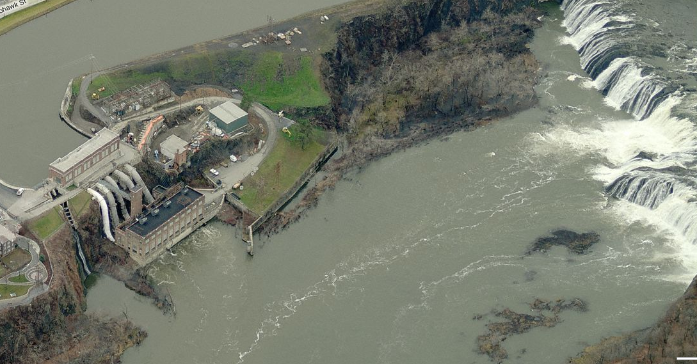
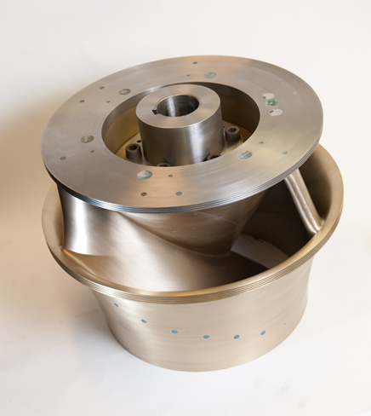
Water Power Peer Review
  Deployment and Testing of the Alden Fish-Friendly Turbine
  by EPRI, Alden Research Lab, Kleinschmidt Assoc., Normandeau Assoc., and Brookfield Power
Presenter
Mike Sale – Contractor to ORNL
mjsale@frozenhead.net
November 3, 2011
Notes:
One of the most important products of the CH side of the Water Power program. Also, very strong team to carryout the project.

Slide 2
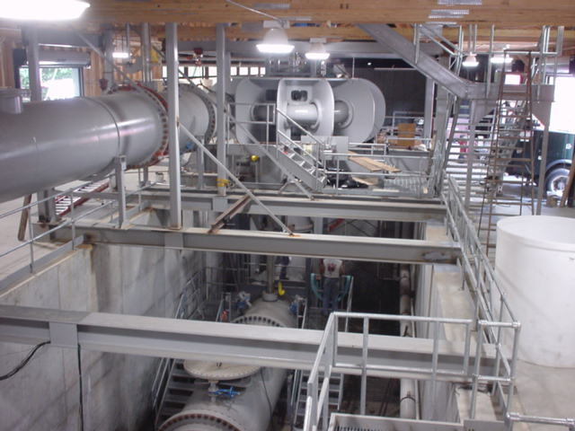
BACKGROUND: work dates back to the old Advanced Hydropower
Turbine Systems Program, starting in 1994
Conceptual design
Pilot-scale testing in laboratory
Redesign for manufacturing and construction
Alden Turbine Pilot Scale Test Loop
>42,000 fish tested

Slide 3
Purpose, Objectives, & Integration
Purpose: Installation and performance testing of the latest version of the Alden “fish-friendly” hydropower turbine.
  Demonstration site at Brookfield’s School Street Hydroelectric Project, Mohawk River, Cohoes, NY
  Full-scale evaluation of energy efficiency and environmental performance
Primary Barrier Addressed: Mortality of fish passaging downstream through hydropower turbines.
  For example, salmon decline in the Columbia River basin possibly related to hydropower operation via turbine mortality on downstream migrating juveniles.
Benefit: Safe passage for fish through turbines enables more generation from available water.
  Generates ~25% more energy than the conventional design through energy recovery of flows otherwise used for the conventional fish bypass system.
Integration: Advances environmental mitigation technologies that promote cost effective sustainable hydropower generation.
  Results will lead to determination of the full costs and benefits of new technology in a real-world setting, reducing uncertainties for future applications.
Notes:
RELEVANCE: It directly addresses the DOE Program goal because it represents highly innovative, new technology development that will enable of new hydropower generation in ways that are both energy and environmentally efficient.

Slide 4
Technical Approach – Year 1
Engineering Design *
Task 1 – Integration Meetings to educate the turbine end user and the regulatory agencies that monitor and dictate environmental performance for the demonstration site to ensure the successful installation and acceptance of the Alden turbine.
Task 2 – Engineering Design
  Subtask 2.1 – Preliminary Design to complete preliminary engineering and to develop cost estimates to allow Brookfield and Voith to implement a purchase agreement. These cost estimates will provide the detail required for a detailed cost and ROI analysis.
  Subtask 2.2 – Final Design to develop the level of engineering detail required to prepare a bid package.
* Project team: EPRI, Alden, Kleinschmidt, Normandeau, Brookfield
Notes:
APPROACH: Project is well designed with highly qualified team (EPRI management, Kleinschmidt Assoc. engineers, Normandeau Assoc. biologists, and Brookfield owners)

Slide 5
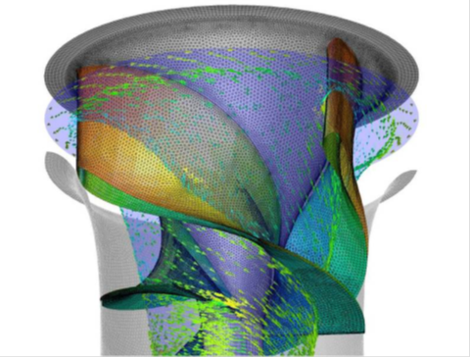
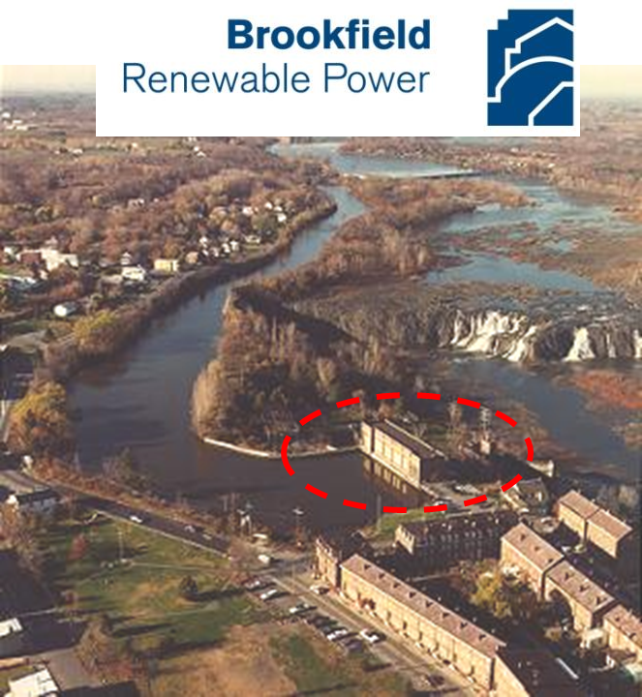
Technical Approach – Year 2
Manufacturing, Construction, and Testing Plan Development
Task 1 – Construction and Engineering Support to evaluate the work conducted in 2010, the overall site preparation and construction plan.
Task 2 – Development of Performance Test Plan to measure fish passage efficiency and power performance efficiency for comparison to theoretical predictions.

Slide 6
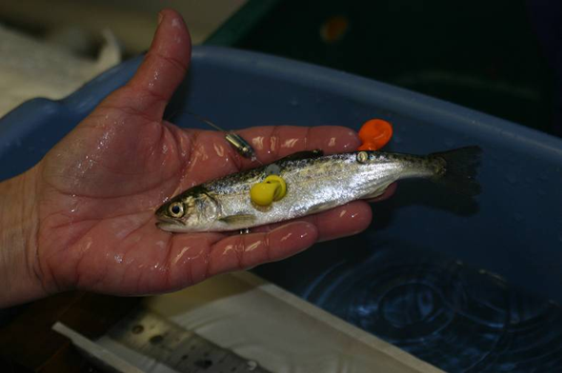


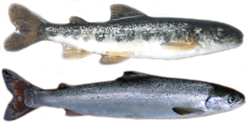
Technical Approach – Year 3
Project Commissioning, Performance Testing, and Final Report
Task 1 – Biological Performance Testing
  Subtask 1.2 – Passage Survival to determine the ability of the Alden turbine installed at School Street to safely pass fish downstream, Normandeau Associates will conduct a direct injury and survival study for turbine-passed fish using the HI-Z Turb’N Tag recapture technique.
  Subtask 1.2 – Predator Challenge to evaluate indirect mortality, a predator challenge evaluation will be conducted to address the potential for sub-lethal injuries and disorientation to lead to increased susceptibility to predation.
Notes:
APPROACH (continued): testing of full-scale performance

Slide 7
Technical Approach – Year 3
Project Commissioning, Performance Testing, and Final Report (continued)
Task 2 – Reporting performed annually, quarterly and on an as needed basis to DOE to document technical progress, problems encountered, and actions taken or recommended to overcome those problems.
Task 3 – Technology Transfer
  Quarterly and Annual Progress Reports to DOE and industry co-sponsors (annual reports also available to public).
  Technical presentations and papers at annual hydropower conferences.
  Papers for publication in trade and scientific journals.
  Scientific and engineering news journals appraised of progress.

Slide 8
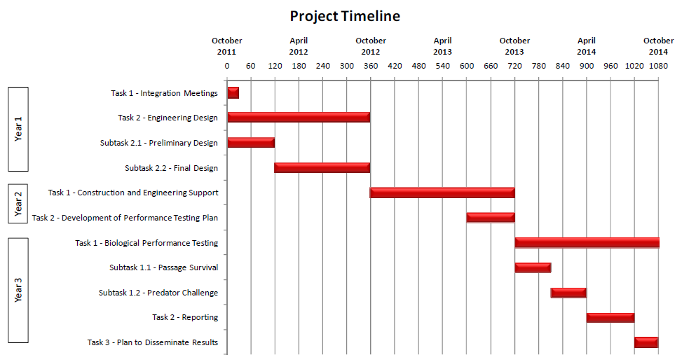
Plan, Schedule, & Budget
Budget: $1.5M (proposed), with approx. $1.5M cost-share
Notes:
ACCOMPLISHMENTS AND PROGRESS: Contract is being negotiated now and project has not begun yet.

Slide 9
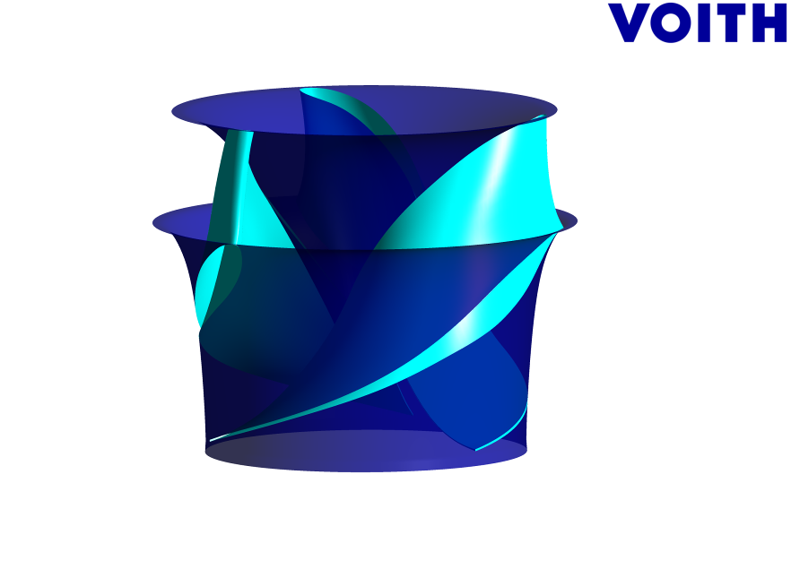
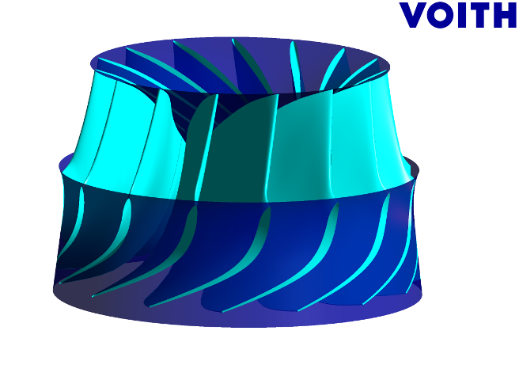
“Fish Friendly” Turbine Development:
Alden Design - What’s Different?
BACKUP SLIDES
Conventional Francis Turbine
Alden Turbine

Slide 10

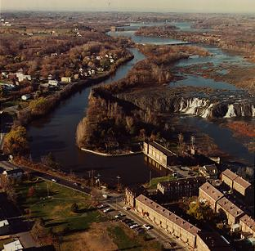
School Street Demonstration Site
Brookfield Renewable Power’s School Street Project:
Mohawk River, NY
92 ft head, ~1200 cfs
~11 MW
Species of concern – blueback herring & American eel
Settlement agreement & agency approval for installation and testing

Slide 11
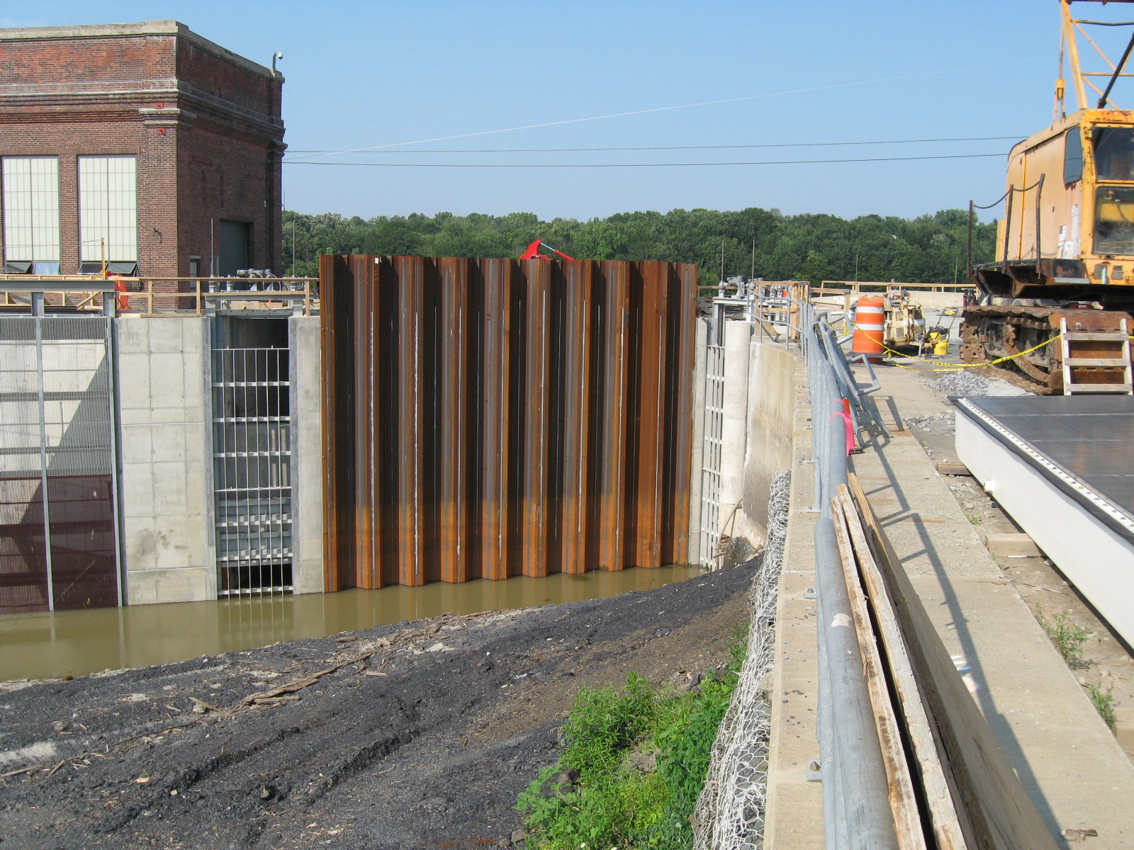
Existing turbine gatehouse
Future turbine intake
Fish bypass
Fish guidance louver
Dewatered School Street Project forebay

