Slide 1
DOE Technical Assistance Program
Engaging Financial Institution Partners
April 25, 2011
Mark Zimring
Lawrence Berkeley National Laboratory
Notes:
Before we jump into today’s presentations I would like to take a
few moments to describe the DOE Technical Assistance Program
(TAP) a little further. TAP is managed by a team in DOE’s
Weatherization and Intergovernmental Program - Office of
Energy Efficiency and Renewable Energy.

Slide 2
What is TAP?
DOE’s Technical Assistance Program (TAP) supports the Energy Efficiency and Conservation Block Grant Program (EECBG) and the State Energy Program (SEP) by providing state, local, and tribal officials the tools and resources needed to implement successful and sustainable clean energy programs.
Notes:
The Department of Energy’s (DOE) Technical Assistance Program (TAP) provides
state, local, and tribal officials the tools and resources needed to implement successful
and sustainable clean energy programs. This effort is aimed at:
Accelerating the implementation of Recovery Act projects and programs,
Improving their performance,
Increasing the return on and sustainability of Recovery Act investments, and
Building protracted clean energy capacity at the state, local, and tribal level.
From one-on-one assistance, to an extensive online resource library, to facilitation of
peer exchange of best practices and lessons learned—TAP offers a wide range of
resources to serve the needs of state, local and tribal officials and their staff.

Slide 3
How Can TAP Help You?
TAP offers:
One-on-one assistance
Extensive online resource library, including:
Webinars
Events calendar
TAP Blog
Best practices and project resources
Facilitation of peer exchange
On topics including:
Energy efficiency and renewable energy technologies
Program design and implementation
Financing
Performance contracting
State and local capacity building
Notes:
These technical assistance providers can provide short-term, unbiased expertise in:
Energy efficiency and renewable energy technologies
Program design and implementation
Financing
Performance contracting
State and local capacity building
In addition to providing one-on-one assistance, we are available to work with
grantees at no cost to facilitate peer-to-peer matching, workshops, and trainings.

Slide 4
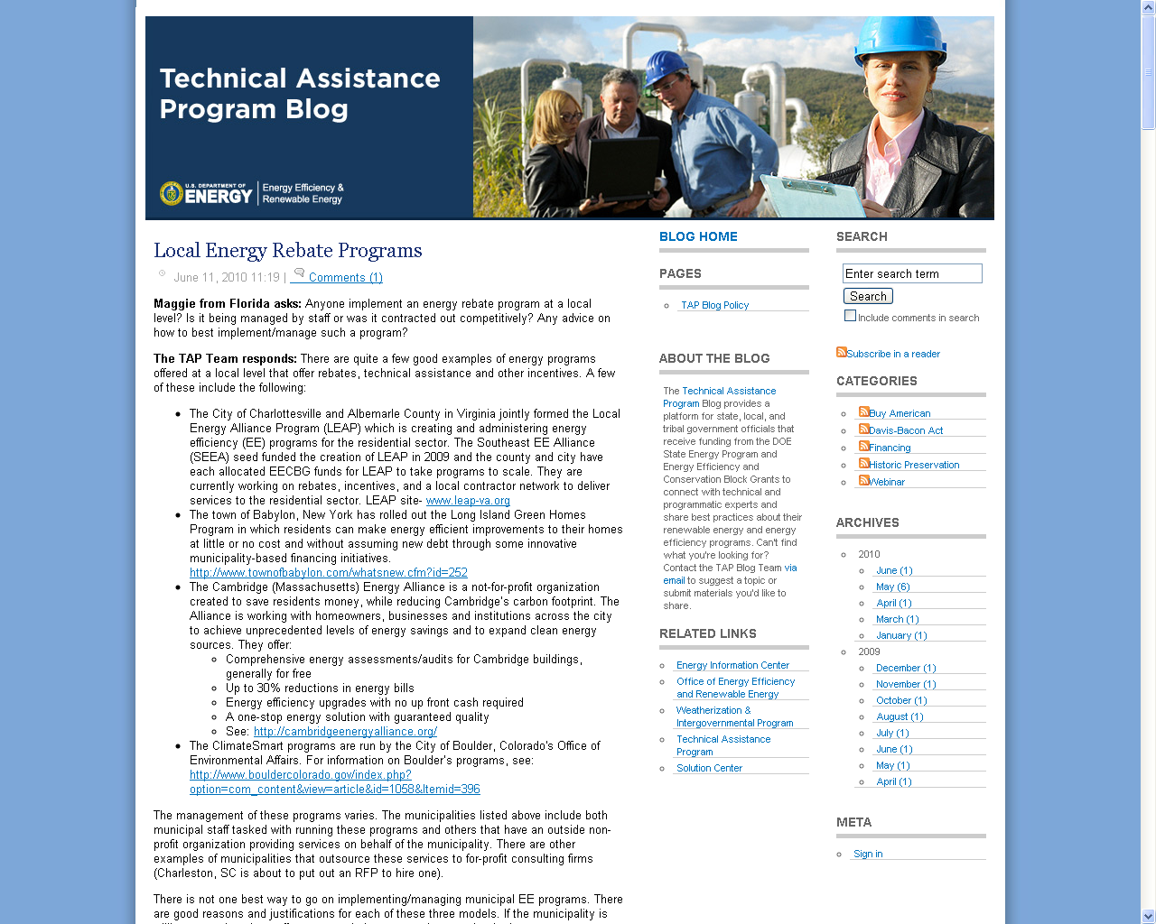
The TAP Blog
Access the TAP Blog! http://www.eereblogs.energy.gov/tap/
Provides a platform for state, local, and tribal government officials and DOE’s network of technical and programmatic experts to connect and share best practices on a variety of topics.
Notes:
We also encourage you to utilize the TAP Blog, a platform that allows
states, cities, counties, and tribes to connect with technical and
program experts and share best practices.
The Blog is frequently updated with Energy Efficiency or Renewable Energy
Related posts. We encourage you to utilize the blog to ask
questions of our topical experts, share your success stories, best
practices or lessons learned, and interact with your peers.

Slide 5
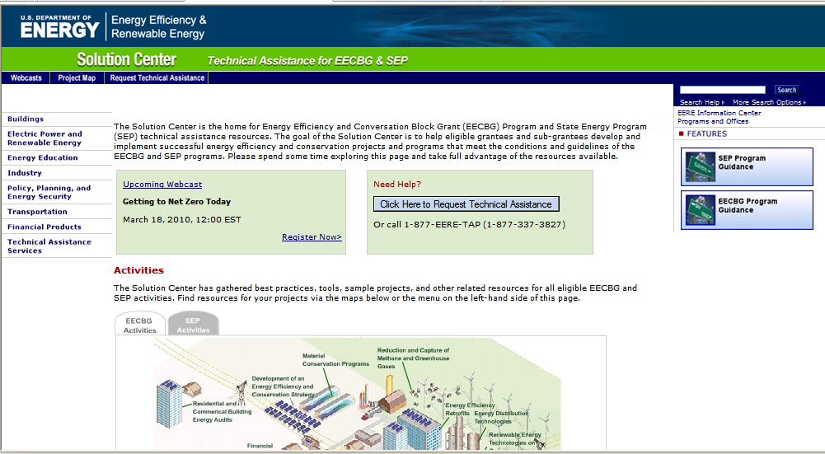
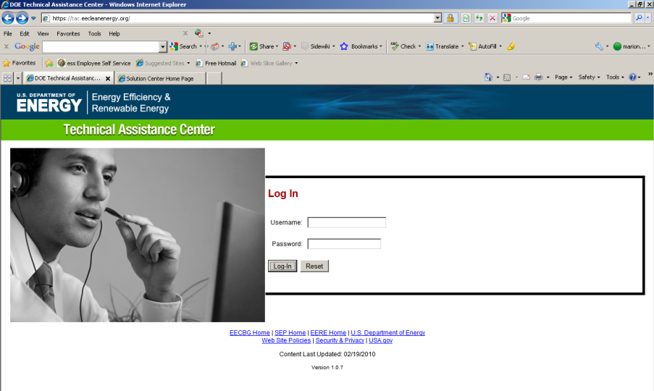
Accessing TAP Resources
We encourage you to:
1) Explore our online resources via the Solution Center
2) Submit a request via the Technical Assistance Center
3) Ask questions via our call center at 1-877-337-3827 or email us at solutioncenter@ee.doe.gov
Notes:
Requests for direct assistance can be submitted online via the
Technical Assistance Center (https://tac.eecleanenergy.org/) or by
calling 1-877-EERE-TAP (1-877-337-3827). Once a request has been
submitted it will be evaluated to determine the level and type of
assistance TAP will provide.

Slide 6
Upcoming Webinars
Please join us again:
Title: Modeling for Grantees
Host: Ed Pierce, Oakridge National Laboratory
Date: April 27, 2011
Time: 3:00-4:15 EDT
Title: Interactions Between Energy Efficiency Programs Funded Under Recovery Act & Utility Customer-Funded Energy Efficiency Programs
Host: Chuck Goldman, Lawrence Berkeley National Laboratory
Date: April 28, 2011
Time: 2:00-3:30 EDT
Title: Residential Retrofit Program Design Guide Overview
Host: Vermont Energy Investment Corporation
Date: May 3, 2011
Time: 2:00-3:30 EDT
For the most up-to-date information and registration links, please visit the Solution Center webcast page at www.wip.energy.gov/solutioncenter/webcasts

Slide 7
Webinar Overview
Residential Energy Efficiency Financing Update
Mark Zimring, Lawrence Berkeley National Laboratory
Financial Stakeholder Engagement Process
Dan Clarkson, Energy Efficiency Finance Corporation
Sustainable Partnerships
Shannon Brock-Ellis, Puget Sound Cooperative Credit Union
Best Practices & Lessons From the Field
Todd Conkey, Wisconsin Energy Conservation Corporation

Slide 8
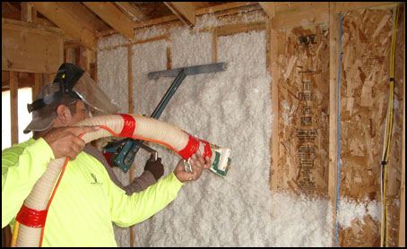
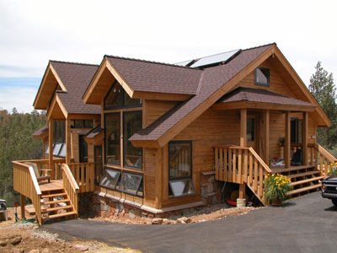
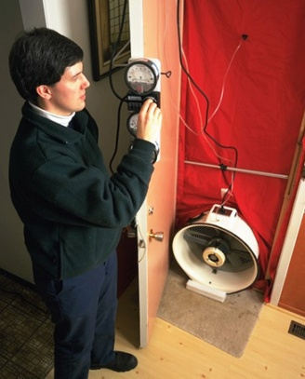
Residential Energy Efficiency Financing Update
Mark Zimring
Lawrence Berkeley National Laboratory (LBNL)
April 25, 2011

Slide 9
State of the Market for EE Financing
Lending is constrained. National lenders are reluctant to provide consumer financing. Local and regional lenders face increased collateral requirements from regulators.
There is no “national model” (yet). Local lenders have limited balance sheets, so developing secondary markets is critical to scale and pricing. Stay tuned…
Local lenders are increasingly active. Community banks, credit unions and community development financial institutions (CDFIs) are partnering with public programs. Many new privately-funded loan programs are being supported by public credit enhancements.
Notes:
$5-10,000 unsecured loans are low margin products for financial institutions
WHEEL?

Slide 10
Trends in EE Finance Options
National Energy Efficiency Loans
Fannie Mae Energy Loans
EGIA GeoSmart Loans
Enerbank “Same as Cash” Loans
Local/Regional Energy Efficiency Financing Products
Local Loan Programs (Community Energy Challenge-Whatcom County, WA)
Regional Loan Programs (Michigan Saves)

Slide 11
Financing Residential Energy Efficiency—Product Comparison
Financing Option | Security | Interest Rate to Borrower | Loan Term | Loan Size | Minimum FICO Score
Fannie Mae Energy Loans (national) | Unsecured | 5.99%-16.99% | 1-10 Years | $2,500-$25,000 | 680
EGIA GeoSmart Loans (national) | Unsecured | 5.99%-13.99% | 5-10 Years | $1,000-$25,000 | N/A
Enerbank (national) | Unsecured | 0% | Up to 18 Months | $1,000-$45,000 | 680
Community Energy Challenge (Whatcom County, WA) | Secured | 3.5%-6.5% | 5,10, or 15 Years | $1,000-$20,000 | 640
Michigan Saves (State of Michigan) | Unsecured | 7% | 1-10 Years | $1,000-$12,000 | 640
Notes:
The National Products involve significant interest rate buy downs by contractors and/or program administrators (~10% of the loan amount)

Slide 12
Austin Energy Case Study
Home Performance with Energy Star Program. Over 8,700 residential energy upgrades since 2006.
Partnered with Velocity Credit Union. 1,800 energy efficiency loans, totaling ~$12.5 million in loan volume
Interest Rate Buydown. AE does not provide a credit enhancement, but buys down interest rates to 0 percent
Download Full Case Study Here: http://eetd.lbl.gov/ea/emp/reports/ee-policybrief_032211.pdf

Slide 13
Benefits to Program Financial Partner
Low cost of customer acquisition. High loan approval and funding rates decrease admin. costs while contractor/program marketing decrease advertising costs
An attractive offer drives customer sales. Low interest product enhances institution’s reputation and helps with cross-selling (3 times higher rate of cross-selling than with other products)
Free Contractor Due Diligence. The quality of work done reflects on the lender’s reputation
A Responsive Program Administrator. EE programs are complex. It is important that program admins are focused on making sure the program works for the lender

Slide 14
Questions?
Mark Zimring
Lawrence Berkeley National Laboratory
mzimring@lbl.gov
510-495-2088

Slide 15
Presenter: Dan Clarkson
Dan is an attorney specializing in government relations and corporate and project finance in the energy sector. Dan develops energy efficiency loan programs with local governments and is responsible for all legal aspects of these relationships at Energy Efficiency Finance Corp (EEFC). EEFC is part of the US Department of Energy’s Financial Technical Assistance Team for ARRA grant recipients.

Slide 16
Financial Stakeholder Engagement Process
Dan Clarkson
Vice President
Energy Efficiency Finance Corp.

Slide 17
Financial Stakeholder Engagement Process:
Step 1. Financial Program Design
Step 2. Obtain Internal Agency Support
Step 3. Lender Partner Analysis
Step 4. Lender Meetings
Step 5. Request for Proposals
Step 6. Bidders Conference
Step 7. Lender Selection
Step 8. Negotiate Financing Facility
and Prepare Implementing Agreements

Slide 18
Key:
Step #. [Name]
Example of Document = deliverable
Document/Meeting Elements

Slide 19
Goals
Overall goal is to work toward a point where the monthly payments for an energy efficiency upgrade would be offset by the energy savings
Net zero to borrower
Loss Reserve reduces Lender’s risk
→ lower interest rates
→ lengthen loan tenors
Municipality grows jobs, saves energy, lowers carbon consumption, gets banks lending again

Slide 20
Step 1. Financial Program Design
Define goals
Sustainability
Leverage
Identify funding sources/amount going toward credit enhancement
Consider the type of credit enhancement :
Loan loss reserve
Interest rate buydown
Subordinated lending
Discuss pros and cons of credit enhancement leveraging impacts
Notes:
Initial Planning
Define scope of the Program: will it include Small commercial? Multi-family? Non-profits? My recommendation: Keep it simple.
Determine the types of Credit Enhancements can be used
Define expected services the Lender will provide

Slide 21
Copy of Design Document

Slide 22
Design Document - text
SustainableWorks Residential Energy Efficiency Loan Program
Loan Loss Reserves for Energy Efficiency Lending . . .
The LRF risk-sharing formula will have two main parameters. The first parameter is the ratio of the LRF funds to the total original principal amount of loans in the EE loan portfolio. Presently, we are thinking this will be in the range of 5-10%, which is the same as a leverage ratio of 10 or 20:1. The second parameter is the share of the losses that the LRF will pay. We are thinking in the range of 90%, which implies that a portion of the first losses will be borne by the FI and covered from their normal loss provisioning. Because all losses after the LRF is exhausted will be borne by the FI, FI incentives for good loan origination, administration and recoveries will be maintained. Therefore, to provide the most meaningful risk protection, we recommend that we consider paying 80-90% of the first losses with LRF funds. A lower leverage ratio means less lending per a given amount of LRF funds. This implies greater risk protection for the lender, which can result in relaxed underwriting requirements and approval of more loans. We need to discuss how such an LRF can support the FI to offer better terms, and broaden access to finance.

Slide 23
Design Document - elements
How much money is there?
How can it be used most effectively?
What are the elements of a loan loss reserve?
Subordinated 0% On-Lending?
Interest rate buydowns?
This document is a tool to discuss the program and help focus on a clearer design.

Slide 24
Step 2. Obtain Internal Agency Support
The Financial Design will need internal support
Schedule meetings with agency managers and elected officials
Present a slide show and distribute Design Doc
Explain benefits of credit enhancements
Show success of this elsewhere
Be attentive to questions and issues (e.g. legal)
Goal: Develop internal champions

Slide 25
Presentation to Managers - slide show -
Notes:
Can also be used for

Slide 26
Internal Presentation - elements
Fully explain model
Bring in financial technical assistance if needed
How can this use of grant funds best meet agency goals?
Obtain clarity on agency procedures
Council approval?
Legal review?
Sole-source contracting prohibitions?
Procurement Department procedures?

Slide 27
Step 3. Lender Partner Analysis
Schedule lender meetings prior to issuing RFP
Yields greater understanding and interest
Research a list of local lenders and larger lenders with regional offices - FDIC and NCUA data
Determine decision-makers in potential lender
Partner relation begins with the first call
Determine internal champion
Notes:
Lender contact and interview scheduling. Experience has shown that meeting with lenders to discuss the intent and logistics of a lending program leads to greater understanding, interest, and therefore increased receipt of qualified proposals. TA will contact lenders to identify key decision makers within the institution and the level of interest in the County’s Program. The Program summary will be provided to support the individual’s effort to drive interest within the organization. TA will schedule meetings for January 24th and 25th with logistical support from County staff. TA anticipates scheduling meetings throughout each day from 9:00 am to 5:00 pm or longer as necessary. Each meeting is expected to be complete within 1.5 hours. By meeting at the lender’s facility the County/EEFC team can get a sense of the place of business. Though for efficiency of time, some meetings may need to take place at a County facility.

Slide 28
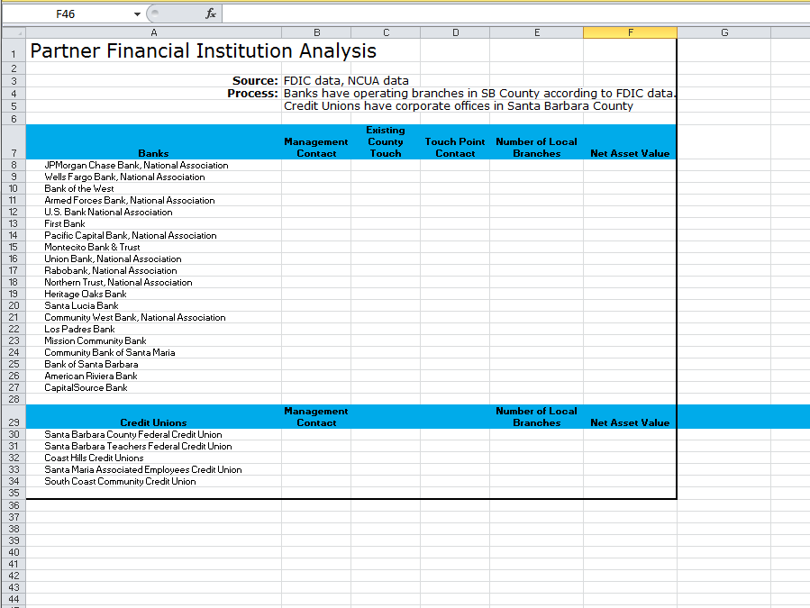
Lender Partner Analysis doc.

Slide 29
Lender Partner Analysis - elements -
Net assets
Geographic scope and saturation
Loan portfolio
Annual report
Decision-maker
Internal champion
Set meeting schedule

Slide 30
Step 4. Lender Meetings
Develop open dialogue on how the loss reserve will benefit the lender:
Provides partial risk coverage to lenders
Uses much of their current underwriting criteria
Fits in their current product offerings
Increases exposure to greater client base
Provides cross-sell opportunities for other lending products
Rides the “green wave”
Notes:
The tone set during the meeting is a congenial conversation, one of providing information and answering questions. Lenders generally feel at ease as they can ask about details without revealing their interests to potential competitors as would be the case during a pre-bid meeting with other interested bidders present.

Slide 31
Step 4. Lender Meetings (cont.)
While at the same time achieving your goals:
Lowers interest rate
Lengthens loan tenor
Allows larger unsecured loans
Reduces required credit score
Increases debt-to-income ratio
Increases or eliminates loan-to-value ratio
Lowers required customer capital contribution

Slide 32
Lender Meeting - elements -
Provide information, answer questions
The Lender will want to know how much reporting will be expected—margins are small on these loans.
Determine the other partners in the Program and how they will assist in its success

Slide 33
Step 5. Request for Proposals (“RFP”)
Modify existing Request for Proposals document, supplied by DOE, to meet municipality’s requirements and format.
DOE TA can review and edit RFP, as needed, to facilitate favorable response by potential lenders and pique their interest and their creativity.

Slide 34
RFP

Slide 35
RFP - text -
4.2 Risk-Sharing Formula
The risk-sharing formula will have two main parameters:
The first parameter is the ratio of the LRF funds to the total original principal amount of Loans in the EE Loan portfolio. Presently, we are thinking this will be 5%, which is the same as a leverage ratio of 20:1.
The second parameter in the risk-sharing formula is the share of losses that the LRF will pay. We anticipate this will be less than 100%, which implies that a portion of the loss will be borne by the FI and covered from its normal loss-provisioning. Because all losses after the LRF is exhausted will be borne by the FI, FI incentives for good Loan origination, administration, and recoveries will be maintained. Both of these parameters are to be proposed by the FI and will be defined in the final agreements among WECC, the FI, and the City.

Slide 36
Step 6. Bidders Conference
Formal presentation with question and answer period for potential lenders
Present modified Lender slide show
Post questions and answers on website

Slide 37
Bidders’ Conference slide show
Notes:
Can also be used for

Slide 38
Concept Proposal for Lender

Slide 39
Bidders Conference - elements
Provide information & answer questions for those unable to schedule individual Lender meetings
Expect that participants will be more guarded
Questions and answers are formal and will be published on the municipality’s web page

Slide 40
Step 7. Lender Selection
Read and evaluate lender proposals
Complete score sheets from RFP
Evaluate scoring elements and compare proposals
Pose further questions to proposers, as needed
Select lender for further negotiations
Notes:
TA will review the proposals then advise the selection committee regarding evaluation and lender selection.

Slide 41
Proposer Scoring Sheet

Slide 42
Actual Results
Credit Score | Term | Rate
680 or above | up to 72 months | 4.49%
 | 86 – 180 months | 4.74%
679 – 640 | up to 72 months | 5.99%
 | 86 - 180 months | 6.24%
639 – 601 | up to 72 months | 7.49%
 | 86 - 180 months | 7.74%
600 and below | up to 180 months | 8.74%

Slide 43
Step 8. Negotiate Financing Facility and Prepare Implementing Agreements
Come to final clarification on financing elements, based on lender’s proposal:
Loan Elements
Loan Projections
Milestones
Risk-Sharing Formula
Account Structure
Disposition of Funds
Notes:
Assist the County in ensuring that all arrangements adhere to all applicable state and federal regulations concerning EECBGs. Coordinate with County counsel.

Slide 44
Loan Loss Reserve Agreement

Slide 45
Loan Loss Reserve Agreement - text -
Article I
Definitions. The following terms shall have meanings as defined:
. . .
“Loan(s)” shall be a loan(s) made by KCU for the purposes of financing Eligible Projects, using a form Loan agreement developed by KCU and approved by the Municipalities, and that meets the Terms, Conditions, and Underwriting Criteria in Annex B and the Project Eligibility Design Criteria in Annex C.
“Loss Amount” shall mean unpaid principal on a Charge-off Loan and shall not include any accrued interest.
“Loss Reserve Percentage” shall equal 5%of the principal amount of a Loan, as applied in Section 3.02, except as otherwise noted in Annex H.
“Loss Share Percentage” shall equal 90% (ninety percent) as applied in Section 3.04.

Slide 46
Loan Loss Reserve Agreement - elements -
Risk-Sharing Formula?
Ratio of (A) LRF funds to (B) total original principal amount of Loans in portfolio.
Share of first losses that LRF will pay, e.g., 90%
Loan Elements?
Eligible borrowers
Eligible Projects
Loan application
Loan terms
Interest rate
Payment schedule
Loan size

Slide 47
Loan Loss Reserve Agreement elements (cont.)
Underwriting guidelines & security
Secured and/or unsecured?
Loan-to-value ratios ?
Borrower contribution?
Personal contribution?
utility rebates or incentives
other rebates and incentives
estimated energy cost-savings
UCC-1?

Slide 48
Loan Loss Reserve Agreement elements (cont.)
Definition of Escrow Account?
Definition of the Reserve Account?
Definition of Loss & Event of Loss?
Interest on both the LRF and Deposit Accounts?
Disposition of loan loss reserve funds at end of Loan period?
Program Fees?
Reprogramming Funds in the Escrow/Reflow Accounts?

Slide 49
Program Agreement

Slide 50
Program Agreement - elements -
Record-keeping
Contact Persons
Training
Marketing Roles
Process for Loan Approval
Loan Closing and Disbursement

Slide 51
Financial Stakeholder Engagement Process: Steps Reviewed
Step 1. Financial Program Design
Step 2. Obtain Internal Agency Support
Step 3. Lender Partner Analysis
Step 4. Lender Meetings
Step 5. Request for Proposals
Step 6. Bidders Conference
Step 7. Lender Selection
Step 8. Negotiate Financing Facility
and Prepare Implementing Agreements

Slide 52
Thank You
Dan Clarkson
206.310.8733
dclarkson@eefinance.net
www.eefinance.net
The following link contains earlier versions of the RFP and the
Loan Loss Reserve Agreement: http://www2.eere.energy.gov/wip/solutioncenter/pdfs/revFinal_V3Ch15SixAttachmentsDec9.pdf
The Clean Energy Finance Guide (“Playbook”):
http://www2.eere.energy.gov/wip/solutioncenter/financialproducts/default.html

Slide 53
Presenter: Shannon-Ellis Brock
Shannon is the Vice President of Marketing and Business Development at Puget Sound Cooperative Credit Union (PSCCU). She has been with PSCCU since 2008, has worked at Credit Unions for over 25 years and is committed to the Credit Union philosophy of “People Helping People”.

Slide 54
Sustainable Partnerships
Presented by:
Shannon Ellis-Brock
VP Business Development
PSCCU

Slide 55
Relationships
PSCCU was established in 1934 to serve employees in the utility field.
Strong ties with our original sponsor group Puget Sound Energy
PSCCU participates in energy fairs and belongs to trade groups such as Home Performance Washington and Efficiency First. These organizations exist to promote the “greener good” when it comes to energy efficiency.
Partnerships with SustainableWorks and Snohomish County who are ARRA grant recipients.
Strong working relationships with local contractors.

Slide 56
Existing & Expanded Program(s)
ARRA funds allowed for lowered interest rates and extended loan terms.
Our relationship with one of the largest utilities in Washington State lead to a pilot program which allowed us to expand our EE Loan program.
Conversations with local groups and trade associations lead to weatherization loan programs, solar financing and Jumbo EE loan options that include discounts for made in WA solar products.
Willingness to adapt – flexibility to create programs to fill needs within the communities in which we serve.

Slide 57
Size – it makes a difference
PSCCU by most standards is a small Credit Union. We are just over 50M in assets and have just over 5000 members.
Our smaller size allows us the flexibility to respond quickly to trends and react to the needs of our target markets.
The chain of command is fairly simple, and it’s easy to get ideas heard by the correct person.
For a small institution like ours, these EE loans make a big difference.
Over the last 18 months, EE loans have become the fastest growing segment of our loan portfolio.
Added work – yes. Added reward – definitely.

Slide 58
Sustainability
Ongoing Commitment.
LRF (Loan Loss Reserve Fund) used as an enhancement, PSCCU shares in the potential losses.
As loans are paid and the monies flow back into the lending pool, we can continue the cycle of lending, indefinitely.

Slide 59
Philosophy
Legacy –
Reputation –
Commitment –
Education –
Making a difference -

Slide 60
Rates & Terms (with LRF)
Credit Score | Term | Rate (fixed)
680 or Higher | Up to 72 months | 4.49%
 | 73 – 180 months | 4.74%
679 - 640 | Up to 72 months | 5.99%
 | 73 -180 months | 6.24%
639 - 601 | Up to 72 months | 7.49%
 | 73 – 180 months | 7.74%
600 | Up to 180 months | 8.74%
Our partnership with SustainableWorks (an AARA grant recipient) prompted us to lower rates and extend terms for all EE loans, with the lowest rates being for loan programs backed by the LRF.

Slide 61
Target Market
Who is your target market?
Does your potential financial institution partner target the same market – are they willing to adapt.
Residential / Commercial.
How can you and the financial institution support each others marketing goals and out reach to the target communities?

Slide 62
Mutual Benefits
Long term relationships that benefit all parties involved.
Shared marketing.
Increased exposure.
How will this relationship benefit the ARRA recipient, the lender, the borrower, the community?

Slide 63
Success
Increased member base.
Well secured loans with low delinquency rate.
Expanded relationships with contractors, utilities and local municipalities.
Over a Million Dollars per Quarter in EE loans.
How will success be measured and reported?

Slide 64
Thank you – feel free to contact me if you have any questions.
Shannon Ellis-Brock
Puget Sound Cooperative Credit Union | PSCCU
shannone@psccu.org | 425-456-2686

Slide 65
Presenter: Todd Conkey
Todd has over 20 years of banking experience and is the Energy Finance Development Director for Wisconsin Energy Conservation Corporation (WECC). Todd’s responsibilities include researching and developing energy efficiency and renewables financing models. He is also charged with finding additional revenue streams within efficiency, capacity and carbon markets.

Slide 66
Engaging Financial Institution Partners
Best Practices and Lessons
from the Field
Presented by
Todd Conkey
Energy Finance Development Director
WECC
Notes:
Todd Conkey has over 20 years of banking experience and is the Energy Finance Development Director for Wisconsin Energy Conservation Corporation. Todd’s responsibilities include researching and developing energy efficiency and renewables financing models. He is also charged with finding additional revenue streams within efficiency, capacity and carbon markets. Thanks for being here Todd.

Slide 67
Foundation
Understand marketplace for program
Cohesive or fragmented
Research possible partners
www.fdic.gov and www.ncua.gov
Partner websites

Slide 68
Blocking and Tackling
Before initial outreach
Develop telephone pitch
Create email with attachment
Develop follow-up strategies

Slide 69
Talking Points for Attachment
Background
Summary of program goals
Provide additional sources
Other successful programs
Credit enhancement concept
Loan Loss Reserve
Set expectations: 5% reserve, 80-90% secondary loss
Graph of structure
Finance Institution role in program
Sustainability fees
Timelines
Contacts

Slide 70
Goals
What are they?
Uncover if you’re talking to the right person
Face-to-face meeting with the right people
Decision makers: Chief Credit Officer, Marketing Head, President
Not branch manager or loan officer
Verbal commitment to participate in RFP

Slide 71
Face-to-Face
Handouts
Perception of program
Guide them as stakeholders
Market leaders
What’s in it for them?
Attraction, retention, PR, partnership
Tell them want you want (in a nice way)
Lower rates, extended tenors, unsecured credit, loosened underwriting given enhancement

Slide 72
Banker Perspective
They understand loan loss reserves
It’s an expense and the percentage is up
You need to understand it also
Regulators and capital ratios
Cash flow lending is king right now
Source of repayment
Real estate values will not drive loan origination

Slide 73
Hurdles and Solutions-Residential
Hurdle | Solution
Home values | Unsecured credit, no appraisal, UCC-1 secured by personal property
FICO scores | Lower Debt-to-Income, shorter length of employment, project benefits
Credit is tight | This is a big add-on to reserves already being allocated
Bank or Credit Union | Credit Unions were more receptive
High reserve | Negotiate step-downs if portfolio performance dictates it
High shared loss percentage | Negotiate based on FICO scores
Energy knowledge | KISS, financial benefits to customer

Slide 74
Hurdles and Solutions- Non-Residential
Hurdle | Solution
Property values | Create cash flow positive program
Transaction appetite versus relationship banking | Program design that leans on relationship banking
Cash flow | Improved Net Operating Income improves cash flow and collateral value
Finance Institution willingness to participate | Create demand in market
Struggling banks | Partner with leaders, new deposits
Limited financial expertise within program | Partner with TAP, lean on other grantees, consider hiring expertise
Volume | Partner with CDFI, SBA providers, centers of influence

Slide 75
Outcome in Wisconsin
Residential Results
Interest rates cut in half (4.75% and 5.50%)
Term tripled up to 15 years
Unsecured up to $15,000
FICO is a part, but not a driver
5% LLR, 20:1 leverage
Commercial Design
Debt Service Reserve Fund (12 months P&I, project specific, all inclusive to Finance Institutions) and PACE financed by Finance Institutions holding first lien/relationship
Relationship driven structure, but estimate 7:1 leverage

Slide 76
Thank You! Contact Information
tconkey@weccusa.org
608.249.9322 x123

Slide 77
Questions?
Thank You!
This webinar will be available online at the DOE Solution Center in ~1-2 weeks:
http://www1.eere.energy.gov/wip/solutioncenter/

