Slide 1
DOE Technical Assistance Program
Introduction to the Residential Retrofit Program Design Guide
May 3, 2011, 2-3:30 pm EST
Nikki Kuhn, VEIC
Richard Faesy, Energy Futures Group
Andy Meyer, Efficiency Maine
Notes:
Speaker introductions

Slide 2

What is TAP?
DOE’s Technical Assistance Program (TAP) supports the Energy Efficiency and Conservation Block Grant Program (EECBG) and the State Energy Program (SEP) by providing state, local, and tribal officials the tools and resources needed to implement successful and sustainable clean energy programs.

Slide 3
How Can TAP Help You?
TAP offers:
One-on-one assistance
Extensive online resource library, including:
  Webinars
  Events calendar
  TAP Blog
  Best practices and project resources
Facilitation of peer exchange
On topics including:
State and local capacity building
Energy efficiency and renewable energy technologies
Program design and implementation
Financing
Performance contracting

Slide 4
Provider Network Resources
State and Local Capacity Building | Trainings Workshops Peer-to-peer matching
Technical | Renewable energy siting and development Review of technical specs for RFPs Strategic planning, energy management, and conservation strategies Green building technologies Building codes
Program Design and Implementation | Policy and program development Coordinating rate-payer funded dollars with ARRA projects and programs Sustainable community and building design State and regional EE and RE assessments and planning EE and RE portfolio program design elements
Financial | Program design support and guidance on financing mechanisms such as: Revolving loan funds (RLFs) Property-assessed clean energy (PACE) Loan loss reserves and enhanced credit mechanisms
Performance Contracting | Designing and implementing a performance contract Leveraging private investment Reducing institutional barriers Tracking and comparing programs

Slide 5







Who We Are
Program Design & Implementation/
Technical Assistance Team

Slide 6
Overview
Why a Residential Retrofit Program Design Guide (Design Guide)
Introduce elements of the Design Guide
  Assess, Plan, Implement, Evaluate
When/where to find the Design Guide
Case Study: Efficiency Maine’s Home Energy Savings Program
Q&A

Slide 7
Purpose of the Design Guide
Audience
  Retrofit program administrators
  State, local, utilities, local energy alliances…
Set the context for what to consider when planning a new (or evaluating existing) Residential Retrofit program.
  What questions to ask/investigate
  Where to find your workforce
  How to administer
  How to launch
  Ways to market
  Incorporating evaluation

Slide 8
Design Guide Content Introduction
Follows the essential elements of energy efficiency program design:
  ASSESS the existing community and market conditions
  PLAN around what conditions dictate
  IMPLEMENT your program, either as fully launched or pilot
  EVALUATE your progress and results along various criteria
PLAN
IMPLEMENT
EVALUATE
ASSESS

Slide 9

ASSESS
Important to understand program’s parameters and environment in which it will operate
  Characterize the market
  Identify exiting Programs & Leveraging Opportunities
  Assess Existing Contractor Resources

Slide 10
ASSESS
Characterize the market:
  Demographics: How many households? Low income? Renters vs. owners?
  Climate: Is it a heating climate, cooling climate, or both?
  Housing stock: How many different building types? Single family vs. small multi-family vs. large multi-family? Age? Common characteristics?
  Consumption by fuel type: What is the average consumption by fuel type, housing type? For heating or cooling (or both)?
  Major end use equipment: What type of heating equipment is used (furnaces, boilers, heat pumps, electric resistance)? Central air conditioners vs. room air conditioners? Domestic water heater fuel and type of equipment? Major electric end uses?
  Utilities and Rates: Are there different utilities? Gas and electric? What are their rates and rate structures?

Slide 11

ASSESS
Identify Existing Programs & Leveraging Opportunities
  Utilities
  Municipal Programs/Initiatives
  State
  Federal
    DOE’s Weatherization Assistance Program (WAP)
    EPA’s Home Performance with Energy Star (HPwES)
    Other possible federal initiatives? (ex: Home Star)
    Home Energy Labeling/Rating Programs (ex: Home Energy Score)
  Renewables and Energy Efficiency
  Financing Options

Slide 12


ASSESS
Assess Existing Contractor Infrastructure
  Certified Contractors & Building Professionals (ex. BPI and RESNET)
  Auditors
  Dominant Retrofit Players
    HVAC Contractors
    WAP subcontractors
    Envelope Contractors
      Air Sealers
      Insulation
        Siding
        Remodelers
        Windows, etc.
    Look for contractors that are certified (ex: BPI, RESNET)
    Pay attention to geographic coverage

Slide 13

PLAN
Plan should clearly identify what program aims to do, how it will do it, and how it will measure success.
  Identify Program Goals
  Identify Program Barriers
  Develop Program Design

Slide 14
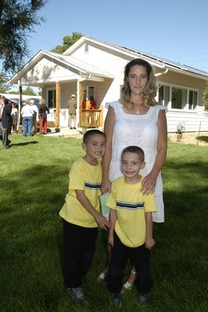
PLAN
Identify Program Goals
  Energy Savings
  Sustainability (post ARRA)
  Carbon Reduction
  Market Transformation
  Jobs
  Etc.

Slide 15
PLAN
Identify Program Barriers
  Demand: Lack of demand usually comes from lack of awareness and lack of financial capacity
    Pay attention to Marketing – both for program administration as well as implementation (contractors)
    Ensure design promotes efficiency gains customers will notice
    Split incentive issues (aka “the landlord-tenant conundrum)

Slide 16
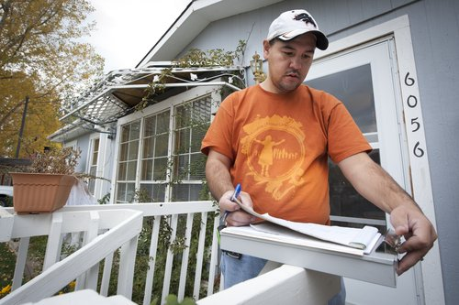
PLAN
Identify Program Barriers (con’t):
  Supply: Must be adequate supply of workforce
    Technical capability of installer market
    Building science understanding of contractors
    Contractor sales skills
    Available training infrastructure

Slide 17
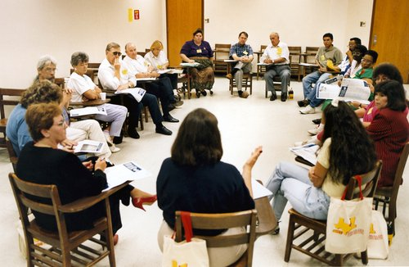
PLAN
Plan Program Design
  Seek expert advice
  Enlist local stakeholders
  Identify and secure resources
    Funding
    Financing
    Personnel, Administrative, Other

Slide 18
PLAN
Plan Program Infrastructure
  Consider your options for administrative models
    All in-house
    In-house administration overseeing implementation contractor
    Efficiency utility model
  Plan Service Delivery Infrastructure
    Direct employees
    Sub-contractors
    Some combination of the two
  Determine the implications of In-House or Out-Sourced Services

Slide 19
PLAN
Plan for a Quality Assurance Process
  Develop certification/accreditation requirements
Develop a Training & Monitoring Plan
Procure Program Staffing Resources
Develop RFP, Hire Contractors
Develop Job Descriptions and Hire
Develop Auditing and Reporting Tools
  XML Data Transfer Protocol
Provide Access to/Incentives for Building Diagnostics Equipment

Slide 20
PLAN
Develop Marketing Plan, Materials and Infrastructure
  Ability to target high savings opportunities
  Ability to quickly react to market conditions
  Contractor sales materials, approaches and training
Develop Quality Assurance/Quality Control Processes
  Contractor oversight
  Customer feedback mechanisms
  Continuous improvement systems
Develop a Call Center
  Consider coordinating with other programs
  Properly train call center staff

Slide 21
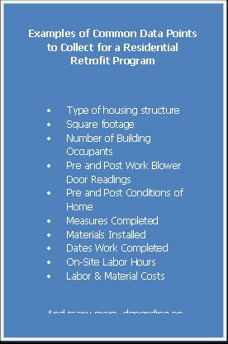
PLAN
Develop Incentive Infrastructure
  Encourage comprehensiveness
  Include all participant classes
  Consider ability to assign customer incentives to contractors
Develop IT (M&V) System
  Integrated system from first call to final inspection
  Automatic reports: For reporting to funding sources and effective program management

Slide 22
IMPLEMENT
Be fully ready for business before opening the doors!
Consider a focused pilot with clear boundaries
Identify and utilize quality work practice guidelines (for example: DOE’s Workforce Guidelines, state WAP technical manuals)
Focus on reducing hassles (for customers & contractors)
Focus on the highest savings opportunities
Support M&V system through IT services
Identify and carry out research and development projects
Offer continuous support to contractors

Slide 23
EVALUATE
Determine who is responsible for evaluation
Develop an evaluation schedule
Develop savings verification process
Develop and implement an RFP to select evaluation contactor(s)
Ensure feedback loops through annual program design process
Links to webinars on Solution Center:
  http://www1.eere.energy.gov/wip/solutioncenter/

Slide 24
Case Study:
Efficiency Maine’s (Better Building Grantee)
Home Energy Savings Program

Slide 25
Residential Weatherization
Program Design Case Study
Notes:
May 3 webinar on the Residential Retrofit Design Guide Overview. Nikki Kuhn and I would welcome your participation and think that you could offer a good deal as our featured Better Buildings grantee.
We suggest that the 1.5 hour webinar be structured as follows:
Introductions and overview (3 min)
TAP overview (2 min)
Design Guide – Nikki and I will introduce it at a high level, per the attached slides (45 min)
Case study on designing, building and running a residential retrofit program – Andy (20 min)
Q&A – (20 min)

Slide 26
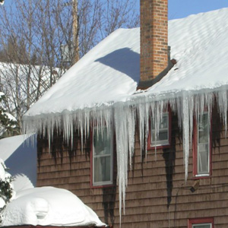

Background
Residential weatherization
Market-based
  Homeowner rebates <$3k
  Average job $10k
BPI-audit based
25% energy savings goal
Started 1/1/10
Initially SEP-ARRA funded
Using Better Buildings to fund financing
Paralleled DOE Design Guide Model

Slide 27
DOE Design Guide Model
PLAN
IMPLEMENT
EVALUATE
ASSESS
Notes:
Beauty of the DOE model is it is a never ending loop
Despite our despite our success so far, we’re still evolving rapidly

Slide 28

DOE Step 1 - Assess
US EPA Home Performance w/ ENERGY STAR
NEEP (peer groups)
Focus Groups
Contractor events
Tradeshows
Advisory Board
Call Center Monitoring
Secret shoppers
In-home shadowing
Our own homes
Notes:
It’s amazing what you find when you assess the existing program
hobbyist auditors don’t return homeowner calls (so we ranked locator by # of jobs),
busy Advisors don’t’ return calls (so we gave them comment fields on our Locator),
call center gives wrong answers,
installers pee in sinks/spit tobacco on floors (so we created Code of Conduct)

Slide 29
DOE Step 2 - Plan
Triennial Plan
  All Efficiency Maine Programs
  Dunsky Energy Consulting
Program Goals
    Goal = 25% savings on 4,000 homes
  Modify homeowner expectations
  Strengthen home performance industry
Original Program Design
  RFP for program design and implementation
  Conservation Services Group

Slide 30
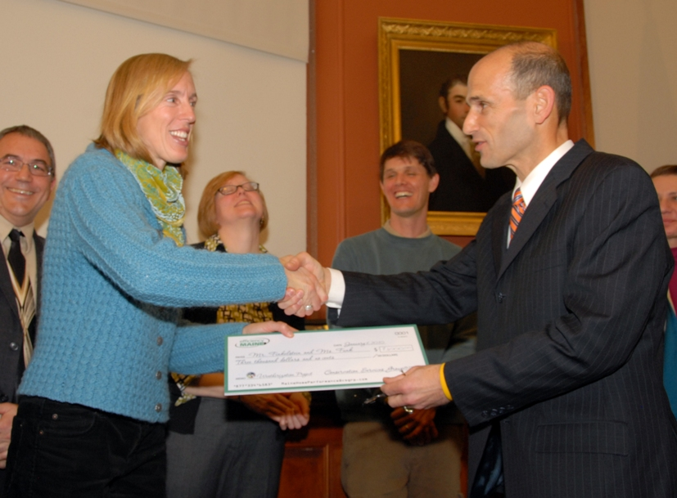
DOE Step 3 - Implement
Initial
Trade Association pre-launch
1 month pilot – smoothed some “kinks”
Governor’s kickoff with program “grads”
75 upgrades completed in 1st 6 months
Summer promo / campaign
Notes:
- had we not re-assessed, we’d still be at a 150 home/year

Slide 31
DOE Step 4 - Evaluate
Weekly reporting
Weekly call center monitoring
Monthly Advisory Board
  External stakeholders
Quarterly Management Reviews
  Delivery team management team
  Marketing vendor management team
  Efficiency Maine management
DOE Technical Assistance Program “Checkup”
3rd Party EM&V (soon)

Slide 32
Sample report
Notes:
- slow start prompted a summer-only promotion
- spiked demand past capacity so extended to year end
- installs exceeded submitted paperwork
- 1,000 jobs submitted in last 2 weeks

Slide 33

Lessons learned – Observe the WHOLE Value Chain
Target audience
Message
Channel
Advertising/PR
Call center
Web
Energy Advisors
  “Auditors/Contractors”
Confirmation letters
Rebate payment
Notes:
- we didn’t ID the “last hurrah” segment until our 3rd quarter
- message morphed from “get cash back for wx” to “home comfort, paid for by energy savings”

Slide 34
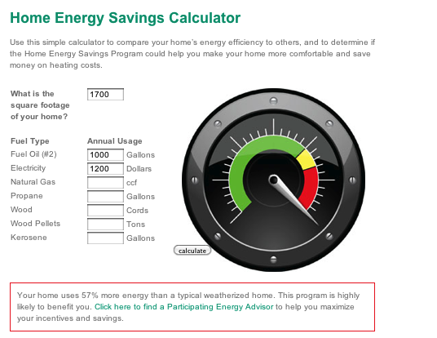
Listen Hard &
Steal Shamelessly
Notes:
- homeowners weren’t willing to shell out $500 for an audit without some assurance they were likely to save $ (stalemate)
- took calculator from a utility, similar to HPwES?

Slide 35
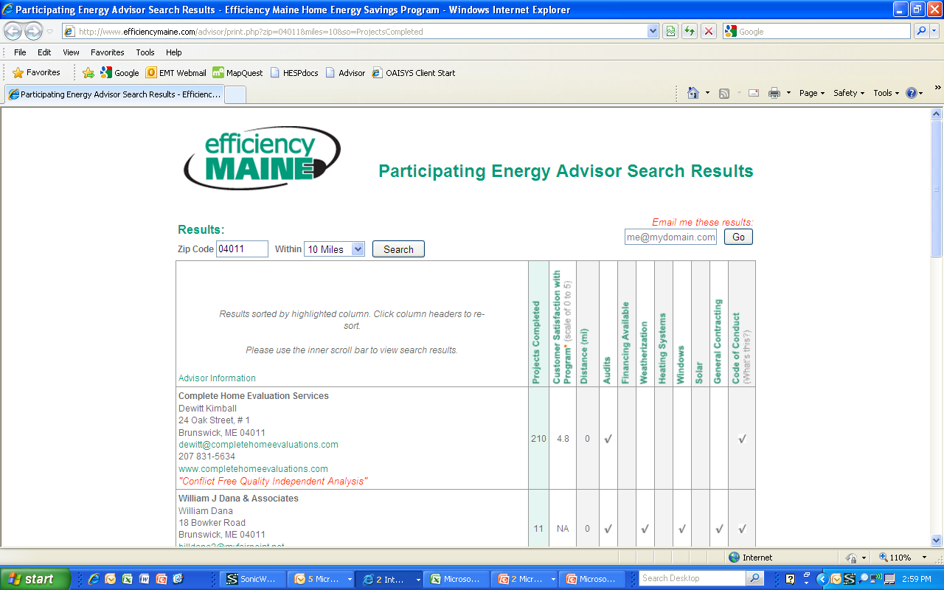
Listen Hard &
Re-re-innovate
Notes:
- focus group showed that homeowners didn’t trust contractors
- we posted a pdf of BPI-certified energy advisors
- sorted by # of jobs (default) differentiates pro’s from hobbyists
- customer satisfaction rating (sortable) differentiates good from bad
- comment field for busy Advisors
- we copied Efficiency Maine’s Business Program Locator, then Maine State Housing Authority’s, then innovated

Slide 36
Sales Training Helps
Notes:
- along with several other initiatives, we did sales training in Aug & Sept
- % of audits resulting in upgrades went from ~20% to over 60%
- we went from 40 reported whole home energy upgrades in 2 yrs to 1,688 homes in 1st full year (192% of goal)
- 36% average heating savings

Slide 37
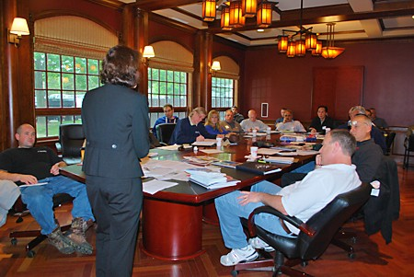
Advisory Boards can help
Top performing contractors,
Top performing auditors,
Oil dealers,
Community college
Homeowners,
Peer utility, and
Local advocacy group

Slide 38
DOE Design Guide Model Works
PLAN
IMPLEMENT
EVALUATE
ASSESS
Notes:
Beauty of the DOE model is it is a never ending loop
Despite our despite our success so far, we’re still evolving rapidly

Slide 39
Resources
Driving Demand for Home Energy Improvements: can be found at http://eetd.lbl.gov/EA/emp/reports/lbnl-3960e-web.pdf).
Design Guide: Coming soon to Solution Center at http://www1.eere.energy.gov/wip/solutioncenter/
Efficiency Maine’s Home Energy Savings Program at http://www.efficiencymaine.com/at-home/hesp_program
DOE’s Workforce Guidelines at http://www1.eere.energy.gov/wip/retrofit_guidelines_overview.html

Slide 40
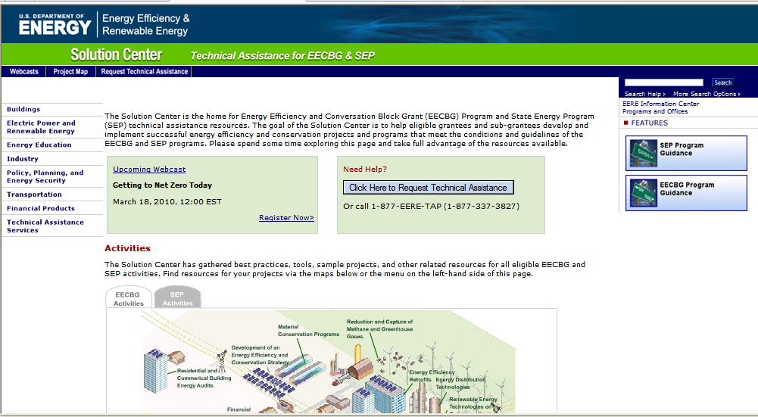
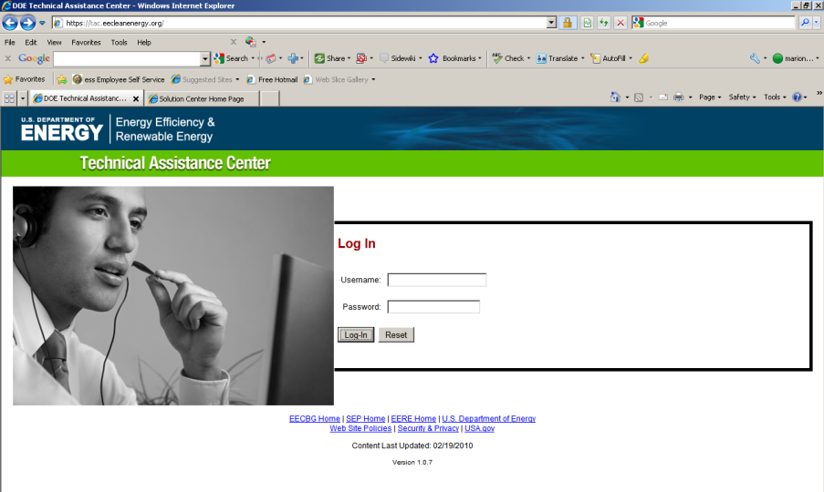
Accessing TAP Resources
We encourage you to:
1) Explore our online resources via the Solution Center
2) Submit a request via the Technical Assistance Center
3) Ask questions via our call center at 1-877-337-3827 or email us at solutioncenter@ee.doe.gov

Slide 41
Upcoming Webinars
Please join us again:
Leveraging Partnerships with Faith-Based Organizations
Date: May 17, 2011
Time: 2:00-3:00 EDT
Traffic Synchronization and Management for Energy Savings
Date: May 18, 2011
Time: 12:00-1:00 EDT
Using Social Media to Engage the Community in Energy Efficiency Projects
Date: May 26, 2011
Time: 1:00-2:30 EDT
Policies and Procedures for Enhancing Code Compliance
Date: May 31, 2011
Time: 2:00-3:00
For the most up-to-date information and registration links, please visit the Solution Center webcast page at www.wip.energy.gov/solutioncenter/webcasts

Slide 42
Questions?
CONTACTS
VEIC: Dan Quinlan, dquinlan@veic.org, 802-488-7677 (Team Lead)
MEEA: Steve Kismohr, skismohr@mwalliance.org, 312-784-7257
NEEP: Ed Londergan, elondergan@neep.org, 781-860-9177
NEEA: Elaine Blatt, eblatt@nwalliance.org, 503-688-5458
SWEEP: Curtis Framel, cframel@swenergy.org, 303-447-0078
SEEA: Scott Slusher, scott@seealliance.org, 480-239-4236
ACEEE: Eric Mackres, emackres@aceee.org, 202-507-4038
NRDC: Lara Ettenson, lettenson@nrdc.org, 415-875-6100
EFG: Richard Faesy, rfaesy@energyfuturesgroup.com, 802-482-5001

Slide 43
Thank you!
Richard Faesy, rfaesy@energyfuturesgroup.com
(802) 482-5001
Nikki Kuhn, nkuhn@veic.org
(802) 488-7812
Andy Meyer, andy.meyer@efficiencymaine.com
(207) 287-6466

