Slide 1
DOE Technical Assistance Program
Interactions between Energy Efficiency Programs Funded Under the Recovery Act and Utility Customer-Funded Energy Efficiency Programs
April 28, 2011
Charles Goldman, Ian Hoffman, Elizabeth Stuart
Lawrence Berkeley National Lab
Notes:
Before we jump into today’s presentations I would like to take a
few moments to describe the DOE Technical Assistance Program
(TAP). TAP is managed by a team in DOE’s
Weatherization and Intergovernmental Program - Office of
Energy Efficiency and Renewable Energy.

Slide 2
What is TAP?
DOE’s Technical Assistance Program (TAP) supports the Energy Efficiency and Conservation Block Grant Program (EECBG) and the State Energy Program (SEP) by providing state, local, and tribal officials the tools and resources needed to implement successful and sustainable clean energy programs.
Notes:
The Department of Energy’s (DOE) Technical Assistance Program (TAP) provides
state, local, and tribal officials the tools and resources needed to implement successful
and sustainable clean energy programs. This effort is aimed at:
Accelerating the implementation of Recovery Act projects and programs,
Improving their performance,
Increasing the return on and sustainability of Recovery Act investments, and
Building protracted clean energy capacity at the state, local, and tribal level.
From one-on-one assistance, to an extensive online resource library, to facilitation of
peer exchange of best practices and lessons learned—TAP offers a wide range of
resources to serve the needs of state, local and tribal officials and their staff.

Slide 3
How Can TAP Help You?
TAP offers:
One-on-one assistance
Extensive online resource library, including:
Webinars
Events calendar
TAP Blog
Best practices and project resources
Facilitation of peer exchange
On topics including:
Energy efficiency and renewable energy technologies
Program design and implementation
Financing
Performance contracting
State and local capacity building
Notes:
These technical assistance providers can provide short-term, unbiased expertise in:
Energy efficiency and renewable energy technologies
Program design and implementation
Financing
Performance contracting
State and local capacity building
In addition to providing one-on-one assistance, we are available to work with
grantees at no cost to facilitate peer-to-peer matching, workshops, and trainings.

Slide 4
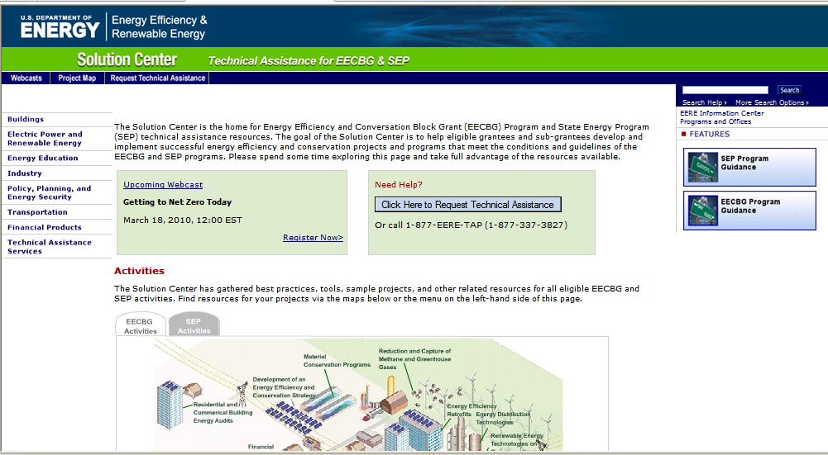
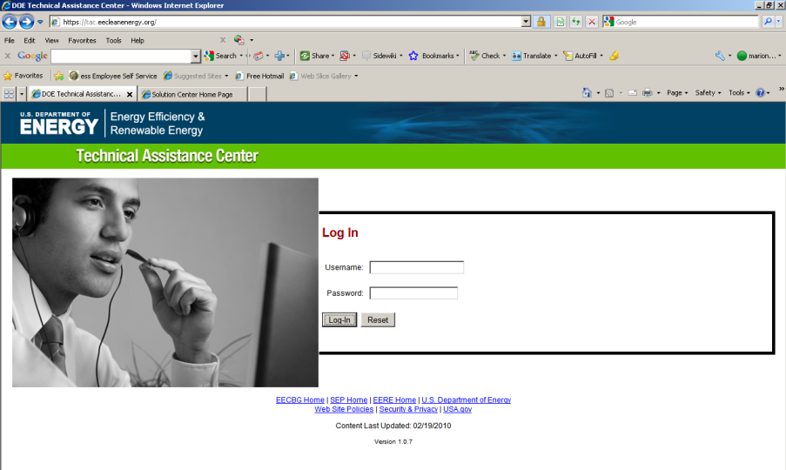
Accessing TAP Resources
We encourage you to:
1) Explore our online resources via the Solution Center
2) Submit a request via the Technical Assistance Center
3) Ask questions via our call center at 1-877-337-3827 or email us at solutioncenter@ee.doe.gov
Notes:
Requests for direct assistance can be submitted online via the
Technical Assistance Center (https://tac.eecleanenergy.org/) or by
calling 1-877-EERE-TAP (1-877-337-3827). Once a request has been
submitted it will be evaluated to determine the level and type of
assistance TAP will provide.

Slide 5
The TAP Blog
Access the TAP Blog! http://www.eereblogs.energy.gov/tap/
Provides a platform for state, local, and tribal government officials and DOE’s network of technical and programmatic experts to connect and share best practices on a variety of topics.
Notes:
We also encourage you to utilize the TAP Blog, a platform that allows
states, cities, counties, and tribes to connect with technical and
program experts and share best practices.
The Blog is frequently updated with Energy Efficiency or Renewable Energy
Related posts. We encourage you to utilize the blog to ask
questions of our topical experts, share your success stories, best
practices or lessons learned, and interact with your peers.

Slide 6
Upcoming Webinars
Please join us again on upcoming webinars:
Residential Retrofit Program Design Guide Overview
Host: TAP Team 4 - VEIC
Date: May 3, 2011
Time: 2:00 – 3:30 EDT
For the most up-to-date information and registration links, please visit the Solution Center webcast page at www.wip.energy.gov/solutioncenter/webcasts

Slide 7
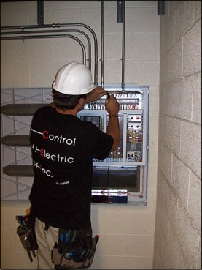
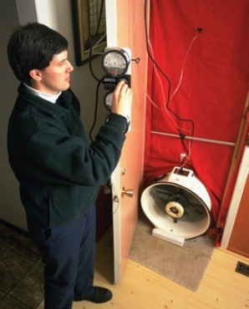
Interactions between Energy Efficiency Programs Funded under the Recovery Act and Utility Customer-Funded Energy Efficiency Programs
Lawrence Berkeley National Laboratory
Charles A. Goldman, Elizabeth Stuart, Ian Hoffman,
Merrian C. Fuller and Megan A. Billingsley
March 2011
Notes:
This report was sponsored by the Department of Energy’s Office of Energy Efficiency and Renewable Energy, Weatherization and Intergovernmental Program and the Office of Electricity Delivery and Energy Reliability.
Why this study?
The Recovery Act provided billions of dollars to state energy offices and local governments to fund energy efficiency, renewable and other energy-related projects and programs. Primary objectives were short-term job creation and significant energy savings, with an emphasis on shovel ready projects where available. Other objectives include using ARRA to jumpstart sustained efforts that outlast the ARRA performance period. Our study looks at how state energy offices chose to allocate those funds and how those programs interacted with existing utility customer-funded programs.
We examine these choices and interactions for insights into an emerging and increasingly complex world of multiple program administrators and funding sources. Our research suggests the Recovery Act experience has clear implications for the future of U.S. energy efficiency.
We use the term utility customer-funded programs for ratepayer-funded energy efficiency programs

Slide 8
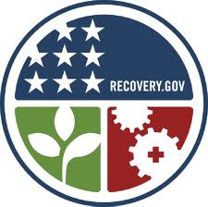
Outline
Study Approach
Overview of utility customer-funded and Recovery Act-funded energy efficiency programs
Results of analysis in 12 case study states
Case study examples
Recommendations

Slide 9
Research Questions
How have the administrators of these two sources of EE program funds interacted?
What impacts did these two types of program administrators have on planning & design of one another’s programs?
To what extent has the attribution of energy savings been a critical issue?
What implications might these interactions have for the future of energy efficiency?
Notes:
Here are our four major research questions
(read the bullet points).
A primary consideration for the future is – what is the potential for the Recovery Act and these interactions to have impact beyond the 3-year funding period?
Learning from these interactions may provide insight into what kinds of policies might help sustain impacts from the Recovery Act.
The Recovery Act experience might also suggest effective roles that the various stakeholders can play in the long term – entities such as local and state government, utility customer program administrators, other community and regional organizations.

Slide 10
Study Approach
Focus on the SEP, EECBG and SEEARP programs - $6.6B total
Most to be spent in 3 years (by September 2012)
Not included:
DOE low-income Weatherization Assistance Program
EECBG funding awarded directly to over 2,200 cities, counties and tribes
Competitive EECBG funding (e.g., Better Buildings grants)
Focus on program design and funding choices made by state energy offices in 12 case study states
California, Colorado, Florida, Hawaii, Maine, Massachusetts, Michigan, Minnesota, New York, North Carolina, Oregon and Wisconsin
Interviews with more than 80 energy efficiency actors
Notes:
The Recovery Act allocated $6.6 Billion to 3 programs for energy efficiency, renewable and other activities - SEP, EECBG, SEEARP.
In the case of state-administered programs, most of the funds will be expended in 3 years – by September 2012. In addition, the Recovery Act provided $5B for low-income weatherization.
We focus on the State Energy Program (SEP) formula grants , Energy Efficiency and Conservation Block Grant (EECBG) funds administered directly by state energy offices, State Energy Efficient Appliance Rebate Program (SEEARP).
These are statewide programs, administered by state energy offices (SEOs) that resulted in thousands of new EE programs across the nation with significant potential for interaction with utility customer-funded programs.
Our study did not include the recovery act funded low-income weatherization program, EECBG funding that went directly to cities, counties and tribes, or the BetterBuildings program.
Our report provides a 50-state overview, then focuses on 12 case study states that had a significant level of utility customer funded programs and offered potential for a range of interactions.
We chose the 12 case study states based on criteria which included:
Level of utility customer funding for EE programs
Diversity of program administrator models
Geographic diversity
The 12 states represent something of a cross-section of states with significant utility customer funding – including a few that are ramping up or recently ramped up due to new programs (Michigan) or due to new higher targets in 2008 and 2009 (Colorado, North Carolina) – plus other states with a long history of offering these programs -- CA, NY, MA, MN, OR

Slide 11
Overview of Utility Customer-funded and Recovery Act-funded Energy Efficiency Programs

Slide 12
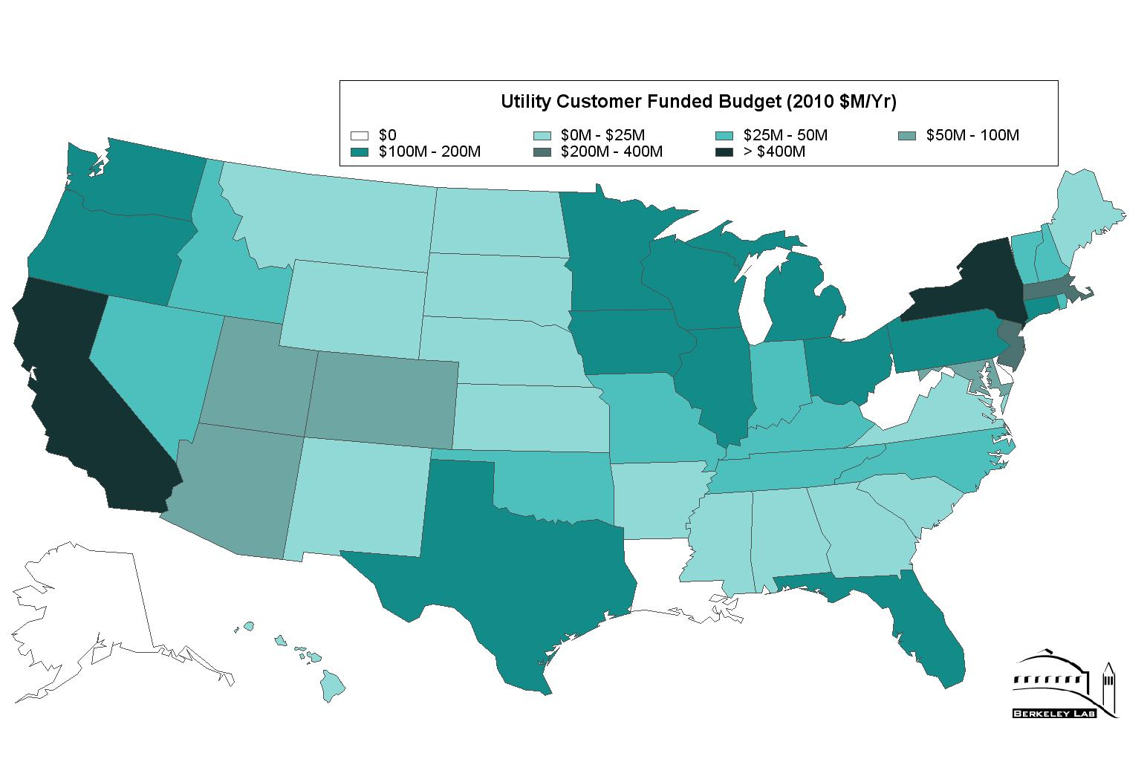
Utility Customer Funding Nationally (2010 - 2020)
2010 Utility Customer-Funded Budget
Total $5.5B
Empty text box for covering
2020 Utility Customer-Funded Budget
Estimate $7.5B - $12.4B
Empty text box for one
Empty text box for own
Notes:
These maps show trends for the estimated long-term increase in budgets of utility customer-funded programs.
Nearly all states have at least one utility or other program administrator that offers energy efficiency programs. This map on the left shows the funding levels and we can see that commitment levels vary.
The 2010 energy efficiency budgets total $5.5 billion which includes $747 million targeted to low-income customers.
Utilities administer these energy efficiency programs in ~30 states; third parties or state agencies administer utility customer-funded programs in 9 states.
15 states have consistently spent more than 1% of annual utility revenues on energy efficiency over the last decade, although commitment levels vary significantly among states.
A growing number of states –are adopting legally binding EERS, which means those states will be making long-term commitments to funding energy efficiency. 24 states have passed EERS and 4 more states are considering them. Typically the energy savings targets are based on annual or cumulative targets.
Taking a look at the map on the right, we see results of a 2009 LBNL study which estimated budget growth for utility customer funded programs under several scenarios. The estimate for 2020 spending is $7.5B for the medium scenario and $12.4B for the high scenario.
Current ‘leaders’ (e.g., California, New York) continue to increase efforts. A much broader array of states that are newer to energy efficiency will continue to grow program funding significantly – especially in the Southwest and parts of the Midwest.
ARRA represented a significant infusion of funds on the EE landscape over 3 years – and will have proportionally more impact in states with little or no utility customer-funded EE.
A key potential benefit to the ARRA funding is that it has been allocated irrespective of existing state EE regulatory or legislative policies. While SEO budgets will return to pre-ARRA levels – ARRA has placed them in the position of being able to contribute to the EE landscape with increased capacity and knowledge.
For the case studies, we focused on states with significant utility customer funding in order to provide ample possibility of interactions with existing programs, so they don’t represent states that are just starting to ramp up. However several of our case study states have programs that have been implemented or ramped up in recent years. We look at the landscape of utility customer-funded programs in these states in order to gain insight into the unique contexts in which each of the state energy offices formulated their Recovery Act programs.

Slide 13
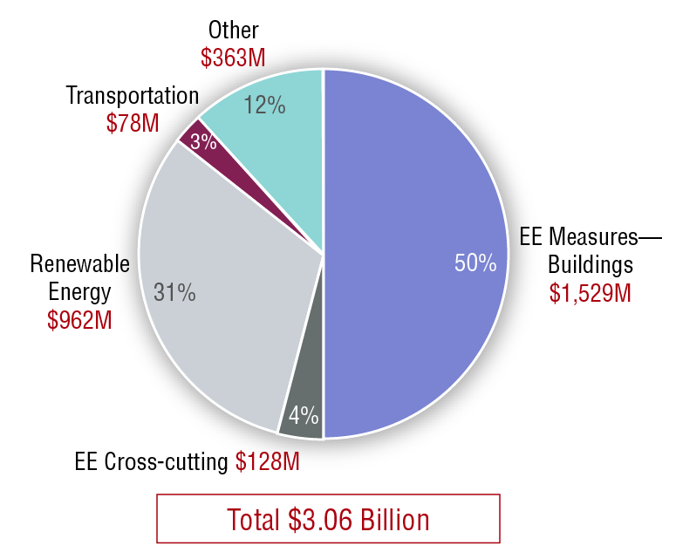
State Energy Program Budgets - National Trends
Notes:
The Recovery Act provided $3.1 billion for DOE’s State Energy Program (SEP) – which is to be expended in 3 years.
Here we see a breakdown of the SEP budget across the 50 states and 5 territories. To compile this information we looked at the applications to DOE and we updated the information from our interviews.
This information was a moving target. During the time that we were doing the interviews and research for this report, programs were changing - some were cancelled, new ones were being created and budget allocations were shifting. So this data represents a snapshot in time, current as of September, 2010.
Looking at SEP allocations by sector, we see that energy efficiency measures and equipment in buildings total $1.53 billion – that’s HALF of the total SEP budget. These activities include: Audits, retrofits, retro-commissioning, industrial processes, technical assistance for performance contracting and revolving loan funds.
Renewable energy programs made up 31% of SEP budgets – these often augmented popular existing programs by providing additional rebates or bridging funding periods.
The 12% allocated to other activities supports such things as climate action plans, transmission reliability, recycling and green procurement programs.
The bottom slice in the pie - Energy efficiency cross-cutting programs - total $128 million and include: Building energy codes, energy efficiency workforce development, technical assistance, education and outreach, marketing, databases and sharing of best practices.

Slide 14
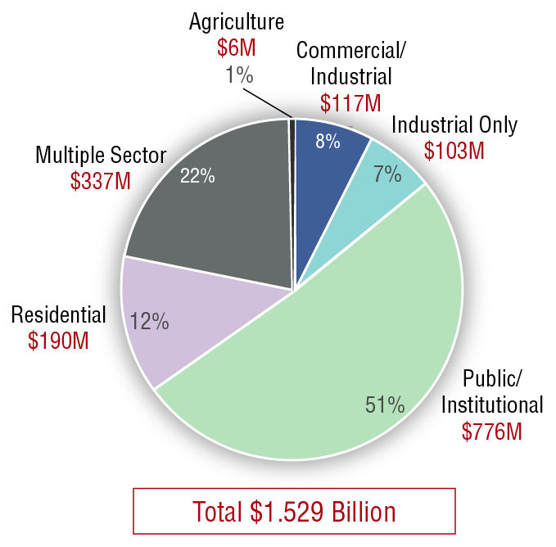
SEP Funding for EE in Buildings
SEP energy efficiency funding ($ million) for buildings by market sector for 50 states, five territories and the District of Columbia
36 states budgeted $775M in programs targeted to public/institutional buildings
Multiple sector programs can include just C/I or all sectors
Notes:
Now we’ll take a look at which sectors these programs are targeting. More than half of the funding for energy efficiency in buildings is going to the public and institutional sector.
We should note that most of the EECBG funds that state energy offices passed through to smaller communities also went to public and institutional sector building retrofits.
Some of the multiple sector programs are open to the full spectrum of C/I customers (i.e., small commercial, large commercial, industrial, nonprofit and public/institutional buildings) while others specifically target a subset of the commercial/industrial sector. Some programs are offered across all sectors -- including residential, commercial and institutional.

Slide 15
Programs with Lasting Impacts
Financing programs have the potential to provide longevity, and flexibility and leverages
Revolving Loan Programs (RLF)
More than $650 million
Loan Loss Reserves (LLR)
More than $20 million
Workforce training & development
Codes and standards
Notes:
Now we’ll take a look at four program areas that may offer longer-term impact – Revolving loan funds, loan loss reserve funds, workforce training & development and energy codes and standards. We’ll talk about some of these in more detail in the next few slides.
Much of the Recovery Act funding will be spent relatively quickly on one-time projects such as building energy retrofits, creating the intended economic stimulus and meeting the DOE’s goals of focusing on shovel-ready energy-saving projects. But these four programmatic activities have the potential for sustained or ongoing benefits.
Revolving loan funds leverage recovery act money for the long term; they also provide flexibility over time because state energy office program administrators can repurpose those funds in the future as long as they meet recovery act guidelines. If these funds are managed to maximize longevity, they could, in theory, last forever.

Slide 16
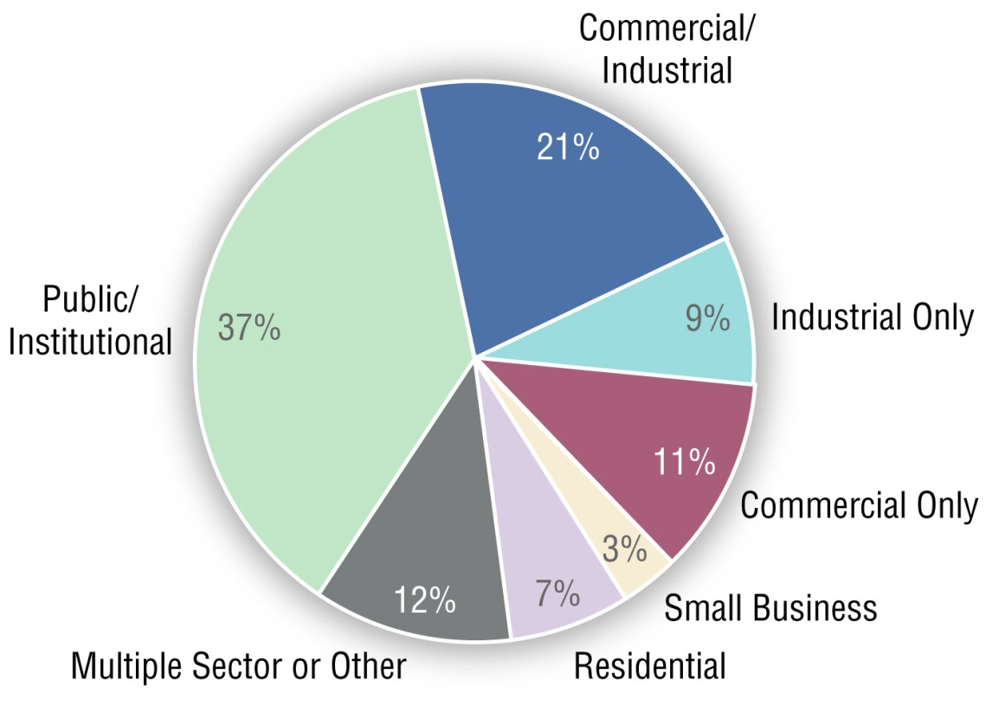
Revolving Loan Funds
Target Sectors for ARRA-funded RLFs
Thirty-five states have established 51 RLFs with over $650 million in ARRA funds:
Quick to set up, which met federal requirements for commitment of Recovery Act funds by 2010
44% for and industrial, commercial, and small business
37% for public/institutional markets
Only 7% targeted at the residential market
Notes:
We estimate that about 35 states and dozens of local governments used recovery act grants as seed money for revolving loan funds (RLFs) or loan loss reserves (LLRs) totaling over 650 million dollars.
A revolving loan fund is a pool of capital that is loaned out, and when the capital is returned by the borrower it is loaned out again for a new project. The fund gets replenished by principal payments and interest and it is only depleted by loan defaults and administrative expenses for the fund.
These RLFs are typically targeted toward specific markets or customer groups such as public sector buildings, commercial sector buildings, industrial facilities, single family and multifamily residential. Each of these different markets has very different financing needs. You can see the market breakdown here.
Across the 50 states, the largest single category for revolving loan funds is public and institutional facilities, with 37% of the $650 million. Commercial and industrial markets account for about 41% of the total loan funds, with smaller amounts going to industrial-only or commercial-only programs.
Nearly 80% of these revolving loan funds target the combined commercial/industrial/institutional sector – equivalent to the commercial/industrial market under the utility customer-funded programs.
State energy office program administrators have the flexibility to change priorities with these loan funds as needed. For example, public buildings often have access to lower cost capital and there are a relatively limited number of these buildings. If administrators decide that the financing needs of public/institutional facilities are largely being met, then they can choose to refocus lending in harder-to-reach markets such as small business or residential. They can also change the terms of the program. For example, they may see a need among “riskier” residential customers who cannot access other financing. In that case, administrators could choose to re-focus their lending on this segment and potentially accept higher loss rates and longer terms in order to reach these underserved markets.
The longevity of these funds means that coordination with utility customer programs can continue over time, and the terms and target markets can be adapted to best complement the programs offered by utility customer program administrators.

Slide 17
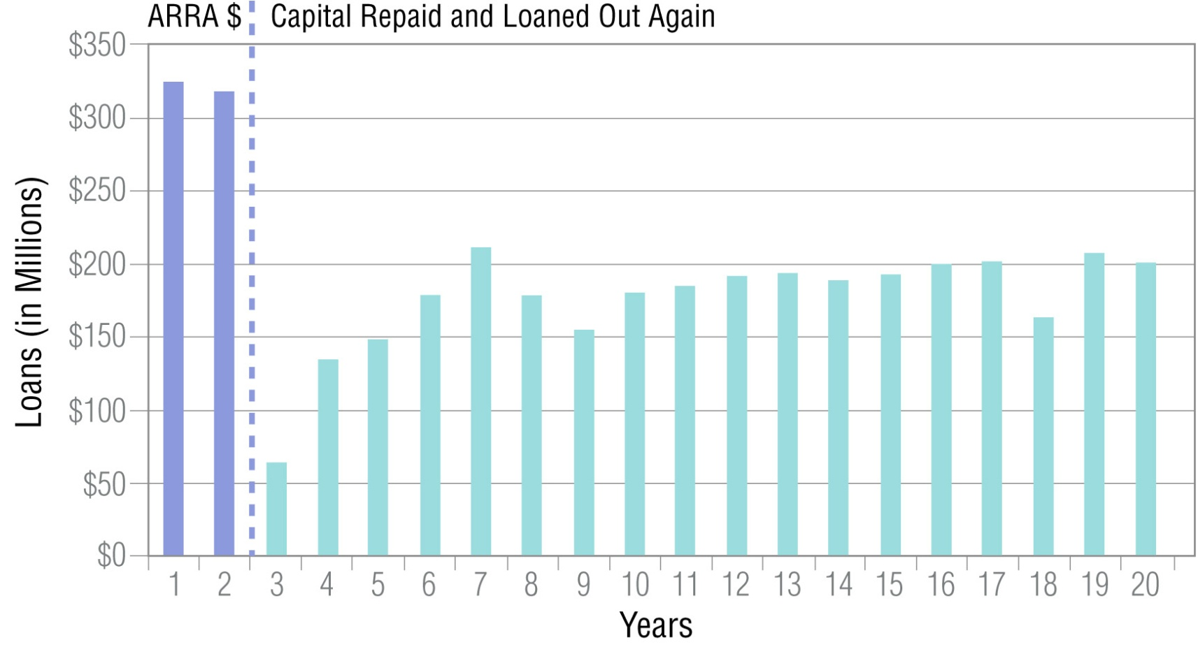
Longevity of Revolving Loan Funds
LBNL estimates that RLFs could finance $150-200 million per year of energy efficiency projects over the next 20 years.
Notes:
We analyzed the potential long-term impact of RLFs over 20 years by doing a cash flow analysis using an excel-based model. In our “base case” we treated the $650 million in RLF capital as a single fund and made a number of assumptions based on typical interest rates, average loan terms, default rates and other data we observed in existing RLFs – in order to develop a rough estimate of capital that could be loaned out for future energy efficiency projects:
On this chart we see that in years 1 and 2 of the RLF lending, only the initial fund amount will be circulating; then after the first loans start getting paid back, funds will be able to be recirculated.
With these assumptions, over $3.8 billion would be loaned out over 20 years – that’s 5.9 times the initial investment of $650 million in nominal terms (not present value). State energy offices that administer and manage these RLF would be able to finance $150 to 200 million of energy efficiency projects annually over the next 20 years.
Note that the amount of loan capital available over 20 years is very sensitive to the loan term – the shorter the term, the faster the money recirculates.

Slide 18
Loan Loss Reserve Funds
At least 7 states and local governments also created loan loss reserves (LLRs):
More than $20 million to support lending for energy efficiency projects
Loan loss reserve funds will not have the longevity of RLFs but provide significant immediate leverage of private funds
Utility customer-funded programs may want to consider similar financing programs once they have been “tested” with ARRA funds
Notes:
At least seven states set aside over $20 million dollars to fund loan loss reserve funds to support other financing for energy efficiency.
Like RLFs, loan loss reserve funds extend the benefit of an initial investment, but in a very different way than RLFs. LLRs don’t have the longevity of revolving loan funds but they offer a quick boost to the amount of capital available. They provide short-term leverage by attracting in private capital because the funds are used to allay some of the risk to the lender.
Utility customer-funded programs may want to consider similar financing programs – incorporating lessons learned from the recovery act programs.
Here’s an example of how a loan loss reserve fund is used for leverage. If a lender agrees to a 5% Loan loss reserve, the lender can provide 20 times the initial funds available to lend on projects – so a LLR of $1 million would support $20 million in lending of private capital. The 5% represents the amount of risk of loss that the public entity is taking on – it also indicates the multiplier of the leverage.
We are seeing ARRA-funded loan loss reserve programs with percentages in the 5-10% and higher range. The higher the percentage, the lower the risk of loss to the lender.
Given the uncertainty about the size and terms of recovery act-funded LLRs and the actual loss rates, we can’t accurately estimate the total amount of funds that will ultimately be available for lending.

Slide 19
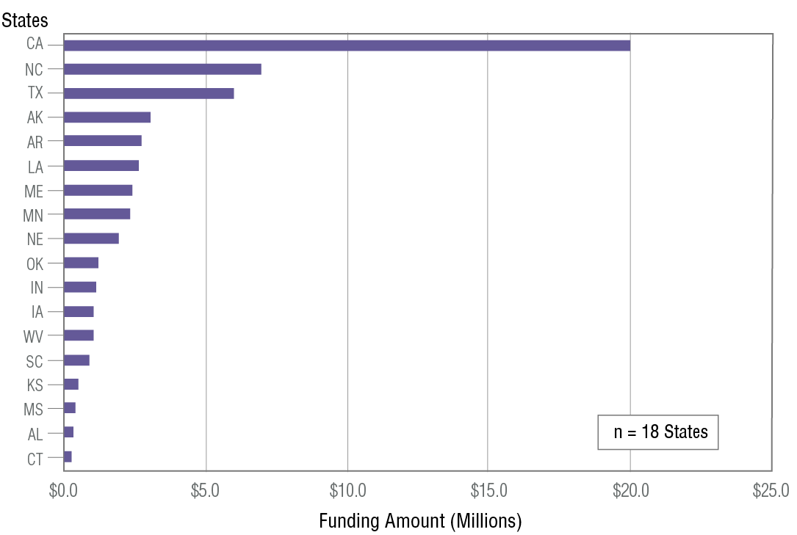
Workforce Training and Development
Spending on Workforce Training and Development by State
18 states invested over $54 million in workforce development and training for the energy efficiency services sector and renewable energy industry
Significant potential for spillover benefits for utility customer-funded programs
Notes:
Investment in workforce development is another area that has potential for longer term impacts on utility customer-funded EE programs.
Eighteen states used over $54 million in SEP funds to create energy efficiency and/or renewable energy workforce development programs of various types.
Four states comprised over 65% of this spending: CA ($20 million), NC ($8 million), TX ($6 million), and AK ($3 million).
Many of these programs involve partnerships with one or more organizations including other state agencies, community colleges, industry, labor, utilities and workforce development boards.
Activities include contractor training for residential energy assessments and upgrades, scholarships for people seeking certifications, and grants to programs and newly certified auditors for purchase of assessment equipment such as blower doors.
Several states that are newcomers to energy efficiency are spending notable amounts on workforce development. For example, Arkansas is spending almost $3 million to build Training Centers of Excellence and Nebraska is spending almost $2 million to develop renewable energy curriculum at community colleges.
These efforts can support the goals of utility customer-funded EE programs beyond the recovery act funding period. Especially in those states that are ramping up their utility customer energy efficiency programs, this early support for training professionals and contractors may help pave the way for program expansion.
And now I’ll turn it over to Ian Hoffman who will talk about the qualitative findings from our case study states.

Slide 20
Program Diversity, Exploration & Interaction in the States

Slide 21
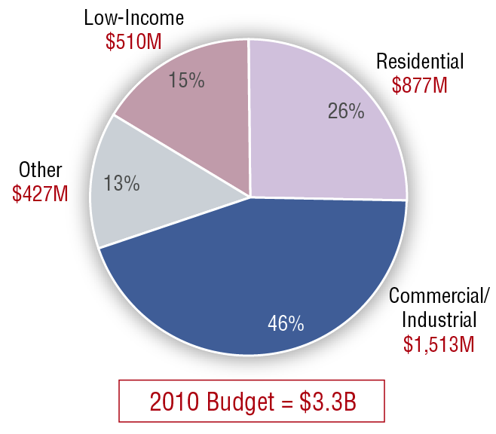
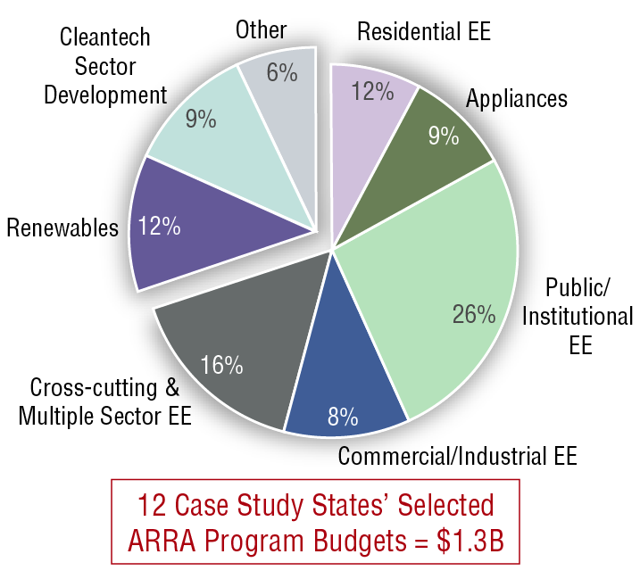
Budgets for 12 Case Study States
Utility Customer Program Budgets in Case Study States by Sector – 1 year
Selected ARRA Budgets in Case Study States by Sector – 3 years
Notes:
The Recovery Act presented states with an unprecedented opportunity. Before ARRA, ALL states and territories together received a few tens of millions of dollars. Now they had 20 times as much. In these 12 states alone, about $400M.
Overnight, SEOs have gone from being modest contributors on the energy efficiency stage to major actors, and they have a lot of things they’ve want to do. Layered on top are demands unique to the state – energy policies, some from the legislature, some from the governor. They have existing energy efficiency programs to consider, and there are economic needs that vary from sector to sector.
These factors play out in state investment decisions. A few states invested all of their money in two or three programs that targeted one or two sectors. But the majority of our case study states assembled diverse portfolios that cover virtually every sector of the economy.
On the left we see a breakdown of the 2010 utility customer-funded budget for EE by market sector for the 12 case study states.
On the right we see a breakdown of how the same states allocated the ARRA grants we’re interested in (SEP, EECBG funds administered by SEOs and SEEARP) from 2009 to early 2012.
On left, we see that Residential and Low-Income programs are 41% and Commercial/Industrial programs are 46%. To the right on the ARRA funded side, residential AND appliance programs are 21% - about half. ARRA- and utility customer-funded budgets for commercial and industrial programs are similar, but ratepayer-program investments in public-sector buildings are modest compared to the 26% of budgets in the ARRA-funded programs. These are schools, state and local government buildings. Those are on lists that SEOs keep – the shovel ready projects envisioned for Recovery Act funding.

Slide 22
Innovation in Markets & Technologies
States targeted efficiency programs towards new markets, technologies, and geographic regions:
New Sectors | New Geographic Areas | New Program Actors | New Technologies & Policies
HI (hospitality) NY, NC (nonprofits) HI, ME (transit-centric planning) | CA, CO (rural areas) HI (non-IOU territory) | CA (regional entities, counties) MI (local governments) MN (cities, local government authority) NY(cities) WI (small towns) | HI (deep seawater air conditioning) ME, MA, MI (multi-fuel retrofits) NY (reprogramming utility software for on-bill financing) NC (new manufactured housing)
Notes:
With the Recovery Act, we see states venturing into territories and markets unserved or underserved by utility customer-funded programs. For example, in this first column, Maine and HI invested in transit-centric planning and zoning to encourage more people to take the bus or train or walk. CA is doing residential retrofits in rural areas, and CO has hired 19 “community energy coordinators” , people already connected in the mountains and rural areas who advise localities on designing efficiency programs and local energy plans.
HI has a feasibility study of seawater air conditioning for hotels, piping chilled water in from the ocean bottom, miles offshore.
In the NE – big oil heating regions – we see multi-fuel programs investing in shell improvements for buildings with oil heat, something that utility customer-funded programs have not been able to do.

Slide 23
Interaction and Coordination Among Program Administrators

Slide 24
Spectrum of Coordination
In the 12 case study states there was a broad spectrum of coordination between state energy office & utility customer-funded program administrators
They engaged in consultation with utility customer-program administrators but decided not to coordinate their programs
Complementary Recovery Act-funded programs were designed as enhancements, extensions or enablers of utility customer programs
Administrators tried full collaboration in designing and implementing joint programs
Communication or consultation on programs | Complementary programs | Full collaboration
FL, MN, NC, NY, WI, CA | CA, CO, FL, HI, MA, ME, MI, MN, NC, NY, OR | HI, CA, ME, MA, MN
Notes:
Here’s the core of what we were interested in – how did these two types of entities interact? The answers are all over the map and even varied within a single state – because states had multiple programs and so multiple opportunities for deciding whether to coordinate programs and how.
First, in NO state that we studied did we find ZERO coordination whatsoever. What we did find was that energy offices informed utility customer funded administrators about what they were doing. We call this communication or consultation. Sometimes the two administrators went their separate ways – standing up different programs to different markets, and sometimes the SEO offered the same sorts of programs to the same markets as the utility customer programs.
Most states, however, had at least one program that we term complementary – they are enhancements or extensions or enablers of utility customer-funded programs. A “bonus” rebate on the same appliances would be an enhancement. Adding ARRA-funded rebates to the end of an appliance rebate program funded by utility customers would be an extension. We see two flavors of these complementary program: negotiated – that is, they talked about it – and non-negotiated – they didn’t really talk about it. For instance, the Governor’s Energy Office in Colorado went out more or less on its own and put together a web portal that’s a one-stop information clearinghouse for information about utility and ARRA-funded rebates, tax credits, retrofit contractors – so information barriers, transaction costs go down and utility customer funded programs benefit – a big enabler.
Collaboration is more than just fuller coordination – we have multiple pots of money coming together for joint programs in which both parties have influence over critical design issues and work together very closely on branding, incentive setting, who does marketing and outreach, who does workforce training, where’s the financing piece. People are sorting out roles, dividing up responsibilities. Complementary programs can be joint programs, but with collaboration, we’re talking about a more hand-in-glove arrangement.
Hawaii for example delegated ARRA funds to the third-party administrator of utility customer programs for existing solar hot-water heater rebate costs, then added low-interest financing, all presented as a package to the consumer. We have more examples but let’s talk more about coordination as function of many considerations.
----------Background------------------------------------------
In CA, for example, the CEC pitched the IOUs on a joint appliance rebate program, and the utilities saw a relatively small amount of money, tied to federal requirements, and a joint program just looked like more trouble than it was worth.

Slide 25
Benefits of Coordination
Coordination between ARRA- and utility customer-program administrators offers potential benefits:
Allows administrators to leverage existing resources, infrastructure and experience
Both types of program administrators can influence program targeting, design and implementation issues to mitigate market disruption and consumer confusion
Joint programs can have a broader support base than either taxpayer or utility customer programs on their own and may increase the longevity of programs
Different administrators and funding sources can serve complementary purposes better suited to their skills and objectives
Notes:
We’re not making a value judgment or advocating that coordination was called for in all cases. Sometimes coordination – at least complementarity or collaboration – was not advantageous to the SEO or the utility customer program administrator or both. But here are some of the benefits if the barriers to coordination are overcome. The biggest is leverage: Each program administrator gets more resources toward a common goal – money and partners, but expertise, KNOWLEDGE of the market and mechanisms for delivery, whether these are trade allies of the utility customer funded programs or revolving loan funds from the SEO.
There’s an opportunity to mitigate or at least manage the potential for confusion or disruption in a market.
And there’s longevity. More players means a broader based of support for continuing programs and a better chance of ARRA-funded programs being adopted into a utility customer funded portfolio after ARRA ends. Coordination can be a path to program sustainability.
Lastly, joint programs offer at least the OPPORTUNITY for the actors to do what they do best or what other parties are constrained from doing as fully as they would like – in other words move towards natural niches in this new energy efficiency landscape.

Slide 26
Observed Divisions of Labor
Utility Customer-Funded Program Administrators
Rebates
On-bill financing
Retail vendor partnerships
Manufacturer & distributor partnerships
Marketing & outreach: State & Service Territory
Access to customer bills
EM&V
Workforce training/development
SEO ARRA-Funded Program Administrators
Credit enhancements
Loan loss reserves
Interest-rate buy downs
Revolving loan funds & other financing
Marketing & outreach: State & Local
Innovation & exploration of new or underserved markets
Workforce training/development
Notes:
We observed some interesting divisions of labor in the various approaches to coordination and/or collaboration. Here are some examples. State energy offices might have financing but not rebates. Utility customer-funded programs have rebates but often not financing. Cost-effectiveness screening for utility-customer funded programs can limit activities that are critical but have less easily quantified energy savings, such as workforce training or education of customers.
For marketing, certainly utilities know their customers – but so does the local township with an ARRA subgrant from the state.
So these are only SOME of the values that program administrators bring to decision making on the DEGREE of coordination…

Slide 27
Decision Factors for Complementarity & Collaboration
Utility Customer-Funded Program Administrators
State ARRA-Funded Program Administrators
Credit for savings?
Leverage of funds & savings
Manage market confusion
Relief from CE constraints
Narrow objectives, e.g. energy savings
Interpersonal/interagency relations
Autonomy/Compromise
Fed. requirements/uncertainty
Leverage of other funds, expertise & infrastructure
Program sustainability
Broad objectives, e.g. job creation, econ. Development
Interpersonal/interagency relations
Autonomy/Compromise
Delays in Resolving Fed. Requirements vs. Deadlines for Spending
Favors coordination Does not favor coordination Depends - Could go either way
Notes:
Here we have a PARTIAL list of those considerations. Some of these factors motivated program administrators to create complementary or collaborative programs – some did not. On the left side, we have decision factors for utility customer funded programs. On the right side we have decision factors for the states’ ARRA-funded program administrators. Remember the Conventional Wisdom charts in Newsweek? For the fuller forms of coordination, there were upsides, downsides and considerations that could cut either way. The green arrows denote positive drivers – the benefits for each party of joint programs – leverage of dollars, savings, expertise and infrastructure – an opportunity to survive the end of ARRA funding.
We also see some factors that can cut either way – the blue arrows. Joint programs can produce both energy savings and economic development, but are programs designed around a single objective likely to bring both program administrators on board? Also, relationships between agencies and individuals can matter a great deal – depending on the nature of the relationship – they can make cooperation harder or easier. It is possible to have both in the same state.
At the bottom, the red arrows indicate factors that clearly argue against joint programs: Both types of program administrators faced uncertainty over how federal requirements would apply to those programs, and the ARRA-funded program administrator also faced tight deadlines – they couldn’t wait long for clarity and for a partnership to come together. More commonly, both types of administrators faced having to compromise on their own program, of letting someone else influence the design and delivery. These generally are upfront considerations and so especially early in the ARRA grant period, it wasn’t clear the interests of these two types of program administrators were aligned.

Slide 28
Examples from the Case Studies
What did states do?

Slide 29
Hawaii: Mutual Benefits & Objectives Matter More Than Size
Hawaii State Energy Office (HSEO)
Staff: ~12
SEO wanted 3rd-party administrator expertise, delivery infrastructure
RP admin wanted to manage market impacts
Joint programs took work
Fridge recycling: >200 units/day
Solar Hot Water Heater Financing
Customer Behavioral Feedback
Notes:
Anyone who thinks they’re too small and overcommitted to manage higher forms of coordination, here’s another view. In this study, we have utilities and SEOs who decided that coordinating was too much trouble.
Some smaller states felt they had little choice but to coordinate. The utility customer-funded program administrator had capacity, experience and the infrastructure to design and administer programs.
In smaller states, these were powerful arguments for a high degree of coordination. In HI, it was collaboration across multiple programs, including some new territory for the state’s third-party administrator of utility customer-funded programs. This wasn’t easy: It took an MOU and a rewriter of the contract with that third party administrator – R.W. Beck – to enable joint programs and multiple sources of funding. So far, the results are intriguing. The new third-party administrator, R.W. Beck and the HSEO put appliance rebates together with ARRA-funded RECYCLING CENTERS. For several weeks, the largest of these centers was taking in more than 200 fridges PER DAY. The HSEO is adding low-interest financing to rebates for solar hot water heaters. The HSEO also wanted a behavioral feedback program – actually telling people how much energy they use compared to their town or neighbors so they’ll use less. Opower is the contractor, but Beck helped secure access to the necessary utility customer data. The third-party administrator is considering each of these for support by utility customer funds.

Slide 30
California: Coordination Benefits & Costs
Potentially competing mandates - statutory (CEC) vs. regulatory (IOUs) - for statewide home energy upgrade programs
Risk of two statewide programs
Redundancy, recipe for consumer confusion
ARRA programs have financing but little or no rebates
Utility programs have rebates but no financing
Now Energy Upgrade California: one brand, one-stop web portal, one clearinghouse for financing (in development)
Experience to date:
Very labor intensive
Slow – lots of moving parts
Diffuse decision making
Notes:
California presents one of the nation’s most extensive collaborations of ratepayer and taxpayer-funded programs – and the benefits could be substantial but collaboration has been difficult.
The California Energy Commission and the state’s IOUs in 2009 were developing statewide programs for residential retrofits on somewhat separate tracks, the utilities using $100 million in residential portfolio funds, and the CEC using ARRA funds to meet a new statutory mandate to administer residential and commercial retrofits. It became clear early in 2010 that there could be two, redundant programs operating in the same market, under different brands and messages, with different incentives – perfect storm for consumer confusion. The agencies and IOUs decided to collaborate, and after a great deal of work, the result is Energy Upgrade California. Now residential and commercial retrofits in multiple cities and regions are covered by the same brand (shown down at right, with the trademark), the same packages of improvements, the same base incentives – all presented to consumers through a single web portal. There’s talk of including financing choices and other features on this portal, so people can assemble a full work package – assessment to upgrade – in a single, online visit. There’s even an official EUC glossary; Everyone is supposed to speak the same language, from utility commissioners to the contractor at the kitchen table.
This level of collaboration comes at a cost. IOUs report intensive, often weekly coordinating meetings with local subgrantees to hammer out marketing and design details. The overarching structure is very large, lots of committees. Decision making is diffuse. California bears watching as a test case for full collaboration statewide, across multiple PROGRAMS, multiple players, multiple sources of money.

Slide 31
Colorado: Complementarity Through Scaled Incentives
Colorado SEO sought to boost residential efficiency market where utility customer incentives were modest
SEO created 40% cap & adjusts own incentives
Statewide system tracks all ARRA projects and sources of funding (including tax credits)
Notes:
The CO SEO (Governor’s Energy Office) had the idea of using rebates and grants where existing utility incentives were modest in order to boost the market. These include rebates for energy efficient equipment in residences and commercial buildings and for solar and wind installations).
This is the type of complementary program where the SEO and the utilities negotiated the arrangement. Together they honed the program details so all Coloradans had access to incentives and so as not to distort the market where incentives could be combined. As a result of these talks, the SEO created a cap formula so customers could get up to 40% of the equipment or measure cost, when all financial incentives – state, utility, tax credits – were combined. Under that 40% cap, the SEO’s portion of that is capped at 30% of the total allowable incentive level.
In some cases where the utility offered what the SEO assessed was a modest incentive, the SEO doubled the incentive. For example, in Denver, a typical residential insulation project costs $800 to $2,000. Xcel offers a $300 insulation rebate. In this case, the SEO also provides up to $300, adjusting as necessary not to exceed the 40% cap for combined incentives. The SEO is tracking all rebate and grant projects funded by ARRA and requires applicants to disclose all funding sources so it has the needed information to adjust ARRA grants or rebates when necessary.
In some cases where a utility rebate already hit the 40% incentive cap, the SEO offered no rebate at all.
CAG:KEEP THIS AS BACKGROUND:Important note: Customers of Xcel Energy and Black Hills are ineligible for the ARRA-funded renewable energy rebates due to existing incentives offered by the two IOUs.

Slide 32
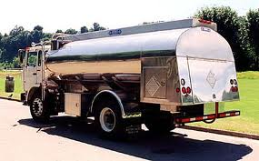
Northeast: New Multi-Fuel Programs
Maine: SEP funds envelope measures in oil-heated buildings
Massachusetts: SEP provides boiler/heater rebates for moderate income families. Local EECBG programs support thermal measures in oil-heated buildings
ARRA programs laid groundwork for future fuel oil EE programs
Developed workforce infrastructure, gained experience with new measures
Proposed legislation in both states includes new PBF for fuel oils
Maine: HP 801, LD 1066 would establish new assessment on heating fuels
Massachusetts: H00879 would establish Oil Heat and Propane Energy Efficiency Fund
Notes:
In the Northeast, we find examples of innovation – new policies – with the introduction of “fuel neutral” retrofit programs that tighten the building envelope and replace furnaces for homes relying on unregulated fuels.
About 80% of Maine’s households and 40% of Massachusetts households rely on oil for heating. Others rely on propane. In those homes, building thermal measures (e.g., insulation and air sealing) and some heating equipment replacements have not been eligible under the guidelines for electric and natural energy efficiency programs. Maine’s ARRA-funded program complements existing electric utility customer programs by introducing support for new “fuel neutral” measures, including thermal measures that save energy from unregulated, delivered fuels. Maine’s program also may be used to evaluate the feasibility of implementing a new system benefit charge on heating oil & propane to fund thermal efficiency measures and reduce dependency on fossil fuels.
In Massachusetts, the Oil Heat Council and Conservation Services Group used a $1.7 million SEP grant to administer the state’s first comprehensive oil-heat energy efficiency program. The program will provide rebates for replacing inefficient oil boilers and heaters owned by moderate income families. In addition, smaller cities and towns are using state EECBG subgrants to fund thermal measures (e.g., insulation, windows, duct sealing) in oil-heated buildings.
Legislation is now pending in both states to put a charge on these delivered fuels for energy efficiency. The ARRA-funded programs didn’t prompt these bills, as far as we know – there have been proposals in the past. But the programs provide a proof of concept and establish the infrastructure for delivering on oil-heat efficiency.
CAG: KEEP BELOW AS BACKGROUND:
Proposed legislation in Maine - HP 801, LD 1066: “An Act To Increase Home Weatherization and Energy Independence”- would establish a new assessment on heating fuels (#2 heating oil, kerosene and propane) to support Efficiency Maine Trust heating fuels efficiency and weatherization to support the Heating Fuels and Weatherization Fund, which would be used to fund weatherization programs in the state.
This legislation is being proposed in conjunction with HP436 LD 553 “An Act To Reduce Maine’s Dependence on Oil” which proposes that Efficiency Maine Trust develop a comprehensive plan to reduce Maine’s dependence on oil through myriad means including weatherization.
Proposed legislation in Massachusetts – Bill H00879 – currently in committee. Excerpt: “Section 35JJ: There shall be established and set up on the books of the commonwealth a separate fund to be known as the Oil Heat and Propane Energy Efficiency Fund.… The fund shall be administered by the oil heat and propane efficiency trust... The fund shall be an expendable trust fund and shall not be subject to appropriation or allotment.

Slide 33
Minnesota: Creative RLF Use in Industrial EE Collaboration
Commercial/Industrial Revolving Loan Fund
Trillion BTU program enlisted an experienced finance program administrator: St. Paul Port Authority
Leverages funds from largest IOU and local economic development agencies
Utility heavily subsidizes audits and engineering studies
Projects designed to create immediate positive cash flow for companies
Diverse portfolio of projects
E.g., foundries, hospitals, office towers
Notes:
In Minnesota, we find an example of a collaboration on a commercial/industrial program involving a state revolving loan fund and utility rebates. It’s called the Trillion BTU program.
The St. Paul Port Authority had some experience in financing industrial development, so the SEO gave $5 million in SEP funds to the Authority for a revolving loan fund. This financing is combined with rebates and technical assistance from the utility - Xcel Energy – and economic development partners. Businesses can get energy audits fully paid for by Xcel. If the business gives the green light, Xcel pays 75% of the cost of the engineering studies, then the program tailors a package of Xcel rebates, loans from other entities and Port Authority financing through the RLF to cover 100% of the cost of the identified energy efficiency improvements. Loan payments are structured to be less than the expected energy savings, so the projects can provide an immediate positive cash flow without the business using any of its own capital.
The program is building a diverse portfolio of projects (e.g., foundries, hospitals, large office towers), with a target of $11 million in projects. Again: Multiple players, multiple sources of money working very closely, collaborating even on the project level.

Slide 34
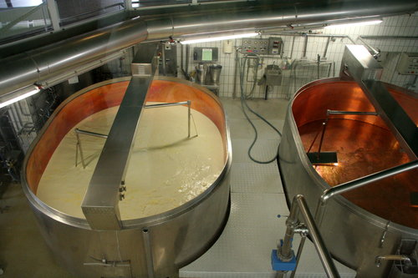
Wisconsin: Economic Stimulus Through Cleantech & Industrial Efficiency RLFs
State Office of Energy Independence sought bigger projects, more economic than energy efficiency focus
MOU with WI Department of Commerce for 3 RLFS with 2% interest rate and minimum cost share of 75%
Greater production of cleantech goods
Retooling “Rust Belt” manufacturing for cleantech
Increased energy efficiency or onsite renewable generation at factory
Example loans
PV component manufacturer & PHEV battery
maker increasing production
Auto-parts maker retooling for wind turbine parts
Cheese maker converting whey lactose into
methane for process heat
Notes:
The Midwest invested in programs to drive manufacturing efficiency or cleantech manufacturing. Wisconsin stood out – it spent 95% of its SEP funds on this alone. Focus on Energy, the umbrella name for the third-party administered efficiency programs in the state, has very robust industrial programs that are the single largest share of annual energy savings. But the former governor was interested more in transitioning toward a cleantech economy with more potential for job creation. His Office of Energy Independence wanted larger projects than Focus on Energy could offer - and more of an economic development thrust. State officials developed three RLFs aimed, respectively, at increasing production of cleantech goods or renewable energy goods; retooling existing factories for cleantech manufacturing and increasing energy efficiency and on-site renewable generation for industrial facilities. Through an MOU, the state Dept of Commerce administers the loans funds – vets the applications, makes the awards and services the loans. The rates are very low but the requirement for leverage – investment by the applying industry, financing or grants from other entities – is very high 75%.
What kind of work is WI doing here? Some legacy manufacturers are turning to cleantech. Some cleantech manufacturers are expanding. And in a state with more cows than people, there’s a lot going on with biopower and combined heat and power in the agriculture sector, making methane from waste whey at cheese plants, for example. (For those like me, who don’t know what whey is, it’s the liquid part of milk; has sugar – lactose – that can be digested into methane.
You can see from the examples that this has a lot more to do with economic objectives than with energy efficiency per se – so not necessarily a clear reason to collaborate with the utility customer-funded program administrator.

Slide 35
Implications for the Future
Challenges & Recommendations
Notes:
Pass off to Chuck Goldman, the study’s lead author.

Slide 36
Ongoing Challenges
Varying program goals
ARRA goals of job retention and creation were not aligned in some cases with utility customer-funded program primary goals of energy savings and market transformation
Short-term infusions of cash not necessarily supportive of long-term market transformation
Time and capacity limits
Tight deadlines required unprecedented ramp-up from state and federal program administrators
Uncertainty over Recovery Act statutory requirements limited coordination with utility customer-funded programs
“Fully integrated” utility/ARRA programs would need to meet all ARRA obligations
Notes:
As we’ve talked about, for some states, the ARRA goals of economic stimulus and job creation were not always aligned with the goal of energy savings.
We also heard repeatedly that these short-term, large infusions of money don’t lend themselves to more enduring changes in the market – don’t necessarily produce lasting changes in the people’s willingness to invest in energy efficiency.
Not surprisingly, ARRA required an extremely rapid increase in capacity for government entities – and delays affected decisions and actions downstream.
Likewise, uncertainty over the statutory requirements of the Recovery Act – Davis Bacon prevailing wage mandates, NEPA, historic preservation review – these tended to limit state options. The more uncertainty and the closer states got to spending deadlines, the less appetite they had for fuller forms of coordination and more comprehensive, more challenging programs.

Slide 37
Attribution of Savings & Impacts
Attribution is a critical issue for utility customer program administrators with performance incentives or Energy Efficiency Resource Standards
Some states have not settled on exactly what to report and how to attribute savings
A number of case study states have decided to give full credit for any savings achieved to the UC administrator, others have decided to give proportional, or strictly separate, the credit based on funding source/amount
More refined state and utility reporting guidance could produce consistent approaches to estimating energy savings impacts claimed by multiple program administrators
Progress toward EERS compliance by utility administrators may be accelerated by federal taxpayer dollars
Full credit of savings to UC administrator | Proportional credit of savings to UC administrator | Strict separation of ARRA & UC savings | Unresolved
CA, FL, MA, MI, MN, NC | HI, ME, WI | NY | CO, OR
Notes:
The attribution and claiming of savings from projects that utilize both Recovery Act funds and utility customer funds programs has been a big issue and the subject of intense negotiations in several states. It is most critical for administrators of utility customer-funded programs with performance incentives or in states that have adopted Energy Efficiency Resource Standards with savings targets.
SEOs have a lot at stake here too – savings credit is a key attraction for encouraging joint efforts with administrators of utility customer-funded programs – but the fact is that SEOs don’t decide this. Utility regulators do.
Regulators had a number of options.
Option 1: Allow administrators of utility-customer funded programs to claim full credit for energy savings from coordinated or joint programs. This is what we saw in half the states, generally those with a performance incentive and/or EERS. First, full credit provided incentive for coordination with the ARRA-funded administrator and the resulting leverage of ARRA funds, and second, it avoiding the extra trouble of parsing the relative contribution of utility customer funds and ARRA funds to savings through EM&V. Giving full credit to the ratepayer program administrator was the path of least resistance – The SEO was happy, the ratepayer administrator was happy, and no more work was needed.
Option 2: Negotiate partial or proportional credit for energy savings achieved by both program administrators. We saw different approaches in each of these three states. In general, regulators were inclined to provide some guidance but generally leave this up to an EM&V contractor. Last we checked, Oregon also was leaning in the direction of sorting out relative savings. What makes these states different from the others? First they’re either government agencies or third-party administrators – it’s a different administration model. They have a different relationship to regulators, and they have very modest or no performance incentives.
Option 3: Keep utility customer- and ARRA-funded rebate programs separate and distinct, avoiding attribution questions entirely; This is what we saw in New York, where NYSERDA and the utilities were engaged in an open proceeding on EERS compliance. Keeping things separate kept one issue out of contention.
Option 4: Allow administrators of utility-funded programs to receive credit for energy savings if they partner with state energy offices on ARRA-funded program and increase their overall savings targets to reflect this new situation; We saw this in no state that we examined.

Slide 38
Recommendations for Existing Programs
Track and share the performance of revolving loan fund programs that will last well beyond the ARRA time frame
Assist SEOs in retargeting RLFs on more credit-challenged markets (e.g., residential, small business).
Preserve the capacity, lessons learned, and practical know-how being developed at the state and local level
Notes:
Most revolving loan funds programs will last well beyond the ARRA performance period. It is important for DOE (and states) to track and monitor the impact of these funds over time (10-15 years). Dissemination of data about default rates, program administration costs, and appropriate interest rates will be useful in evaluating program impacts and informing program administrators and financial institutions for future financing programs. Going forward, DOE should also consider providing technical assistance to state energy offices that want to modify their RLF terms or target markets in order to focus on underserved markets that most need project finance for energy efficiency projects (e.g., residential home energy improvements, small business).

Slide 39
Recommendations for Existing Programs
Energy code updates and compliance efforts
Recovery Act energy grants came with the expectation that states would implement the latest residential and commercial energy codes
Evaluators may want to assess whether the level of SEP investment and effort in states to update their codes is consistent with meeting the Recovery Act’s requirement to adopt the latest energy codes
Notes:
As a condition of receiving Recovery Act energy grants, governors of all states committed to the secretary of energy that they would meet statutory mandates to implement the latest residential and commercial energy codes, with 90% compliance, by 2017. Use of SEP grants for those purposes has been uneven, however, and strongest in states with fairly up to date codes.
Overall, 16 states are spending $17 million of SEP funds on code development and enforcement, and an additional two states are spending an amount that is less easy to ascertain because the money for code work is not separately budgeted from SEP funds for other purposes. The majority of this SEP budgeting for code work – about two thirds – is in states that already tend to keep their codes up to date. Of the 18 states that either do not have building energy codes or whose codes are significantly outdated codes (pre-2006), only six states are spending SEP dollars on code advancement (Building Codes Assistance Project 2010). We should note that the DOE also is paying contractors from other ARRA funds to help with code implementation and compliance training in some states – about $9 million in total. But we still think evaluators should assess whether the level of investment and effort in states historically slow to update their codes is consistent with meeting the Recovery Act’s requirement to adopt the latest energy codes and achieve 90% enforcement by 2017.
--------------------------------------------------
Current model energy codes mandated by ARRA: 2009 International Energy Conservation Code (IECC) for homes and the ANSI/ASHRAE/IESNA Standard 90.1-2004 or 90.1-2007 for commercial buildings.
It’s important to note that states also received about $9 million in additional ARRA funding for code adoption, training and compliance through program initiatives funded by DOE’s Building Technologies Program. 24 states received a total of $7.3 million for the Adoption, Training and Compliance Solicitation, 5 states received funding for compliance pilots ($750,000 total) and 15 states shared a total of $1 million for BCAP’s Compliance Assessments.

Slide 40
Recommendations for Future Programs
Funding for innovative EE pilots by states, localities
Utility customer-funded programs are bound by cost effectiveness, regulations, the aversion of shareholders to certain activities and risks
With SEP funding, states piloted programs in unserved or underserved markets and explored new technologies
Continued support could establish SEOs as innovators, testing out new programs for adoption into utility customer-funded portfolios
Resource-efficient loading order at the project level
A “loading order” that encourages or requires customers to implement cost-effective efficiency measures prior to installing renewable energy systems should be evaluated as a best practice
Notes:
In several states, we heard enthusiasm from regulators and administrators for utility customer-funded programs about the more creative things that SEOs were doing. In HI, the SEO wanted to benchmark hotels and state office buildings for energy use. One regulator in HI said: “We never would go out benchmarking commercial buildings. It’s just not cost effective. But I’ll take that data, and I’ll go after those buildings for retrofits…Now I’ll know where they are.”
Innovation and exploration are niches that SEOs can fill – things that utilities are reluctant to do for a variety of reasons: It’s not cost effective or the savings are uncertain. It’s untested or perceived as risky. With the SEP funds, some SEOs have shown that they can serve as incubators or administrators of program pilots. We think the role warrants encouragement in the future, possibly through competitive grant support. If successful, SEOs could develop a pipeline of new or improved program concepts or designs or uses of emerging technologies – into the program portfolios funded by utility customers.

Slide 41
Contact:
Charles Goldman
Lawrence Berkeley National Laboratory
cagoldman@lbl.gov
510 486-4637
URL: http://eetd.lbl.gov/ea/emp/emp-pubsall.html

