Slide 1
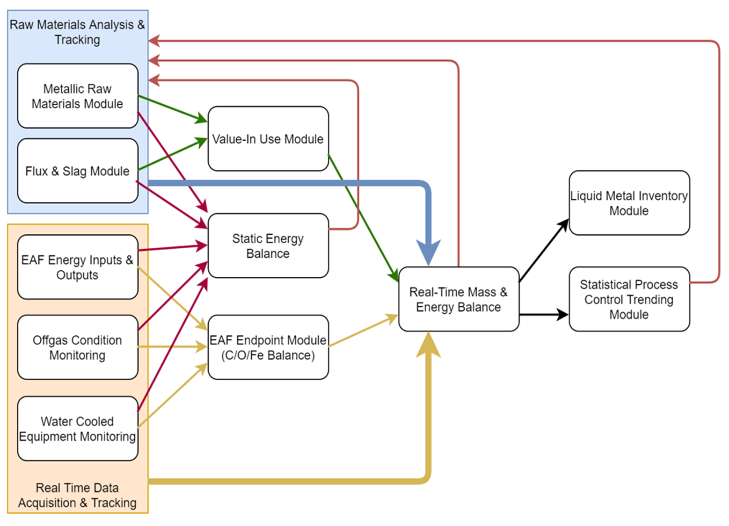
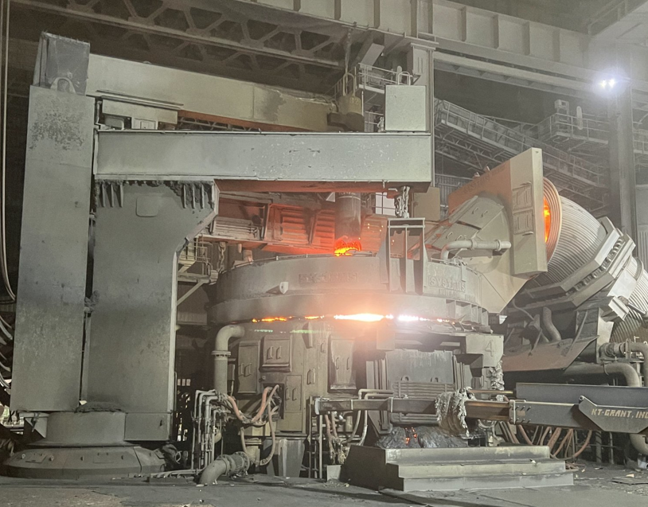
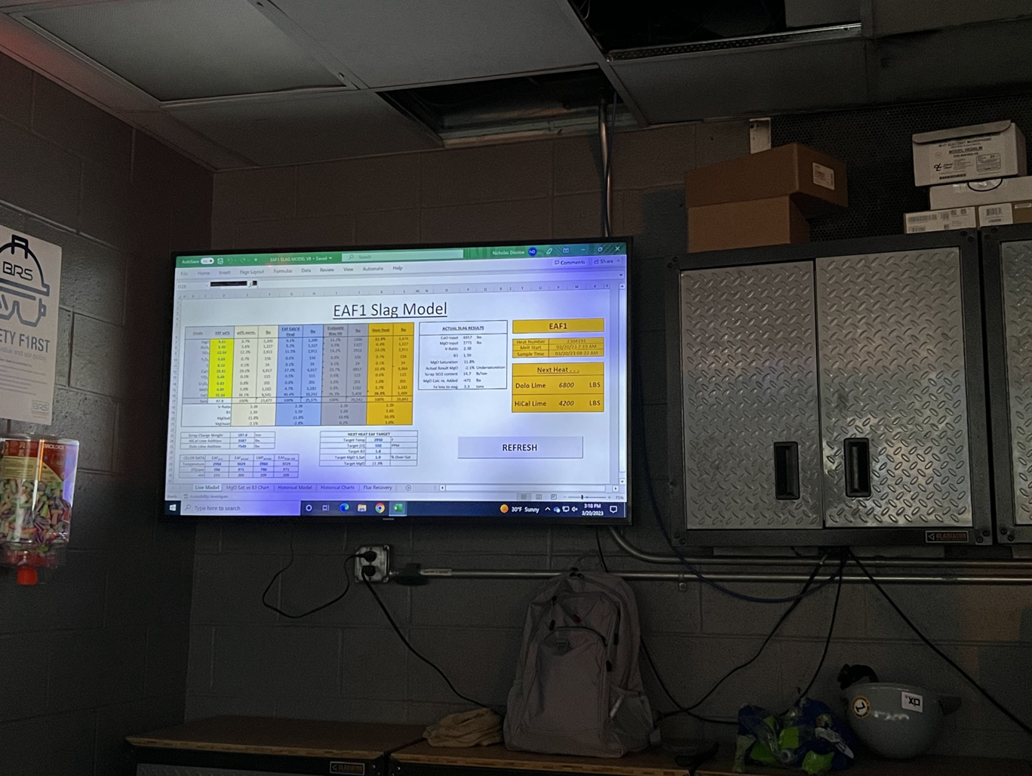
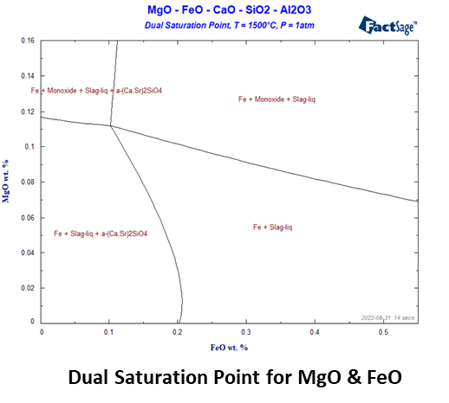
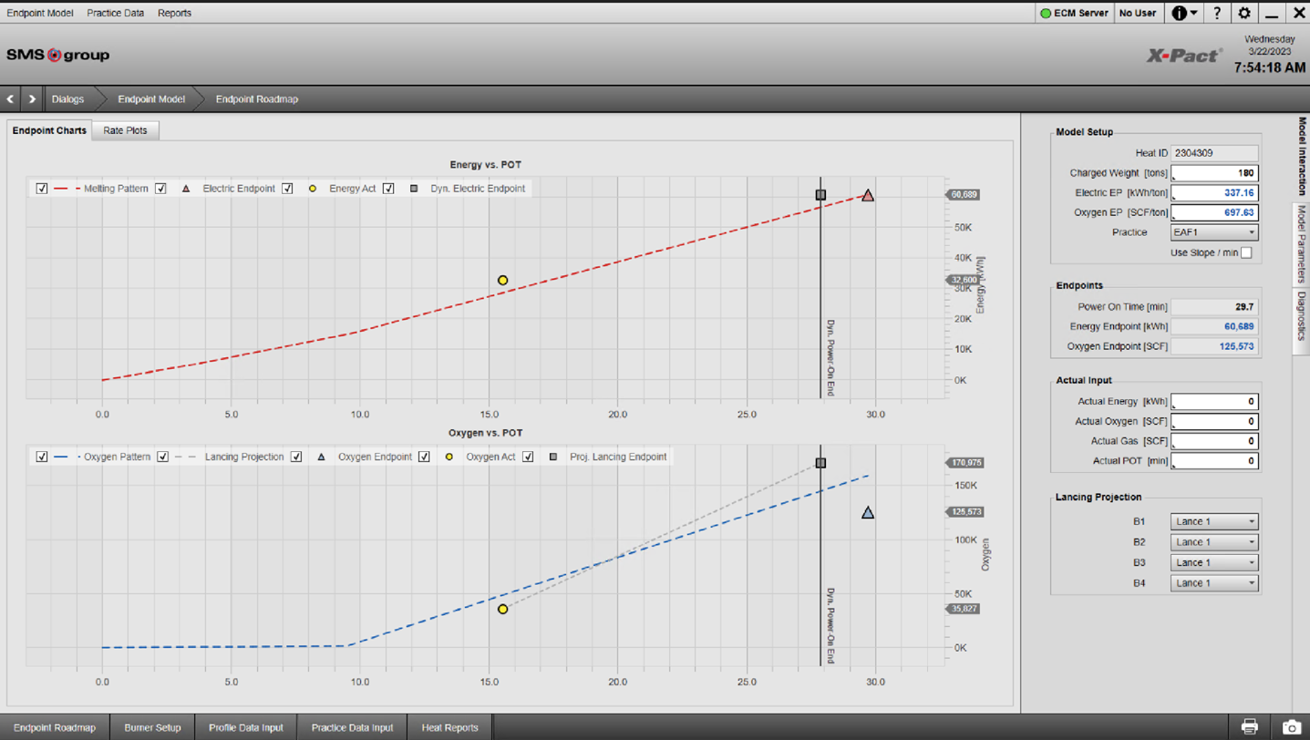
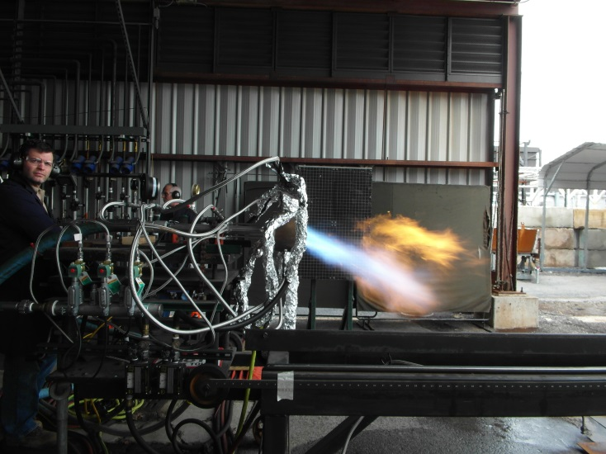
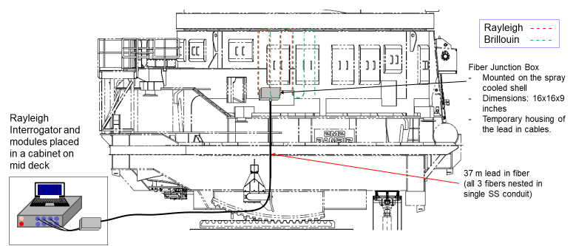
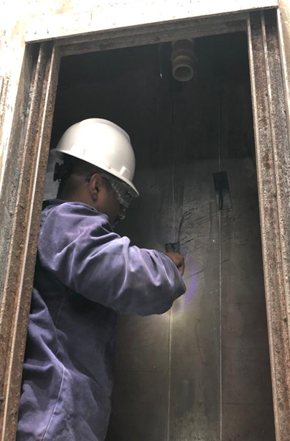
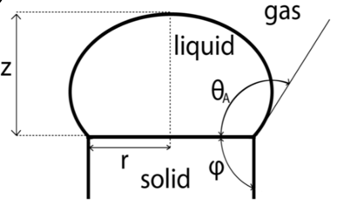

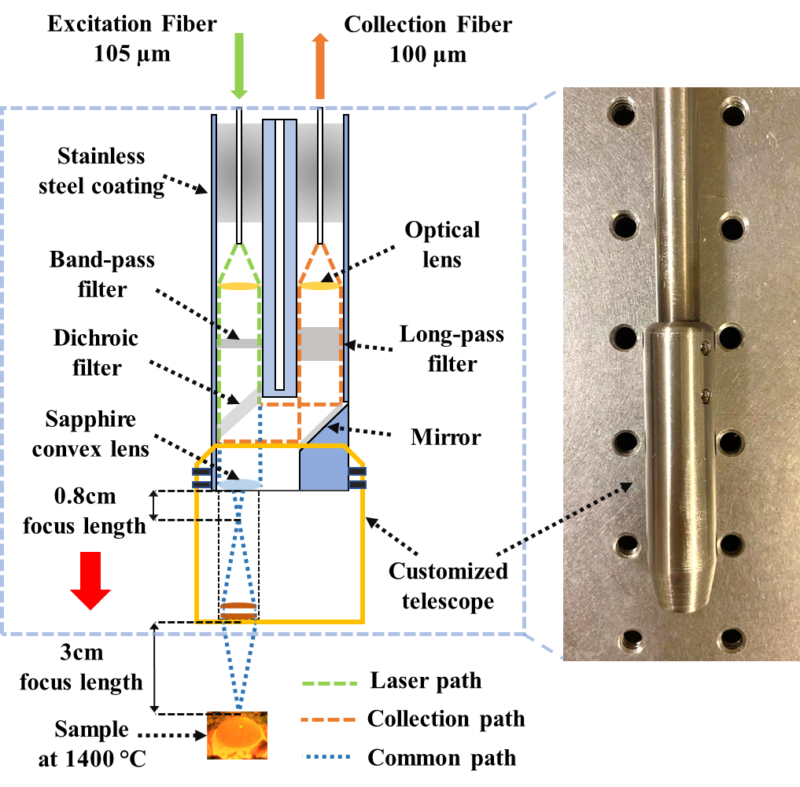
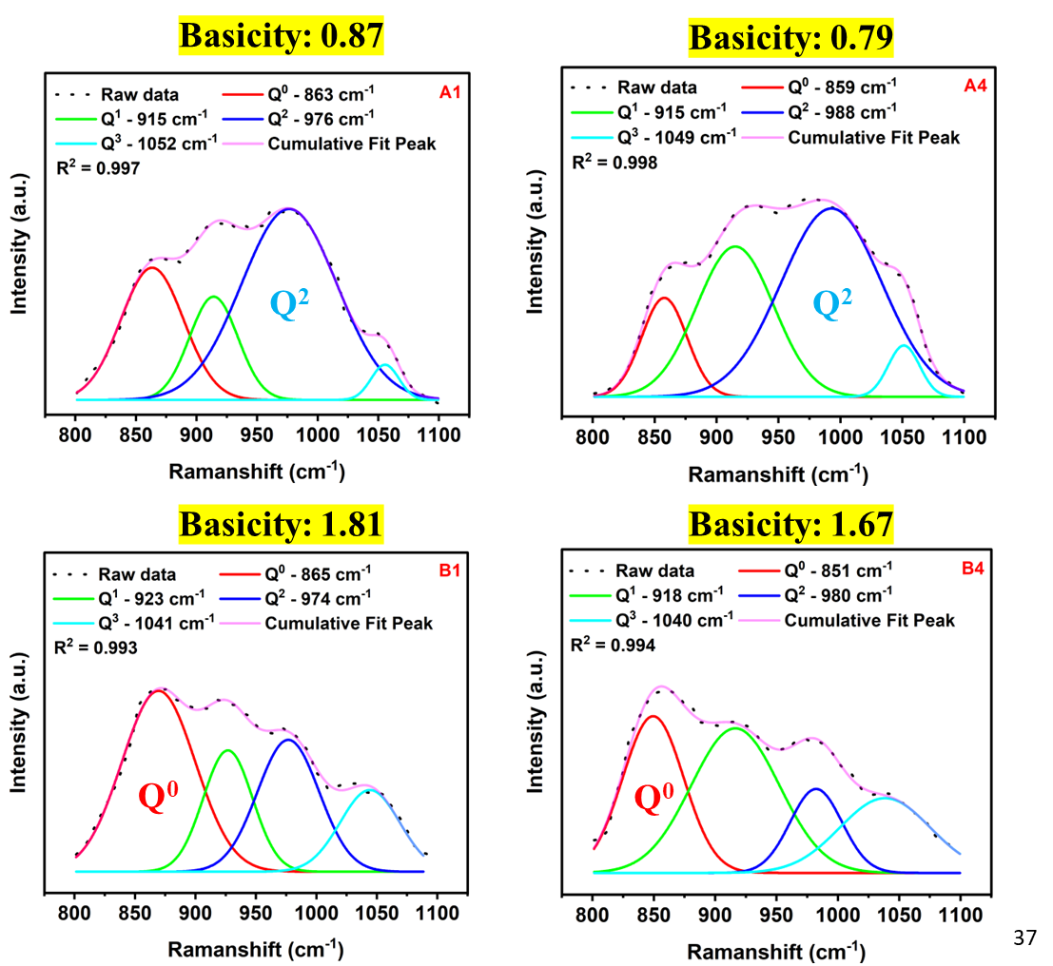
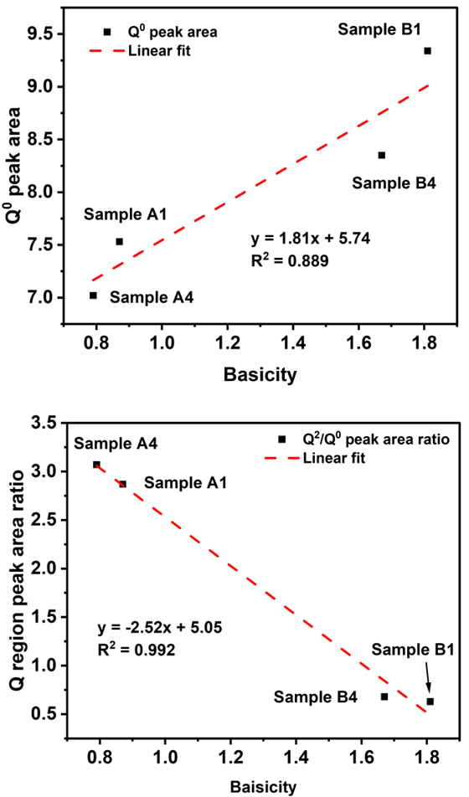
Intelligent Dynamic EAF Advisory System (IDEAS) for Improving EAF Operating Efficiency
IEDO
Ronald O’Malley ∙ Missouri University of Science & Technology
DE-EE0009392 ∙ Project Period: 07/01/2021 – 12/31/2024
AMMTO & IEDO JOINT PEER REVIEW
May 16th-18th, 2023
Washington, D.C.
This poster does not contain any proprietary, confidential, or otherwise restricted information
Abstract
Background
Conclusions
The Intelligent Dynamic EAF Advisory System (IDEAS) program seeks to employ advanced optical fiber sensor technology in combination with newly developed directed energy input injector systems and inputs from other EAF sensor and monitoring systems to enable real-time dynamic control of the EAF in response to variations in incoming raw materials to improve the operating efficiency and reduce the energy intensity of EAF melting.
The objective of IDEAS is to develop an expert system utilizing modules that function as the digital twins tied to fundamentals to aid in optimizing electric arc furnace (EAF) operations in response to variations in incoming raw materials. The research will employ novel fiber optic sensors to provide spatially distributed thermal data, weight sensing, and rapid slag composition feedback to the expert system. The research will decrease the production of waste and improve energy and operating efficiency in the EAF.
Preliminary feedback from initial trials with the IDEAS control modules have shown promise and, although not yet fully implemented, have already demonstrated operating efficiency benefits at BRS. The inclusion of inputs from future fiber optic sensing system data, improved injector technology, and improved slag property data will further enhance the model.
Alignment with Office Mission
Results
Key Achievements
The IDEAS program integrates new sensor, control systems, and flexible injection technologies to enable next generation EAF dynamic controls that supports the IEDO mission to accelerates the innovation and adoption of cost-effective technologies that eliminate industrial GHG emissions and to promote an efficient and competitive industrial sector. The research also supports EERE goals for improvements in process energy efficiency by providing new tools to the industry to accelerate efficiency improvements and smart manufacturing adoption.
The individual process modules for the real-time mass and energy balance have been installed at Big River Steel, meeting the BP1 project plan. Installations have been initiated at CMC.
Patents/IP: A provisional patent has been filed for the remote fiber optic Raman probe for in-situ slag analysis.
Major releases of public information: One paper, one presentation, and two planned conference proceedings at AISTech 2023 in Detroit.
Key Accomplishments:
Successful system configuration, data collection system, and model installation at BRS site and progress on installation at CMC site.
Burner systems for BRS selected and designed and design of CMC system underway.
Significant progress on fiber optic installations on spray panels and rocker arm at Big River. Successful data collection demonstrated from bottom anode.
Raman slag analysis demonstrated in the lab at 1500 C.
ASU Slag dual saturation model complete and slag property measurements underway.
Challenges and Impact
Background and Introduction
New fiber optic sensors are being integrated and demonstrated in 2 production EAF environments during routine operation and scheduled maintenance outages, which limits access and presents several challenges.
EAF Slag Model Display
EAF Endpoint Module Display
Linde Fluidic CoJet Injector
Future Work
EAF Slag Modelling
Complete installation of the dynamic control system at BRS and begin evaluating and tuning the system.
Finalize sensor & instrumentation review for BRS and CMC for BP2 milestone.
Complete installation of fiber optic sensors at BRS and begin installations at CMC.
Continue module activation and tuning at BRS and CMC per BP2 milestones
Data collection systems, module configurations, and operator displays are being finalized at Big River Steel (BRS) and being evaluated by operating personnel. Work is also underway to install required sensors and module systems at CMC Birmingham. Linde is configuring trial burner systems for both test sites. ASU is working on refining slag models for the EAF slag properties using lab verification tests for slag saturation and interfacial energy. MS&T is working to ruggedize the fiber optic sensor systems to improve survivability in the steelmaking production environment. Ruggedized fiber optic sensors are being
Technology Transfer
installed to demonstrate furnace shell and bottom anode temperature mapping, furnace weight, and slag chemistry.
Fiber Installation on EAF Panel
CIX is well positioned to expand the application of this integrated dynamic EAF advisory system to a broad number of EAFs in the US. Missouri S&T has also been approached by an equipment supplier to co-develop a commercial fiber optic Raman analysis system for EAF slags using their existing sampling technology based on the work demonstrated in this program.
Project Outline
Fiber Installation
on EAF Panel
Innovation: Intelligent Dynamic EAF Advisory System (IDEAS)
Project Lead: Missouri University of Science & Technology
Project Partners: Continuous Improvement Experts (CIX), Arizona State University, Nucor, USS Big River, Gerdau North America, Commercial Metals Company, Linde
Timeline: 07/01/2021 – 12/31/2024 ∙ Progress: 35%
Budget: $6,688,739 ∙ Cost Share: 21.8%
End Project Goal: The optimization platform will provide an effective integrated approach to EAF optimization using novel sensors, innovative burner/injector systems, and advanced real time data analysis, resulting in actionable real time operational adjustments. The platform will also provide tools to enhance early training of equipment operators and process engineers through enhanced analytics of the process. The experiments utilizing novel sensor technology will provide a more effective method of monitoring water-cooled system integrity while avoiding the challenges in current systems.
References
Interfacial Energy
Measurements
B. Zhang, H. Tekle, R. J. O’Malley, J. D. Smith, R. E. Gerald II and J. Huang", In Situ High-Temperature Raman Spectroscopy via a Remote Fiber-Optic Raman Probe", IEEE Transactions on Instrumentation and Measurement, IEEE Transactions on Instrumentation and Measurement, Vol. 72, Feb. 2023, pp. 1-8, doi:10.1109/TIM.2023.3244238.
Z. Voss, “IDEAS: Intelligent Dynamic EAF Advisory System for Improving Operating Efficiency“, 4th European Academic Symposium on EAF Steelmaking, June 18, 2021.
 | FY21 Costs | FY22 Costs | FY23 Costs | Total Planned Funding
DOE Funded | $161,076 | $1,133,874 | $2,048,000 | $5,227,988
Project Cost Share | $105,643 | $459,592 | $500,000 | $1,460,751
Raman Probe for in-situ Slag Analysis
Deconvolution of Raman Spectra
Peak Area Correlations
Acknowledgements
The presenters would like to thank the DOE-EERE IEDO for their support for this project along with our industry partners Nucor, USS Big River, Gerdau North America,, Commercial Metals Company, and Linde. We would also like to thank the PSMRC consortium members for their early seed support for this work.
U.S. DEPARTMENT OF ENERGY
OFFICE OF ENERGY EFFICIENCY & RENEWABLE ENERGY

